Slide 1
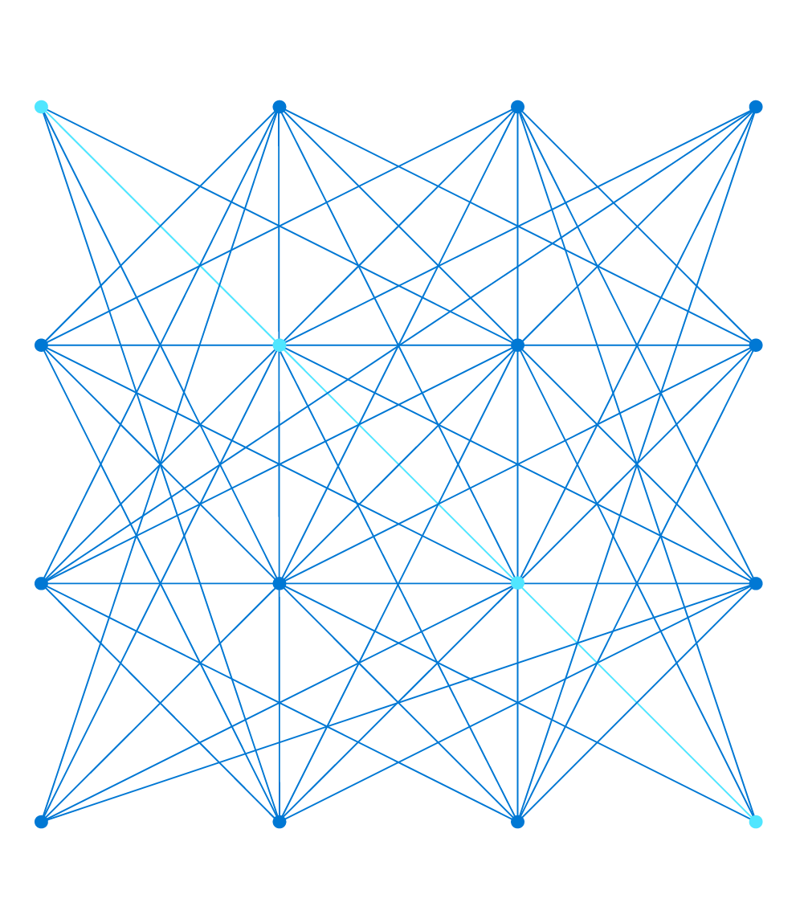
Simplify networking and learn about Remote user connectivity with Azure Virtual WAN
Wellington Lee Product Manager

Slide 2
Agenda
Azure Virtual WAN Overview
Key Partner announcements
Remote User Connectivity
Virtual WAN User VPN Basics
[New] Support for 100K users /hub
[New] Support for multiple authentication
[New] Support for dual radius servers for HA
[New] Custom IPsec support in P2S
Other Key feature announcements
[New] Static 1-1 NAT [Public Preview]
[New] Routing 0/0 to a SPOKE Virtual Appliance
Demo
Summary

Slide 3
Azure Virtual WAN Overview
Unified framework for networking, security and routing using the Microsoft Global Backbone

Slide 4
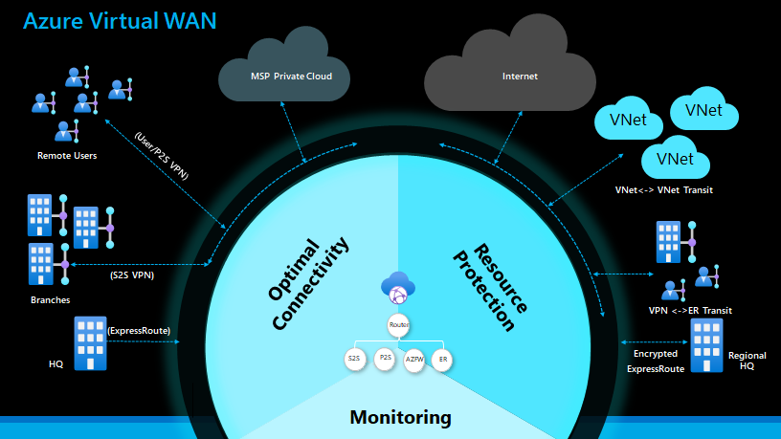
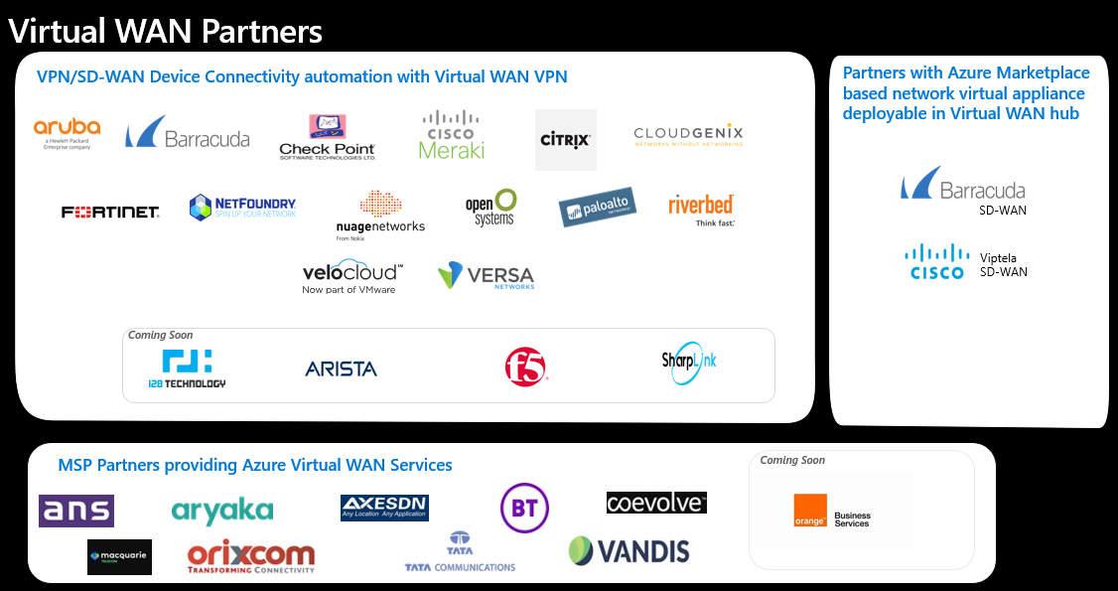
Azure Virtual WAN
Unified framework for networking, security and routing
using the Microsoft Global Backbone
Microsoft managed hub
Virtual Hub Router – automatic hub to hub
Virtual Hub Router – Fully meshed hubs
Transit between VPN and ExpressRoute, VNETs
Custom Routing
Integrated Network Virtual Appliance (NVA)
vWAN
routing
enabled capabilities
ER
Encryption
P2S Traffic mgmt
S2S connectivity automation
FW Manager Partners
Virtual WAN Partners
vWAN unique
8 ckt/Hub
20 Gbps agg
10,000/Hub
18 Gbps agg
1,000/Hub
20 Gbps agg
500/Hub
50 Gbps agg
V<->V
vWAN hub scale
ExpressRoute
User/P2S VPN
Site/S2S VPN
VNet
Connectivity & Security
Azure FW

Slide 5
Azure Virtual WAN
Unified framework for networking, security and routing using the Microsoft Global Backbone
VPN, ER
Throughput : $/scale unit
Connection : $/conn unit
FW : Per hr, Per GB
Virtual Hub : Per hr, Per GB
Hub to hub : Source Destination based Egress only charges
VNet
VNet
VNet
VNet
vWAN pricing
Microsoft managed hub
Virtual Hub Router – automatic hub to hub
Virtual Hub Router – Fully meshed hubs
Transit between VPN and ExpressRoute, VNETs
Custom Routing
Integrated Network Virtual Appliance (NVA)
Internet
vWAN
routing
enabled capabilities
Fully meshed hubs
West US Hub
Asia Hub
ER
Encryption
P2S Traffic mgmt
S2S connectivity automation
FW Manager Partners
vWAN unique
8 ckt/Hub
20 Gbps agg
100,000/Hub
200 Gbps agg
1,000/Hub
20 Gbps agg
500/Hub
50 Gbps agg
V<->V
vWAN hub scale
ExpressRoute
User/P2S VPN
Site/S2S VPN
VNet
Connectivity & Security
Azure FW
ExpressRoute User (Seattle)
P2S User (Redmond)
S2S User
(Seattle)
P2S User
(Singapore)
S2S User (Singapore)

Slide 6
Remote User Connectivity
Understanding basics of Point-to-site VPN in Virtual WAN and cool new features

Slide 7
Virtual WAN User VPN Basics
Combination of Profiles, built-in Traffic Manager and Point-to-site VPN Gateways
Hub Level Profiles (Download from the Virtual Hub Resource)
User automatically connects to traffic manager that sits at the Hub level in the background
Load balanced across Gateway instances
WAN Level Profiles (Download from the Virtual WAN Resource)
User automatically connects to traffic manager that sits at the WAN levels
Performance based routing to select closest Hub
Load-balanced across Gateway instances
WAN-Level Traffic Manager
Traffic Manager
Traffic Manager
1 unit
2 unit
WAN Level VPN User
Hub 1 VPN User
P2S VPN GW Instances
P2S VPN GW Instances
Hub 2 VPN User
Hub 1 (West US)
Hub 2 (Australia)

Slide 8
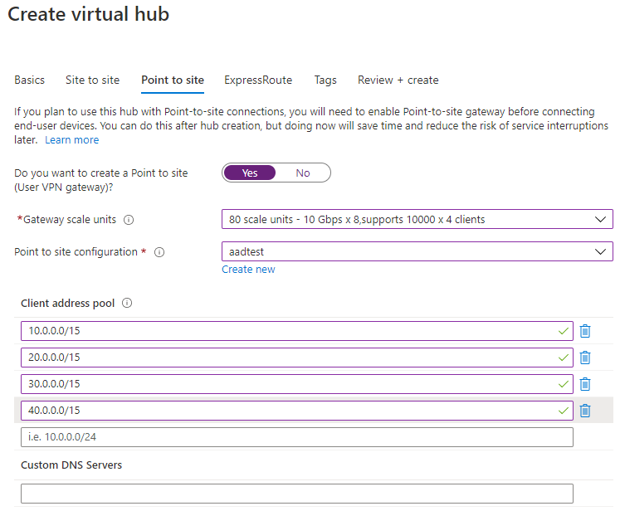
Support for 100K users / hub
Description: Deploy additional scale units to support a high number of users connecting to a single Virtual WAN Hub
Scenario: Large number of remote workers need to access workloads in Azure
Up to 200 Gbps of aggregate capacity
Gateway deployments optimized to handle increased load
Define your own address pools

Slide 9
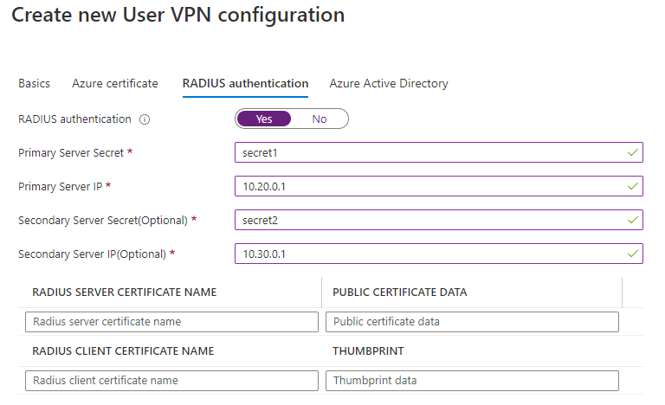
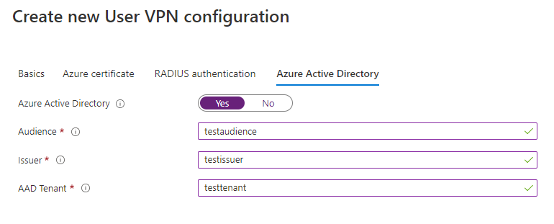
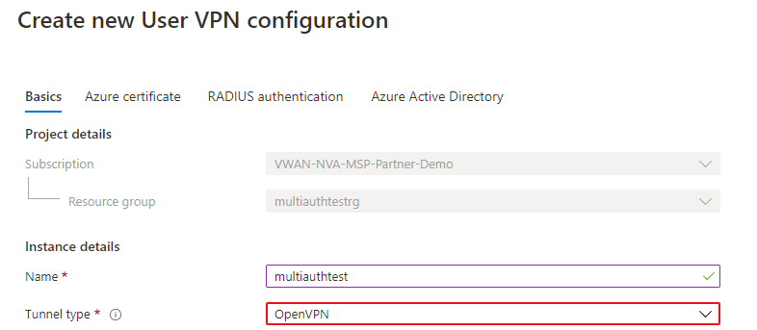
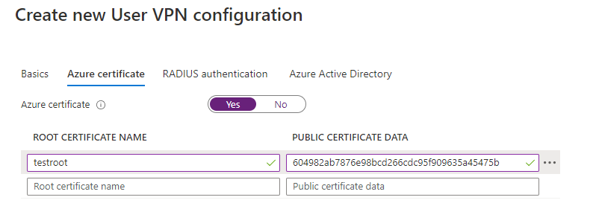
Support for multiple authentication
Description: Allow for multiple types of authentication on a single Virtual WAN Hub
Scenario: Increasing flexibility in remote user connections to support hybrid deployments
Support for Open VPN with Azure Active Directory, RADIUS and Certificate-based authentication
Configure clients effortlessly with profiles downloaded from Azure Portal

Slide 10
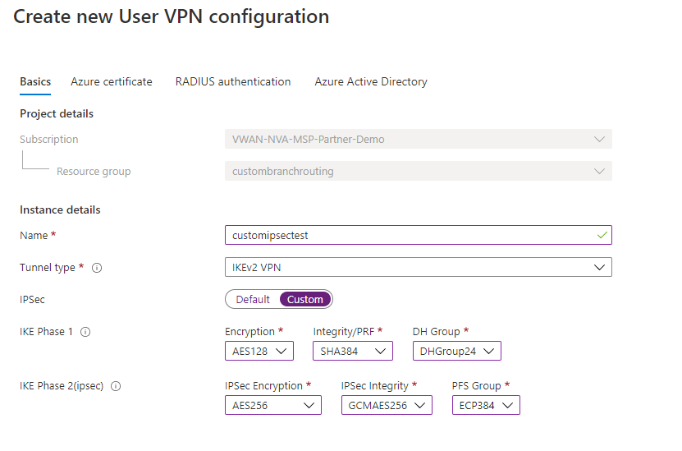
Support for P2S Custom IPsec
Description: Custom parameters for IKE Phase 1 and IPsec Phase 2 connectivity
Scenario: Providing more connectivity options for compliance
Customizations available: https://go.microsoft.com/fwlink/?linkid=2154051

Slide 11
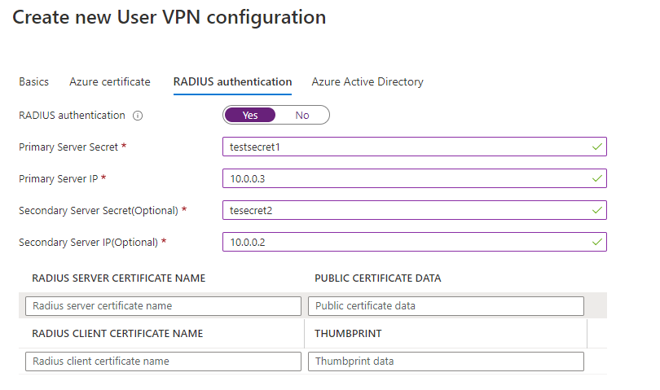
Support for dual radius servers
Description: Connect two Radius serves to a Virtual WAN Hub to authenticate remote users
Scenario: Ability to have resiliency/HA across radius servers in the same region/hub
Smart routing to ensure authentication servers are highly available
One configuration, two IP addresses and server secrets

Slide 12
More announcements
Site-to-site VPN NAT, Routing

Slide 13
Site-to-Site VPN NAT
Static one-to-one NAT route traffic from an external (host) IP Address to an internal IP address associated with an endpoint inside a Virtual Network (virtual machine, computer, container, etc.)
Branch 1
192.168.1.0/24
NAT Rule : 192.168.1.0/24 <-> 10.1.1.0/24
VNET
Site-to-site VPN IPsec Connection
VNET Connection
Scenario: Branch with overlapping IP accessing Azure VNET resources
Parameters
Name
Type
Mode
Mapping
Link Connection
VNET
Virtual WAN Hub with a Site-to-site VPN Gateway
20.1.1.0/24
Branch 2
192.168.1.0/24
Sample Packet Translation
Src IP: 192.168.2.3
Dest IP: 20.1.1.3
TCP
Data
Src IP: 10.1.1.3
Dest IP: 20.1.1.3
TCP
Data
NAT

Slide 14
Routing 0/0 to a SPOKE Virtual Appliance
VNet2a
VNet2b
VNet1
VNet2
Scenario : Ability to use a SPOKE VNET appliance for all traffic entering the hub
0.0.0.0/0 route does not propagate from a hub to other hubs in a Virtual WAN
Ability to set up multiple next hop IP in a VNET connection
Network Virtual Appliance (NVA)
10.2.0.5
Configure
Route : 0.0.0.0/0
Next hop : 10.2.0.5 (NVA IP)
Virtual Hub
192.168.1.0/24
192.168.2.0/24

Slide 15
Demo
Integrated Velocloud Network Virtual Appliance Offers in Virtual WAN

Slide 16
Velocloud VMWare demo video placeholder- we will provide you this after we get video from the partner. Thanks.

Slide 17
Azure Virtual WAN
New NVA Integrations
Velocloud VM Ware
Remote User connectivity features
Support for 100K users /hub
Support for multiple authentication
Custom IPsec support in P2S
Support for dual radius servers for HA
Other key announcements
Site-to-site NAT for overlapping Branch Address prefix
Routing 0/0 to a SPOKE Virtual Appliance
Unified framework for networking, security and routing using the Microsoft Global Backbone
Contact: azurevirtualwan@microsoft.com

