Slide 1
Optimize connectivity to your Azure services over the internet
Mahesh Nayak
Principal Program Manager
Azure Networking

Slide 2
Setting the context
Digital adoption has taken a quantum leap. Organizations are adopting to an “Internet first" approach.
Optimized connectivity matters now more than ever.
Intelligent Cloud
Intelligent Edge

Slide 3
Optimized network for “internet first"
Closer proximity to Microsoft’s global users
Edge PoP placement
Reliable last mile
Microsoft Azure Peering Service
Optimize connectivity
Premium secure, no jitter, high throughput network routing to origin
Microsoft global network
Cost optimized routing over the internet
Routing preference feature
New!
Accelerate performance with delivery at the edge
Azure Frontdoor
Azure CDN
Optimize app delivery
Save bandwidth costs by caching content and delivering from the edge
Secure web apps with WAF at the edge

Slide 4
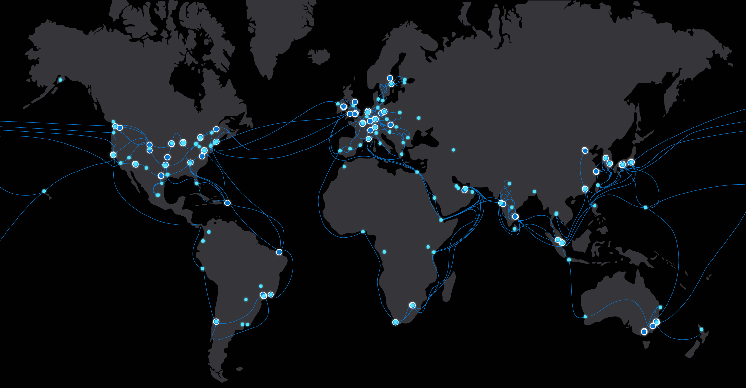
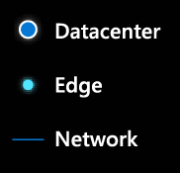
Microsoft global network
61
Azure
regions
165k+
miles of fiber +
subsea cables
180+
Network
edge sites
200+
Express route partners
20k+
peering
connections

Slide 5
Best performing cloud network, securely scales your infrastructure
180+ Network POPs placed within 25 milliseconds from 85% of GDP
  All Azure DC-DC traffic encrypted by default
Traffic runs on the Microsoft private global network closest to the user with cold potato routing, irrespective of geographies
Azure traffic between datacenters stays on Azure network and does not flow over the internet
  99.05% of Azure inter-region pairs beat the internet*
Inter-AZ, inter-region hosting architecture
for HA/DR
*Claims based on the results from the ThousandEyes 2020 "Cloud Benchmark Performance" report. The findings are based on data gathered within and between multiple global regions of the five public cloud providers over a four-week period.

Slide 6
Routing preference
Enables network choices, letting you optimize for performance or cost
Cold potato routing
Performance optimized (best experience)
Route via the Microsoft global network
Enters the Microsoft network closest to the user
Stays on Microsoft backbone until it exits Microsoft closest to the user
Default network for all our networking services
Hot potato routing
Cost optimized (best price)
Routes via the internet (ISP network)
Enters the Microsoft network closest to the hosted service region
Exits Microsoft in the same region the service is hosted
Route via Microsoft global network
Customer
Local ISP
Microsoft PoP
closest to service
Microsoft
global network
Azure Services
Route via ISP network
Customer
Local ISP
ISP network
Microsoft PoP
closest to service
Azure Services

Slide 7
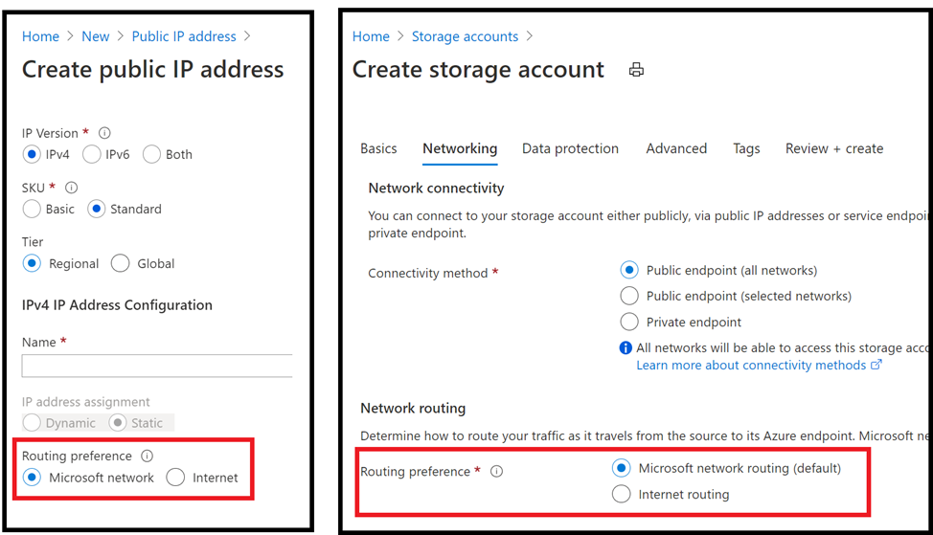
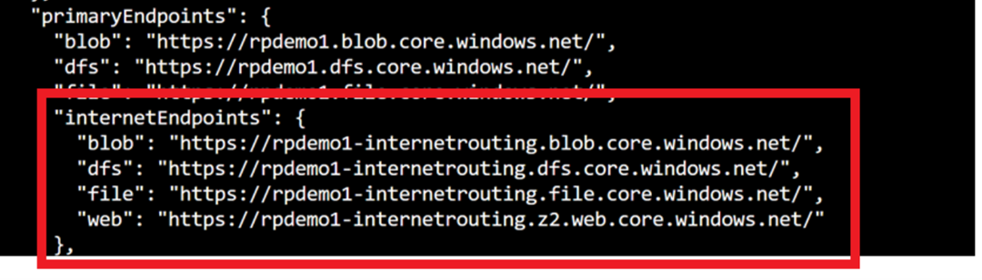
Enable routing preference
Choose routing for public IP
Associate IP to resources
  Virtual machine/VM scale sets
  Internet-facing load balancer
  Azure Kubernetes Service
  App Gateway
  More…
Choose routing for storage
  Additional end point created for storage services

Slide 8
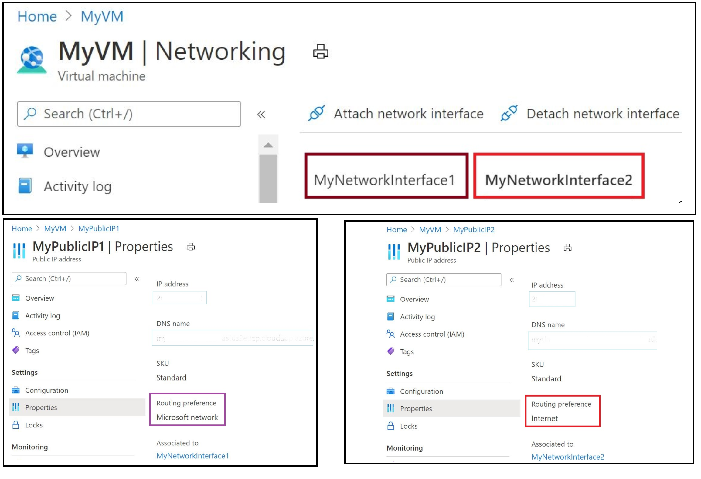
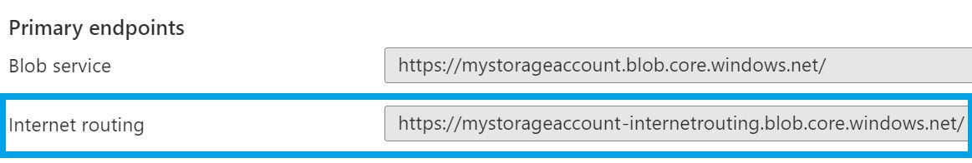
Enable power of both routing choices
Grants more control with both routing choice enablement
Supports VM NIC with multiple public IPs of mix routing types
Enable VM with multiple NICs of diverse routing types
Configure load balancer with multiple FE IPs of mix routing types
Allows you to publish more routing specific endpoints for storage services

Slide 9

Azure Peering Service
Delivering optimal public Internet connectivity to Microsoft Cloud
MS Peering partner
Enterprise grade Internet connectivity
Connectivity partners
Local and geo peering redundancy
High-capacity peers
Optimized internet traffic routing
Telemetry platform
Latency deviation
BGP route anomalies
Performance degradation events
Route Anomalies Detection and Auto Remediation (RADAR)
20 million routes monitored for real time BGP leaks, hijacks or withdrawals
Peering service platform
Customer
Monitoring
Operational
insights
User telemetry
RADAR
Internet

Slide 10
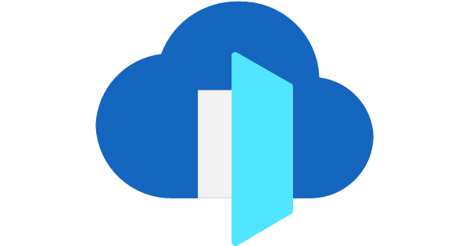

High Reliability – primary and backup paths
Geography B
Connection B
Geography A
Connection A
Customer
Microsoft Services
Office 365, Azure
Geography A
MS Peering partner
Microsoft global network
Connection C
Geography C
Preferred shortest path
Failover path to other locations (Geo redundant edge PoP)
Connections

Slide 11
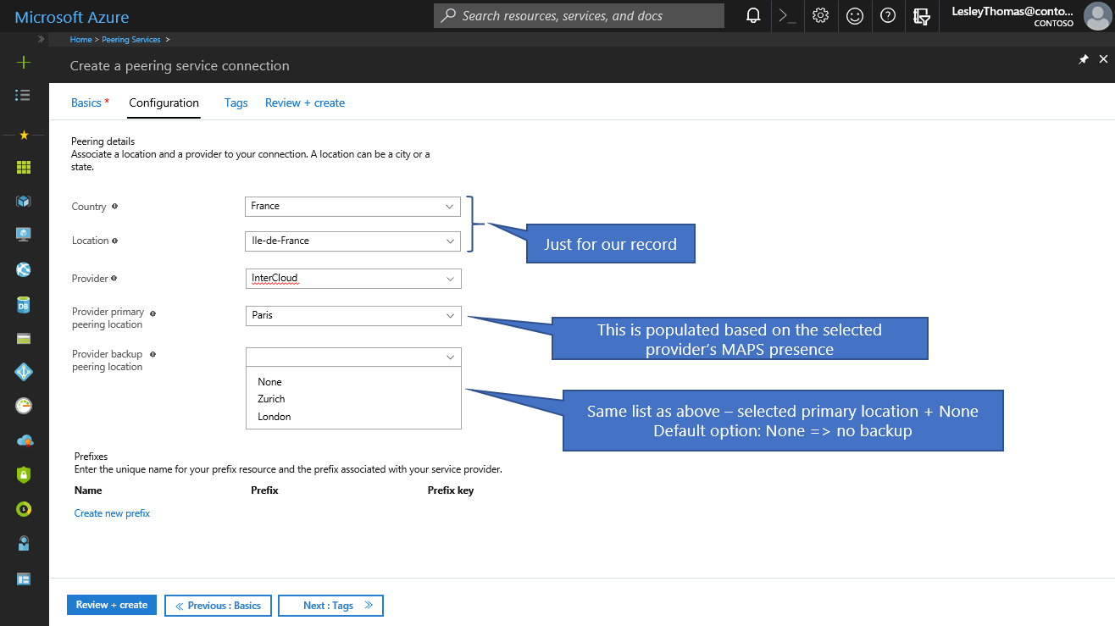
Primary & backup paths in peering service
Primary & backup path enablement
Customer Disaster Recovery (DR) coverage
Allows customers to configure primary & backup peering service locations
Routing policy with peering service partners/providers for primary & backup locations
Peering location selection by providers

Slide 12
Thank you

