Slide 1


Azure Load Balancing: Best-suited for your workload
Anavi Nahar
Senior PM Manager, Azure Networking
@AnaviNahar
Sergio Figueiredo
Senior PM, Azure Networking
©Microsoft Corporation
Azure

Slide 2


What is a Load Balancer?
GoLowWaste.com
172.168.37.31
Public IP

Slide 3

What is a Load Balancer?
Distribution of workloads across multiple compute resources
GoLowWaste.com
USED TO:
172.168.37.31
  Optimize resource use
  Maximize throughput
  Minimize response time
  Avoid overloading any single resource
  Improve availability

Slide 4
Why use Azure for load balancing?
Dynamic scaling
Secure
Integration with Azure services
Cost effective
Rich monitoring and metrics

Slide 5



Azure’s load balancing options
Load Balancer
Application Gateway
Traffic Manager
Front Door
Network Layer (TCP/UDP)
Extreme perf sensitive
Ultra-low latency
Application Layer (HTTP/HTTPS)
TLS/cert based auth
DNS-based load balancing
Variety of routing options
Application Layer(HTTP/HTTPS)
Load balancing at the edge

Slide 6
Azure Load Balancer
Network/Layer 4 load balancer
TCP/UDP applications
  Supports HTTP and HTTPS health probes
Ultra-low latency
High bandwidth
Pass-through/
transparent load balancer
  No packet transformations
  Source IP is maintained
Multiple Public IPs on frontend
Availability zones support

Slide 7
Azure Load Balancer – Zone redundancy
Built to withstand zone failures
1 Load Balancer to achieve in-region redundancy
1 zone redundant Public IP to achieve in-region redundancy
Regionally resilient single frontend IP
AZ₁
AZ₂
AZ₃
Scale out

Slide 8
Azure Load Balancer components
    Frontend
    Public – Public LB
    Private – Internal LB
    Health probe
    Rules
    LB rules
    Inbound NAT rules
    HA port rule
IP
IP
IP
IP
IP
IP
VM
VM

Slide 9
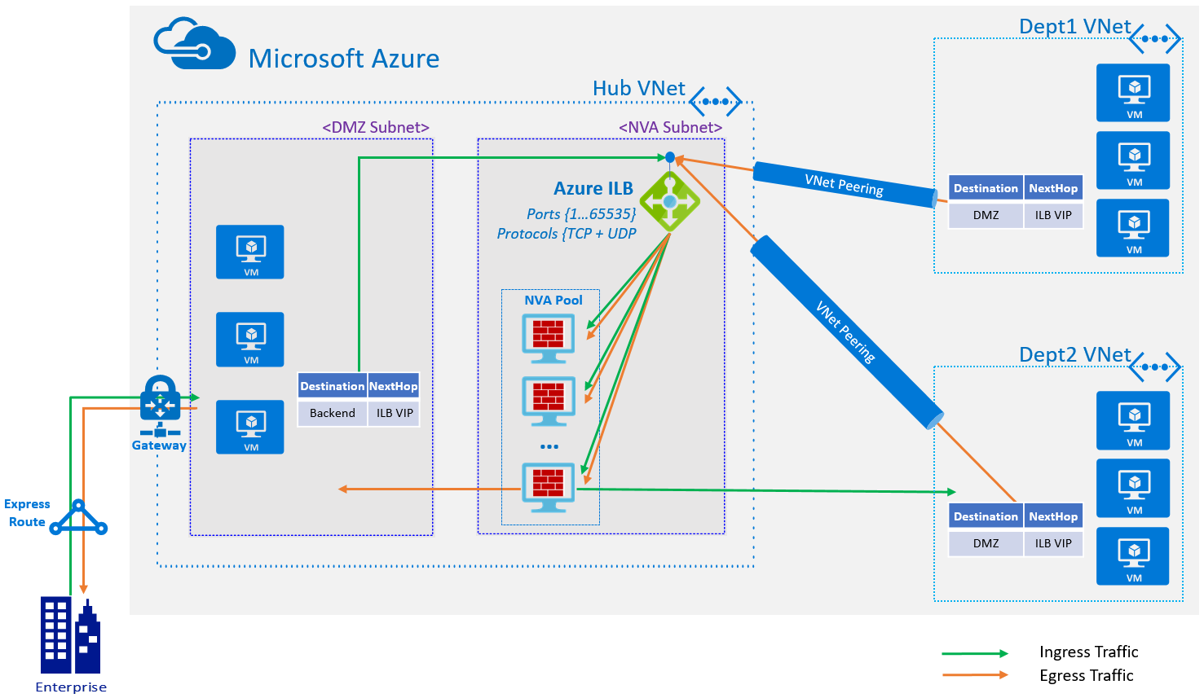
Azure Load Balancer – HA ports
  High Availability (HA) ports
  A single rule to specify:
    All ports
    All protocols
  Powerful use case for NVAs
    Enabled NVAs to scale to n instances

Slide 10
Azure Load Balancer components
    Frontend
    Public – Public LB
    Private – Internal LB
    Health probe
    Rules
    LB rules
    Inbound NAT rules
    HA port rule
    Backend pools
    VMs, VMSS
    IP addresses
IP
IP
IP
IP
IP
IP
VM
VM

Slide 11
Azure Load Balancer routing
  Regional and Global
  5 tuple hash
    Source IP
    Source port
    Destination IP
    Destination port
    Protocol
  2 tuple hash
    Source IP
    Destination IP
IP
IP
IP
IP
IP
IP
VM
VM

Slide 12
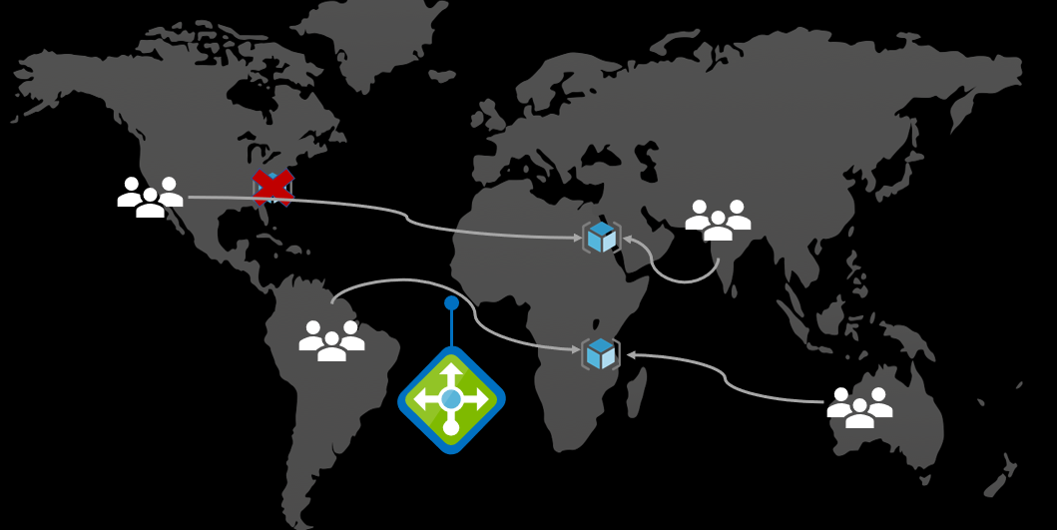
Azure Load Balancer
RECENT UPDATES
Cross-region support
SKU upgrade while retaining Public IP
  Basic to Standard | IP preservation
IP based backends
Resource group moves
Load Balancer insights in Azure Monitor

Slide 13
Application Gateway
Application/
Layer 7 load balancer
HTTP/HTTPS applications
  WebSocket and HTTP/2 support
TLS termination
Terminates connections
  Source IP is changed
Auto scaling support
Availability zones support
HTTP to HTTPS redirects
Single Public IP on frontend

Slide 14
Application Gateway components
  Frontend
  Public, Private
  Listener
  Routing rules
  Backend pools
  VMs, VMSS
  IP addresses, FQDN

Slide 15
Application Gateway routing
GoLowWaste.com
172.168.37.31
  Regional
  Content based
  Incoming URL attributes
/images/*
/video/*
  Host/domain name based
  Cookie based session affinity

Slide 16
Application Gateway
RECENT UPDATES
GoLowWaste.com
172.168.37.31
Mutual authentication
URL rewrite
Wildcard listener
Ingress Controller for AKS
/images/*
/video/*

Slide 17
Traffic Manager
DNS-based load balancer
Supports external, non-Azure endpoints
  Hybrid cloud and on-premises deployments
Public facing endpoint
Routing methods
  Priority, weighted, performance, geography, subnet, multi-value

Slide 18
Azure Front Door
Global, edge load balancer
Layer 7 (HTTP/HTTPS)
  Anycast protocol
  Split TCP
Internet facing
Advanced routing
  Priority, weight

Slide 19
Which one do we choose?
Load Balancer
Application Gateway
Traffic Manager
Front Door
Layer 4 (TCP/UDP)
Extreme perf sensitive
Ultra-low latency
Layer 7 (HTTP/HTTPS)
TLS/cert based auth
DNS-based load balancing
Variety of routing options
Layer 7 (HTTP/HTTPS)
Load balancing at the edge

Slide 20


Best practices
Client considerations
GoLowWaste.com
Always use DNS
Traffic manager
DNS caching may occur
  Re-resolve DNS before reconnecting after failures
172.168.37.31
Public IP

Slide 21
Best practices
Azure Load Balancing
Nature of application
Regional, global
Type of workload
Azure only vs. on-prem
Latency
How sensitive your application is to latency
Cost considerations

Slide 22
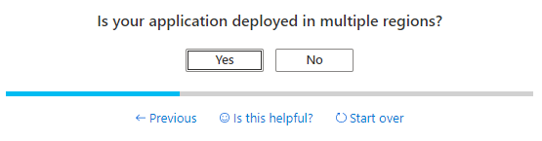
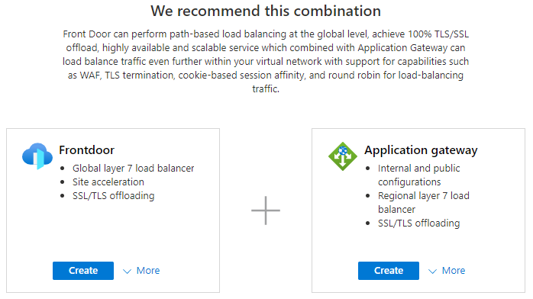
Azure Load Balancing options
OVERVIEW
Simplify experience of choosing a Load Balancing option
Service comparison in the Azure Portal
Discoverability of New Learn modules Training per Load Balancing service
Browse all Load Balancing Services in one centralized location

Slide 23
Azure Load Balancing
Demo
Application gateway
Internal and public configurations
Regional layer 7 load balancer
SSL/TLS offloading
Frontdoor
Global layer 7 load balancer
Site acceleration
SSL/TLS offloading
Load balancer
Load 4 load balancing
Internal and public configurations
High availability across zones
Traffic manager
DNS-based traffic load balancer
Global across Azure regions
High availability

Slide 24
Azure’s load balancing comparison
 | Azure Load Balancer | Application Gateway | Azure Front Door
Health check protocol | HTTPS, TCP, UDP | HTTPS, HTTP, HTTP/2
TLS/SSL termination
Private Link integration
Client IP preservation
IPv6 support
Customer-owned static IP
WebSockets

Slide 25
References
Doc landing page
aka.ms/azureloadbalancing

Slide 26
Thank you!
Anavi Nahar
Senior PM Manager, Azure Networking
@AnaviNahar
Sergio Figueiredo
Senior PM, Azure Networking
©Microsoft Corporation
Azure

