Slide 1
Microsoft 365 Network Connectivity Video Series
Managing Connections Using The IP/URL Web Service
Jeff Mealiffe
Principal Program Manager / Architect
Microsoft 365 Core Engineering

Slide 2
Managing Connections Using The IP/URL Web Service
01 Microsoft 365 traffic differentiation
02 IP/URL web service deep-dive
03 Demo

Slide 3

Microsoft 365 Network Connectivity Principles
Microsoft 365 endpoints
{REST:API}
SSL
B&I
Datacenter
Branch
Branch
ISP
aka.ms/o365ip
Optimize Microsoft 365 traffic
Use the endpoint categories to differentiate Microsoft 365 traffic from generic Internet traffic for more efficient routing.
Enable local egress
Egress Microsoft 365 data connections through Internet as close to the user as practical with matching DNS resolution.
Enable direct connectivity
Enable direct egress for Microsoft 365 connections. Avoid network hairpins and minimize network latency (RTT) to Microsoft’s global network.
Modernize security for SaaS
Avoid intrusive network security for Microsoft 365 connections. Assess bypassing proxies, traffic inspection devices, and duplicate security already available in Microsoft 365.
Learn more at: aka.ms/PNC

Slide 4
Microsoft 365 traffic differentiation

Slide 5
Identification of Microsoft 365 traffic
Egress traffic (outbound from customer network) targeting Microsoft 365 service endpoints
Ingress traffic (outbound from Microsoft cloud service to customer network) for hybrid connectivity
Service endpoints are well defined based on namespace, IP address, protocol, port
Customer network infrastructure dictates how traffic can be identified and treated
Complex management of egress traffic means multiple layers of identification
  Proxy PAC files focus on namespace
  IP routing plane manages egress path for specific IP prefixes
  Egress firewall rules allow required IP/port combinations

Slide 6
How is Microsoft 365 traffic different?
Generic Internet traffic is typically untrusted
  Unknown service infrastructure
  Untrusted content publisher
  Unpredictable behavior
  Best-effort performance within a browser
Microsoft 365 traffic is not just generic Internet traffic
  Most service infrastructure controlled by Microsoft
  Operating on content which is generally owned/controlled by customer
  Utilizing specifically designed scenarios/features for productivity
  Specific application connectivity requirements to achieve performance
Level of trust

Slide 7
Microsoft 365 IP and URL categories
Default | Allow ~100 URLs | Optimize <10 URLs
Direct network traffic similar to web browsing Some endpoints clearly marked optional, lost functionality is described May not be in Microsoft datacenters Most endpoints will have URLs only Standard Internet latency is okay | Connectivity is required for Office 365 Recommended not to SSL break & inspect Some network latency is not expected to cause major performance issues Should not use authenticated proxy | Microsoft hosted IPs and URLs Expect slow rate of change All ExpressRoutable (if used) Should not SSL break & inspect the traffic to these endpoints Recommend bypassing proxy server and use local egress from the user’s location

Slide 8
When is endpoint management relevant?
Performance optimization
Internet egress with restrictions in place
  Proxy in outbound egress path
  Firewall with default deny for egress
Multiple egress paths
  SD-WAN
  ExpressRoute
  VPN
Ingress to handle hybrid scenarios

Slide 9
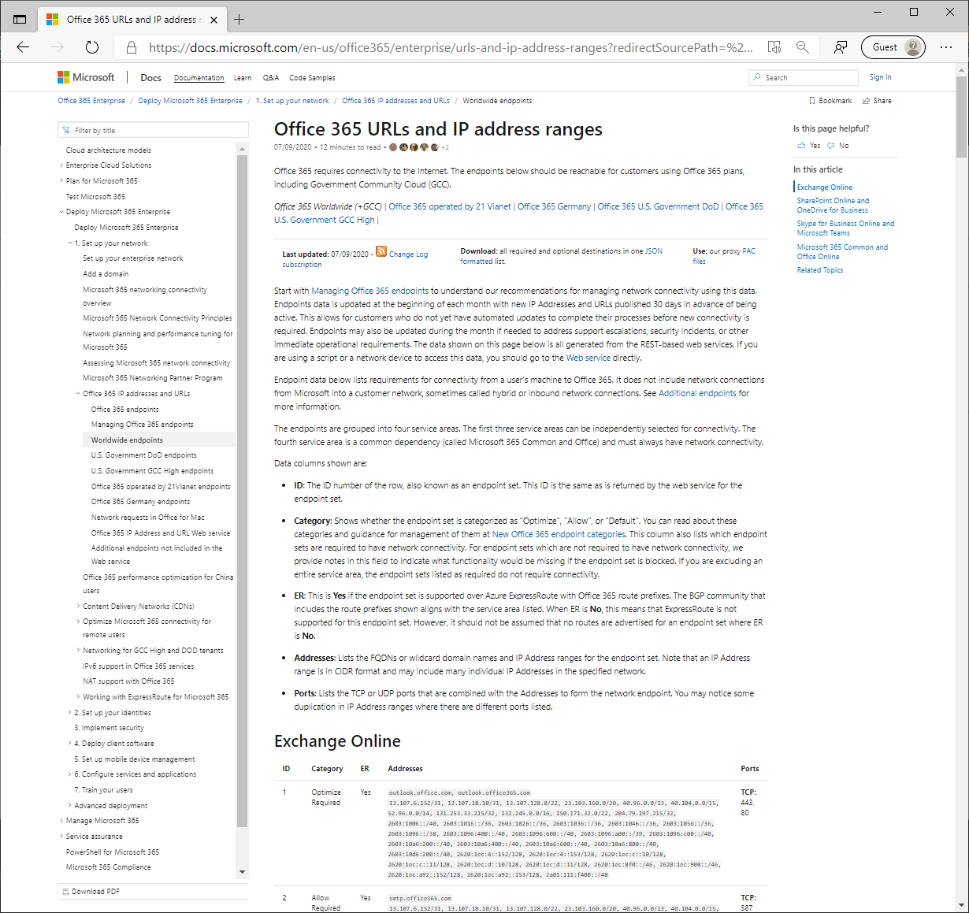
Endpoint publishing
Human-readable docs published at http://aka.ms/o365ip
Easy to use reference to lookup endpoint details on-demand
Not designed for automation
  However RSS feed available as “change log” – generated directly by the version web service method
Data sourced from authoritative endpoints database, changes published on monthly cadence

Slide 10
IP/URL web service deep-dive

Slide 11

Microsoft 365 IP addresses and URLs web services
Data from the HTML page is needed by devices, not people
Benefits with the Web services
Automation and validation of data during publishing
System readable data for direct network device integration
Data available in JSON or CSV format
Includes Optimize, Allow, Default categorization of Microsoft 365 endpoints
Includes ExpressRoute routable flag for each endpoint
Version change notification published alongside the data
All provided attributes are supported by owning development teams
  /endpoints – provides the endpoints required for firewall ACLs or proxy servers
  /version – can be polled to identify the latest version or for an RSS feed
  /changes – returns specific changes made
Network devices can fetch and identify Microsoft 365 network traffic
Details
We’re working with network service vendors to integrate this
Configure them for optimal Microsoft 365 connectivity
Customers using these configured devices will have recommended configuration and all monthly updates automated

Slide 12
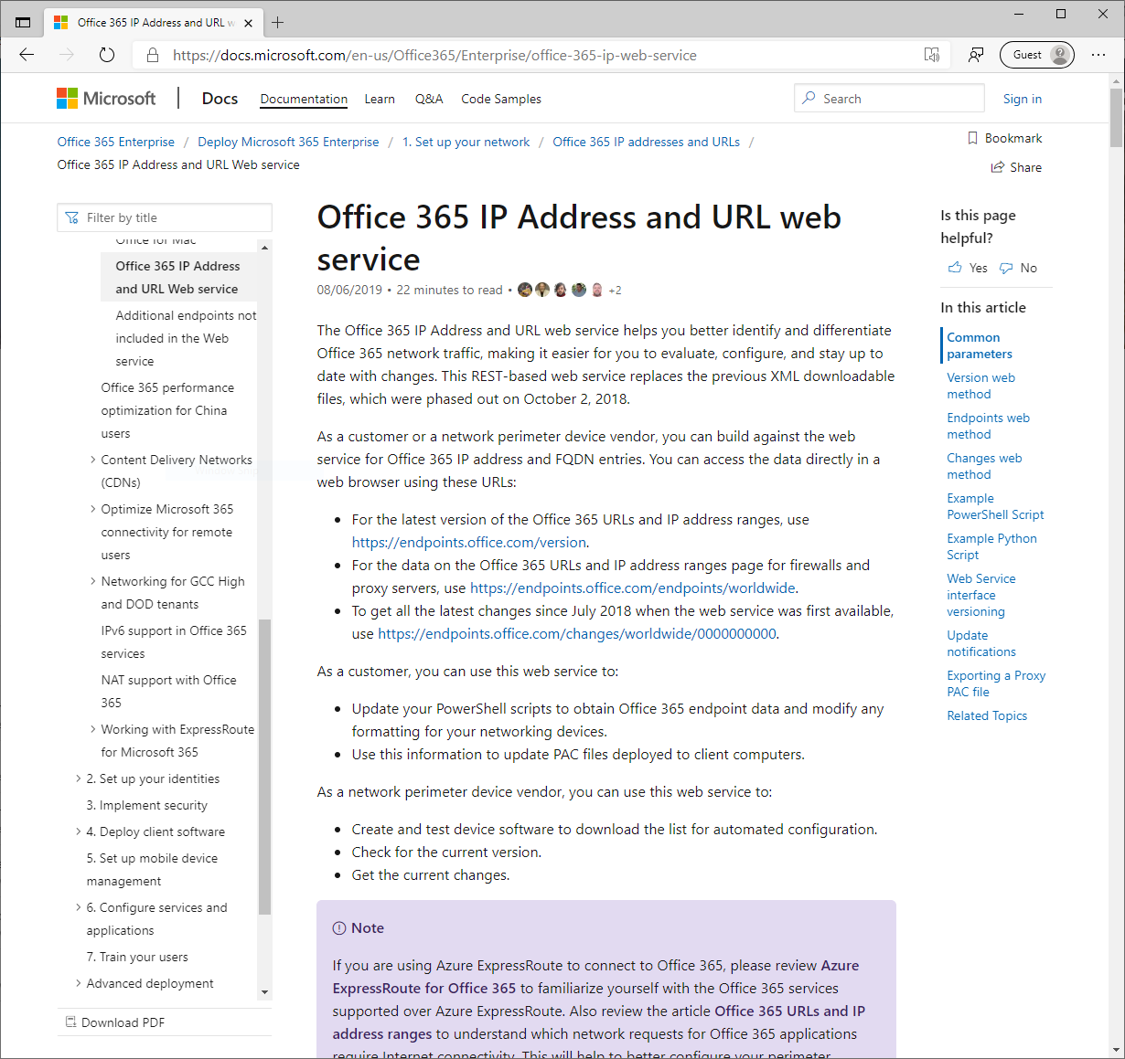
Web service capabilities
API documentation at http://aka.ms/ipurlws
RESTful APIs support output in 2 formats
  Format=<JSON|CSV>
All requests must include an ID, used for telemetry/troubleshooting. Generate a unique ID per-client
  ClientRequestId=<guid>
Follow guidance carefully to avoid rate limiting / 429 errors
Instance scope (optionally) provided within URL path after method name
  https://endpoints.office.com/method/instance?...
  Worldwide | China | Germany | USGovDoD | USGovGCCHigh

Slide 13
Version web service method
Version method provides quick insight into current version as a signal for when to pull down new details
Not rate limited, designed for polling
Guidance is to poll hourly
AllVersions=<true | false> - Can be used to get historical version data.
Format=<JSON | CSV | RSS> - This call supports RSS output
GET https://endpoints.office.com/version/worldwide?ClientRequestId=0a5f1054-abaa-4643-a528-963c8e25ea94&AllVersions=false&Format=JSON
{
"instance": "Worldwide",
"latest": "2020080600"
}

Slide 14
Endpoints web service method
Endpoints call provides detail on current IPs and URLs representing Microsoft 365 services
Don’t poll – use version method to determine if new data is available
Output includes an array of endpoint sets
  Sets include service, urls, IPs, ports, category, and various other parameters
ServiceAreas=<Common | Exchange | SharePoint | Skype> - Scope results to specific services
TenantName=<tenant_name> - Allows for substitution of tenant-specific URLs
NoIPv6=<true | false> - Allows for optional exclusion of IPv6 prefixes

Slide 15
Example endpoints query output
PS C:\> $ep = Invoke-RestMethod("https://endpoints.office.com/endpoints/worldwide?clientrequestid=0a5f1054-abaa-4643-a528-963c8e25ea94")
PS C:\> $ep|?{$_.category -eq "Optimize" -and $_.serviceArea -eq "Exchange"} |ft -a
id serviceArea serviceAreaDisplayName urls ips tcpPorts expressRoute category required
-- ----------- ---------------------- ---- --- -------- ------------ -------- --------
1 Exchange Exchange Online {outlook.office.com, outlook.office365.com} {13.107.6.152/31, 13.107.18.10/31, 13.107.128.0/22, 23.103.160.0/20...} 80,443 True Optimize True
PS C:\> $ep|?{$_.category -eq "Optimize"} |ft serviceArea, urls
serviceArea urls
----------- ----
Exchange {outlook.office.com, outlook.office365.com}
Skype
SharePoint {*.sharepoint.com}

Slide 16
Changes web service method
Changes method provides history of prior changes as well as change context (implications)
Don’t poll – use version method to determine when to query for changes
Requires a version number to use as a base – all changes since the base returned as output
Version=<YYYYMMDDNN>
GET https://endpoints.office.com/changes/worldwide/2020080100?ClientRequestId=0a5f1054-abaa-4643-a528-963c8e25ea94&Format=JSON
[{ "id": 586,
"endpointSetId": 5,
"disposition": "Change",
"version": "2020080600",
"impact": "RemovedIpOrUrl",
"remove": { "ips": ["191.234.140.0/22"] }
}]

Slide 17
Demo

Slide 18
Managing infrastructure configuration using the IP/URL web service

Slide 19
Additional resources and recommended actions
View our Microsoft 365 Network Connectivity video series page – aka.ms/netvideos
Use our tools to help identify and differentiate traffic
Focus on ensuring Optimize category traffic reaches Microsoft in an optimal way
Use our web service APIs to keep infrastructure configuration up-to-date
Office 365 IP/URLs – http://aka.ms/o365ip
IP/URL web service API docs – http://aka.ms/ipurlws

