Slide 1
Microsoft 365 Network Connectivity Video Series
Microsoft 365 network connectivity testing tools
Paul Andrew
September 1, 2020

Slide 2
Microsoft 365 network connectivity testing tools
Microsoft 365 Admin Center – network connectivity
  Provides network assessment and network insights for connectivity to Microsoft 365
  Specific network tests to identify user experience impacting issues for Exchange Online, SharePoint Online, and Microsoft Teams
  Network perimeter at each office location is evaluated
Microsoft 365 network connectivity test tool

Slide 3

Microsoft 365 Network Connectivity Principles
Microsoft 365 endpoints
{REST:API}
SSL
B&I
Datacenter
ISP
aka.ms/o365ip
Optimize Microsoft 365 traffic
Use the endpoint categories to differentiate Microsoft 365 traffic from generic Internet traffic for more efficient routing.
Enable local egress
Egress Microsoft 365 data connections through Internet as close to the user as practical with matching DNS resolution.
Enable direct connectivity
Enable direct egress for Microsoft 365 connections. Avoid network hairpins and minimize network latency (RTT) to Microsoft’s global network.
Modernize security for SaaS
Avoid intrusive network security for Microsoft 365 connections. Assess bypassing proxies, traffic inspection devices, and duplicate security already available in Microsoft 365.
Learn more at: aka.ms/PNC

Slide 4
Three methods for tests to user location
Windows Location Services
Windows Location Services must be enabled on the client machines
Location obfuscated to 300m x 300m
Results aggregated over 3 days to automatically identified cities
One location per city only
Updated every 24 hours
LAN Subnet ID entered
You enter all office locations with LAN Subnet IDs
You can enter multiple offices within a City
CSV Import available
Results aggregated over 3 days are correlated with those offices
Updated every 24 hours
Microsoft 365 network connectivity test tool
User at location runs test with typed or detected location
Has additional DNS, proxy, VPN, buffer bloat, required FQDN tests
Result appears within a minute of the user completing it
User must be signed into the tenant
No aggregation and no regular tests

Slide 5
Demo

Slide 6
Demo summary
Microsoft 365 Admin Center network connectivity
Windows Location Services to collect test samples
  City is auto detected
LAN Subnet IDs for each location
  Office locations and LAN Subnet information can be CSV uploaded
Single test reports can be submitted from the Microsoft 365 network connectivity test tool
  This adds additional tests such as for proxy server, VPN, and TCP connectivity

Slide 7

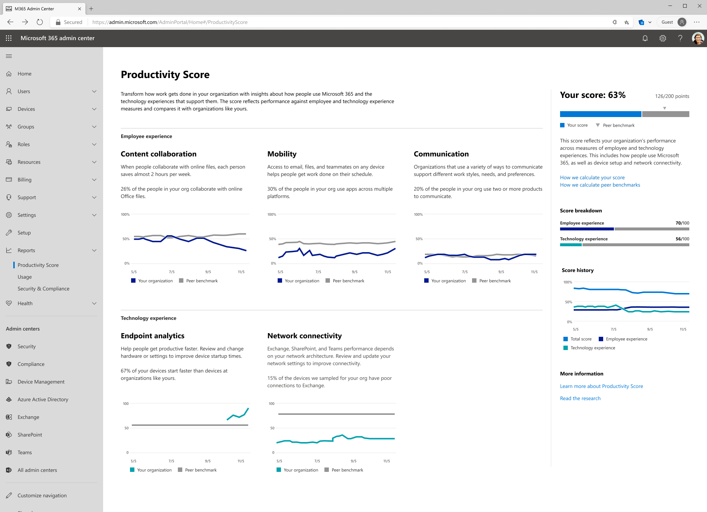
Productivity Score
Insights that transform
how work gets done
Visibility
Understand how your
organization works
Insights
Identify where you can enable improved experiences
Actions
Update skills and systems
so everyone can do their
best work

Slide 9

Additional resources and recommended actions
Join our public preview. Launching at Ignite 2020
http://aka.ms/netignite
View our Microsoft 365 Network Connectivity video series page
http://aka.ms/netvideos
Discussion about these tools
http://aka.ms/netforum

