Slide 1
Automate your Planner tasks workflow
Jackie Duong | Program Manager

Slide 2




Everyone has different task management workflows

Slide 3

Power Automate
Efficiently scale automation
Automate workflows using your favorite apps
Securely integrate automation
Build low-code workflows in a secure, compliant manner
Accelerate productivity
Minimize repetitive, manual tasks and create more time
Take care of what’s important. Automate the rest.

Slide 4

Planner
Intuitive, organized experience
Add and sort your team’s tasks in a familiar Kanban board
Familiar, collaborative teams
Organize around content-rich cards; coordinate in Teams
Fast, visual insights
Quickly see the entire range of your plan’s status
All on the Microsoft Cloud.
All for free.

Slide 5

Better together
Automate the monotonous
Build workflows that take care of repetitive, low-value requirements, like sending daily plan summaries, for you
Expedite workflow creation
Develop your own workflows or choose from more than 96 premade, Planner-enabled templates, including:
Post a Teams message when tasks are created
Create tasks for selected file in SharePoint
Create tasks from Office 365 emails
Send a digest email of all outstanding tasks
Add tasks to Excel on a weekly basis
Create tasks to review OneNote pages

Slide 6
Data flow from app
Demo
…
Automatically create tasks from specific responses in external forms
Addressing negative customer reviews
Reviewing survey outliers
Pursuing upsell opportunities
Tracking product feedback for next update

Slide 7
Demo
Data flow from app

Slide 8

Real-time task changes
Demo
…
Automatically assign and create follow-up tasks
Create follow-ups to task completions
Automatically move tasks into buckets
Set due dates based on compliance regulations
of new tasks
+2 weeks

Slide 9
Demo
Real-time task changes

Slide 10
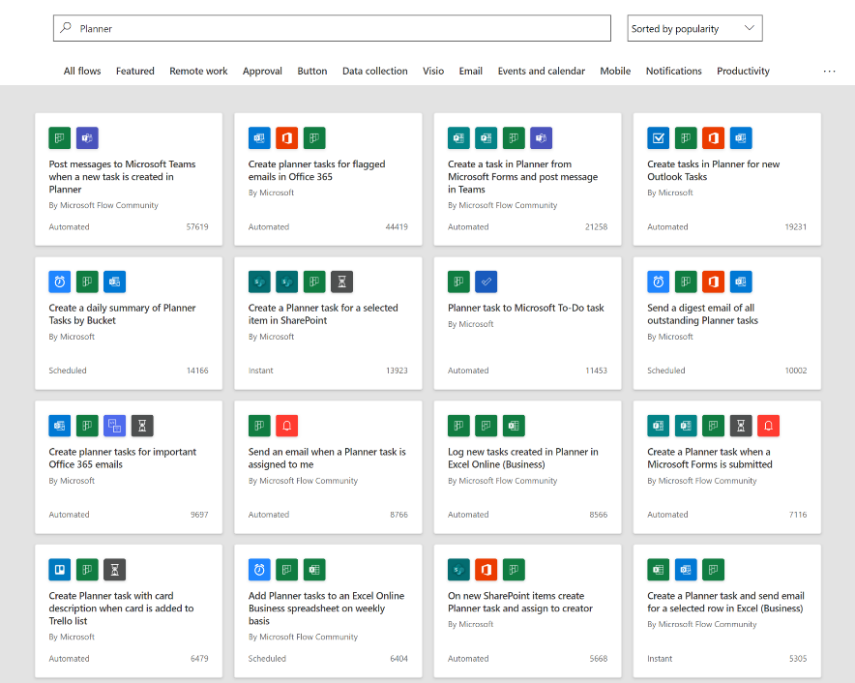
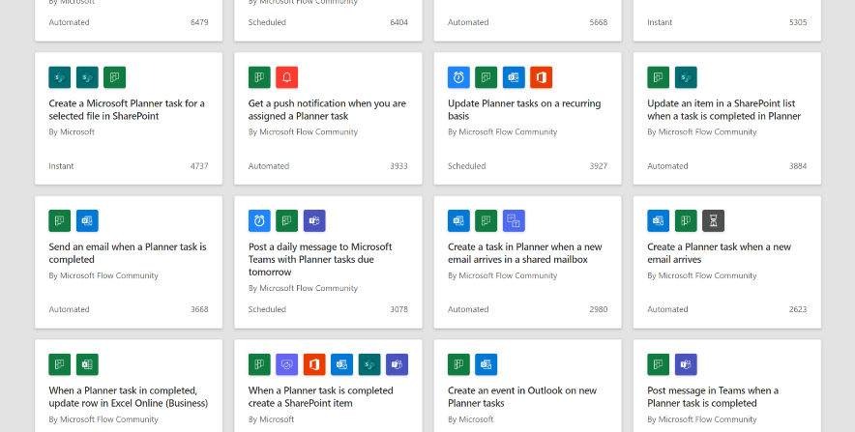
Power Automate
Planner
Intelligent task management automation for all

Slide 11

Learn more and stay connected
Planner website
aka.ms/planner
Tasks in Microsoft 365 website
aka.ms/tasks
Planner roadmap announcements
office.com/roadmap
Planner Tech Community
aka.ms/planner-techcommunity
User feedback portal
planner.uservoice.com

Slide 12






Hone your task management skills
Managing task capabilities across Microsoft 365
Presented by Holly Pollock
aka.ms/session/Tasks/Overview
Get more done with Microsoft Planner
Presented by Si Meng
aka.ms/session/Planner/Overview
Automate your Planner tasks workflow
Presented by Jackie Duong
aka.ms/session/Planner/Automate
You just watched this one
Transform change management by
syncing Message center posts to Planner
Presented by Paolo Ciccu
aka.ms/Admin1019
Microsoft 365: Enabling virtual collaboration
for the future of our hybrid work environment
Presented by Shalendra Chhabra
aka.ms/VideoHub
Digitize and transform business processes with no-code building blocks and app templates in Teams
Presented by Aditya Challapally and Weston Lander
https://aka.ms/TeamsPlatform/NoCode
Cortana: What’s new and what’s next for your personal productivity assistant in Microsoft 365
Presented by Malavika Rewari, Saurabh Choudhury, and others
aka.ms/CortanaSessionIgnite2020

