Slide 1

Use Microsoft Search API in your own application
Nicolas Moreau
@nmoreau

Slide 2
Agenda
Microsoft Search and Graph APIs
Search API Walkthrough and demos
Example of a search integration in Microsoft Dynamics
Resources

Slide 3








Microsoft Search Mission
Microsoft Search connects you to the knowledge and expertise across your organization and beyond, helping you to be more productive, take action, and save time

Slide 4










Why a new search API in Graph ?
One single API designed to scale to all Office 365 workloads
Expose first party scenario programmatically
Expose Microsoft Search intelligence to developers
Microsoft Search

Slide 5
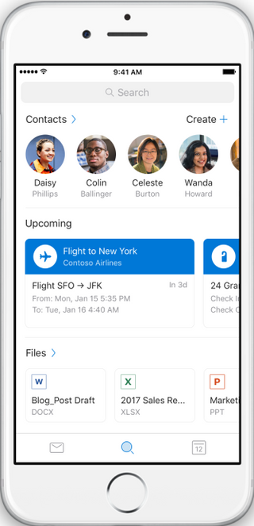
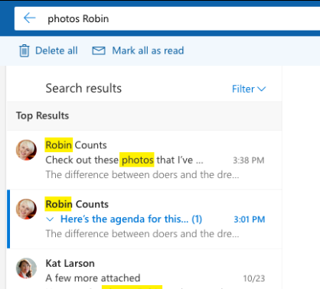
Microsoft Search Experiences
Outlook Search – Top Results

Slide 6
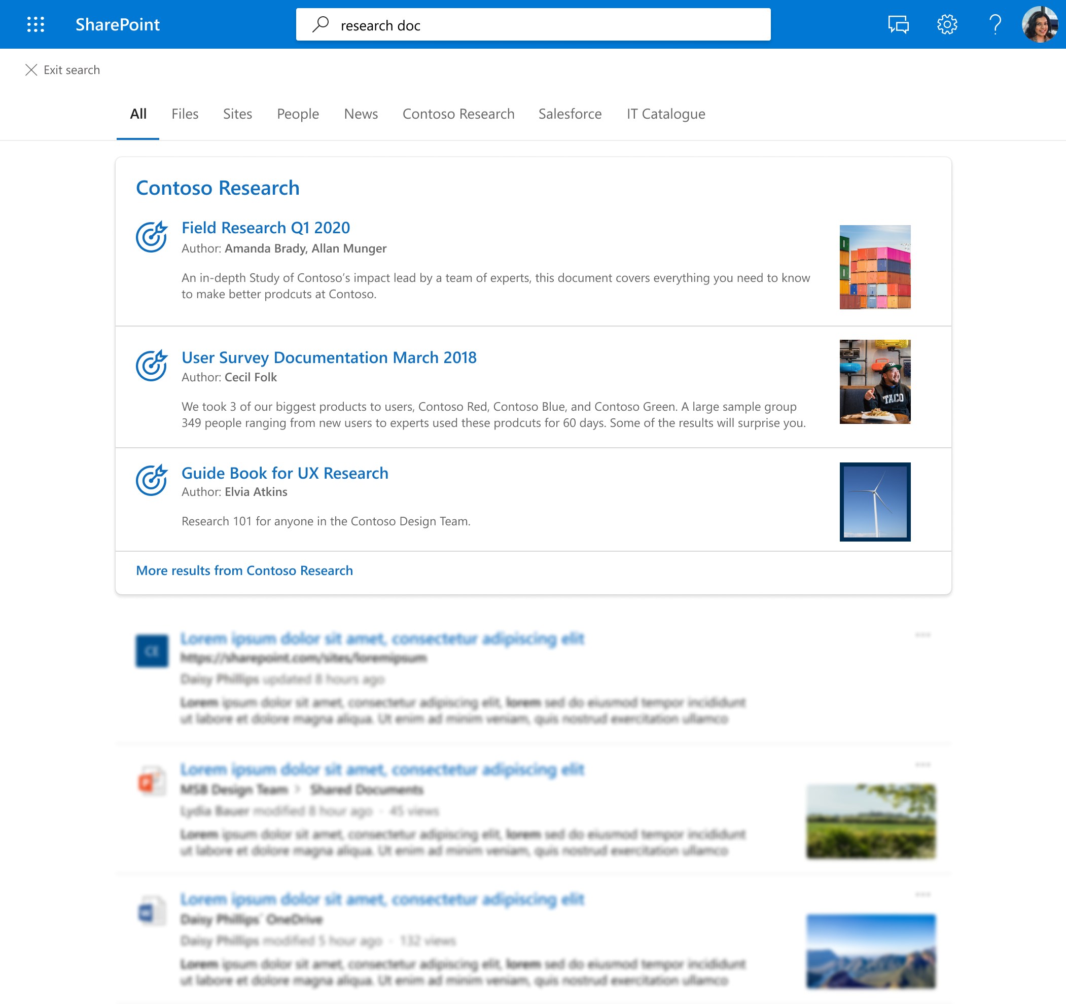
Microsoft Search Experiences
Outlook Search – Top Results
SharePoint / Office.com
Exposing files and content in SharePoint

Slide 7
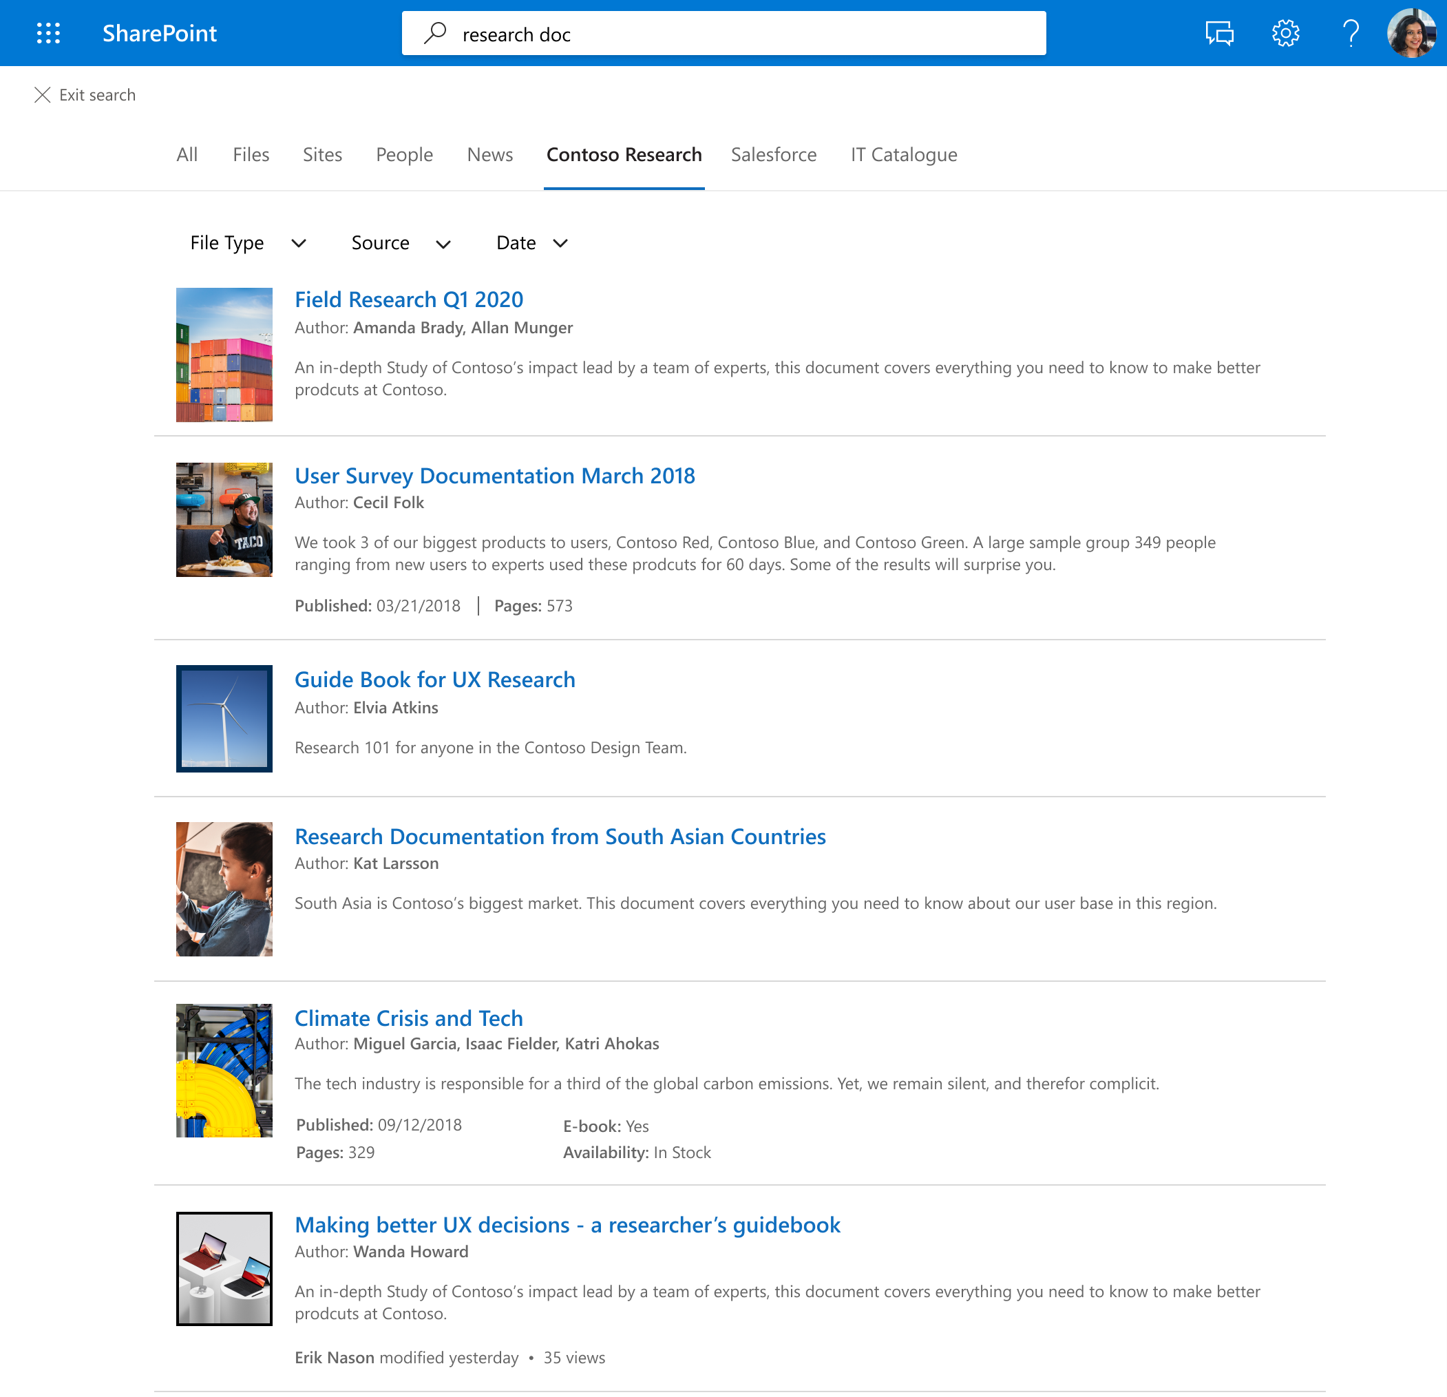
Microsoft Search Experiences
Outlook Search – Top Results
SharePoint / Office.com
Exposing files and content in SharePoint
Exposing Graph Connectors content

Slide 8
Search API Walkthrough
Note : some properties have been renamed since the demo was recorded
Check the latest Search API documentation on https://aka.ms/mssearchapi

Slide 9
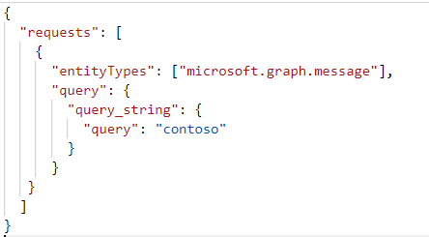
Anatomy of a (simple) ‘request’
POST https://graph.microsoft.com/beta/search/query
requests []
entityTypes[]
queryString
Note : some properties have been renamed since the demo was recorded
Check the latest Search API documentation on https://aka.ms/mssearchapi

Slide 10
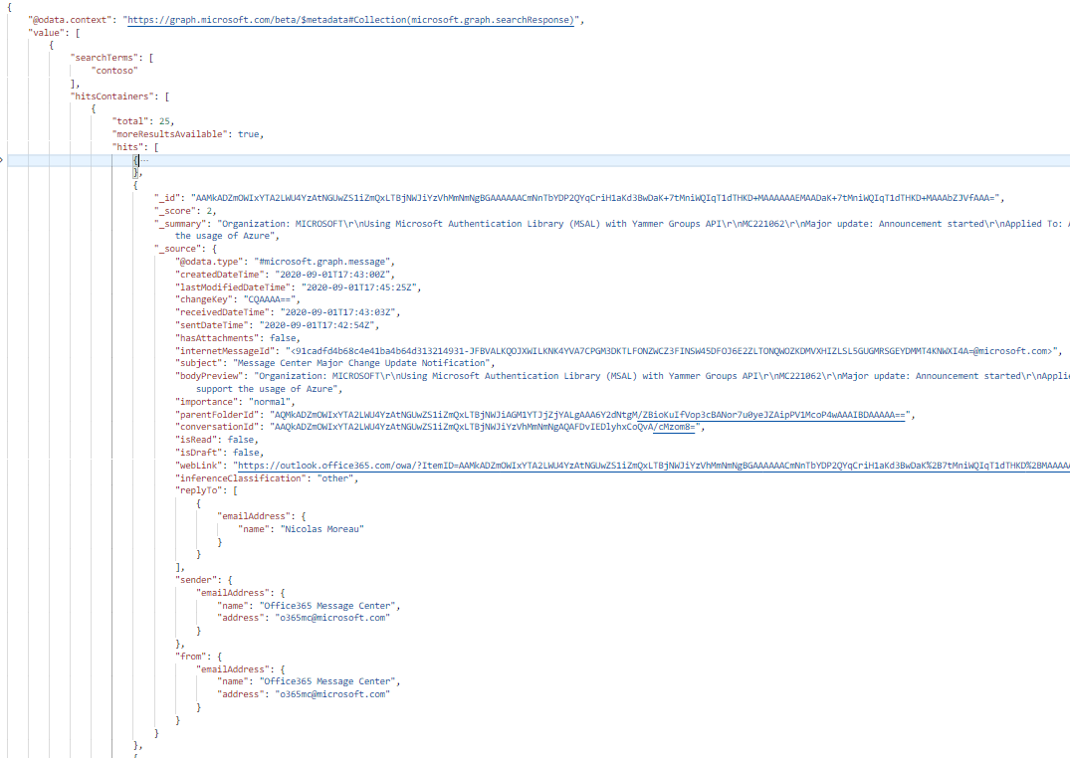
Anatomy of a ‘response’
value []
searchTerms
hitContainers[]
total
moreResultsAvailable
hits[]
id
idsor
rank
summary
resource
{
graph entity
}
Note : some properties have been renamed since the demo was recorded
Check the latest Search API documentation on https://aka.ms/mssearchapi

Slide 11
API Capabilities and Types
M365 Workload | Entity Types
Mail | Messages
Calendar | Events
SharePoint | DriveItems (Files)
OneDrive for Business | DriveItems (Files)
Connectors | External Items
SharePoint/OneDrive Business | ListItem (new)
SharePoint/OneDrive Business | List (new)
SharePoint/OneDrive Business | Site (new)
SharePoint/OneDrive Business | Drive (new)
An endpoint in MS Graph (since 09/19) https://graph.microsoft.com/beta/search/query
Query are scoped by entity
Results are Graph entities
Support KQL from underlying workload
More entities (new)
Select Properties (new)
Sort Results (new)
Refine Results with aggregations (new)
1x2 column

Slide 12
API Capabilities and Types
M365 Workload | Entity Types
Mail | Messages
Calendar | Events
SharePoint | DriveItems (Files)
OneDrive for Business | DriveItems (Files)
Connectors | External Items
SharePoint/OneDrive Business | ListItem (new)
SharePoint/OneDrive Business | List (new)
SharePoint/OneDrive Business | Site (new)
SharePoint/OneDrive Business | Drive (new)
An endpoint in MS Graph (since 09/19) https://graph.microsoft.com/beta/search/query
Query are scoped by entity
Results are Graph entities
Support KQL from underlying workload
More entities (new)
Select Properties (new)
Sort Results (new)
Refine Results with aggregations (new)
1x2 column

Slide 13
Demo – Microsoft Search in Graph PostMan Collection
Note : some properties have been renamed since the demo was recorded
Check the latest Search API documentation on https://aka.ms/mssearchapi

Slide 14
Demo – Microsoft Search API integration
Microsoft Dynamics Knowledge Management

Slide 15
Learn More about Microsoft Search and Graph
Search API Documentation at https://aks.ms/mssearchapi
  “Check the latest doc which is the source of truth !”
Graph API PostMan Collection at https://aks.ms/graphpostman
Watch replays and more at https://aka.ms/MicrosoftSearch/YouTube
GitHub Samples at https://github.com/microsoft-search
Give feedback in GitHub, or UserVoice

Slide 16
END

