Slide 1
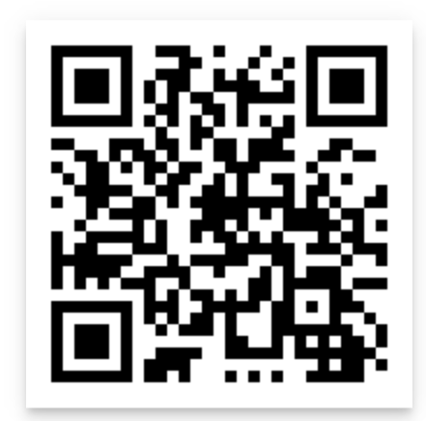
What’s new in Security and Compliance in SharePoint and OneDrive
Sesha Mani
Principal Group Product Manager (GPM), Microsoft
/in/seshamani
@SeshaManiS

Slide 2
Agenda
Trends in security landscape
New security controls to your unique challenges
New compliance controls
Summary

Slide 3
Agenda
Trends in security landscape
New security controls to your unique challenges
New compliance controls
Summary

Slide 4
300M
40%
Global office workers are expected to be working from home¹
CIOs indicate that Information Security is a primary risk from COVID-19²
BCG remote work study
Gartner CXO survey
Notes:
© Microsoft Corporation. All rights reserved.
9/29/2020 3:36 PM
4

Slide 5
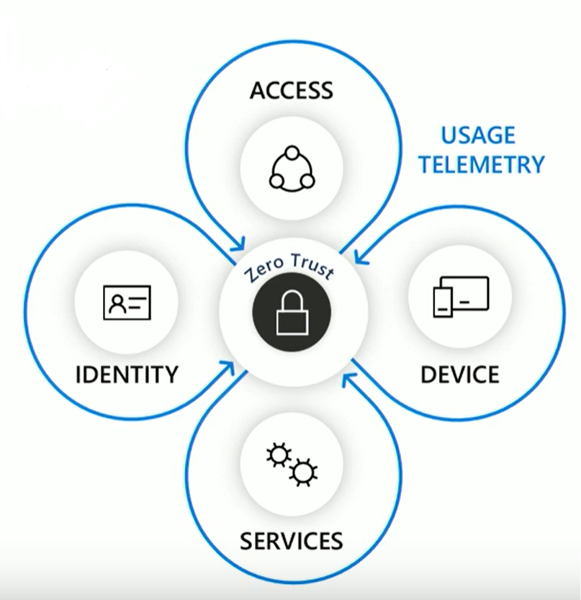
Zero trust model Strong user identity Managed device Least privileged access

Slide 6
Agenda
Trends in security landscape
New security controls to your unique challenges
New compliance controls
Summary

Slide 7
Agenda
Trends in security landscape
New security controls to your unique challenges
New compliance controls
Summary

Slide 8
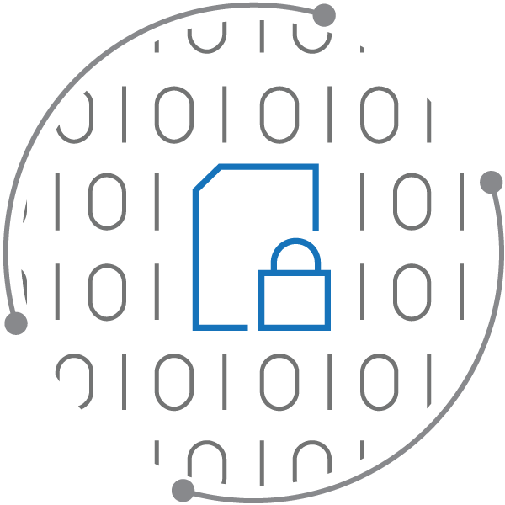
Security pillars for digital era
Locations
Users
Data
Devices
Information Protection
…

Slide 9
Security pillars and available controls
Users
Devices
Locations
Information Protection
Internal vs External (Guests)
MFA Policy
Sharing policies
Mobile Device Mgt (Intune)
Fine grain Conditional access (Unmanaged devices)
Idle session timeout
IP Address Policy
Multi-geo & data residency
Unified session revocation
Sensitivity labels for Files
Sensitivity labels for Teams/Sites
Auto classification
Data loss prevention (DLP)
https://aka.ms/M365SecurityCorner

Slide 10
Microsoft Information Protection (MIP)

Slide 11
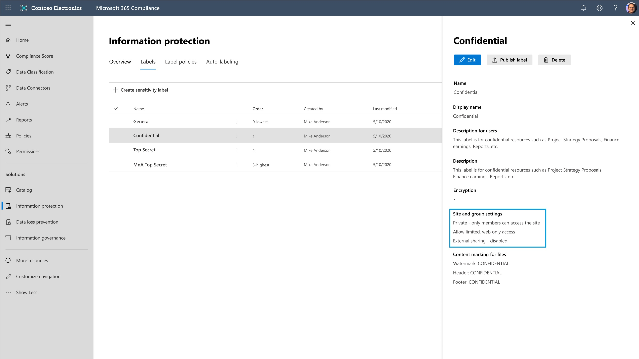
Simplify information protection using Sensitivity Labels
Microsoft Information Protection (MIP)
Easily classify, detect, and label your ever-increasing digital data
Manually/Automatically protect Files & Emails with policies like Encryption and Watermarking
Set consistent policies on Teams, Sites, and Groups like Device, now with external sharing policies

Slide 12
Demo: Sensitivity labels for Files and Teams/SharePoint Sites

Slide 13
Would you like to try Sensitivity Labels in SharePoint/OneDrive/Teams, now with Sharing Policies?

Slide 14
Public Preview Sensitivity Labels with External Sharing Policies
^{https://aka.ms/MIPSharing}

Slide 15
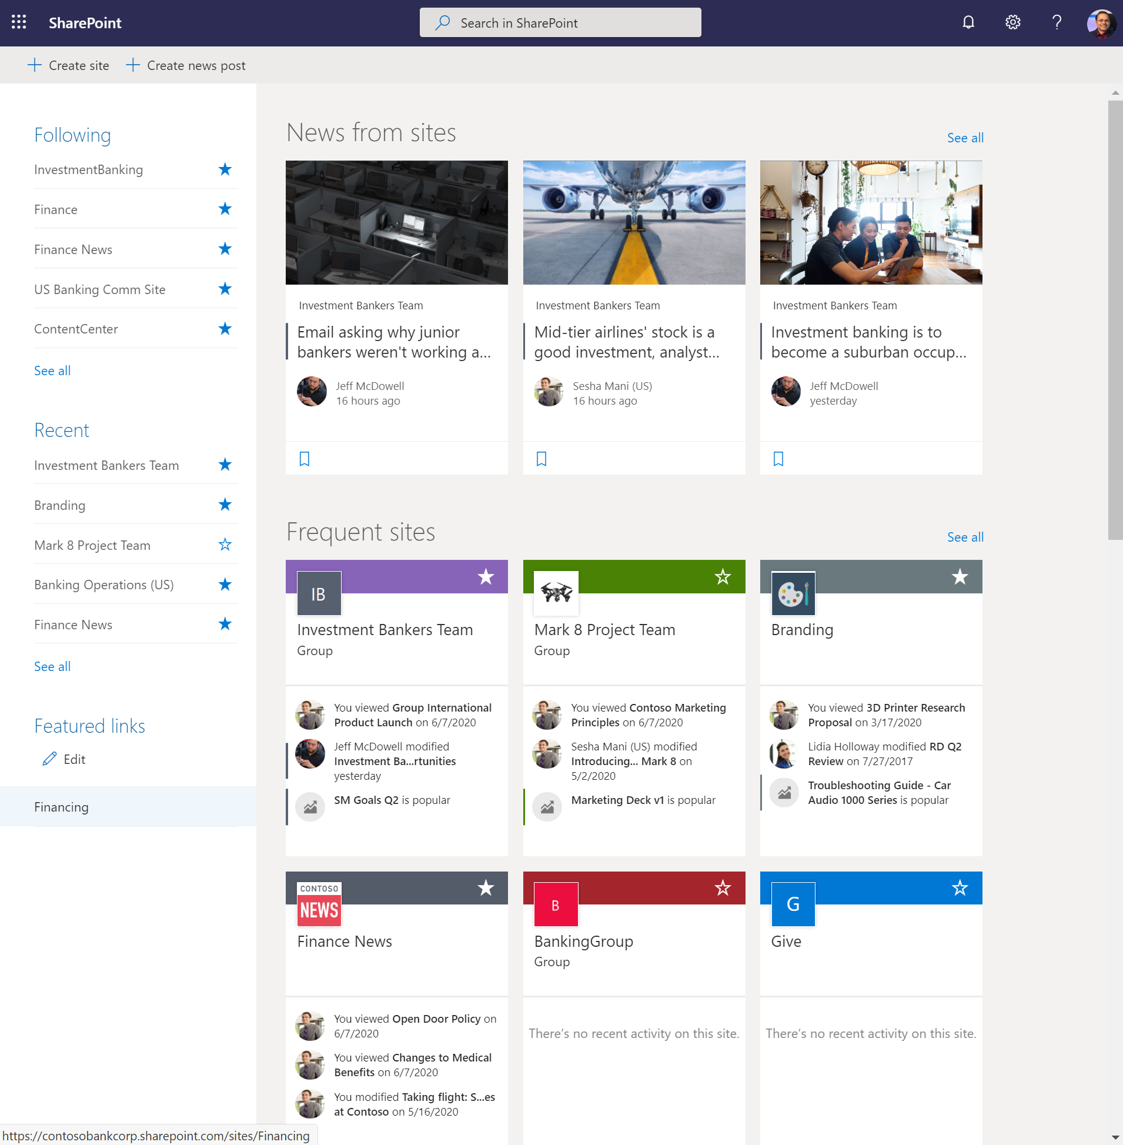
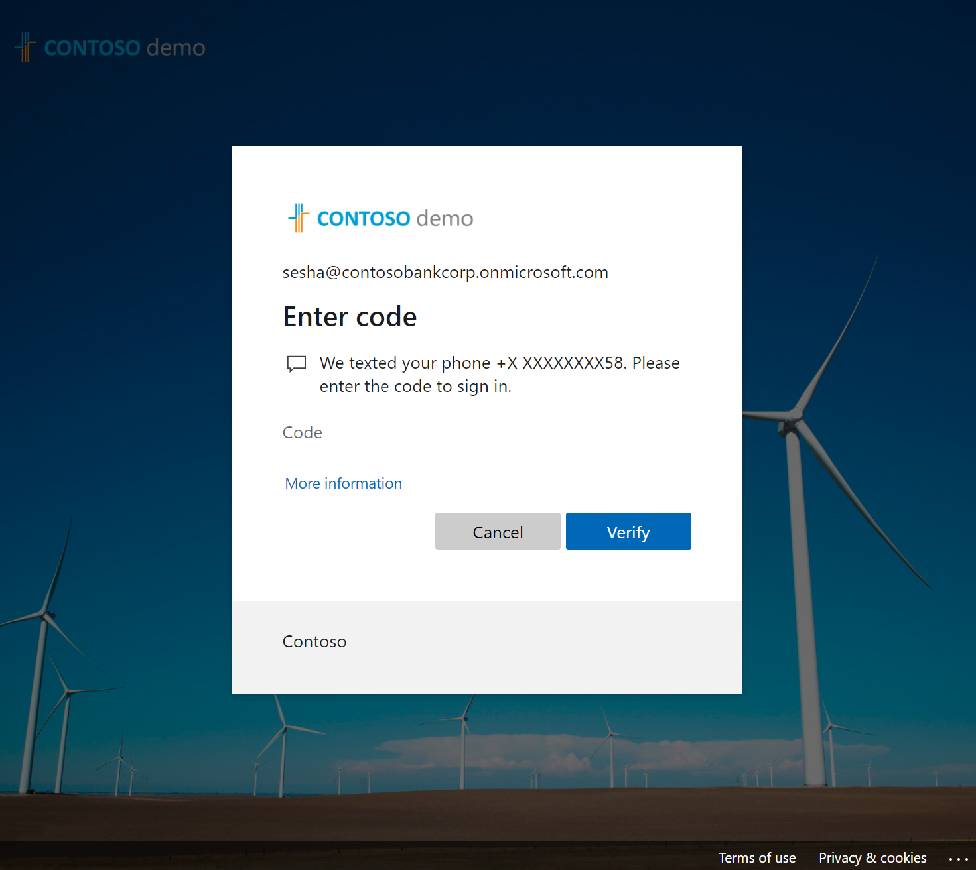
Next up – MFA Policy associated with sensitivity label
Like device policies at site level, you can now do MFA (multi-factor-authentication) at site level
Tailor the additional authentication requirements for business sensitive sites
Interested in previewing? Enroll in this form: https://aka.ms/ODSPSecurityPreviews

Slide 16
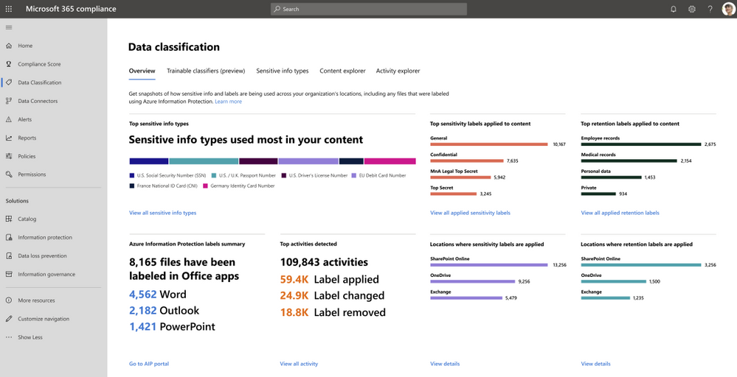
Data Classification Explorers – Know your data
Data classification shows you full insights to how many items are labeled and with what labels across your Microsoft 365
Content explorer shows detailed view of distribution of sensitive info types and labelled files
Activity explorer shows detailed view of activities on labelled files
https://aka.ms/MIPDataClassification

Slide 17
But, wait there’s more…

Slide 18
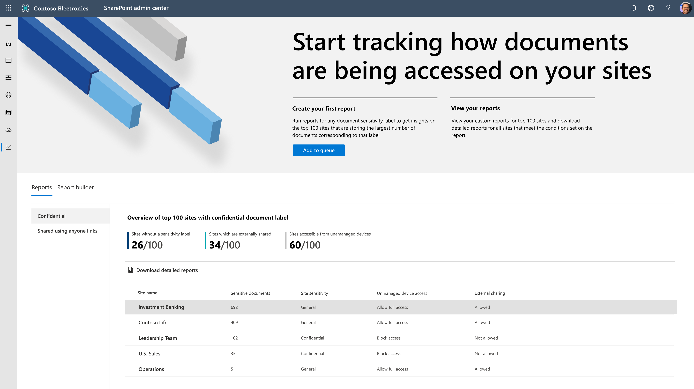
Data access governance (DAG) insights
Insights into sensitivity-based top-100 sites sorted by number of sensitive files and corresponding access & sharing policies

Slide 19
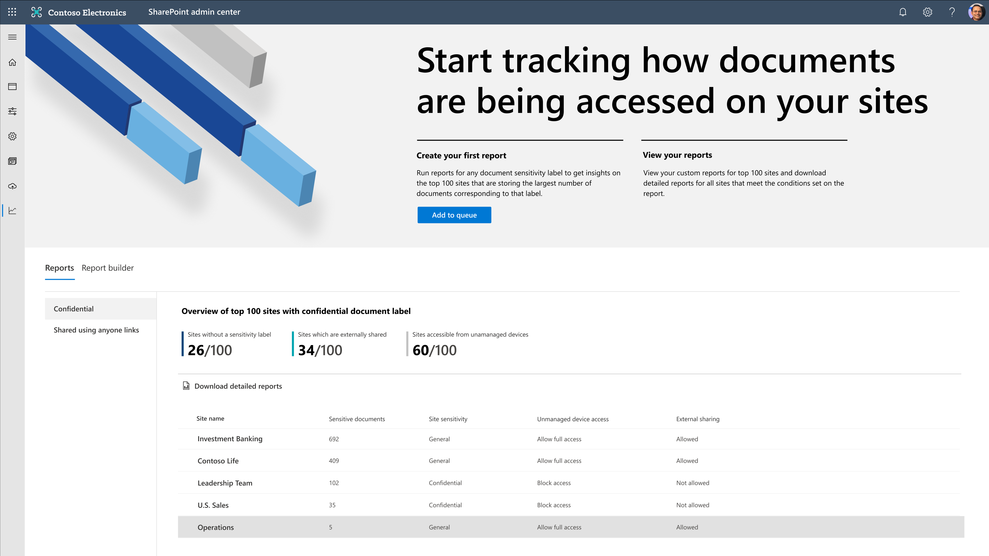
Data access governance (DAG) insights
Learn access patterns by reviewing the over exposed sites with company sharable or anonymous links

Slide 20
Demo: Data access governance in SharePoint sites & Teams

Slide 21
But, wait there’s more…

Slide 22
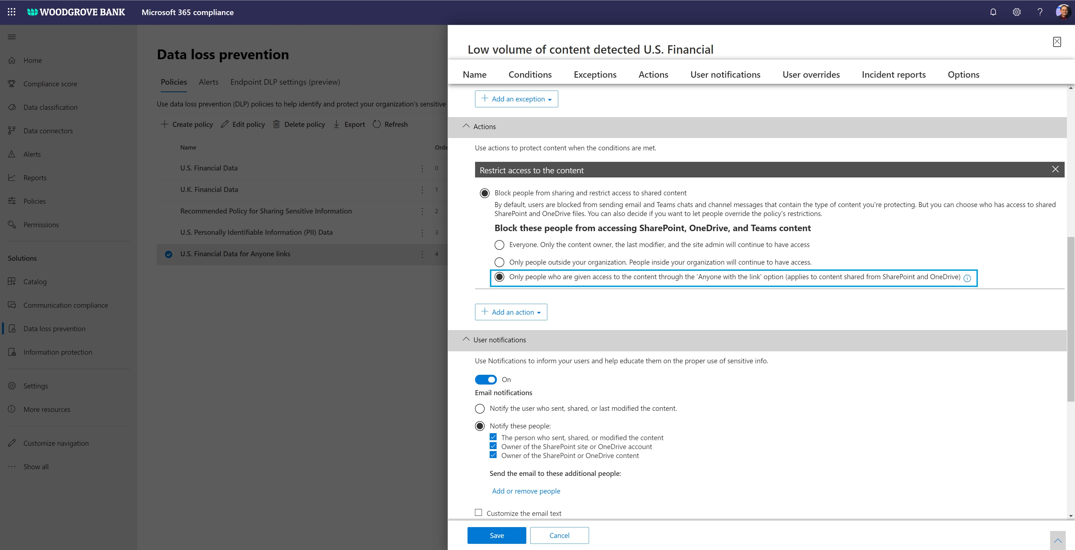
DLP – Block anonymous access/sharing for sensitive files
Sharing is caring – however, oversharing and overexposure of your business sensitive files is not
DLP block anonymous access will protect your sensitive content even if the files were shared anonymously before

Slide 23
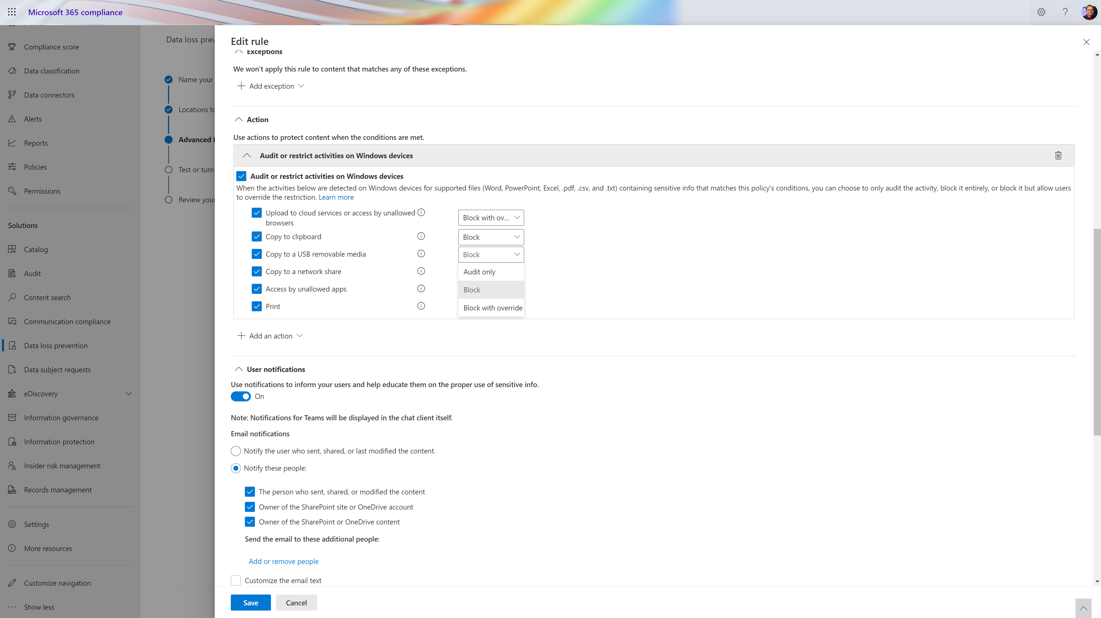
Data loss prevention – Endpoint DLP
Endpoint DLP enables you to protect policies and taking actions in your managed Windows devices
Granular protections across the endpoints and action options like Audit only, Block

Slide 24
Demo: Data loss prevention (DLP) – New rules and actions

Slide 25
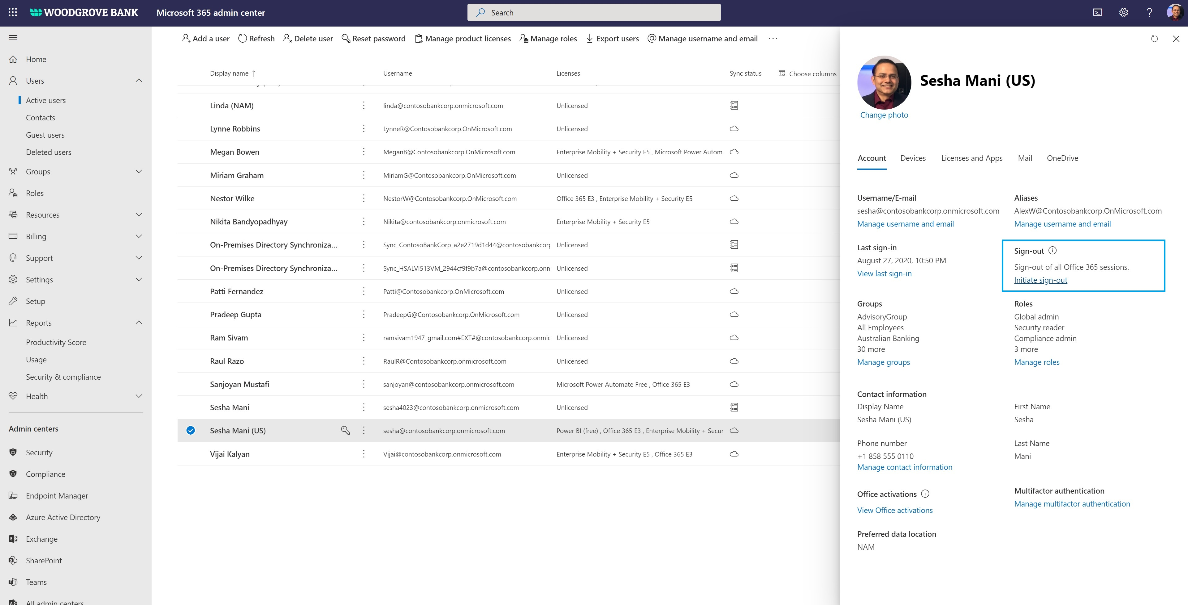
Unified session sign-out across Microsoft 365
Unified session sign-out allows one to sign the user out across all the Microsoft 365 clients and apps
Unusual activities like impossible travel or device state change are triggers for admins to invoke this session revocation

Slide 26
Demo: Unified session sign-out – Continuous access evaluation

Slide 27
Recap – security controls
MIP Sensitivity Labels
External sharing policies
MFA policy with labels
Data classification explorers
Data access governance
Data loss prevention (DLP)
Block anonymous access
Endpoint DLP
Sessions - Unified session sign-out

Slide 28
Agenda
Trends in security landscape
New security controls to your unique challenges
New compliance controls
Summary

Slide 29
Agenda
Trends in security landscape
New security controls to your unique challenges
New compliance controls
Summary

Slide 30
Insider Risk Management
Identify and take an action on critical insider threats
Rich Insights via tailored templates
Machine learning correlates native¹ and third-party signals to identify insider risks
Privacy built-in
Anonymity controls ensure data about risks is appropriately managed
End-to-end investigations
Integrated investigation workflows allow for collaboration across IT, HR and legal
1. Teams, SharePoint Online, Exchange Online, OneDrive for Business and Windows 10

Slide 31
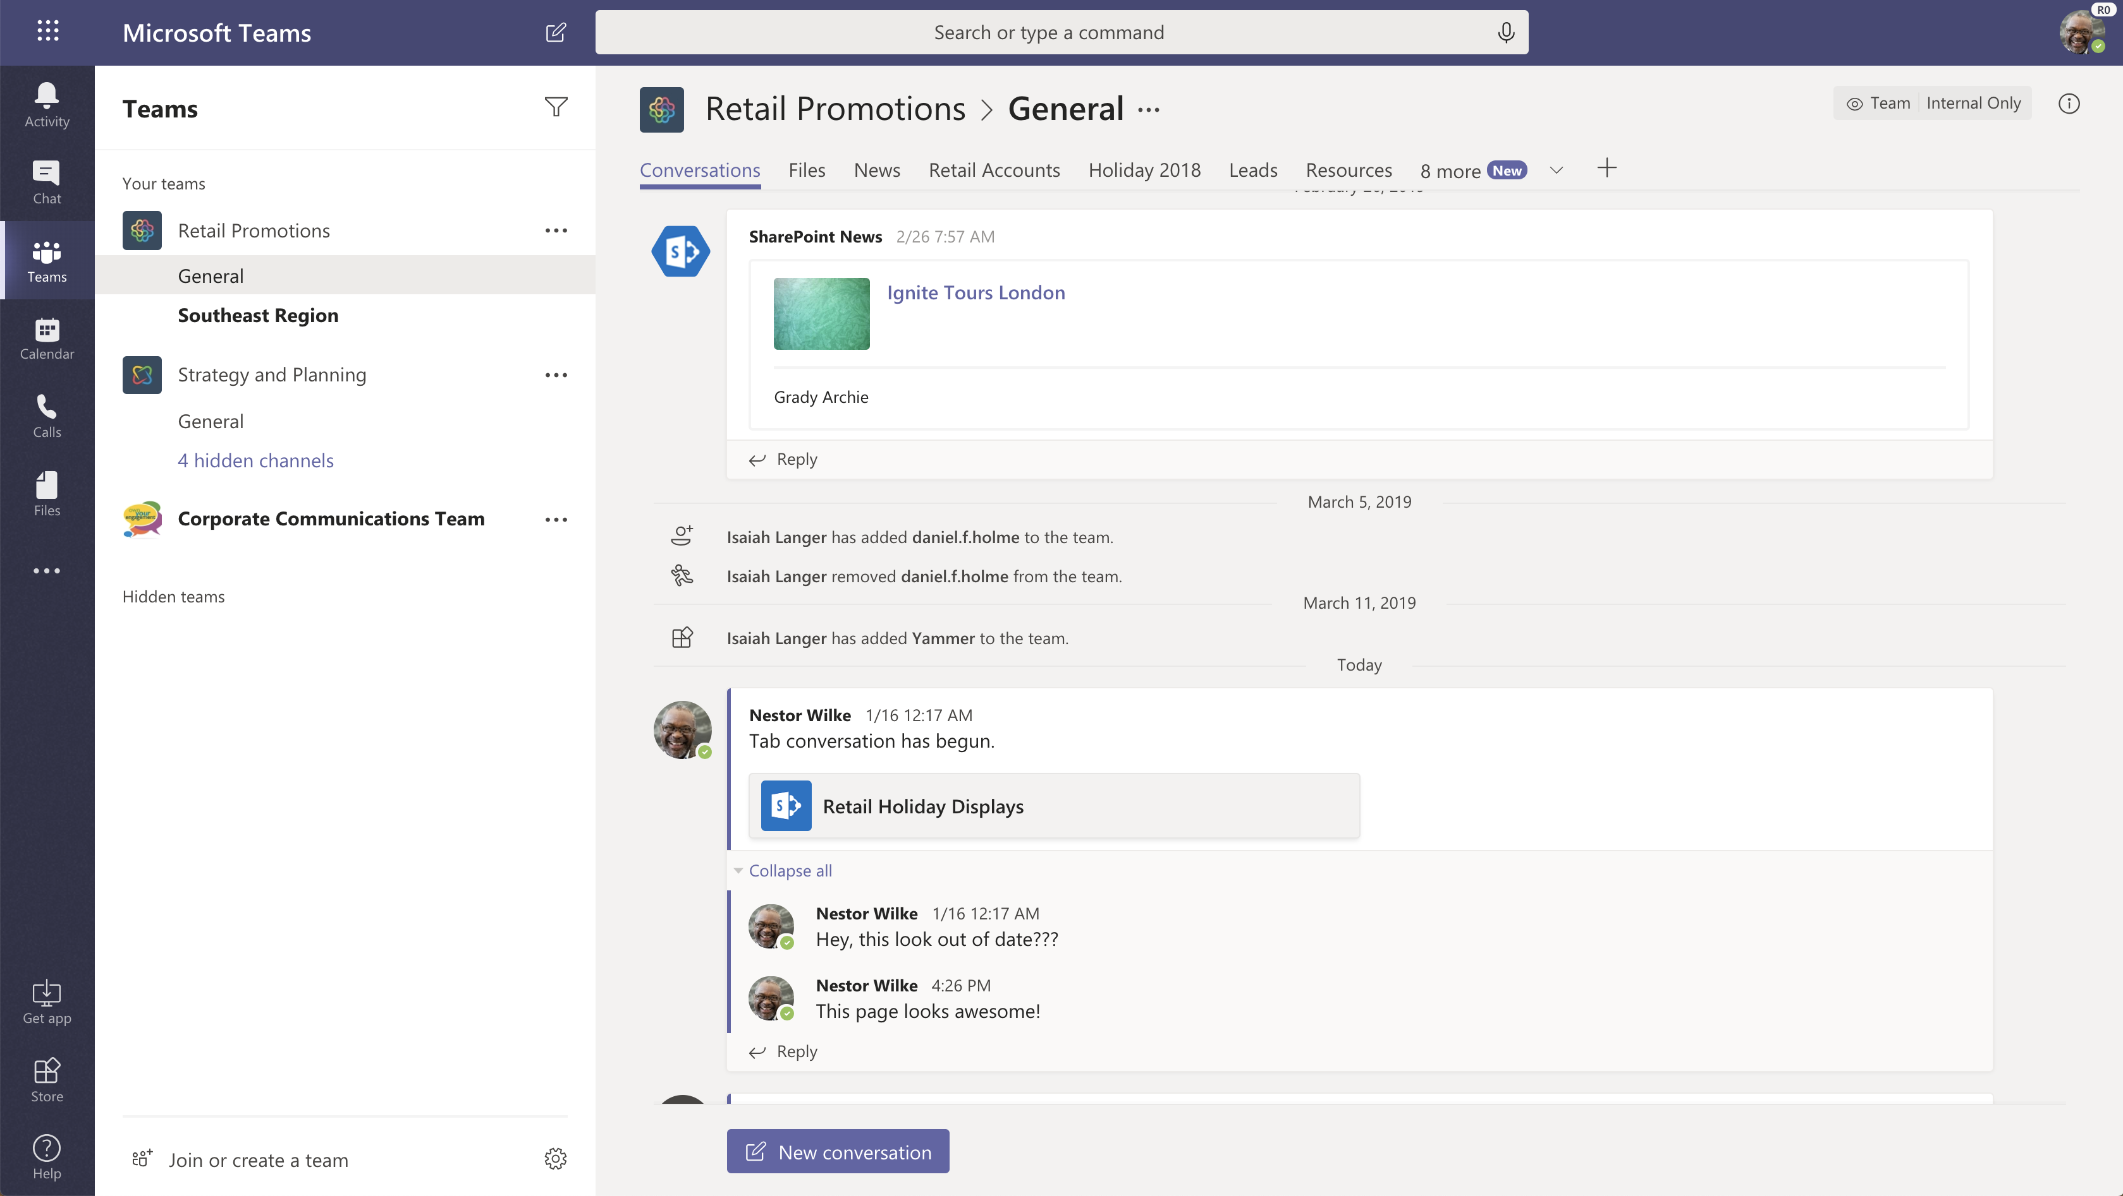
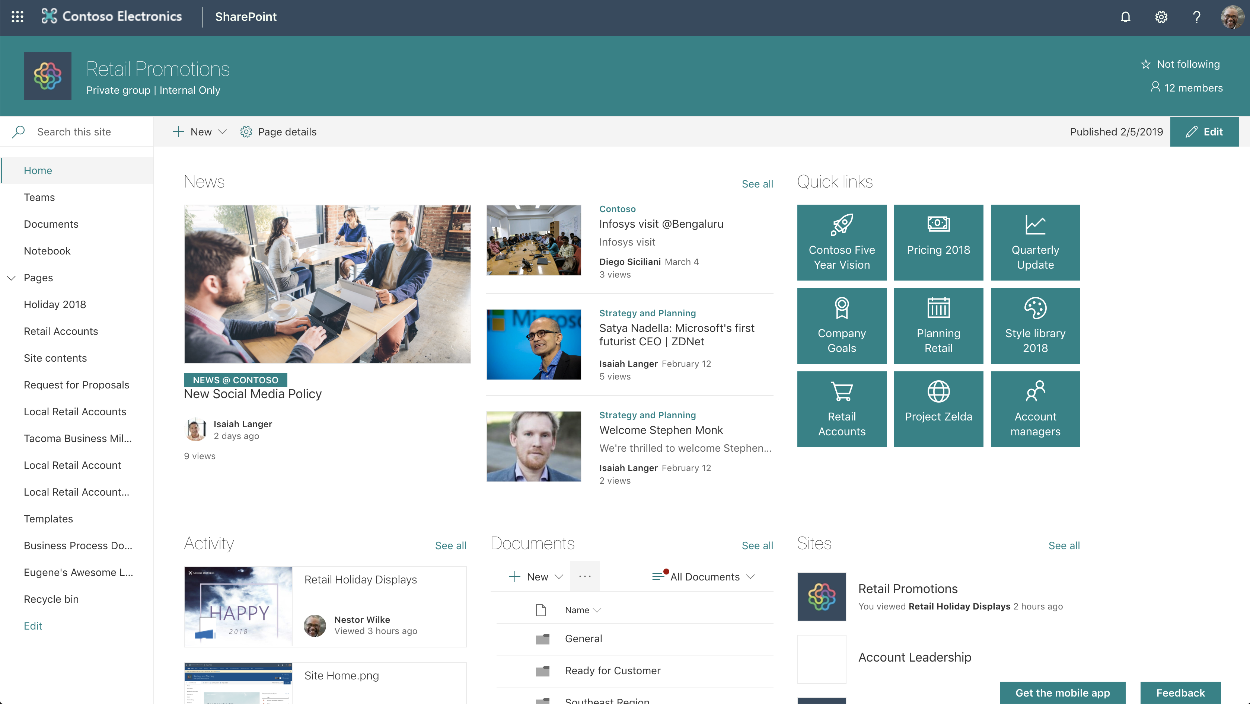
Investment Banking
Advisory

Slide 32
Investment Banking
Advisory

Slide 33
Investment Banking
Advisory

Slide 34
Investment Banking Information
Advisory Information
Conditional Access:
IB Must Match
Conditional Access:
IB Must Match
Members only
Members only

Slide 35
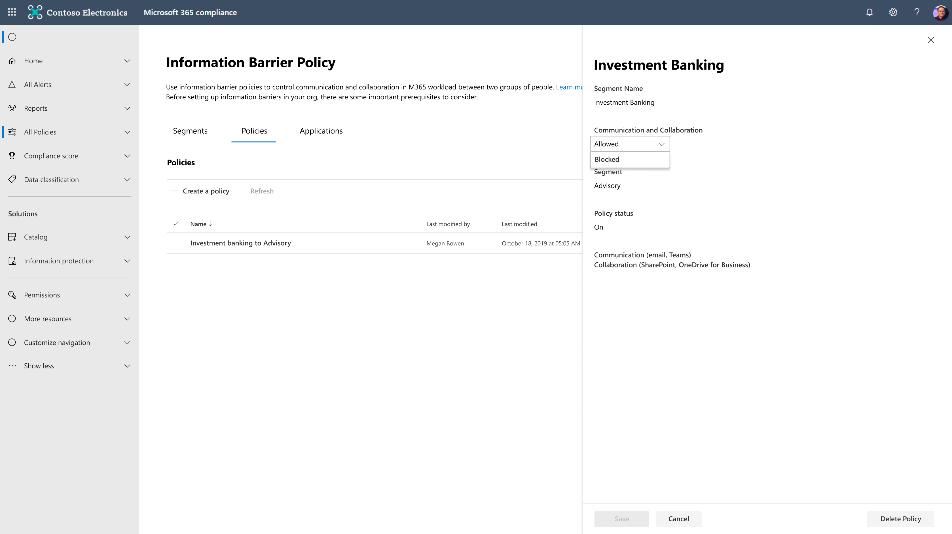
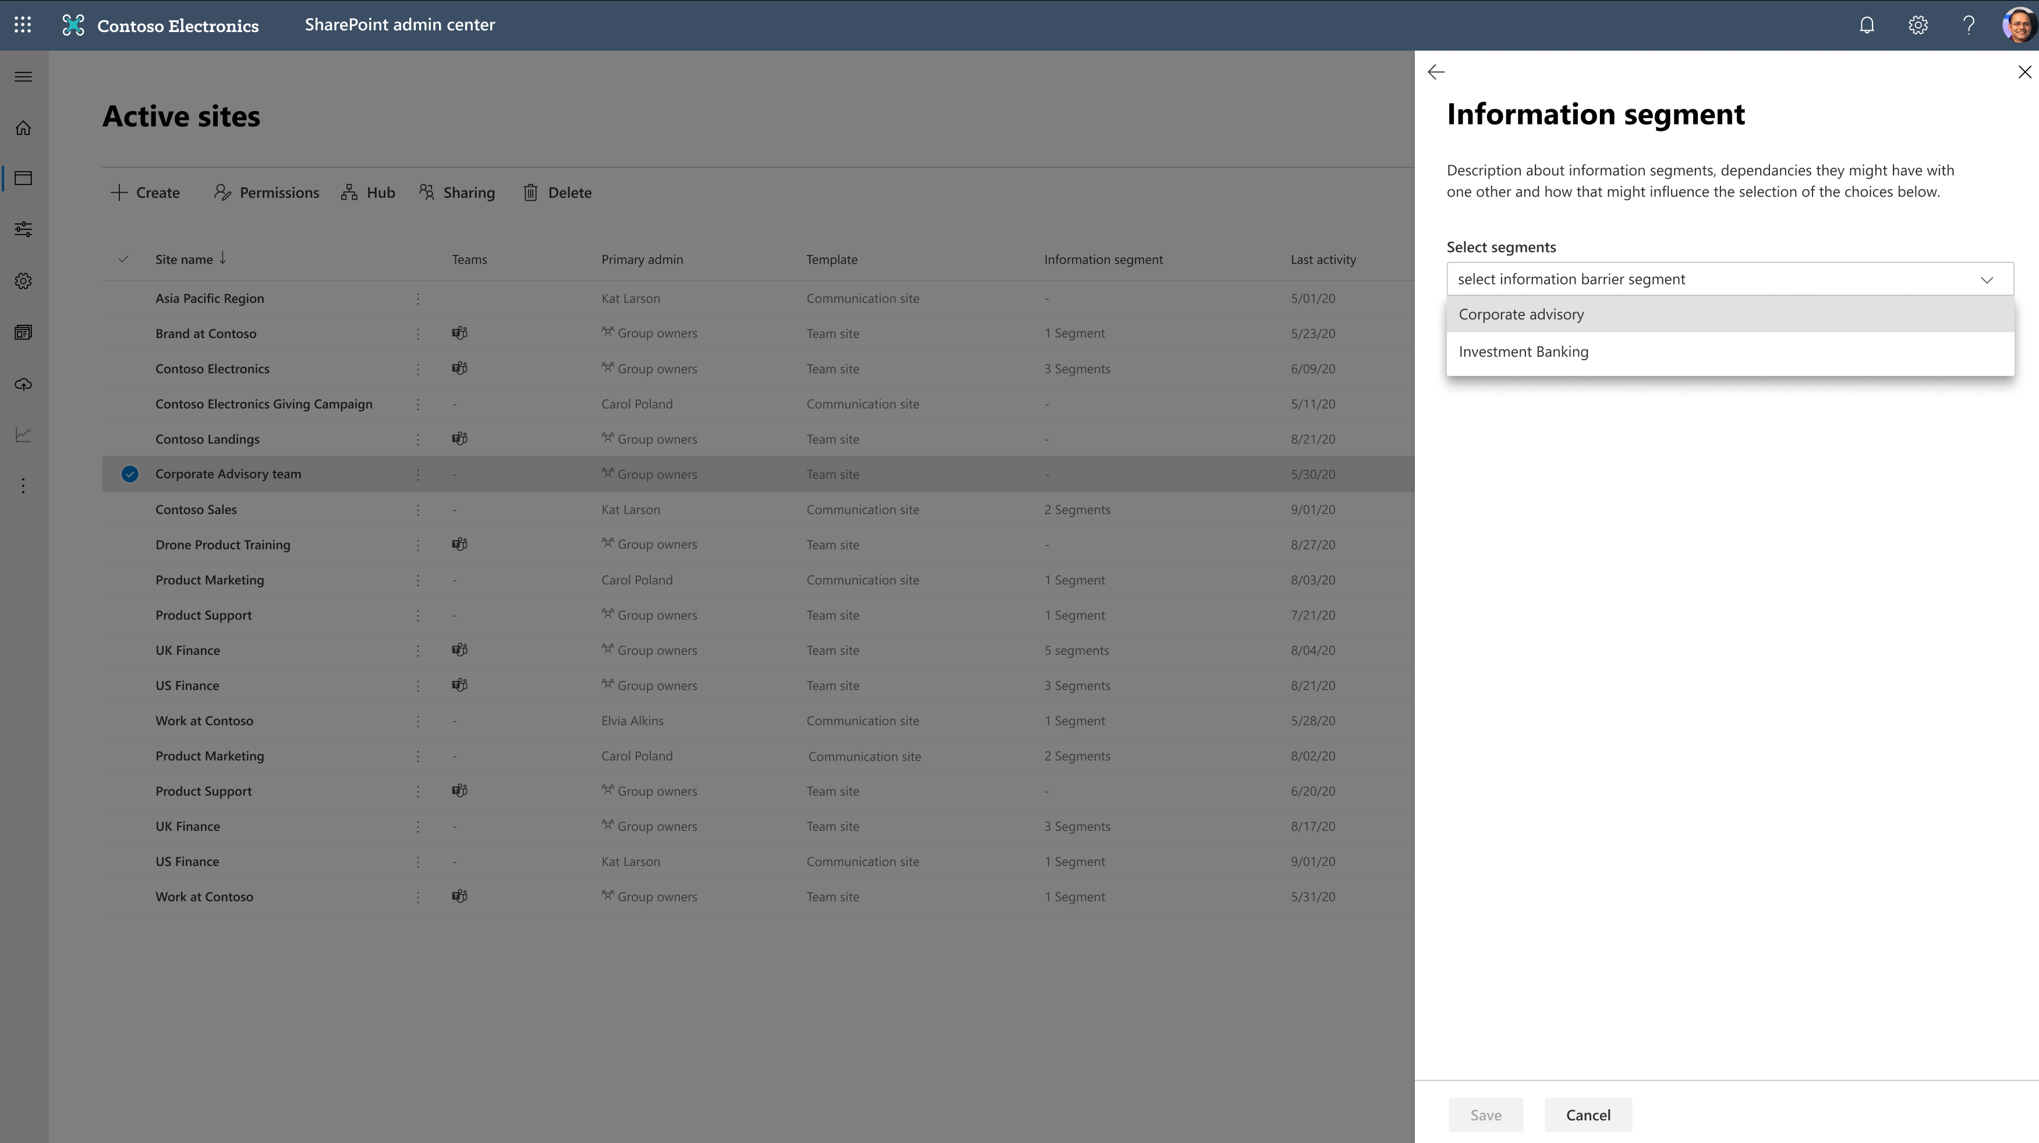
Information Barriers (IB)
Segment the users in your enterprises per compliance requirement
Associate teams/sites to specific info barrier segment, as needed
Achieve barriers in communication and collaboration with this advanced conditional authorization

Slide 36
Demo: Information barriers

Slide 37
But, wait there’s more…

Slide 38
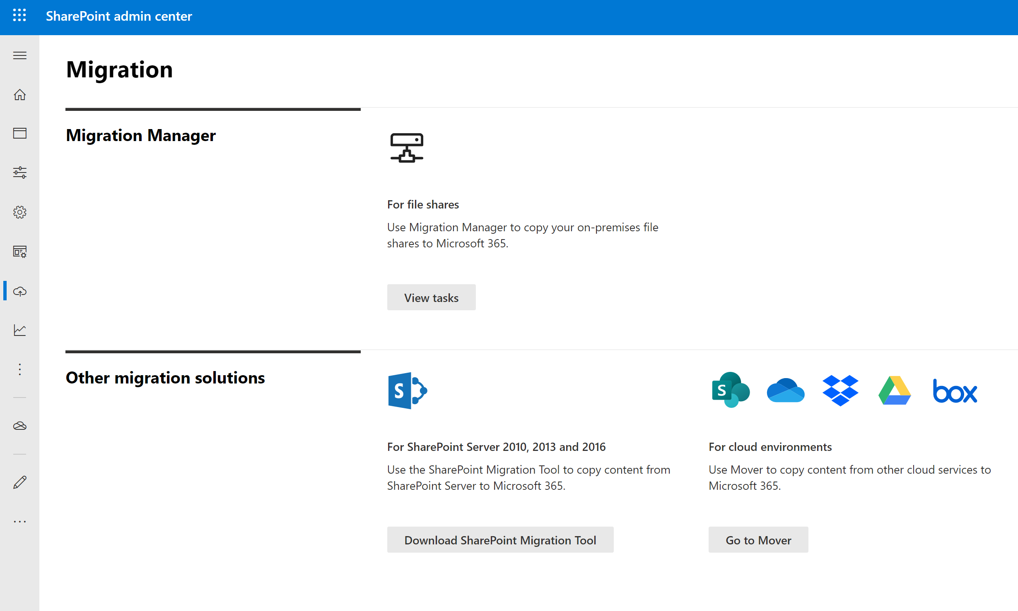
Migration manager
Migrate content to M365 through a simple interface
Automatic task distribution across multiple migration agents
Centralized task management and reporting
Access tools based on your sources including on-prem server and other cloud storage providers
Learn more at https://aka.ms/MigrateToM365​

Slide 39
Agenda
Trends in security landscape
New security controls to your unique challenges
New compliance controls
Summary

Slide 40
Agenda
Trends in security landscape
New security controls to your unique challenges
New compliance controls
Summary

Slide 41
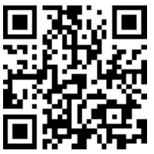
Summary
Available Now
EOY CY’2020
Sensitivity Labels for Teams/Sites (GA)
Office Client Co-auth for Protected Files (Limited Preview)
Sensitivity Labels with Protection for Files (GA)
MFA Policy at Site Level (Public Preview)
Auto Classification w/ Sensitivity Labels (GA)
Data access governance in SharePoint (Limited preview)
Endpoint DLP (Public Preview)
Migration Manager with Box migrations (Public Preview)
DLP Block anonymous access for sensitive files (GA)
Multi-Geo for Teams Chat (Limited Preview)*
Continuous access evaluation (Public Preview)
Customer key for Teams (Limited preview)*
M365 Insider risk management (GA)
SharePoint Admin homepage improvements (Public Preview)*
M365 Information Barriers (GA)
Multi-Geo for SharePoint & OneDrive & Exchange (GA)*
Expiring external user permissions (GA)*
Migration Manager (GA)*
Network connectivity insights (Public Preview)*
GA – Generally Available
* Capabilities covered in other videos
https://aka.ms/M365SecurityCorner

Slide 42
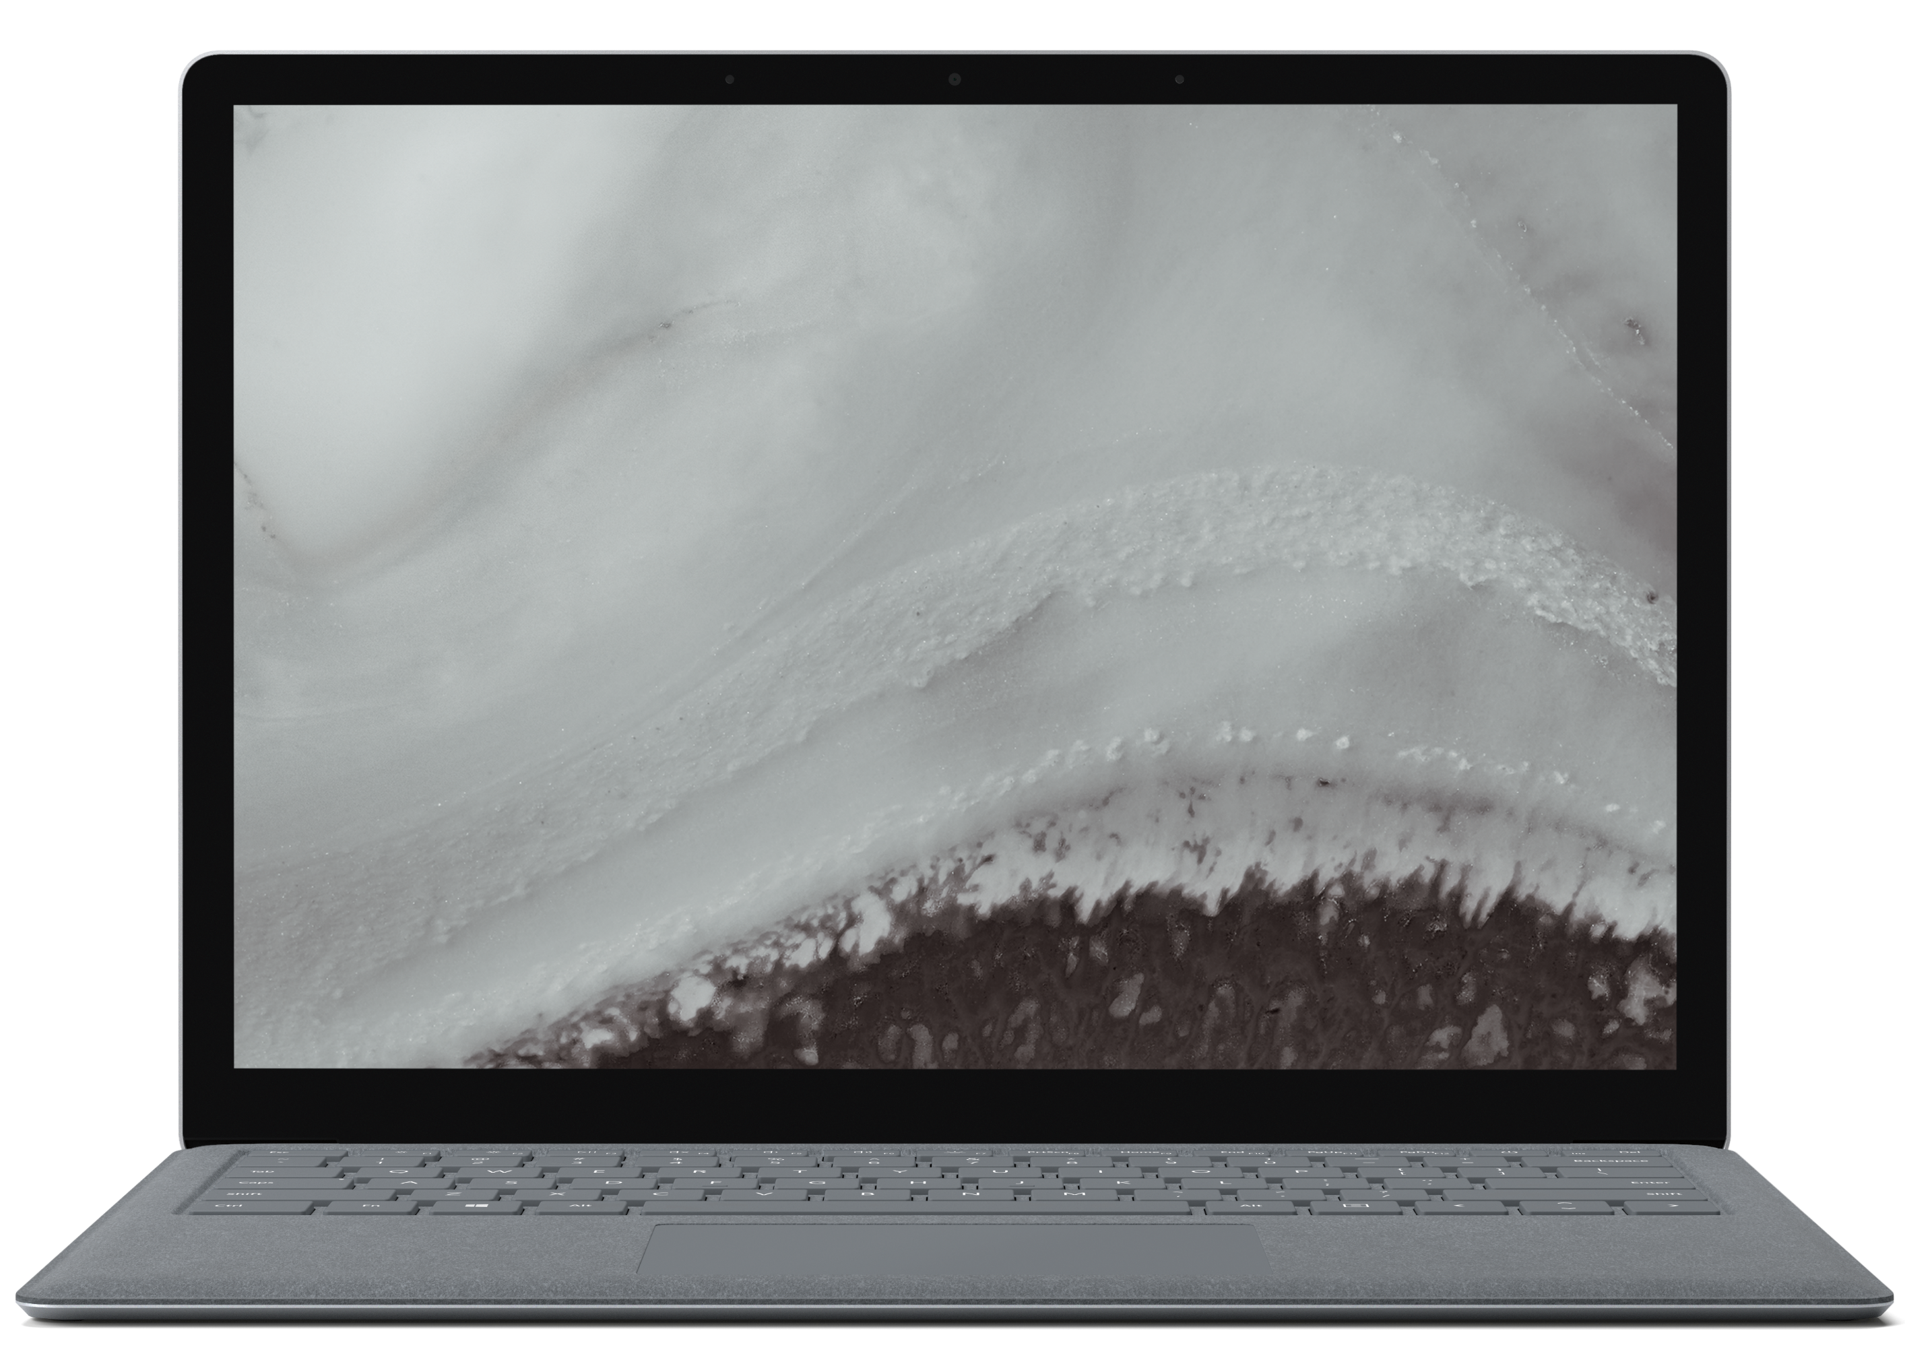
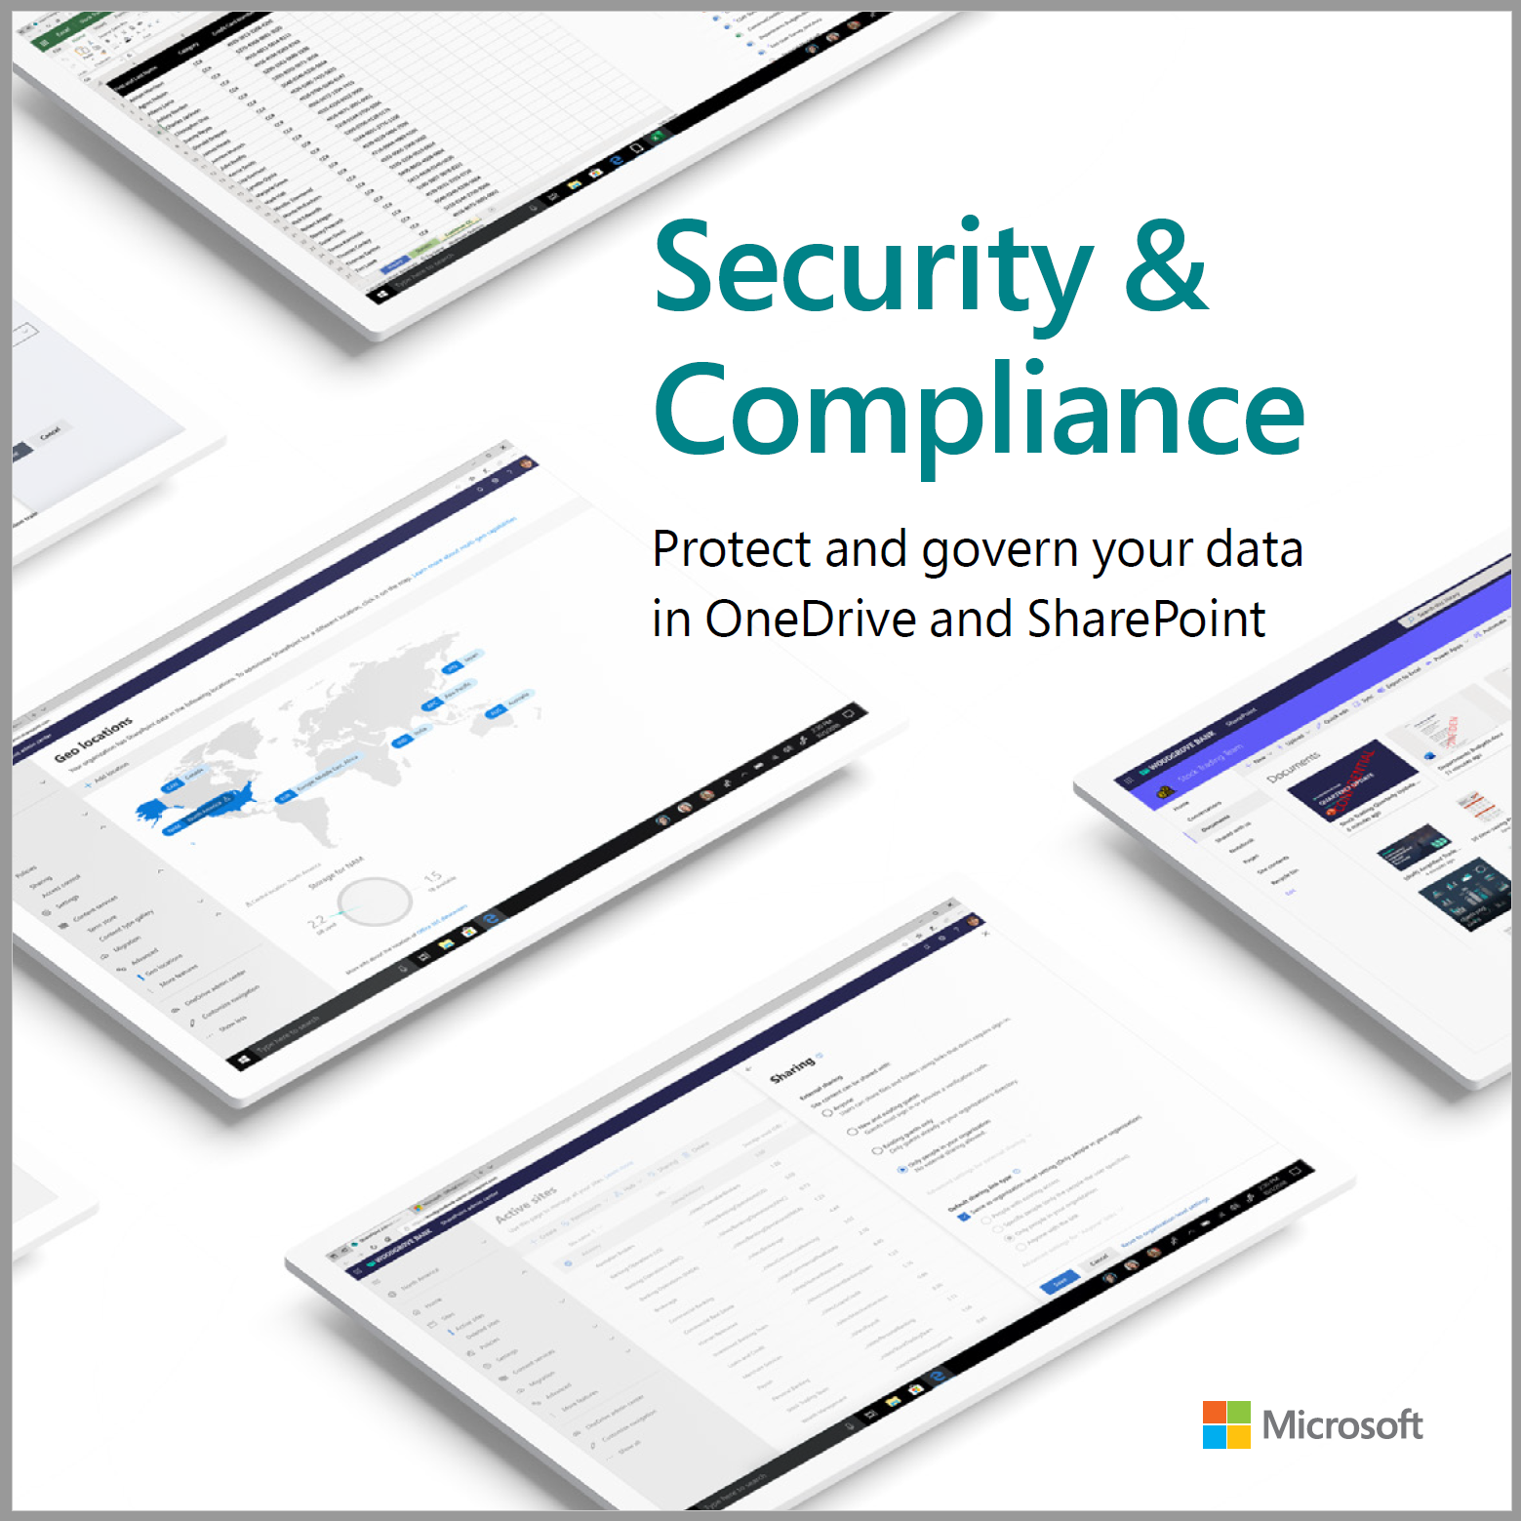
SharePoint and OneDrive - Security & Compliance cook book
Discover the frictionless security and comprehensive compliance controls you can use to secure and govern your SharePoint and OneDrive content in Microsoft 365
https://aka.ms/sharepointsecuritycookbook

Slide 43
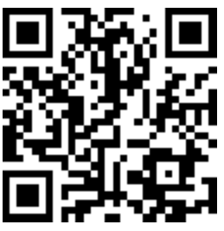
Call to action
Check out Security & Compliance Resources for SharePoint and OneDrive and Teams at:
https://aka.ms/M365SecurityCorner
https://aka.ms/ODSPSecurityPreviews

Slide 44
Related sessions
Session title | Speakers | Videos
Collaboration, Intranet, and Knowledge | Jeff Teper | https://aka.ms/SC9001
What’s new in Security & Compliance in SharePoint, OneDrive (this session) | Sesha Mani | https://aka.ms/SC1108
Information protection in SharePoint, OneDrive, and Teams | Sesha Mani | https://aka.ms/SC11
Deep dive on MIP Labels in SharePoint, OneDrive, and Teams | Sanjoyan Mustafi | https://aka.ms/SC12
Administering Multi-Geo is a snap | Sesha Mani; Adriana Wood | https://aka.ms/SC3024
What’s new in SharePoint Administration | Dave Minasyan | https://aka.ms/SC1110
What’s new to easily migrate content to Microsoft 365 | Yogesh Ratnaparkhi | https://aka.ms/SC1109
Turbocharging Microsoft 365 cloud user experiences | Shyam Narayanan | https://aka.ms/SC1072
Supporting mergers, acquisitions, and divestitures in Microsoft 365 | Robert Lowe, Sesha Mani | https://aka.ms/Admin1002
How Microsoft manages Microsoft 365 Groups for its employees | David Johnson | https://aka.ms/Admin1003

Slide 45
THANK YOU

