Slide 1
How to Successfully Activate and Adopt Project Cortex
Nkem Okoye, James Eccles, Lauri Ellis

Slide 2
Overview
  Intelligent Content Services
  Topic Experiences
Project Cortex

Slide 3
Agenda
Prepare for and activate
  Intelligent Content Services
  Topic Experiences
Adoption Strategies

Slide 4
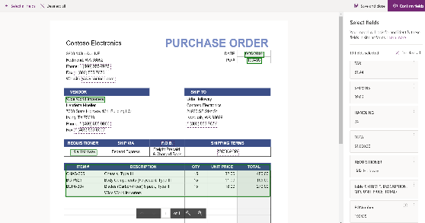
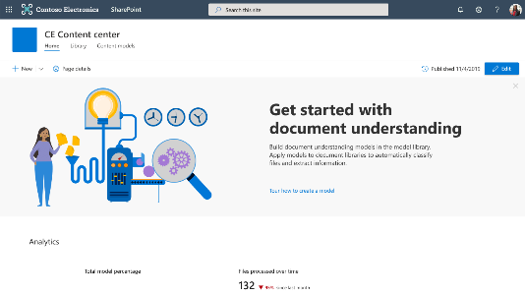
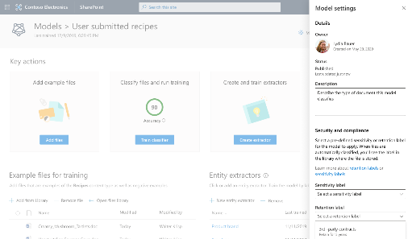
Intelligent Content Services
Content understanding
Content processing
Content analysis and management
Create no-code AI models to classify and extract information from content to automatically apply metadata for knowledge discovery and reuse.
Automate capture, ingestion and categorization of content and streamline content-centric processes using Power Automate.
Control and manage content to improve security and governance with enhanced MMS and integration to Microsoft Information Protection.

Slide 5
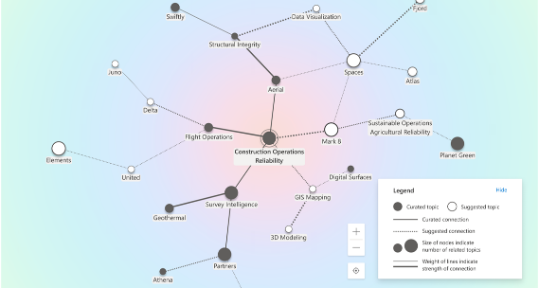
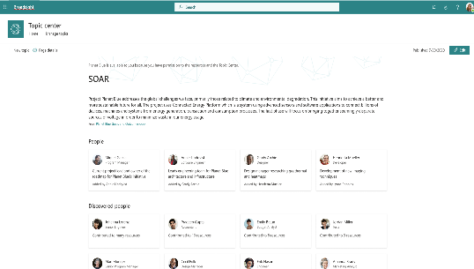
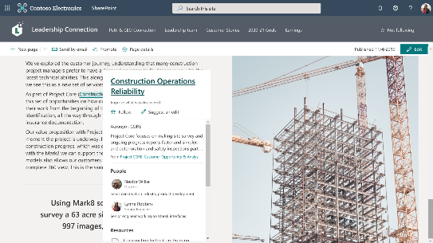
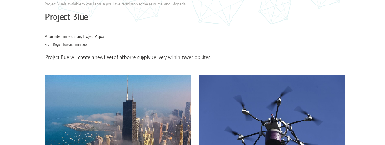
Topic Experiences
Topic Identification
Topic Curation
Topic Discovery
AI identifies knowledge and people and automatically organizes them into related topics.
Subject matter experts refine topics through topic pages, and AI learns from your input.
Discover knowledge in the apps you use every day through topic cards - you can also discover topics in Microsoft Search.

Slide 6
Categorize content and extract metadata with Intelligent Content Services

Slide 7
Intelligent content services overview
Manual
Document understanding
Form processing
Object detection
Capture content types and metadata from purchase orders, applications, other structured documents
Any content, aided by use of managed terms and content types
Capture content types and metadata from contracts, resumes, other unstructured documents
Process digital content - photos, scans, receipts, business cards, videos with OCR & text
Interactive
Machine-teaching
Partly automated
Fully AI-automated

Slide 8
Premium Managed Metadata Service
Term store reports
Content type push
New import format
Understand the composition of your term store & manage it better
Ensure that your critical content types are automatically added to new lists in desired hubs
Define richer import files with a new format based on SKOS, with support for properties & multiple term sets

Slide 9
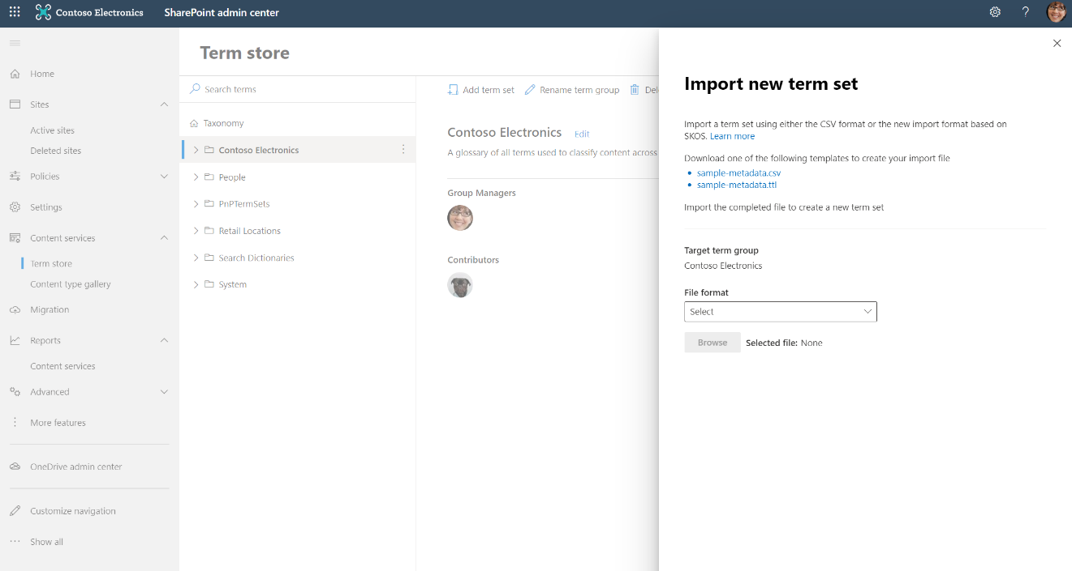
Managed metadata service with Project Cortex
  1040: Project Cortex: 101 of Taxonomy & Metadata
  1041: Project Cortex: Deep Dive on Metadata

Slide 10
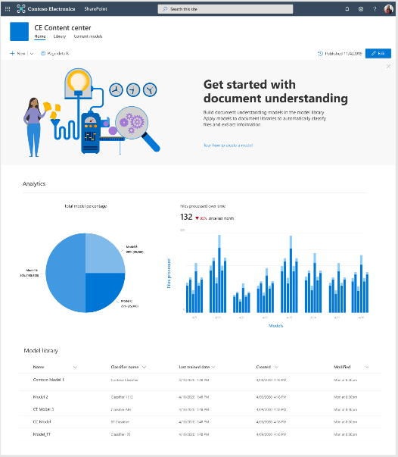
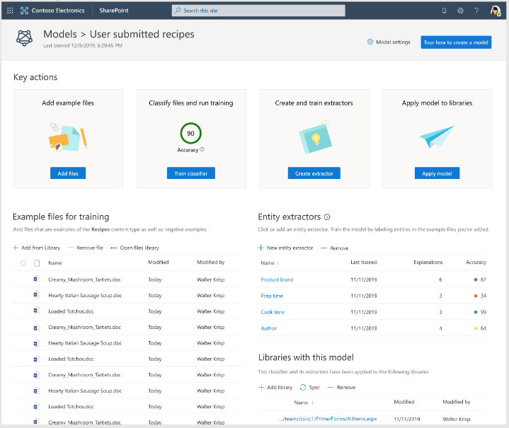
Document understanding
  Available in all regions.
  Models work on all Latin alphabet languages.
  Does not have capacity restrictions.

Slide 11
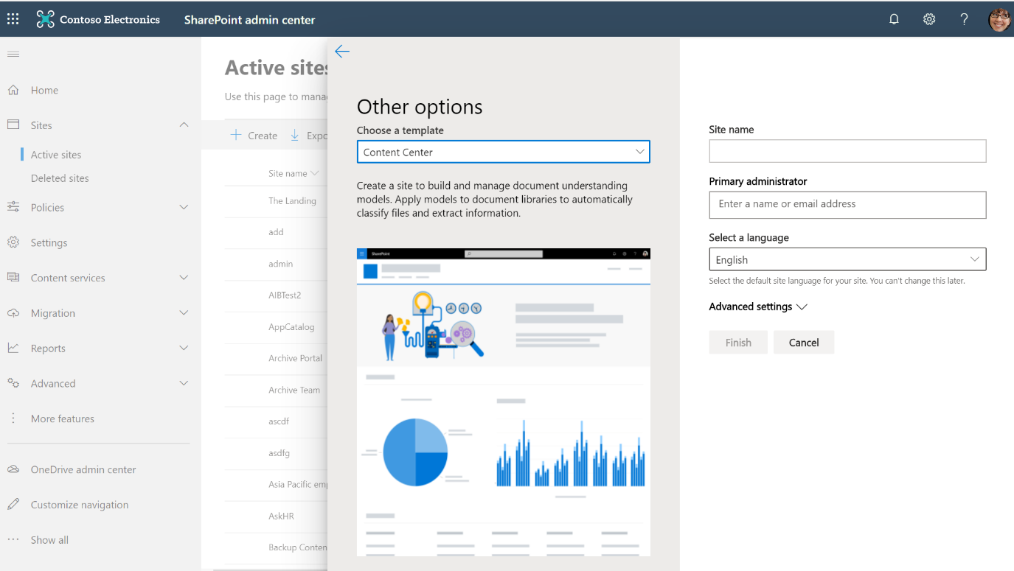
Content Center

Slide 12
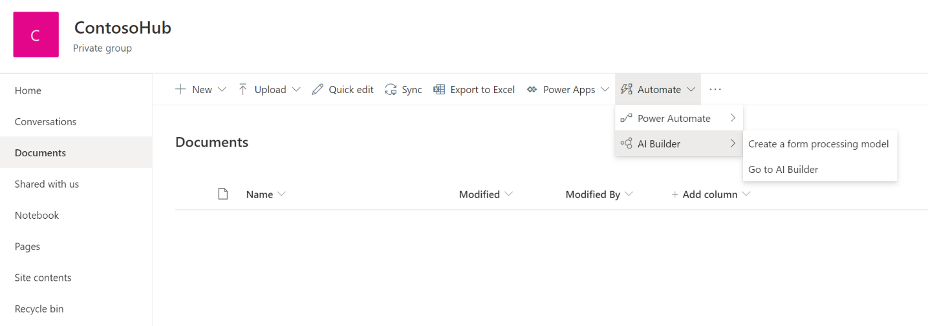
Form processing
  Available in
  APAC
  Australia
  Canada
  EU
  JP
  LATAM
  UK
  US
  Uses AI Builder credits
  Provisioned against the default CDS environment

Slide 13
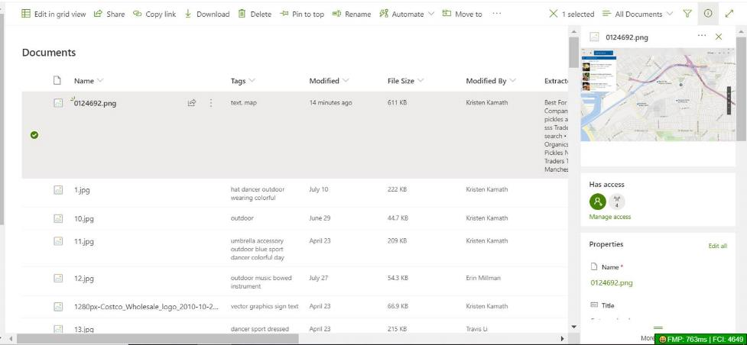
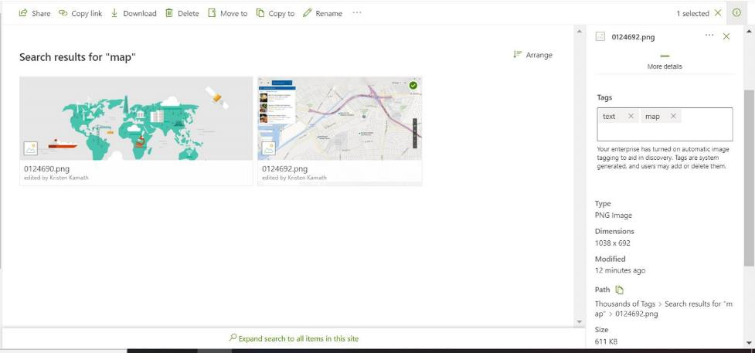
Object detection
  Available in all regions
  Thousands of tags with Project Cortex
  Improve search and workflows based on tags on images and PDFs

Slide 14
Questions to help prepare
What scenarios are driving the business?
Who will build the models?
Where will they build and apply models?

Slide 15

Business scenarios
  Content processing – contracts, statement of work etc.
  Invoice analysis
  Automate business processes
  Improved search results
  Compliance risk management

Slide 16




Who will manage Content Understanding?
Model management roles and activities
SharePoint/Knowledge Admin
AAD Role
Power Platform
Admin
AAD Role
Knowledge Manager
AAD Role
Model owner
(Champions)
Own Configure form processing
Manage Content Centers and permissions.
Configure CDS environment for form processing
Purchase and allocate AIB credits
Gather use cases
Establish best practices
Review model analytics
Gather business use cases
Create and apply models

Slide 17
Where – Model creation and application
Form processing
Document understanding
Decide which sites will get Form processing action
You can create multiple content centers for different business areas
  Are there existing processes or repositories that could be enhanced?

Slide 18
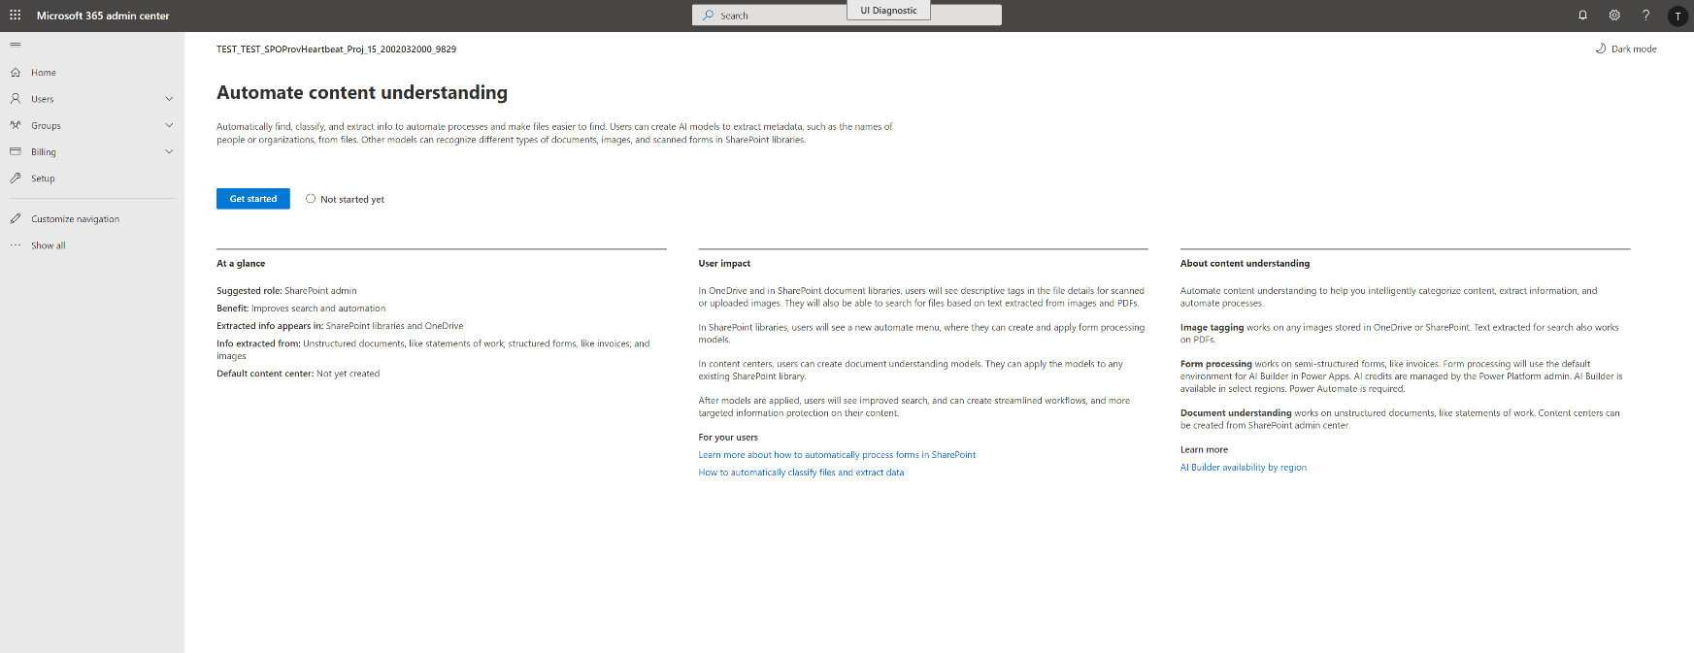
M365 Admin Center > Setup > Organizational knowledge

Slide 19
Configuring Intelligent Content Services

Slide 20
Connect and organize knowledge with Topic Experiences

Slide 21

Business scenarios
  Role onboarding & training
  Expertise finding
  Information sharing
  Expanded decision making
  Improved time to market

Slide 22
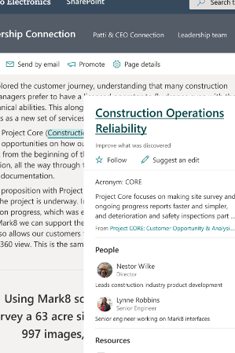
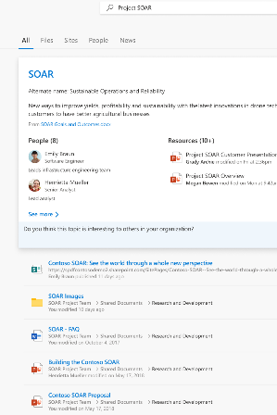
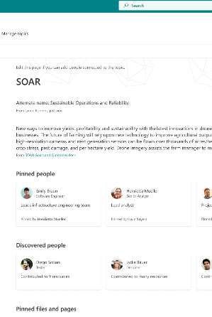
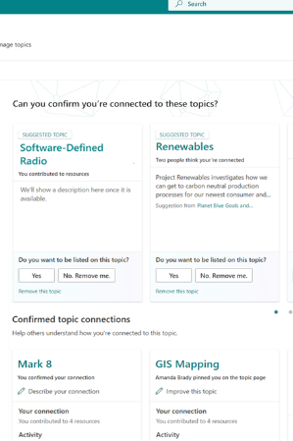
Topic experiences overview
Topic Cards and Highlights
Topic Search
Topic Pages
Topic Center

Slide 23
Things to know
Topic discovery is improved when more content is available
The security, privacy and location of your data is preserved
Users need a license to view topic experiences
Discovery is initially on English language content

Slide 24
Questions to help prepare
What content should be used for topic discovery?
Who will manage topics?
Who will see topic cards and highlights?
Which topics are expected?

Slide 25




What content should be used for topic discovery?
Maximize the content that is indexed, while staying in control
Migrate
Connect
Scope
Permissions

Slide 26
Migrate to Microsoft 365
Tools and services to help
  Mover https://aka.ms/mover
  SharePoint Migration Tool (SPMT) https://aka.ms/SPMT
  Migration Manager https://aka.ms/MigrationManager
  Microsoft 365 FastTrack https://fasttrack.Microsoft.com/microsoft365
  Partner migration tools and services https://www.microsoft.com/solution-providers
Make the most of your migration
  Migrate to a modern site
  Maintain usernames
  Make service account names descriptive

Slide 27
If you can’t migrate, connect
Using Graph Content Connectors bring external data into Microsoft Search
Future developments will bring external data into Topic Experiences
https://aka.ms/IWantConnectors

Slide 28
Review permissions
Topics will only show resources that the viewer can access
Encourage site
owners to review sharing and permissions
Audit Microsoft 365 Groups and Teams for appropriate use of Public vs Private
Review use of “everyone”, “everyone except external users” or broad security groups

Slide 29
Scope what content is used for discovery
You are always in control of what is indexed
  Configured in the Microsoft 365 Admin Center
Include or Exclude Sites as topic sources
Exclude topics by name
  Configured on Content
SharePoint content excluded from search

Slide 30

Who will manage topics?
Topic management roles and activities
Knowledge Administrator
AAD Role
Knowledge Manager
AAD Role
Topic Contributor
SME
Sets up Topic experiences
Ensures that security and compliance standards are enforced
Understands licensing agreement
Owns quality of Topics and network of curators
Performs topic management tasks such as create, edit, delete and reject topics
Contributes to Topics, curating pinned people and resources.

Slide 31
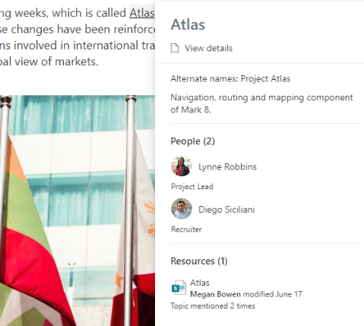
Who will see topic cards and highlights?
Control the end user experience for topics
  Who can see Topics?
Everyone in my organization
Only Selected people or security groups
No one
  Which Topics are visible?
Show all candidate topics
Show only confirmed topics

Slide 32
Which topics are expected?
Plan for topics that can be seeded
The quality and quantity of topics is based on your content
Better together: People + AI
Improve topic discovery by manually creating topics

Slide 33
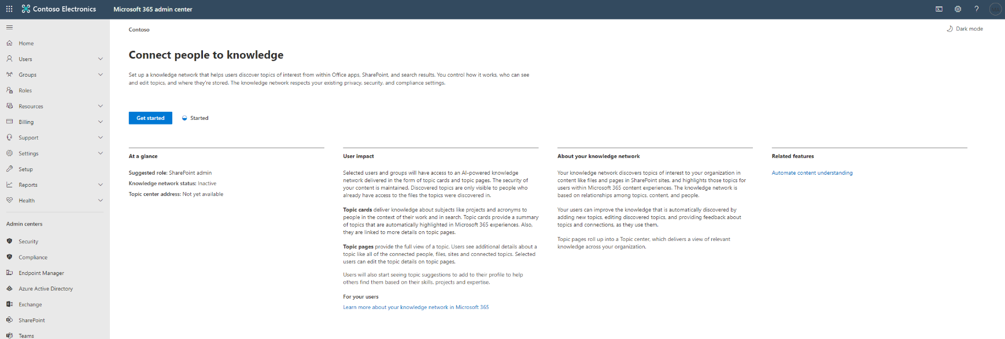
M365 Admin Center > Setup > Organizational knowledge

Slide 34
Configure Topic Experiences

Slide 35
Adoption Strategies
Plan for roll out across your company and gain broad adoption to further business goals

Slide 36
Adoption Success Factors
Get started
Engage Your Org
Train Your Org
Build Champions

Slide 37
Getting Started: Stakeholders / Project Team
Others who may be involved:
Tenant Administrator (set-up)
Power Platform
Administrator (set-up)
Search Manager
Executive Sponsor(s)
Project Lead(s)
Knowledge Administrators*
Knowledge Managers*
Content Managers & Model Owners
Taxonomy Managers
Champions

Slide 38

Getting Started: Defining Scenarios
Intelligent Content Services
Topic Experiences
  Content processing – contracts, statement of work etc.
  Invoice analysis
  Automate business processes
  Improved search accuracy
  Compliance risk management
  Role onboarding & training
  Expertise finding
  Information sharing
  Expanded decision making
  Improved time to market

Slide 39

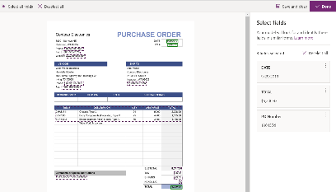
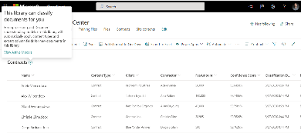
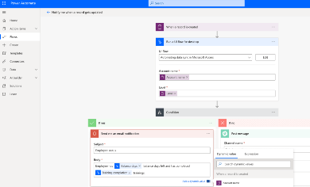
Scenario planning example 1
Save time & money, Automate invoice data extraction,
Workflows to take action on invoices and compliance
Drive Business Transformation
WHO
HOW
Save time & money
Automate invoice data extraction
Workflows to take action on invoices
Compliance
WHAT
WHY

Slide 40

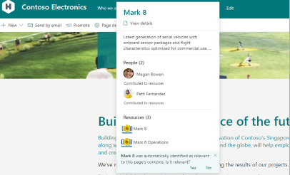
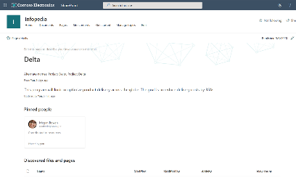
Scenario planning example 2
Quickly ramp up new employees, drive community and engagement.,
Help employees connect to experts and break down information silos
Drive Business Transformation
WHO
HOW
Faster employee ramp up
Help employees connect to experts
Drive community and engagement
Break down information silos
WHAT
WHY

Slide 41
Scenario prioritization: impact vs ease of implementation
Copy these to map!
Medium priority | High priority
Low priority | Medium priority
High
Scenario name
Scenario name
Scenario name
Scenario name
Scenario name
Scenario name
Scenario name
Focus
area
High priority
Impact
Add your scenario’s name and add as many as needed
Low
Ease of implementation
Hard
Easy

Slide 42





Plan for launch
What What content should be used for topic discovery?
Identify stakeholders, confirm scenarios, and develop project plan
Configure Cortex settings and apply licenses
Begin awareness and training – Recruit Champions
Roll out in stages
Gather feedback and iterate
As usage grows plan for any AI Builder credits as needed

Slide 43
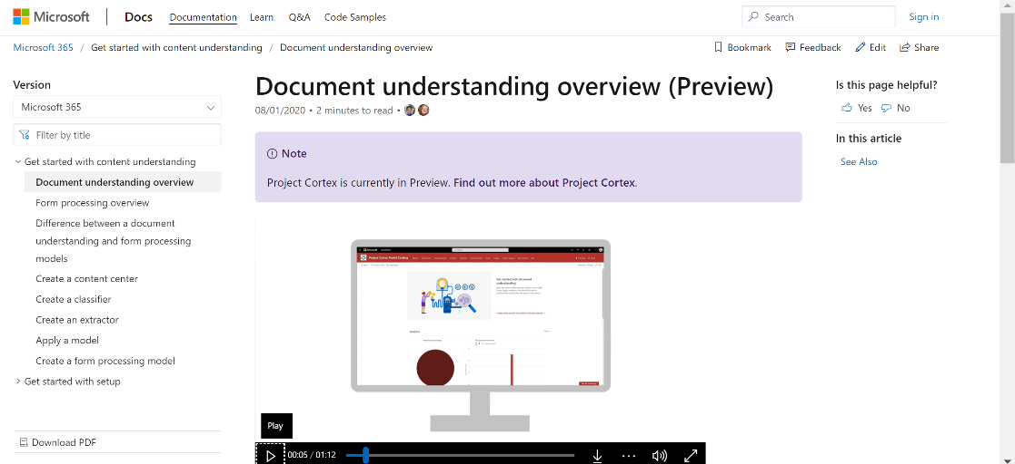
Train your Organization
Recruit from different roles – Knowledge Managers, SMEs, content and business process owners
Available now:
Project Cortex Resource Center aka.ms/projectcortex
Getting Started with Content Understanding
aka.ms/cudocs
      Overview and how-tos
      Video content – more coming soon!
      Includes section on driving adoption
      Coming Soon:
      Getting Started with Topic Experiences
      Sample scenarios and solution starters
      Training and Quick Start resources
      Learning Pathways content

Slide 44


Build a Champion Network
Recruit from different roles – Knowledge Managers, SMEs, content and business process owners
Champions can:
Create a circle of influence amongst their teams
Help with peer training and coaching for document understanding models
Drive topic curation & maintenance
Give something back - recognize the work that Champions are doing through public recognition and awards
Hackathons
Yammer Communities
Aka.ms/O365Champions

Slide 45

Encouraging ongoing engagement
Maintain active Yammer group(s)
Share success stories
Periodically host additional engagement events
Set challenges for people and run competitions

Slide 46
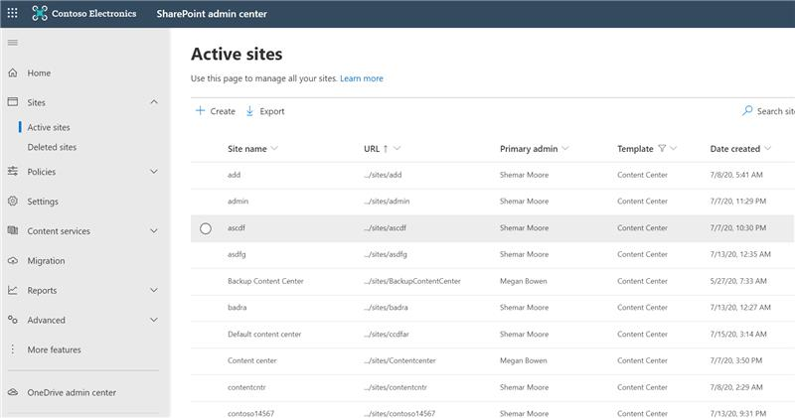
Measuring success
Intelligent Content Services
Content Center usage
  List of active Content Centers via admin UI
  Number of models per Content Center
Others
  Term Store reports
  Savings through improved governance and control
  Ease of finding processed documents via search
  Business process automation and new opportunities generated

Slide 47
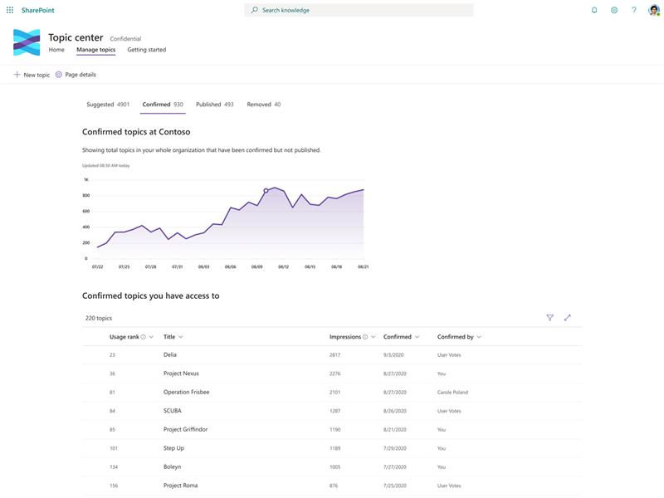
Measuring success
Topic Experiences
Topic usage
  Topic impressions
  Quantity of topics – both confirmed and unconfirmed
  Number of published Topic pages
Others
  End user feedback via Topic Cards
  Employee satisfaction and engagement
  Positive impact to search analytics – for example lowering abandoned searches

Slide 48




Next steps to get started
Get people involved now
Gather stakeholders and create scenarios
Complete preparation steps
Socialize and promote

Slide 49

b
Deploy and govern knowledge management
Adopting content capture and process automation services for content in Microsoft 365​
Metadata Services in Microsoft 365: Deep Dive With the Product Team
aka.ms/ProjectCortex
aka.ms/ProjectCortex/partner
aka.ms/ProjectCortex/community
additional videos
Comms & Resources

