Slide 1
Governance and management best practices for Microsoft 365 Groups
Vinay Jagannatha Rao
Program Manager, Microsoft 365 Groups
vijagan@microsoft.com
Microsoft 365 Groups

Slide 2
IT Admin’s Dilemma
Should I enable self-service?
Self – Service Enabled
How do I manage groups at scale?
How do I ensure group governance?
Group
Governance

Slide 3
Groups Governance Tools & Best Practices
Sensitivity Labels
Information Barriers
Ownership Governance
Naming Policy
Expiration Policy
Creation Permissions
Group Guest Access

Slide 4
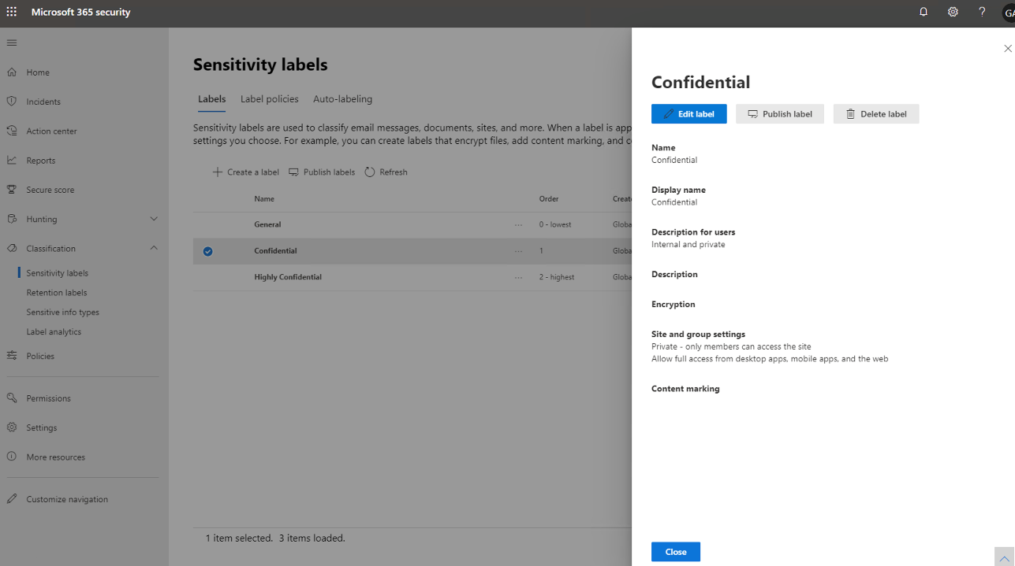
Sensitivity Labels on Groups (GA)
Create Sensitivity labels
Specify Site and Group Settings
Publish a single policy for groups across apps
Associate labels with groups

Slide 5
Demo – Sensitivity Labels on Groups

Slide 6
Sensitivity Labels on Groups (GA)
Benefits
Automatically enforce policies on Groups through labels
Labels help you classify Groups across your organization
Create different labels for Documents and Groups
Changes made to label settings will be automatically reflected on Groups
Guidance
Migrate existing Azure Information Protection labels to sensitivity labels
Restrict who can create public and external groups by publishing appropriate labels
Enable self-service Group creation with sensitivity labels
Documentation: Sensitivity Labels on Teams, Microsoft 365 Groups and SharePoint Sites

Slide 7
Info Barriers
Information Barriers
Create Ethical wall Block communication & collaboration
Researchers
Traders
FINRA 2241, Debt Research Regulatory Notice 15-31
Conflict of interest

Slide 8
Information Barriers
HR Segment
Segment users in the organization as per compliance requirement
Define policies for each of the segments
Associate segments to sites to restrict access and membership
Trading Segment
Research Segment
Teams honors IB when adding users to Teams group

Slide 9
Demo – Information Barriers

Slide 10
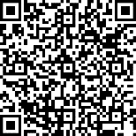
Information Barriers
Benefits
Prevent conflict of interest within the organization
Policies automatically enforce information barriers in Teams and SharePoint Sites
Restrict access by associating segments to a group explicitly (Coming soon)
Groups are automatically made compliant when users change segments (Coming soon)
Guidance
Segment users in the organization such that every user belongs to a single segment
Restrict groups to certain segments use SharePoint PowerShell to add segments explicitly
Sign up to talk more about Information barriers on groups!
Documentation: Information Barriers in Microsoft Teams | Use Information Barriers with SharePoint

Slide 11
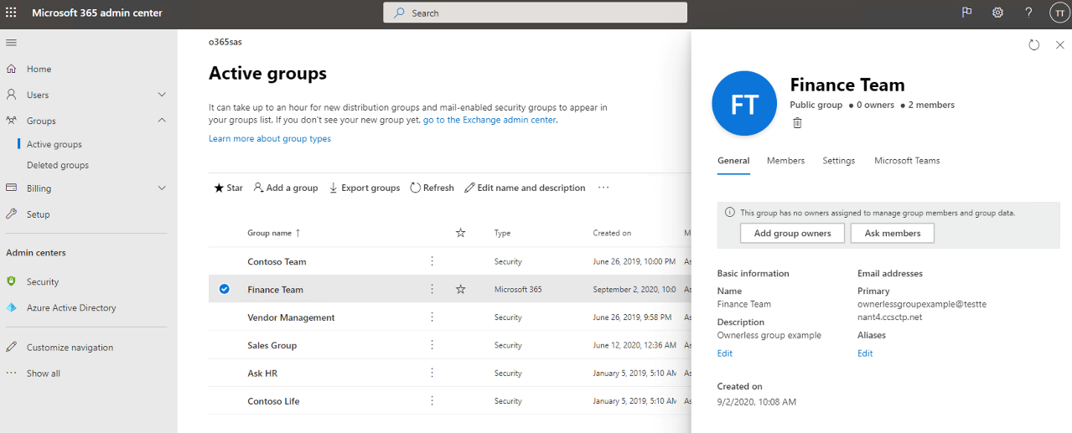
Ownership Governance
Coming Soon
View count of owners for a specific group
Send e-mail to ask members to take up ownership
Assign owners easily to a group

Slide 12
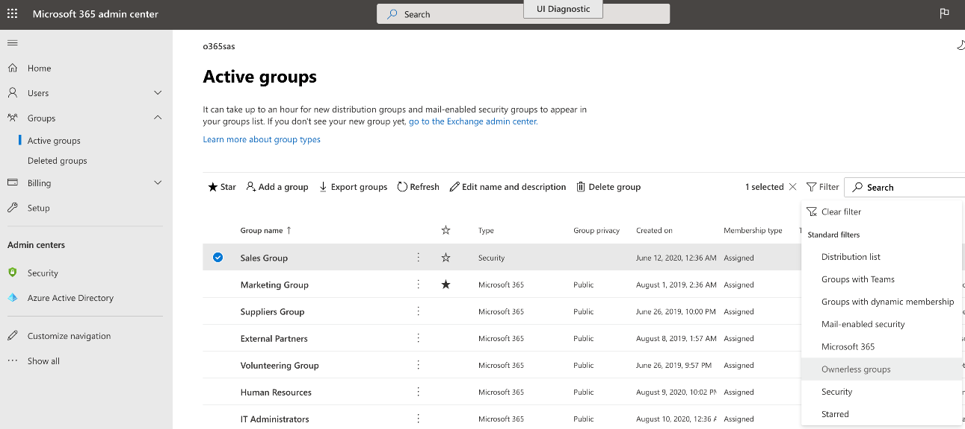
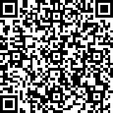
Ownership Governance
Coming Soon
View filtered list of groups with no owners
Automate management of ownerless groups
Sign up for Preview !

Slide 13
Demo – Ownership Governance

Slide 14
Create Allow List of Users for Group Creation
#Create Security Group via Azure Portal
$GroupName = "Allowed To Create Groups"
#Allow users in the Security Group to create Office 365 Groups
$AllowGroupCreation = "False"
$settingsObjectID = (Get-AzureADDirectorySetting | Where-object -Property Displayname -Value "Group.Unified" -EQ).id
if(!$settingsObjectID){
$template = Get-AzureADDirectorySettingTemplate | Where-object {$_.displayname -eq "group.unified"}
$settingsCopy = $template.CreateDirectorySetting()
New-AzureADDirectorySetting -DirectorySetting $settingsCopy
$settingsObjectID = (Get-AzureADDirectorySetting | Where-object -Property Displayname -Value "Group.Unified" -EQ).id
}
$settingsCopy = Get-AzureADDirectorySetting -Id $settingsObjectID
$settingsCopy["EnableGroupCreation"] = $AllowGroupCreation
if($GroupName){
$settingsCopy["GroupCreationAllowedGroupId"] = (Get-AzureADGroup -SearchString $GroupName).objectid}
Set-AzureADDirectorySetting -Id $settingsObjectID -DirectorySetting $settingsCopy
Identify the set of user with permission to create a Group
Create a Security Groups with all these users
Configure users in this Security Group to have permission for Group creation

Slide 15
Group expiration policy
Benefits
Auto-renewal of groups based on user activity
Expire inactive groups older than a specific period
Group owners get emails/ app notifications to take renew
Can set expiration policy to specific groups
Expired groups can be restored within 30 days
Guidance
Pilot with specific groups initially and review Audit Logs for auto-renewed groups
Choose inactive groups based on the activity report in Microsoft Admin center
Onboard your helpdesk team and communicate renewal process to group owners
Ensure groups have multiple owners & configure email for ownerless groups
Documentation: Microsoft 365 Group Expiration Policy | Configure Office 365 groups expiration

Slide 16
Naming policy
Benefits
Applies to all apps
Ensure group names follow your organization schema
Use fixed strings or Active Directory attributes as prefixes and/or suffixes
Define custom blocked words
Available in AAD portal
Guidance
Use short strings as suffix
Use attributes with values
Don’t be too creative, total name length has a maximum of 264 characters
Documentation: Microsoft 365 Groups Naming Policy

Slide 17
Groups guest access
Benefits
Enables safe teamwork outside the firewall
Works with any email addresses
Based on common Azure B2B platform
Guidance
Enable guest access if you haven’t already!
Use guest access when you are working with individuals outside your organization
Govern using allow/block guest domains, guest inviter role , access review
Use Entitlement Management to avoid repetition
Documentation: Manage Groups Guest Access | Azure AD Access Reviews | Guest Inviter role | Entitlement Management

Slide 18
Related Content for Microsoft 365 Admins
#SIDETRACKED @ IGNITE
Microsoft 365 Groups videos
Improved IT Efficiency and Agility
Role-based Access Control in Microsoft 365 | https://aka.ms/Admin1008
Microsoft 365 admin mobile app: administration on-the-go with productivity with flexibility | https://aka.ms/Admin1009
Improve IT efficiency and agility and stay informed as you enable self-service tasks | https://aka.ms/Admin1010
Making IT more efficient with improvements to Microsoft 365 Groups | https://aka.ms/Admin1011
Leveraging user feedback about Microsoft 365 in your organization | https://aka.ms/Admin1015
Drive external collaboration for your organization using Microsoft 365 Groups | https://aka.ms/Admin1007
Modern Cloud Management
How to manage Microsoft 365 in a remote work world | https://aka.ms/Admin3010
Transform change management by syncing Message Center posts to Planner | https://aka.ms/Admin1019
Managing updates of Microsoft 365 Apps using servicing automation | https://aka.ms/Admin1016
Microsoft 365 Groups roadmap updates | https://aka.ms/Admin1013
Microsoft 365 Groups architecture overview and deep dive | https://aka.ms/Admin1017
Governance and management best practices for Microsoft 365 Groups | https://aka.ms/Admin1018
Effective controls for Microsoft 365 Apps in the Microsoft 365 admin center | https://aka.ms/Admin1120
Managing work and life with Microsoft 365 Groups | https://aka.ms/Admin1022
Complex Org Investments
Multi-tenant management in the Microsoft 365 admin center | https://aka.ms/Admin1004
Supporting Mergers, Acquisitions, and Divestitures in Microsoft 365 | https://aka.ms/Admin1002
Aggregated views of Service Health and Message Center for admins that manage multiple tenants | https://aka.ms/Admin1006
How Microsoft manages Microsoft 365 Groups for its employees | https://aka.ms/Admin1003

Slide 19
Thank you!
Key Resources
Tech Community | aka.ms/M365GroupsTC
User voice | aka.ms/M365GroupsUV
Microsoft Graph | aka.ms/M365GroupsGraph
Roadmap | office.com/roadmap
FastTrack | microsoft.com/fasttrack
Vinay Jagannatha Rao
Program Manager
Vinay.jagannatha@microsoft.com |
Microsoft 365 Groups

