Slide 1
Microsoft 365 Groups: Overview and Architecture
Arun Varadharajan
Principal Program Manager
arvaradh@microsoft.com

Slide 2
Agenda
Introduction to Microsoft 365 Groups
Groups Architecture deep-dive
Group Creation/Provisioning
Group Lifecycle/Deletion
Member/Roster management
Administration/Policies
Closing

Slide 3
Microsoft 365 Groups Overview

Slide 4
Powering collaboration across Microsoft 365
Membership service for 22+ Microsoft 365 teamwork apps
Advanced sharing
Partner ecosystem
Microsoft 365 Groups
Azure Active Directory
Centrally managed, secured, and governed

Slide 5
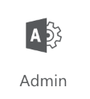
Microsoft 365 Groups - Architecture
Management
Groups powered Office apps
Office apps leveraging Groups
3rd party apps
Manage Policies
Manage Groups
Manage Groups
Manage Groups
Collab with Group
IP Policy Service
Microsoft Graph API
Expiry Service
Groups Policies Azure Active Directory Security | Compliance Centers
Groups Object & Membership Azure Active Directory
Guest Policy Service

Slide 6
Microsoft 365 Groups Architecture Group Creation/Provisioning

Slide 7
Groups Visibility
Create
Outlook
Teams
Yammer
Groups created in Outlook are not visible in Teams
Default visibility for Group via SharePoint, Planner, and Stream
Can be Team-ified
Groups created in Teams are not visible in Outlook
Can be exposed in Outlook using PowerShell
Groups created in Yammer are not visible in Outlook
Cannot be Team-ified as they are Yammer-ified ;-)
View
SharePoint
Stream
Planner
SharePoint
Stream
Planner
SharePoint
Stream
Planner
*SharePoint site collections – can be group-ified and are visible in Outlook by default

Slide 8
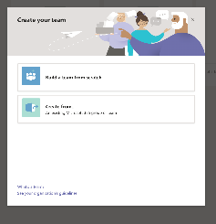
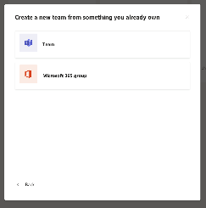
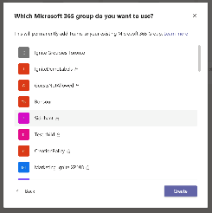
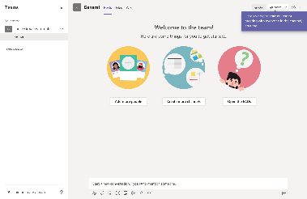
Enable Outlook Groups in Teams

Slide 9
Enable Teams in Outlook clients
Set-UnifiedGroup -Identity “New Team” -HiddenFromAddressListsEnabled $false
The HiddenFromAddressListsEnabled parameter specifies whether the Microsoft 365 Group appears in the global address list (GAL) and other address lists in your organization.
Set-UnifiedGroup -Identity “New Team” -HiddenFromExchangeClientsEnabled:$false
The HiddenFromExchangeClientsEnabled switch specifies whether the Microsoft 365 Group is hidden from Outlook clients connected to Microsoft 365.

Slide 10
Groups Visibility
Outlook groups are not created in Teams by default
Member are confused which surface to use
Cluttering of left-nav in either apps
Teams can be easily enabled through these steps
Outlook
Teams

Slide 11
Groups Visibility
Teams groups are not visible in Outlook by default
External members could be sending emails to the Group but none of the internal members are active. Eg: internal helpdesk scenario
Cluttering of left-nav in either apps
Outlook/Email support can be easily enabled through these steps
Teams
Outlook
Set-UnifiedGroup -Identity “New Team” -HiddenFromAddressListsEnabled $false
The HiddenFromAddressListsEnabled parameter specifies whether the Microsoft 365 Group appears in the global address list (GAL) and other address lists in your organization.
Set-UnifiedGroup -Identity “New Team” -HiddenFromExchangeClientsEnabled:$false
The HiddenFromExchangeClientsEnabled switch specifies whether the Microsoft 365 Group is hidden from Outlook clients connected to Microsoft 365.

Slide 12
Group flow
Components
Primary datastore is Azure Active Directory
Cross-app Notification
All apps are notified of changes to Group config or membership
Resources
Resource provisioning and behavior options on Group object
Azure Active Directory

Slide 13
Group flow
Create Team
Azure Active Directory

Slide 14
Group flow
Create Team
Azure Active Directory
Reliable notification published

Slide 15
Group flow
Create Team
Azure Active Directory
All required resources are provisioned

Slide 16
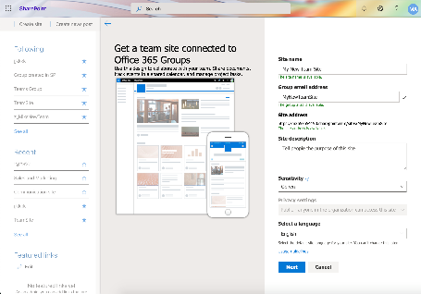
Group – Create Policies
Components
Check creation policy
Can this user create a Group
Naming policy
Prefix, suffix and blocked words
Unique email and Site URL
IP Labels
List of allowed ‘sensitivity labels’ for this user and their privacy/external configs from SCC policy store

Slide 17
Group – Create – Data Residency
Components
Preferred Data Location (PDL)
Defined at the Group level
Inherits from creator’s PDL

Slide 18
Group – Create – Data Residency
Components
Cross-geo move
Exchange mailbox is moved automatically
SPO and OneDrive are moved manually by admins using cmdlets
Not supported yet for other apps

Slide 19
Microsoft 365 Groups Architecture Group Lifecycle/Deletion

Slide 20
Group Lifecycle and Deletion flow
Active
Expiry/Delete
Retention
Soft-deleted
Hard-delete
New
Restore

Slide 21
Group Activity tracking and Auto-Renewal
Components
Activity Tracking service
Tenant wide activity tracking at the Groups level
Send, reply, like mail
View/Edit files
Read, write chats
Only active on Teams, SharePoint or Outlook tracked for auto-renewal
Only intention activities are covered by with a bias for retaining group vs deleting it
Expiry service
Policy based expiry flow with reminder emails for inactive Groups
Portal for owners to manually renew Groups
User U1 is active on
Group G1 belonging to
Tenant T1
Microsoft 365 Groups
Activity Tracking
If Group G1 is in expiry window and active
then, auto-renew G1
Else, mark G1 for deletion
Azure Active Directory

Slide 22
Group Deletion flow
Group object in Azure AD
Exchange mailbox
Planner Plan
Teams channel thread
SharePoint Site

Slide 23
Group Deletion flow
Group object in Azure AD
Exchange mailbox
Planner Plan
User deletes
Group
Teams channel thread
SharePoint Site

Slide 24
Group Deletion flow
Group object in Azure AD
Exchange mailbox
Planner Plan
User deletes
Group
Teams channel thread
SharePoint Site

Slide 25
Group Deletion flow
Group object in Azure AD
Group object soft-deleted for 30 days
Exchange mailbox
Planner Plan
Planner content is soft-deleted for 30 days
Teams channel thread
SharePoint Site

Slide 26
Group Deletion flow
Group object in Azure AD
Group object soft-deleted for 30 days
Group delete notification
Exchange mailbox
Planner Plan
Planner content is soft-deleted for 30 days
Teams channel thread
SharePoint Site

Slide 27
Group Deletion flow
Group object in Azure AD
Group object soft-deleted for 30 days
Group delete notification
Exchange mailbox
Planner Plan
Group is soft-deleted for 30 days
& email address is released
Planner content is soft-deleted for 30 days
Teams channel thread
SharePoint Site
Group is soft-deleted for 30 days
Group is soft-deleted for 93 days
& site-url is not released

Slide 28
Group Deletion flow - Restore
User restores from
GroupsHub in OWA
Group object in Azure AD
Group object soft-deleted for 30 days
Group delete notification
Exchange mailbox
Planner Plan
Group is soft-deleted for 30 days
& email address is released
Planner content is soft-deleted for 30 days
Teams channel thread
SharePoint Site
Group is soft-deleted for 30 days
Group is soft-deleted for 93 days
& site-url is not released

Slide 29
Group Deletion flow - Restore
User restores from
GroupsHub in OWA
Group object in Azure AD
Group object is restored
Group delete notification
Exchange mailbox
Planner Plan
Group is soft-deleted for 30 days
& email address is released
Planner content is soft-deleted for 30 days
Teams channel thread
SharePoint Site
Group is soft-deleted for 30 days
Group is soft-deleted for 93 days
& site-url is not released

Slide 30
Group Deletion flow - Restore
User restores from
GroupsHub in OWA
Group object in Azure AD
Group object is restored
Group restore notification
Exchange mailbox
Planner Plan
Group is soft-deleted for 30 days
& email address is released
Planner content is soft-deleted for 30 days
Teams channel thread
SharePoint Site
Group is soft-deleted for 30 days
Group is soft-deleted for 93 days
& site-url is not released

Slide 31
Group Deletion flow - Restore
User restores from
GroupsHub in OWA
Group object in Azure AD
Group object is restored
Group restore notification
Exchange mailbox
Planner Plan
Group restored if email address is available
Group is restored
Teams channel thread
SharePoint Site
Group is restored
Groups is restored

Slide 32
Group Deletion flow
Group still in deleted state
Group object in Azure AD
Group object soft-deleted for 30 days
Group delete notification
Exchange mailbox
Planner Plan
Group is soft-deleted for 30 days
& email address is released
Planner content is soft-deleted for 30 days
Teams channel thread
SharePoint Site
Group is soft-deleted for 30 days
Group is soft-deleted for 93 days
& site-url is not released

Slide 33
Group Deletion flow – Hard-delete
On 31st day
Group object in Azure AD
Group object hard-deleted
Group hard-delete notification
Exchange mailbox
Planner Plan
Group is hard-deleted
Group is hard-deleted
Teams channel thread
SharePoint Site
Group is hard-deleted
Site content is available for 93 days

Slide 34
Group Deletion flow – Hard-delete
On 94th day
Group object in Azure AD
Group object hard-deleted
Group hard-delete notification
Exchange mailbox
Planner Plan
Group is hard-deleted
Group is hard-deleted
Teams channel thread
SharePoint Site
Group is hard-deleted
Site content is permanently deleted

Slide 35
Group Deletion flow - Retention
Compliance center
Retention policy for 7 years
Group object in Azure AD
Group still in deleted state
Group object soft-deleted for 30 days
Group delete notification
Exchange mailbox
Planner Plan
Group is soft-deleted for 30 days
& email address is released
Group is soft-deleted for 30 days
Teams channel thread
SharePoint Site
Group is soft-deleted for 30 days
Group is soft-deleted for 93 days
& site-url is not released

Slide 36
Group Deletion flow –Retention
On 31st day
Compliance center
Retention policy for 7 years
Group object in Azure AD
Group still in deleted state
Group object hard-deleted
Group hard-delete notification
Exchange mailbox
Planner Plan
Mailbox content is not deleted
Group is hard-deleted
Teams channel thread
SharePoint Site
Teams content is not deleted
Site content is not deleted

Slide 37
Microsoft 365 Groups Architecture Member/Roster management

Slide 38
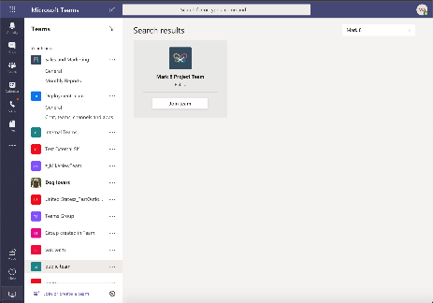
Group - Join
Components
Check creation policy
Can this user create a Group
Search/Discovery service
Recommended list of all groups that the user is not a member of.

Slide 39
Member Addition
Components
Welcome mail
Specific to app
Can be disabled by admins
Pending member flow
Maintain pending member roster across Microsoft 365 apps until owner approval with actionable email support
Join/Add to a public group or add by group owner
Azure Active Directory
App specific welcome email

Slide 40
Member Addition
Components
Welcome mail
Specific to app
Can be disabled by admins
Pending member flow
Maintain pending member roster across Microsoft 365 apps until owner approval with actionable email support
Join/Add to a private group by non-owner
Pending member flow, wait on owner approval
Azure Active Directory
App specific welcome email

Slide 41
Guest/External Member Addition
Additional Components
Tenant level Policies
Guest is from eligible domain,
Group is external enabled
User has inviter role for tenant
Azure Active Directory
Guest already added to the Tenant
App specific welcome email

Slide 42
Guest/External Member Addition
Additional Components
Tenant level Policies
Invitation and redemption flow
Guest is from eligible domain,
Group is external enabled
User has inviter role for tenant
Azure Active Directory
Guest is new to the Tenant
Guest invitation and redemption flow
App specific welcome email

Slide 43
Guest/External Member Reviews
Additional Components
Tenant level Policies
Membership review service
Guest is from eligible domain,
Group is external enabled
User has inviter role for tenant
Azure Active Directory
Guest already added to the Tenant
App specific welcome email
Use periodic Guest access reviews to keep your tenant secure

Slide 44
Microsoft 365 Groups Architecture Administration/Policies

Slide 45
Groups Governance – Admin Roles & Endpoints
App-specific examples
Suite-wide examples
Exchange and Email related policies
Exchange Admin Center, EXO Cmdlts
Exchange Admin
Teams policies
Teams Admin Center & Cmdlets
Teams
Admin
SharePoint site settings and policies
SharePoint Admin Center, SPO Cmdlts
SharePoint Admin
Group management and restoration
Microsoft 365 Admin Center
Groups Admin
Global Admin
Naming, Creation, Expiry, Guest and audit logs
Azure AD Portal and Cmdlets
Groups Admin
Global Admin
Security and compliance policies
Security and compliance center & Cmdlets
Security
Admin

Slide 46
Microsoft 365 Groups - Architecture
Management
Groups powered Office apps
Office apps leveraging Groups
3rd party apps
Manage policies
Manage Groups
Manage Groups
Manage Groups
Collab with Group
IP Policy Service
Microsoft Graph API
Expiry Service
Groups Policies Azure AD and Security &Compliance Center
Groups Object & Membership Azure AD
Guest Policy Service

Slide 47
Powering collaboration across work and life
Collaboration Spaces for Work
Collaboration Spaces for Life
Collaboration at Work
Collaboration with Friends and Family
Microsoft 365 Groups
Azure Active Directory
Microsoft Account

Slide 48
Other useful Groups videos

Slide 49
Related Content for Microsoft 365 Admins
#SIDETRACKED @ IGNITE
Microsoft 365 Groups videos
Improved IT Efficiency and Agility
Role-based Access Control in Microsoft 365 | https://aka.ms/Admin1008
Microsoft 365 admin mobile app: administration on-the-go with productivity with flexibility | https://aka.ms/Admin1009
Improve IT efficiency and agility and stay informed as you enable self-service tasks | https://aka.ms/Admin1010
Making IT more efficient with improvements to Microsoft 365 Groups | https://aka.ms/Admin1011
Leveraging user feedback about Microsoft 365 in your organization | https://aka.ms/Admin1015
Drive external collaboration for your organization using Microsoft 365 Groups | https://aka.ms/Admin1007
Modern Cloud Management
How to manage Microsoft 365 in a remote work world | https://aka.ms/Admin3010
Transform change management by syncing Message Center posts to Planner | https://aka.ms/Admin1019
Managing updates of Microsoft 365 Apps using servicing automation | https://aka.ms/Admin1016
Microsoft 365 Groups roadmap updates | https://aka.ms/Admin1013
Microsoft 365 Groups architecture overview and deep dive | https://aka.ms/Admin1017
Governance and management best practices for Microsoft 365 Groups | https://aka.ms/Admin1018
Effective controls for Microsoft 365 Apps in the Microsoft 365 admin center | https://aka.ms/Admin1120
Managing work and life with Microsoft 365 Groups | https://aka.ms/Admin1022
Complex Org Investments
Multi-tenant management in the Microsoft 365 admin center | https://aka.ms/Admin1004
Supporting Mergers, Acquisitions, and Divestitures in Microsoft 365 | https://aka.ms/Admin1002
Aggregated views of Service Health and Message Center for admins that manage multiple tenants | https://aka.ms/Admin1006
How Microsoft manages Microsoft 365 Groups for its employees | https://aka.ms/Admin1003

Slide 50
Thank you!
Key Resources
Tech Community | aka.ms/M365GroupsTC
User voice | aka.ms/M365GroupsUV
Microsoft Graph | aka.ms/M365GroupsGraph
Roadmap | office.com/roadmap
FastTrack | microsoft.com/fasttrack
Arun Varadharajan
Principal Program Manager
arvaradh@microsoft.com

Slide 51
Thank You

