Slide 1
Microsoft 365 Groups Roadmap Updates
Venkat Ayyadevara
Partner Group Program Manager
venkat.ayyadevara@microsoft.com | @vrayyadevara
Microsoft 365 Groups
Mike McLean
Principal Program Manager
mmclean@microsoft.com | @mikemcleanlive
Microsoft 365 Groups

Slide 2
Agenda
Microsoft 365 Groups
Overview
Innovations
Roadmap

Slide 3
Microsoft 365 Groups Overview

Slide 4
Microsoft 365 Groups Powering Collaboration Across Microsoft 365
Share knowledge and information using email, calendaring, documents and more
Enable communications in a secure and controlled manner
Streamline the creation and use of collaboration features
Leverage self-service capabilities to reduce costs and save time
Microsoft 365 Groups: Overview and Architecture deep dive - https://aka.ms/Admin1017

Slide 5
Microsoft 365 Groups by the numbers…
191%
Annual increase in usage across Groups platform
180%
1-month COVID-19 usage spike to connect with family & friends
7.5M
Guests active through Microsoft 365 Groups
1,268
Organizations use sensitivity labels with Groups
160K
Groups with sensitivity labels
79%
Groups auto-renewed due to high-value activity

Slide 6
Evolving the Microsoft 365 Groups Platform
2019
Power 22+ apps
2020
Governance at scale
Families & communities
2021
Model real-world org structures & functions

Slide 7
Microsoft 365 Groups One Platform for Your Whole Day
Work
School
Family
Community
Groups power apps that bring together people and the resources they need to achieve more

Slide 8
Powering collaboration across work and life
Membership service for 22+ Microsoft 365 teamwork apps
Advanced sharing
Partner ecosystem
Microsoft 365 Groups
Azure Active Directory
Centrally managed, secured, and governed

Slide 9
Powering collaboration across work and life
Collaboration Spaces for Work
Collaboration Spaces for Life
Collaboration at Work
Collaboration with Friends and Family
Microsoft 365 Groups
Azure Active Directory
Microsoft Account

Slide 10
Office 365 Groups roadmap presented in Ignite 2019
Microsoft
Microsoft 365 Groups classification using Microsoft Information Protection Labels (General Availability)
Expanded capabilities for Groups Administrator role
Additional Microsoft 365 admin center enhancements
Improvements to Dynamic Groups at scale
(Private Preview)
(Private Preview)
Information Barrier support for Microsoft 365 Groups
Native Mode for Yammer
Group driven membership
(Open-sourced group membership management tool)

Slide 11
Microsoft 365 Groups Innovations

Slide 12
Microsoft 365 Groups Innovation
Recent Highlights
Governance
Management at Scale
Work and Life
Microsoft Information Protection Labels general availability
Information Barrier support in Microsoft 365 Groups
Microsoft 365 admin center support for exporting groups, editing email address, etc.
Convert internal users to guest users
Ownership governance
Improvements to Dynamic Groups at scale
Dynamic Membership rules validation
Yammer All Company backed by Microsoft 365 Groups
Support for Application Authentication in Microsoft Graph
Assign Azure AD Roles to Microsoft 365 Groups
Microsoft 365 Groups rebranding
Alignment in group creation experiences
Outlook desktop classic message view
Groups for Outlook.com
Teams for personal use

Slide 13
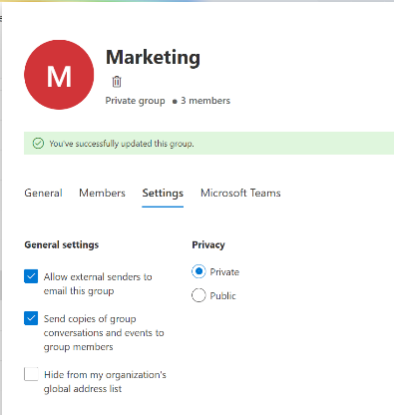
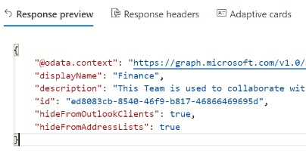
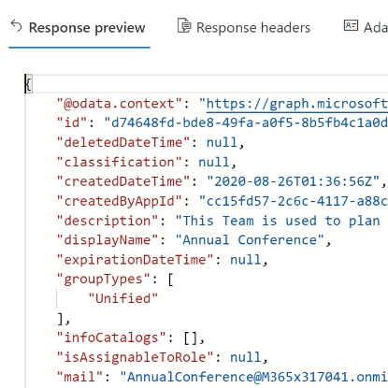
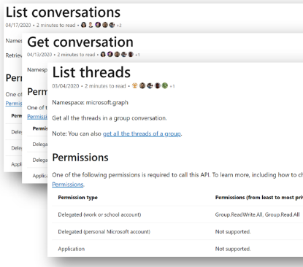
Groups Enhancements in Microsoft Graph
Properties mastered in Exchange Online can now be modified without an Exchange license
Hide and show groups with new properties:
hideFromOutlookClients hideFromAddressLists
Group creation source populated in createdByAppID for all 1st and 3rd party registered apps
Application Authentication supported on conversations APIs for Group.ReadWrite.All and Group.Read.All
https://aka.ms/exchangeproperties
https://aka.ms/hideFromOutlookClients
https://aka.ms/CreatedByAppID
https://aka.ms/AppAuthGroups

Slide 14
Improvements to Dynamic Groups at scale
Challenges |  |  | Improvements
Performance | Time to process group is relative to size of tenant Tenant processing and group update is slow and can take up to 24 hours |  | Time for new group creation is proportional to the size of group Deliver SLA in minutes for dynamic group membership updates. Optimized performance for these operators: -eq, -in, -startsWith
Reliability | Single object failure blocks whole tenant processing In case of machine failure, tenant processing is blocked |  | Single object failure won’t block tenant processing Other objects will continue to be processed No machine dependency If one machine fails, other machines will pick up and continue tenant processing
 | In case of machine failure, tenant processing is blocked |  | No machine dependency. If one machine fails, other machines will pick up and continue tenant processing.
Scalability | Customer demand for dynamic groups in market segments such as education |  | Support for 5,000 dynamic groups per tenant Increased size of dynamic group extended to 10K+ members

Slide 15
Microsoft 365 Groups Innovations - Demo
Mike McLean

Slide 16
Microsoft 365 Groups Roadmap

Slide 17
Microsoft 365 Groups roadmap
Microsoft 365 Groups rebranding
Information Barrier support (General Availability)
Improvements to Dynamic Groups at scale (General Availability)
Yammer Support for Azure B2B Guests (General Availability)
Group ownership governance
Microsoft 365 admin center enhancements
Admin-configured Group driven membership
Microsoft 365 Groups enhancements for Work and Life scenarios

Slide 18
Related Content for Microsoft 365 Admins
#SIDETRACKED @ IGNITE
Microsoft 365 Groups videos
Improved IT Efficiency and Agility
Role-based Access Control in Microsoft 365 | https://aka.ms/Admin1008
Microsoft 365 admin mobile app: administration on-the-go with productivity with flexibility | https://aka.ms/Admin1009
Improve IT efficiency and agility and stay informed as you enable self-service tasks | https://aka.ms/Admin1010
Making IT more efficient with improvements to Microsoft 365 Groups | https://aka.ms/Admin1011
Leveraging user feedback about Microsoft 365 in your organization | https://aka.ms/Admin1015
Drive external collaboration for your organization using Microsoft 365 Groups | https://aka.ms/Admin1007
Modern Cloud Management
How to manage Microsoft 365 in a remote work world | https://aka.ms/Admin3010
Transform change management by syncing Message Center posts to Planner | https://aka.ms/Admin1019
Managing updates of Microsoft 365 Apps using servicing automation | https://aka.ms/Admin1016
Microsoft 365 Groups roadmap updates | https://aka.ms/Admin1013
Microsoft 365 Groups architecture overview and deep dive | https://aka.ms/Admin1017
Governance and management best practices for Microsoft 365 Groups | https://aka.ms/Admin1018
Effective controls for Microsoft 365 Apps in the Microsoft 365 admin center | https://aka.ms/Admin1120
Managing work and life with Microsoft 365 Groups | https://aka.ms/Admin1022
Complex Org Investments
Multi-tenant management in the Microsoft 365 admin center | https://aka.ms/Admin1004
Supporting Mergers, Acquisitions, and Divestitures in Microsoft 365 | https://aka.ms/Admin1002
Aggregated views of Service Health and Message Center for admins that manage multiple tenants | https://aka.ms/Admin1006
How Microsoft manages Microsoft 365 Groups for its employees | https://aka.ms/Admin1003

Slide 19
Thank you!
Key Resources
Tech Community | aka.ms/M365GroupsTC
User voice | aka.ms/M365GroupsUV
Microsoft Graph | aka.ms/M365GroupsGraph
Roadmap | office.com/roadmap
FastTrack | microsoft.com/fasttrack
Venkat Ayyadevara
Partner Group Program Manager
venkat.ayyadevara@microsoft.com | @vrayyadevara
Microsoft 365 Groups
Mike McLean
Principal Program Manager
mmclean@microsoft.com | @mikemcleanlive
Microsoft 365 Groups

