Slide 1
Secure Application and Content Delivery with Azure
Sept 2020

Slide 2















Application delivery product suite
employees, customers, devices, data
Cloud-native CDN and ADC
CDN
Azure Front Door
Dynamic apps, APIs
Azure CDN
Static, files, VOD
Application Gateway
ADC
+
Azure Web
Application Firewall
Azure DDoS
Protection
Azure Firewall
Cloud-native network security services
PaaS, IaaS and on-premises backends
Notes:
Are your customers starting to use infrastructure as code and why? How do cloud native help developers and security teams go faster with lower risk.
Where and how do partners play?

Slide 3
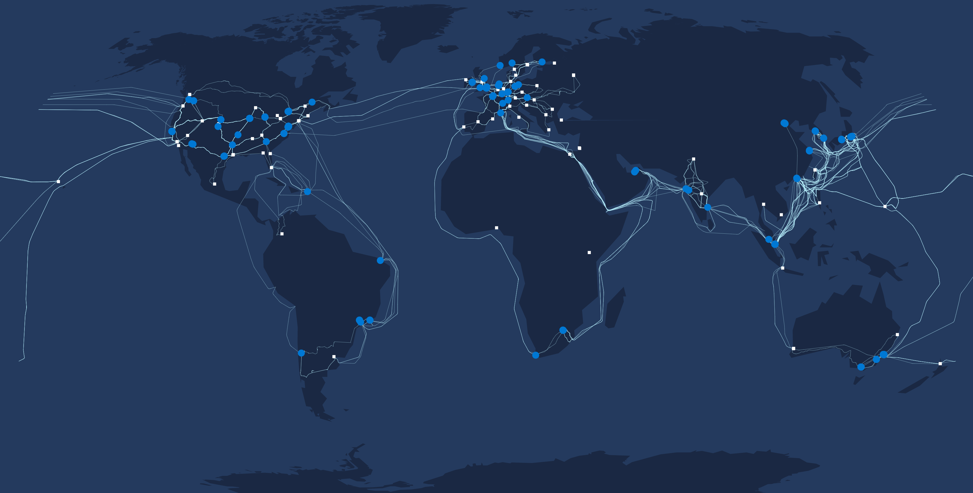
Microsoft’s global delivery network
Datacenter
Edge/CDN PoP
Future Edge/CDN PoP
Regional Cache
WAN Link
60 Tbps
network
capacity
160+
edge/CDN
PoPs
20k+
peering
connections

Slide 4


















Microsoft’s global content delivery network
Build on the “battle-tested” platform used to power reliable and fast global services at Microsoft that instantlys scale on demand
2012
2014
Azure’s content delivery network enables Bing to operate at scale with competitive performance while also scaling agile development across many independent microservices.
2015
Azure’s massive capacity, an expansive network backbone, rich peering and strong stance on security improved LinkedIn’s availability, reduced median PLT by over 20%
2017
2020
Notes:
https://aka.ms/linkedin-on-afd

Slide 5
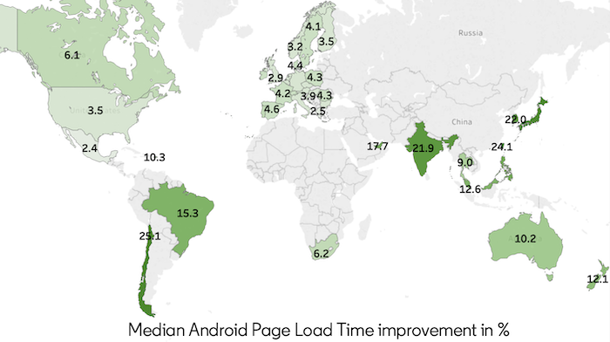
LinkedIn on Azure Front Door
Azure Front Door’s global network of 165+ PoPs, massive capacity, an expansive network backbone improved LinkedIn’s availability, reduced median PLT by up to 25%
AFD improves LinkedIn’s availability through strong peering relationships, dedicated private connectivity that bypasses the public internet, insulating Microsoft’s connections from internet instability. Something cost prohibitive for LinkedIn to do.
Global users in 245 countries
600,000+ HTTPS requests/sec peak
1,500 TB egress/mo
99% HTTPS, 30% IPv6
98.8% Connection Reuse to Backend
Read the blog:
http://aka.ms/linkedin-on-afd

Slide 6


Azure Front Door + Azure CDN
Key Capabilities
Content Delivery Network
Whole Site Acceleration
App and Content Protection
Cloud Native Development
Massively scaled global private network
Software-defined, massively peered network
Real-user quality of experience steered
Multiple Origins
Domain and certificate management
Dynamic site acceleration
Static caching,
OTT media delivery
Global load balancing
Rules Engine
Wildcard Domains
Web application firewall
DDoS
Bot prevention
Threat intelligence
Integrated with Sentinel
API and orchestration with DevOps
Deep azure integrations
Integrated monitoring and alerting
Security management with Sentinel, Security Center
CLI, PowerShell, SDK, Terraform, ARM templates

Slide 7


Azure CDN
Azure Front Door
Static file delivery
Dynamic site acceleration
OTT video delivery
Global load balancing
Live video delivery
Web application protection
Web Site Caching
Microservice apps / path based LB

Slide 8






Azure CDN
Media
Azure Region
Global multi-CDN native content delivery
  Multi-CDN ecosystem with top-tier providers.
  Spin up CDN services without contracts.
  Azure services like support, fast track, CAT, rapid response applies to all the providers.
  Azure commit / EA discounting applies to all.
App Service
Mobile
API
Media Services
Storage
files.contoso.com
Files
On Prem/External
Updates
Simplified billing
Choice and power
Cloud migration
IoT
Unlike any other CDN – Azure CDN bills only on egress and nothing else. Lower TCO than AWS or GCP.
Solve regional and global scale needs by choosing CDN provider(s) with best-of-breed capabilities
All S400/T100/Hi-Po customers need CDN. As CDN is easily switchable, it. could be the first onboarding service.

Slide 9


Azure Front Door
Region 1
Global secure service front-end at the edge
  1) Application acceleration
  every app with users >~100 miles from region get performance acceleration in 30 countries
  2) Application reliability at Microsoft’s edge
  Global HTTP load balancing with fast failover
  3) Application scalability
  Massive SSL offload, Global app dashboard, service insights
Edge Location
Region 2
/*
/search/*
/statics/*
www.contoso.com
Region 3
Global HA, BCDR
Security at the Edge
Faster apps
Enable fast-failover for regional services, microservices at the Edge with active path monitoring
Stop threats where they come from at the Edge with DDoS protection and customizable WAF
Reduce latency and increase throughput for apps by offloading SSL
at the Edge and accelerating requests
Microsoft Global Network
Notes:
Competitive advantage against AWS; global accelerator doesn’t provide the same quality, value.

Slide 10









Azure WAF with Front Door
Custom rules
OWASP rules
Protect web applications in Azure or elsewhere
Platform managed, ease of use
Highly available, scalable, performant
Meet enterprise compliance standards
Network Edge Locations
Bot mgmt
WAF policy
Azure Global WAF
(Front Door)
1
  Integrated with Azure Front Door at network edge, combine application acceleration, caching, and protection for public facing web applications
  Preconfigured OWASP rules, bot protection integrated with Microsoft threat intelligence, powerful custom rules, rate limiting at edge
Valid requests
2
Azure regions
Other Cloud
On-premises
  WAF@edge recommended for internet facing applications. In Vnet WAF recommended for intranet applications. Customers can also choose to combine both WAF together.
3

Slide 11


Use cases
OTT and Live Video Delivery
Static Object
/ File Delivery
Dynamic Content
Delivery
Secure Global Internet Services
Modern Microservices
Deliver Low Latency, High Throughput Video from Cloud or On-Prem to Global Devices
Deliver Large or Small File Assets to Devices, Browsers with Minimized Cost and Max Performance
Optimize Application Performance and Scale without Caching Content
Secure Applications at the Edge to Optimize App Reliability, Cost and Reputation
Enable Fault-Tolerant and Agile Application Architectures through Edge Load Balancing
Media and Entertainment
Gaming
Telco
Enterprise Video
Manufacturing / Electronics
Retail and Commerce
Enterprise File Delivery
Automotive and IoT
Retail and Commerce
Mobile Apps and Services
SaaS API Platforms
IoT Services, Data
Commerce Platforms
Financial Services
Healthcare
Enterprise LOB Apps
Mobile Applications
Commerce Services
Media Distribution Apps
ISV / Solution Providers

Slide 12
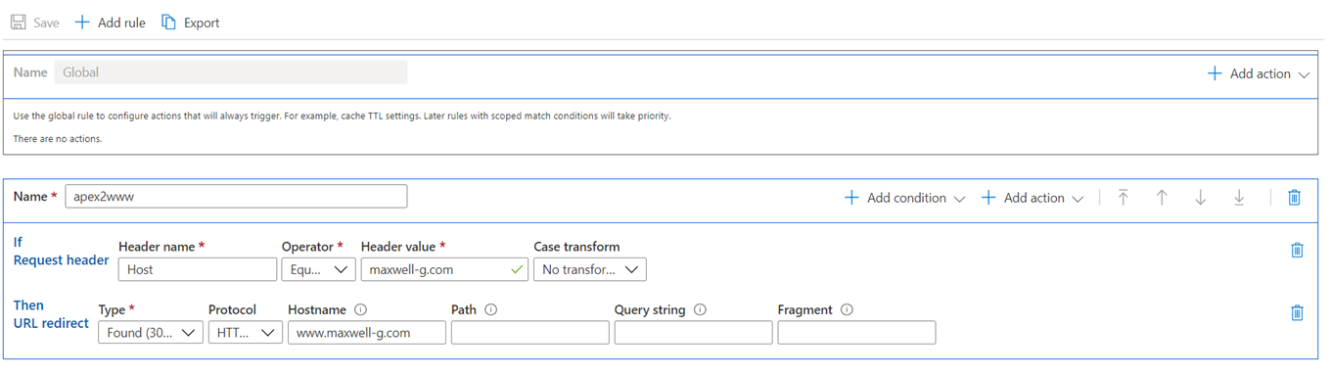
AFD + CDN Rules Engine - GA
Customize how HTTP requests are handled at the edge & have more control of your web application behavior
  GA on AFD and CDN
  Applicable to HTTP Request/Response path
  Supports for match-conditions built in
  Allows for header/parameter based routing

Slide 13
Wildcard Domains
Now map wildcard domain names to your list of front-end hosts/ custom domains, in addition to apex & subdomains
Use wildcards to simplify:
  Traffic Routing via Route Rules
  Certs
  Subdomain management
Example:
  customer1.contoso.com and customer2.contoso can both be captured by *.contoso.com.
Notes:
  Currently only support BYOC certificates for wildcard domains
  Still need to apply WAF policies at the specific subdomain level
Documentation: https://docs.microsoft.com/en-us/azure/frontdoor/front-door-wildcard-domain

Slide 14
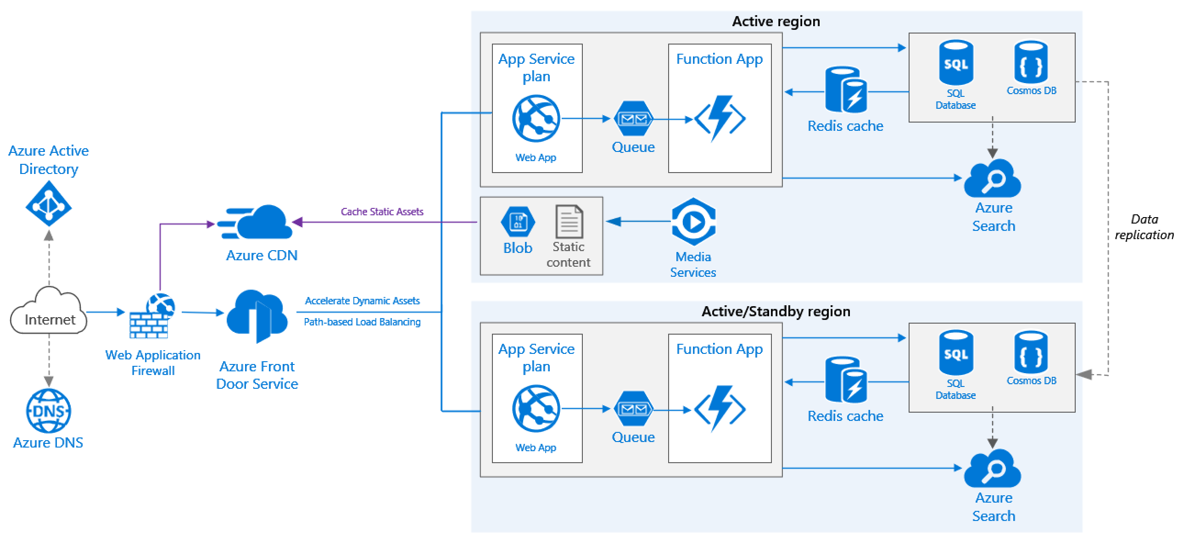
Reference architecture with DNS, CDN, AFD & WAF

