Slide 1
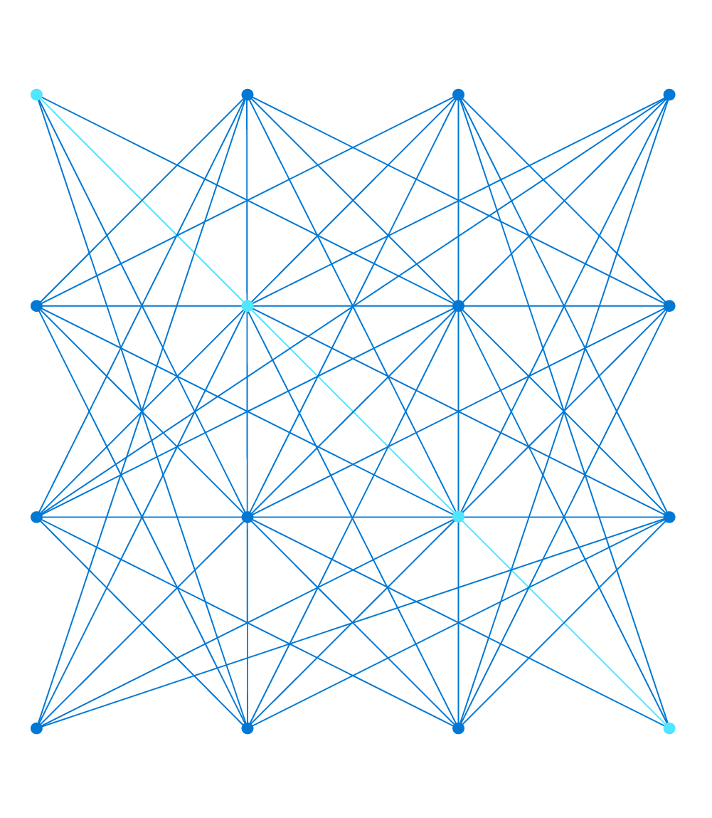
Advanced VNet Concepts
Narayan Annamalai
Group Program Manager, Azure Networking

Slide 2
Agenda
VNet Concepts Overview
New Abilities
Advanced Architectures

Slide 3















Internet
Azure Region
Network Security group
Egress Rules | Action
Virtual Network | Allow
Storage | Allow
Internet | Deny
Load Balancer
Private Endpoints
Service Endpoints
Def GW
VNet (IPv4 + IPv6)
IPv6
IPv4
Peering
VNet
Route Table
Destination | Target
10.1.0.0/16 | Local
10.2.0.0.0/16 | NVA
0.0.0.0/0 | Default
On-premises

Slide 4


Micro Segmentation
Azure Region
Az Monitor
Storage
Network Security Group (NSG): L4 packet filtering for Inbound and Outbound
Application security Groups (ASG): Tagging workloads by Type. Natural Expression for Network Secruity Intent
Service Tags: Aliases for Azure Ip blocks categorized by Service. Referenceable from NSG
Roadmap: Expanding Service Tags to cover all services
VNet
Web
DB
App
NSG
Rule | SRC | DST | Action
Web | Internet | Web:443 | Allow
Db | App | DB:1433 | Allow
Stg | VNet | Storage | Allow
Mon | VNet | Monitor | Allow
Def | VNet | Internet | Deny
DataFactory
ActionGroup
AppConfiguration
LogicApps
LogicAppsManagement
PowerBI
AzureDevSpaces
AzureOpenDatasets
WindowsVirtualDesktop
AzurePortal
New Service Tags

Slide 5

Routing in VNet
VNet 10.1.0.0\16
10.1.1.0\24
Default Routing: Destinations within VNet are reachable at one hop with default routing
UDR: Packets in the VNet can be re-directed to go through a NVA/FW using User defined Route Table
Service Insertion: Can be done for traffic within and going outside the VNet
Future: Service Tags as destinations in UDR
10.1.0.0\24
10.1.3.0\24
10.1.2.0\24
UDR
NVA
Route | DST | Type | Next Hop
VNet | 10.1.0.0\16 | System | Def GW
DB | 10.1.3.0\24 | NVA | 10.1.2.4
App | 10.1.4.0\24 | NVA | 10.1.2.4
Int | 0.0.0.0\0 | System | Def GW

Slide 6



VNet to Internet
Internet
NAT Service
Simplify outbound connectivity
Enabled at Subnet level
Same Outgoing IP Address for the entire VNet
Fully managed, built for Scale
Availability Zone support
1
2
NEW!
Public IP Prefix
VNet

Slide 7


Azure Private Link
New Services (36*)
GA
  Azure Kubernetes Service (AKS)
  ADLS Gen2
  Azure Synapse (SQL DW)
  Azure Database for PostgreSQL
  Azure Database for MariaDB
  Azure Database for MySQL
  Azure Container Registry
  Azure Key Vault
  Azure Batch → Control Plane
  Azure Search
  Azure Cognitive Services
  Event Hub
  Service Bus
  Event Grid → Topics
  Event Grid → Domains
  IoT Hub
  Service Bus
  Azure Backup
  File Sync
  Azure Monitor
Preview
  App Service WebApps → FrontEnd
  Azure Automation
  Azure App Configuration
  Azure Signal R
  Azure Relay
  Azure Site Recovery
  Azure Machine Learning
  Synapse Analytics Workspace
  PowerBI → Front End
  Device Provisioning Services
  Data Factory
  Redis Cache
  Managed Disks (Export)
NSG
Azure Private Link
Private Endpoint
Only access mapped resources
Compute
Azure Services mapped into customer’s Virtual Network
Access given only to the mapped resource, providing exfiltration protection
Private Access to PaaS service from on-premises
Supported for Azure Storage, SQL DB, Cosmos DB

Slide 8




Azure Private Link - Customer Own Service
VNet (10.1.0.0/16)
Deny Outbound
Service VNet
Create your own Private Link service behind Azure Load Balancer
Render your Service privately to many different customers simultaneously
VNet to VNet connectivity w/o Overlapping IP Space constraint
(NEW) TCP Proxy v2 support for knowing your customer
  Header Includes
    Source IP
    LinkID of Private Endpoints
Virtual Network (10.3.0.0/16)
Deny Inbound
Private
endpoint
Subnet (10.1.1.0/24)
(10.3.1.10)
Consumer Network 1
Private Link Service
VNet (10.1.0.0/16)
Standard Load Balancer (ILB/PLB)
Your Own Service
Deny Outbound
Subnet (10.3.1.0/24)
Private
endpoint
Subnet (10.1.1.0/24)
Consumer Network 2

Slide 9
VNet Peering
Azure Region
VNet 1
US West
Subscription A
Subscription B
10.1/16
10.2/16
VNet 1
Europe East
VNet 2
US East
VNet 1
Peering
VNet 2
VNet 3
Europe West
Intra Region
Inter Region
Cross-subscription and Cross-AD tenants
Direct Host-Host communication with no perf bottleneck in between
Direct Private connection between Vnets in different region
Traffic between VNets stays fully within Microsoft backbone

Slide 10


VNet Peering – Transit and Centralize
Transit VNet
Azure Services
Application VNet
Client VNet
Internet

Slide 11



Cross VNet – Cross Region Load Balancing

Slide 12

Thank you

