Slide 1
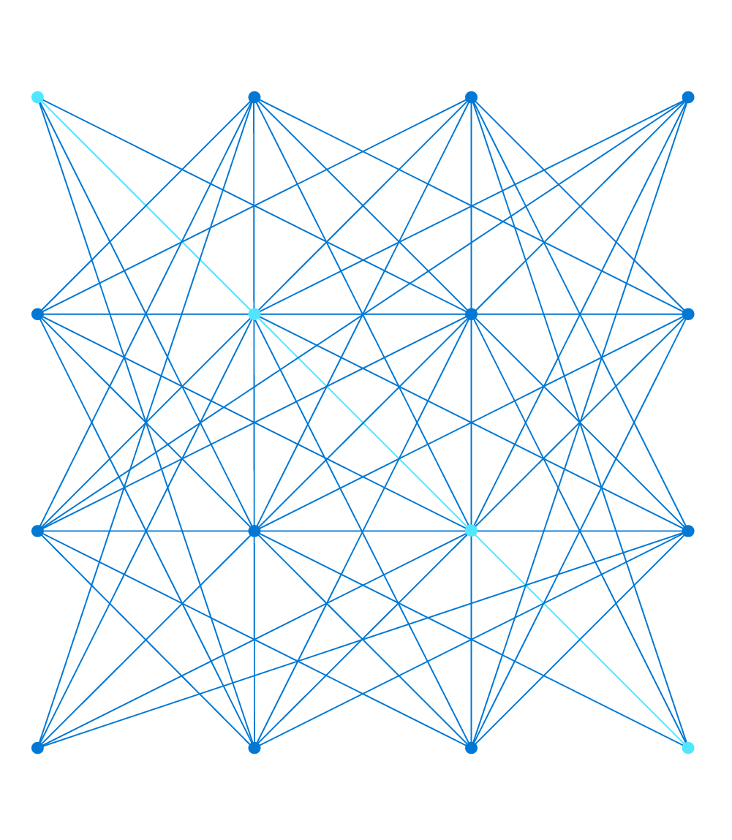
Deliver Secure and Scalable Web Applications with Azure Application Gateway
Cat Yao
Program Manager, Azure Networking

Slide 2
Agenda
Azure Networking Portfolio
Application Gateway Overview
Key Features
Reference Architecture

Slide 3


Connect & Extend
Protect
Azure Peering Services
Virtual WAN
ExpressRoute
VPN
MEC
Firewall Manager
Private Link
Bastion
WAF
Azure Networking services
Modernizing your network
Monitor
Deliver
Internet Analyzer
Net Watcher Traffic Analytics
Application Gateway
Front Door
CDN
IPv6 in Azure VNETs

Slide 4





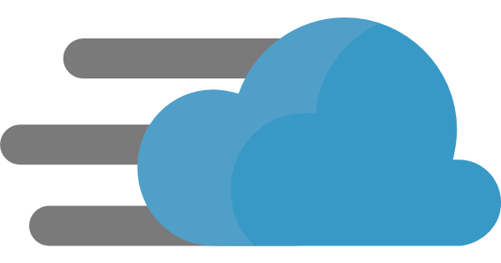

Azure Application Delivery Portfolio
Azure Load Balancer
Application Gateway
Azure
Front Door
Web Application Firewall
Azure Traffic Manager
Azure CDN
Together, application delivery services let you build mission-critical dynamic, high-performance global applications

Slide 5

Azure Application Gateway
Build secure, scalable, and highly available web front ends in Azure
Platform managed
Built in high availability, zone redundancy, scalability
Public or ILB
Public internet, internal, or both
Static VIP
Flexible backends
VMs, VMSS, AKS, Public IP, Cloud Services, ALB/ILB, On-Premises
Security & SSL management
WAF, SSL offload, SSL Re-encryption, SSL policy
Scale out at load
Static VIP
Azure Key Vault
Min capacity
Max capacity
AZ1
AZ2
Azure App Service
AKS
VMSS
On-Premises
Notes:
Centralized SSL offload
Integrated WAF protect you from OWASP attacks

Slide 6
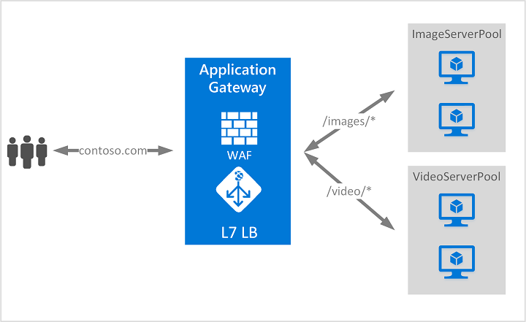

Azure Application Gateway
Layer 7 load balancing
URL path-based
Host based/multiple site hosting with wildcard support*
Round robin
Session affinity
Redirection
Header rewrite
URL rewrite*
Websocket & HTTP/2 traffic
Connection draining
Custom error pages
Notes:
Centralized SSL offload
Integrated WAF protect you from OWASP attacks

Slide 7


Azure Application Gateway
Static VIP
Autoscaling
Grows and shrinks based on application traffic requirements
No need to overprovision or guess instance size
Reduce operating cost
High performance SSL offloads
500-50,000 connections/sec with RSA 2048 bit key Certs
30,000-3,000,000 persistent connections
2500-250,000 HTTP req/sec
Min capacity
Scale out at load
Avail Zone 1
Avail Zone 2
VMSS
VMSS
Autoscaling, improved performance and
faster provisioning

Slide 8












Azure Web Application Firewall
Cloud native Web Application Firewall
OWASP rules
Bot management
WAF policy
Custom rules
Unified WAF offering
Protect your apps at network edge or in region uniformly
Microsoft threat intelligence
Protect apps against automated attacks
Manage good/bad bots with Azure BotManager RuleSet
Site and URI path specific WAF policies
Customize WAF policies at regional WAF for finer grained protection at each host/listener or URI path level
Geo filtering on regional WAF
Enhanced custom rule matching criterion includes filtering by country
Uniform policy
Azure Global WAF
(Front Door)
Azure Regional WAF
(Application Gateway)
PaaS, IaaS and on-premise backends
Notes:
Per site GA
Per URI, geofiltering, bot mitigation public preview

Slide 9
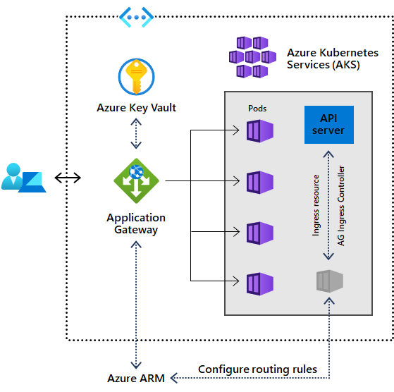
Ingress Controller with AKS
Application Gateway Ingress Controller
Performance benefits over in-cluster ingress controllers
AKS add-on allows for one line deployment of:
Cluster
Add-on
Application Gateway
Add-on is a fully managed way to integrate native L7 load balancing with AKS

Slide 10
Key Features
Latest features of Application Gateway
Public Preview
  Wildcard Listener
  Use wildcard characters like asterisk (*) and question mark (?) in the host name
  Configure up to 5 host names per multi-site listener
  URL Rewrite
  Rewrite the host name, path, and query string of the request URL
  Choose to rewrite URL of all requests on a listener
  Route request based on either the original URL or the rewritten URL

Slide 11







Reference Architecture
Azure Front Door
Web Application Firewall
Objective:
Secure global application delivery
Components:
1. Global HTTP load balancer (AFD)
2. Regional HTTP load balancer to
AKS (Application Gateway)
3. Non-HTTP workload protection
(Firewall)
Web Application Firewall
Azure Firewall
Azure Key Vault
Application Gateway
Storage
SQL DB
VMSS
AKS

Slide 12
Thank you

