Slide 1
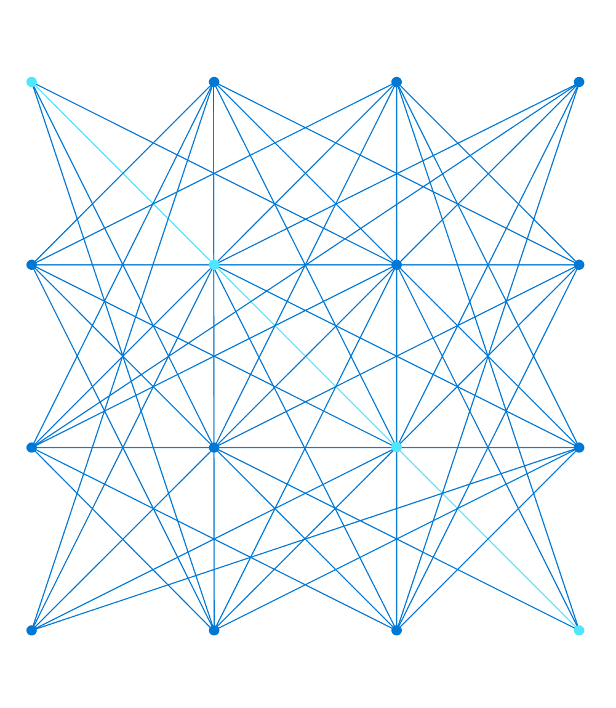
Designing high performance networks for your hybrid workloads
Jared Ross
Senior Product Manager

Slide 2





Setting Context
IaaS
SaaS
PaaS
ExpressRoute
Site-to-Site VPN
Point-to-Site VPN
Direct Internet Breakout – SaaS/Public Internet Services
HQ/Datacenter
Branch
ExpressRoute
Highly distributed, global application experience
Focus on scale across the globe
Considered external to your on-premises network
Optimized public (internet) connectivity
Optimized for private connectivity
Extends on-premises networking into the cloud
Extends your existing security boundary
Notes:
Setting context
IaaS, PaaS, and SaaS all have different connectivity patterns that Microsoft has technologies to help with
Types of services within Azure such as IaaS, PaaS, and SaaS

Slide 3
ExpressRoute
Private Cloud Connectivity

Slide 4

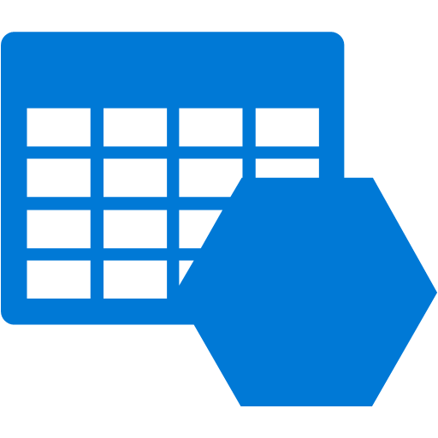
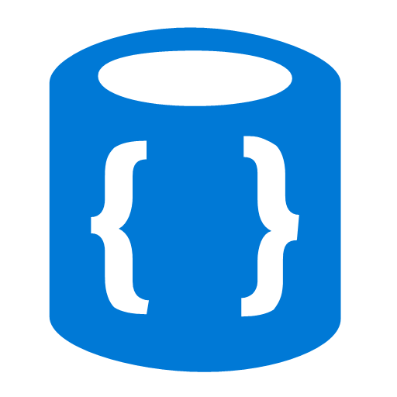



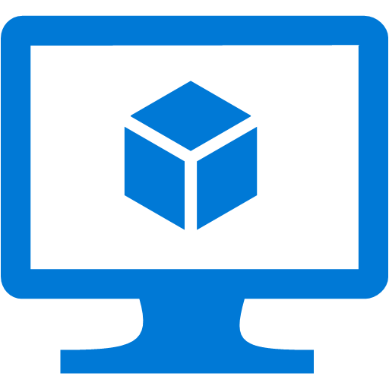

ExpressRoute
Customer’s
Network
Partner Edge
Primary Connection
Microsoft Edge
Secondary Connection
ExpressRoute Circuit
Microsoft Peering for Office 365, Dynamics 365, Azure public services
Azure Private Peering for Virtual Networks and public services via Private Link

Slide 5

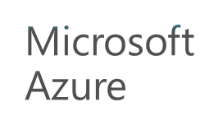
ExpressRoute Connectivity Models
ExpressRoute
ExpressRoute
ExpressRoute
ExpressRoute Direct
WAN
Cloud exchange
co-location
Point-to-point Ethernet connection
Any-to-any (IPVPN) connection
ExpressRoute site
Service provider model
Direct model
Notes:
Left three: you connect to us through an SP. That SP is already connected to Microsoft. Your circuit goes to the physical NNI. Circuit can be 50M, …
Direct: you buy a physical port. 10G, 100G. You connect to us at ER site

Slide 6
ExpressRoute Design Patterns
…
…
VNET Peering
…
One Flat VNET
VNETs all on ER circuit
Hub and Spoke
Quick to deploy; easy to manage; common denominator across Clouds
Subscription-level resource limits; fewer choices for security & compliance setup
Each BU, each workload in its own security & compliance boundary; VNETs in same or different subscriptions (i.e. separate accounting and billing)
Limited VNET connections per circuit; cross-VNET performance limited by gateway and higher latency
Hub to host common services and enforce common policies; virtually unlimited throughput between VNETs; VNETs in same or different subscriptions
Management overhead; bottleneck in hub; no native transit between Spoke VNETs
Notes:
One VNET: owned by a single subscription, you may run into sub level limits
VNET hair pinning: flexibility, set up different levels of securities; there’s a limit on how many VNETs to a circuit
Hub-and-spoke: address the perf issue;

Slide 7
Designing for high availability & disaster recovery
Region 1
Region 2
Connect up to 16 circuits across peering locations for high-availability
Use connection weight or AS Path prepending to select inbound path
Peering Location 1
Peering Location 2
Use Local Preference to select outbound path
Your WAN

Slide 8
Designing for high availability & disaster recovery
Region 1
Region 2
Use your own WAN or Microsoft’s network for connectivity
Make sure you have symmetrical routing
Your WAN
Notes:
You have two private datacenters on your WAN. And two ERs and two Azure regions.
You can decide how to route your traffic.
You need to implement symmetrical routing

Slide 9






ExpressRoute IPv6 Private Peering – Coming Soon
Full end-to-end IPv6 experience from on-premises to Azure
Private Peering support with your own defined IPv6 address spaces in your Virtual Network
Requires ErGwAz1-3 currently, standard, high, and ultra performance SKUs at GA
Available in all availability zone regions in 2020
IPv6 NSG Rules
Application
Subnet
Front-End
Subnet
Application
Subnet
Application
Subnet
IPv6
IPv4
IPv6 User-Defined Routes
Linux VM
IPv6
IPv4
Load Balancer
Windows VM
ExpressRoute Gateway
DDoS Protection
DDoS Protection
DDoS Protection
IPv6 Private Peering
IPv6
IPv6
Internet
On-Premises Networks

Slide 10
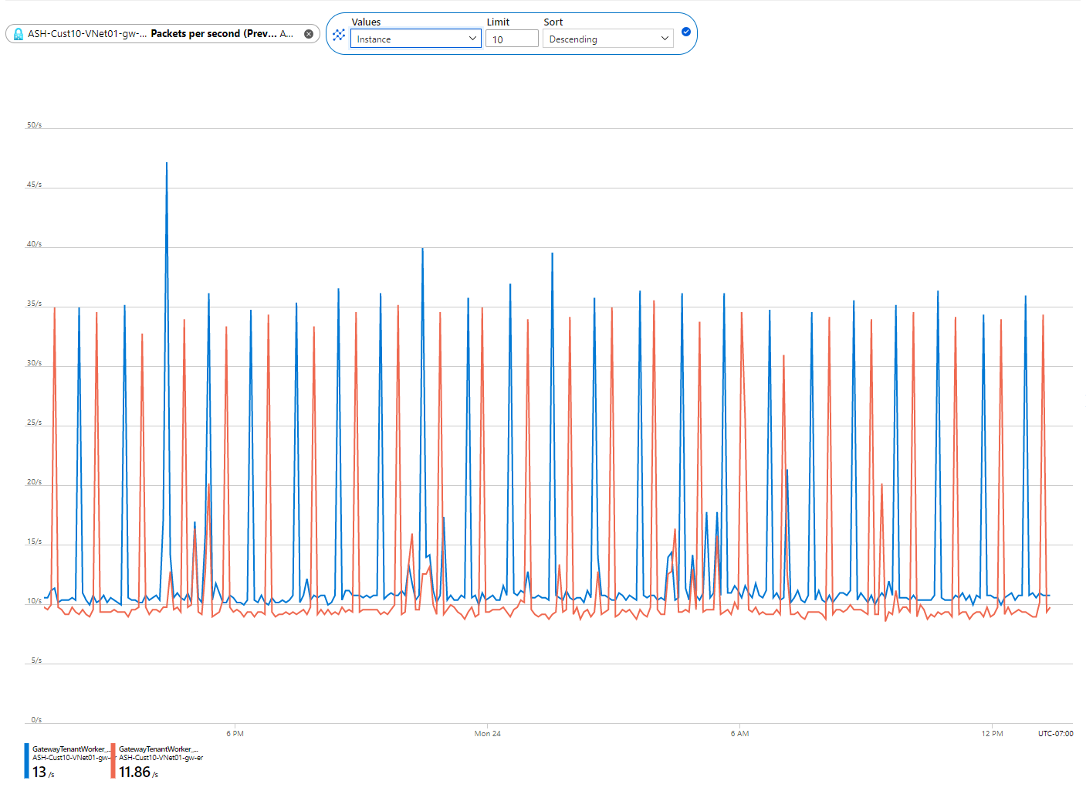
ExpressRoute Gateway Metrics
ExpressRoute gateway metrics available: Packets per Second (PPS)/CPU
Split by instances for finer granularity of reporting
Native alerting via Azure Monitor

Slide 11
VPN
Internet-based secure connectivity

Slide 12
VPN over ExpressRoute Private Peering
Azure region
VPN over ExpressRoute private peering
  Enable IPsec-secured connectivity from customer Virtual Networks to customer on-premises over ExpressRoute private peering
  Support transit from Internet S2S/P2S VPN to ExpressRoute on-premises over the VPN tunnel (not direct transit)
  Communications over the “private” address spaces between the Virtual Networks & ExpressRoute on-premises; no public IP addresses involved
Configuration
  Enable “Private IP address” option on the VPN gateway
  Enable “Use local Azure IP address” option on the VPN connection(s)
Routing
  On-premises network need to filter or prefer the VPN route(s) for Azure VNet(s) to utilize the VPN connection(s)
  On-premises must advertise more specific prefixes or disjoint prefixes via VPN connections to utilize VPN connection(s) from VNet(s)
Single tunnel throughput constraint (~1Gbps)
  Setup multiple private IPsec connections for greater throughput
Spoke
Hub
Spoke
ExressRoute
Az VPN
Microsoft
backbone
ExR edge
Internet edge
Customer
WAN
Internet
Customer VPN
ExpressRoute
Private Peering
Site to site
VPN
Point to site
VPN
Notes:
Routing
Rules
VNet address space: advertised BOTH via ExpressRoute private peering AND VPN connection(s) to ExpressRoute on premises
VPN-connected on-premises address spaces: advertised via VPN connection(s) ONLY
ExpressRoute path is PREFERRED when the same destination prefixes are advertised over both ExpressRoute and VPN connection(s)
Requirements & implications
ExpressRoute on-premises network need to filter or prefer the VPN route(s) for Azure VNet(s) to utilize the VPN connection(s)
Customers must advertise more specific prefixes or disjoint prefixes via VPN connections to utilize VPN connection(s) from VNet(s)
“Transit” between VPN and ExpressRoute is NOT enabled

Slide 13
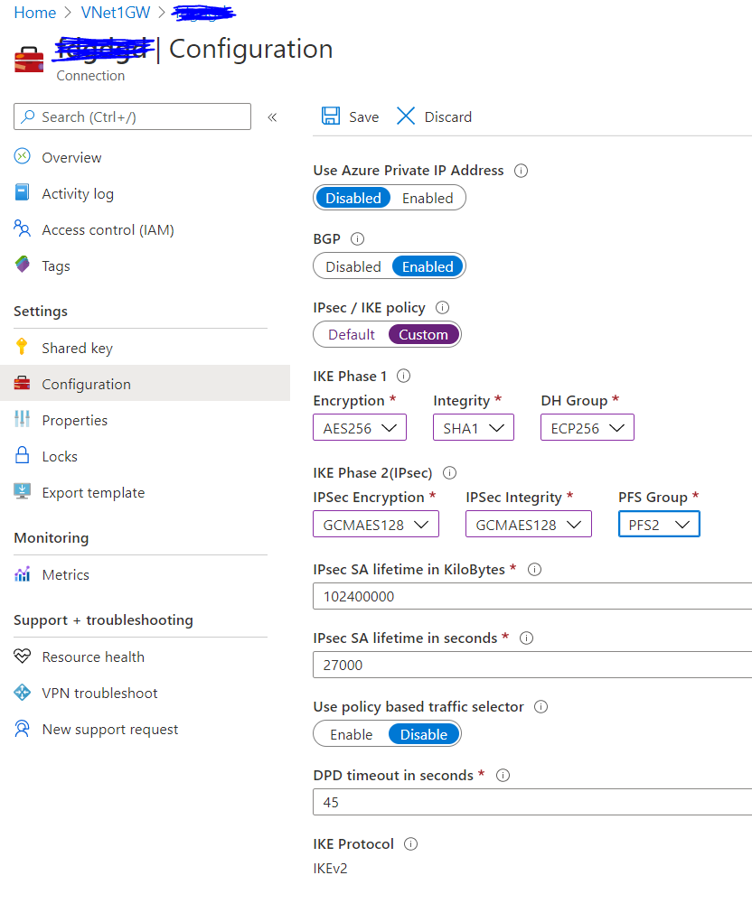
S2S VPN Features
FQDN S2S VPN
  Support customers without static public IP address(es)
  Target S2S with FQDN
BGP with APIPA addresses
  Support BGP peer addresses using APIPA range
  (169.254.0.0/24)
  Interop with legacy VPN devices, AWS VGW, and GCP VPN
Custom IPsec/IKE policy
  Adding portal support for Custom IPsec/IKE policy
  Adding custom DPD timeout support to better adapt to various Internet link conditions

Slide 14
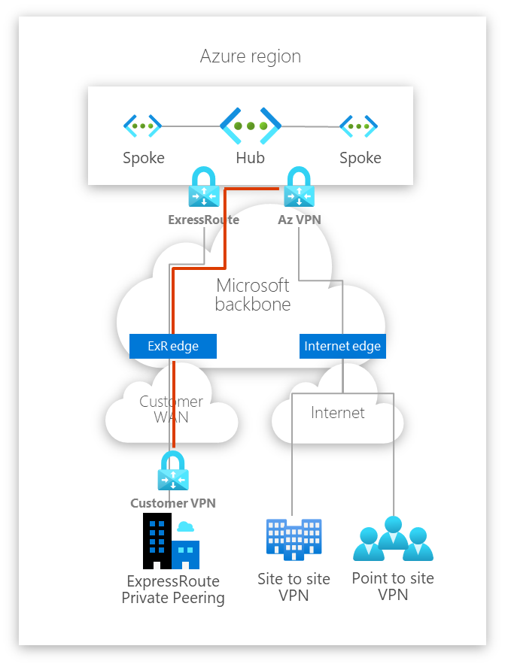
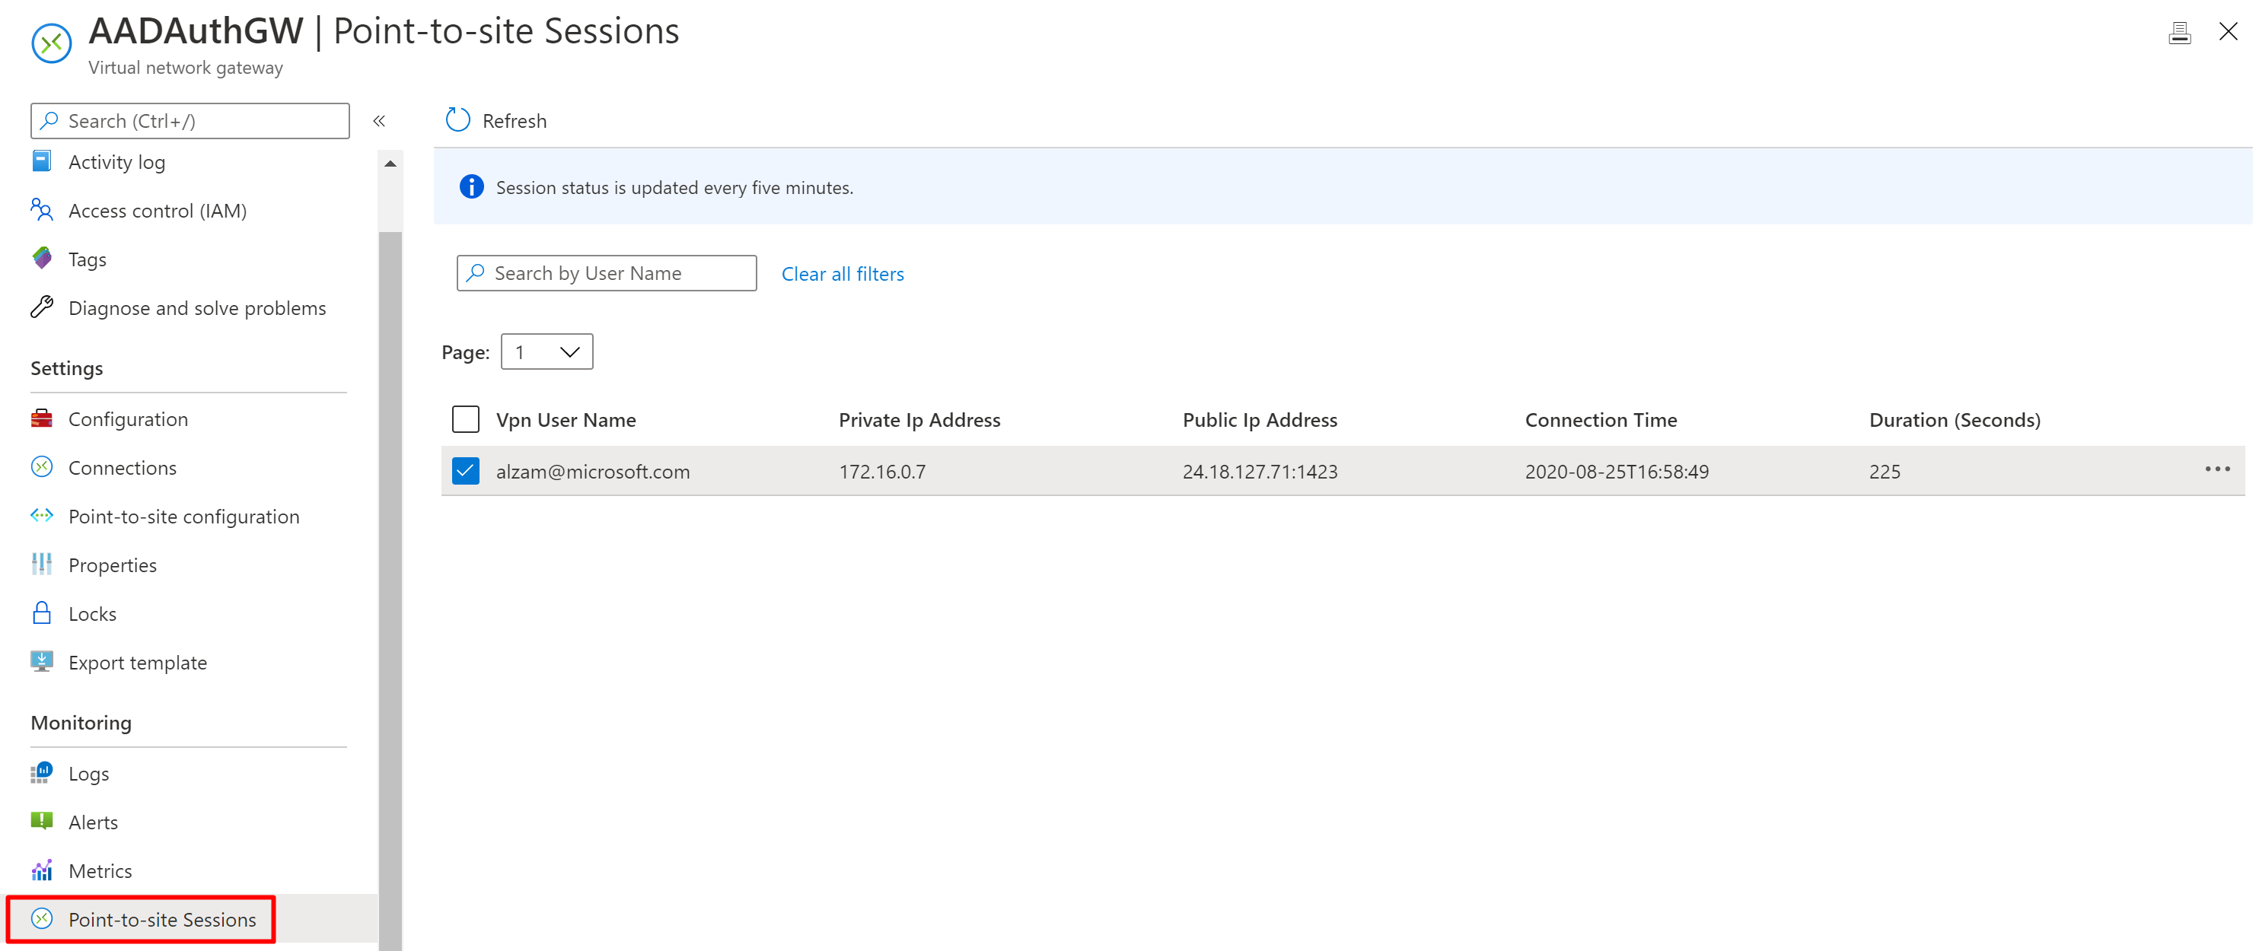
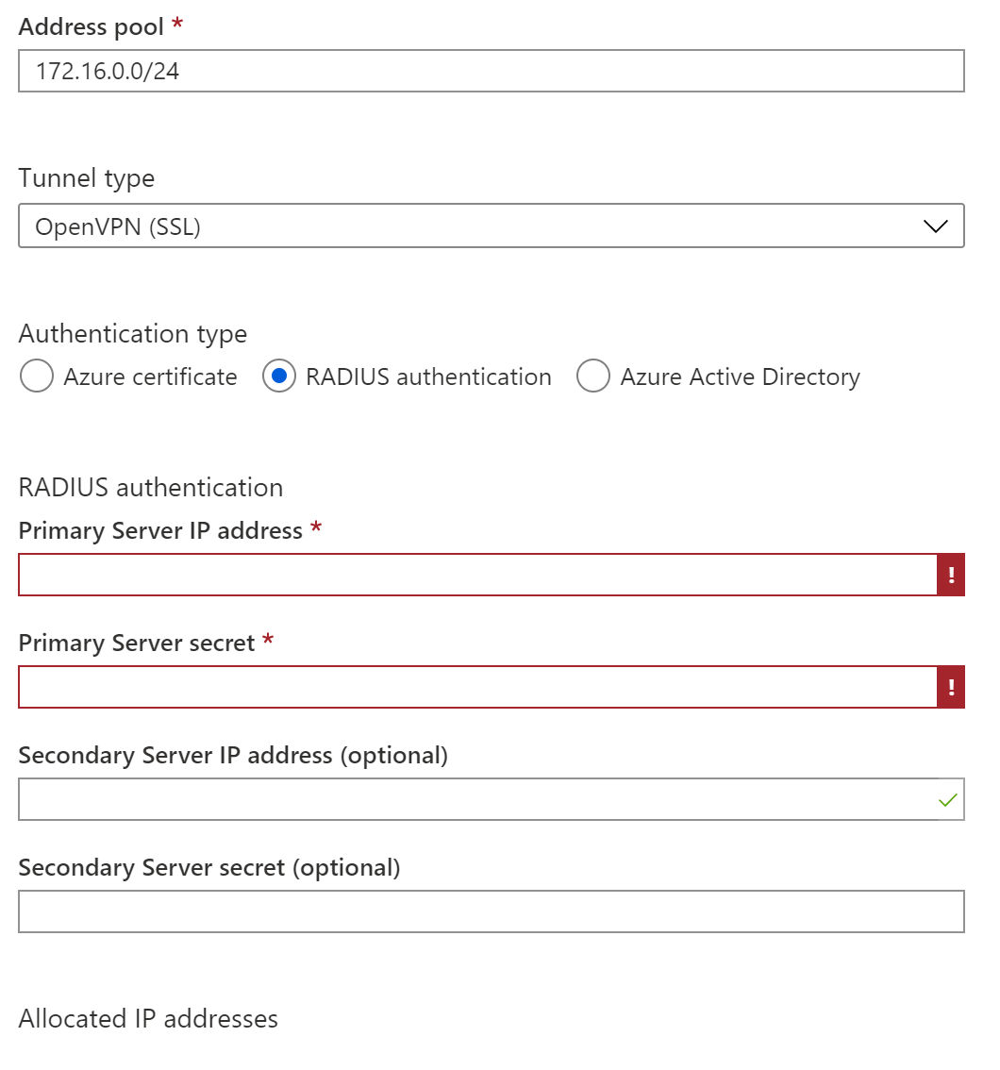
VPN Gateway P2S
P2S session management and revocation
Up to 10,000 concurrent connections
On-prem access through ExpressRoute using VPN over ExpressRoute private peering
P2S/RADIUS - Support 2 RADIUS servers for HA
Azure VPN Client for MacOS
Azure AD and certificate-based authentication co-existence on the same gateway

Slide 15

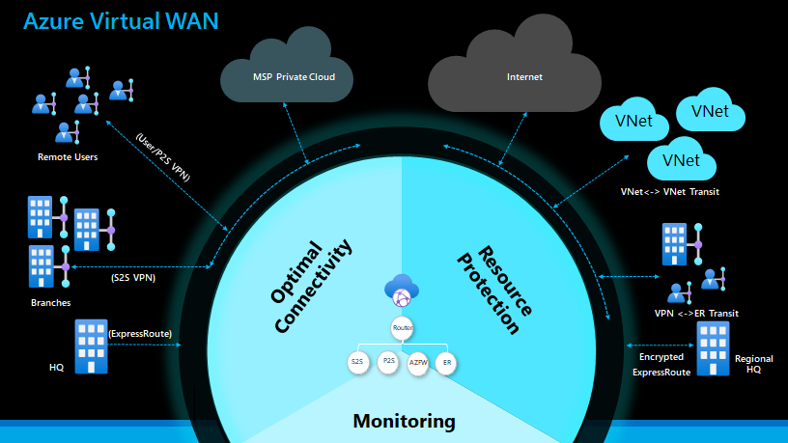
Virtual WAN (vWAN)
Azure Virtual WAN provides ubiquitous connectivity, routing and security in a unified framework
Notes:
Virtual WAN provides a unified framework for connectivity , security and routing. Deployed in hub and spoke based architecture it can be used to accelerate, scale, or re-architect a network.

Slide 16
Internet Connectivity
Notes:
Some of the largest services on the Internet run on Micorosft’s global network including Office 365, LinkedIn, Bing, and many more

Slide 17
Azure Peering Service
Delivering enterprise grade Internet connectivity to Microsoft Cloud Services
Enterprise grade Internet connectivity to Microsoft
Connectivity Providers partnership
Local and geo peering redundancy
High capacity peers (ISPs & Exchanges)
Optimized Internet traffic routing (cold potato)
MS Peering Partner
MAPS Partner
Peering Service Platform
Telemetry platform
Latency deviation
BGP Route anomalies
Performance degradation events
Customer
Monitoring & alerts
Operational insights
Microsoft
Internet
User telemetry
Route Anomaly Detection and Remediation (RADAR)
20 million routes monitored real-time against BGP leaks, hijacks or withdrawals

Slide 18

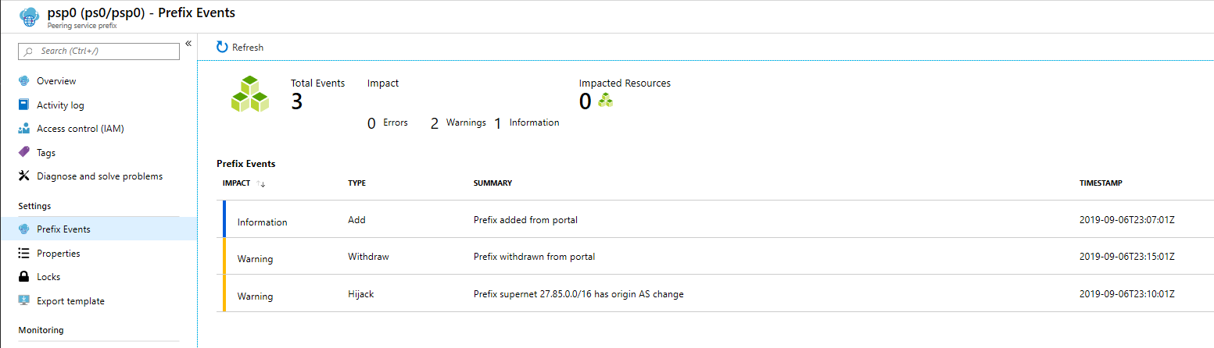
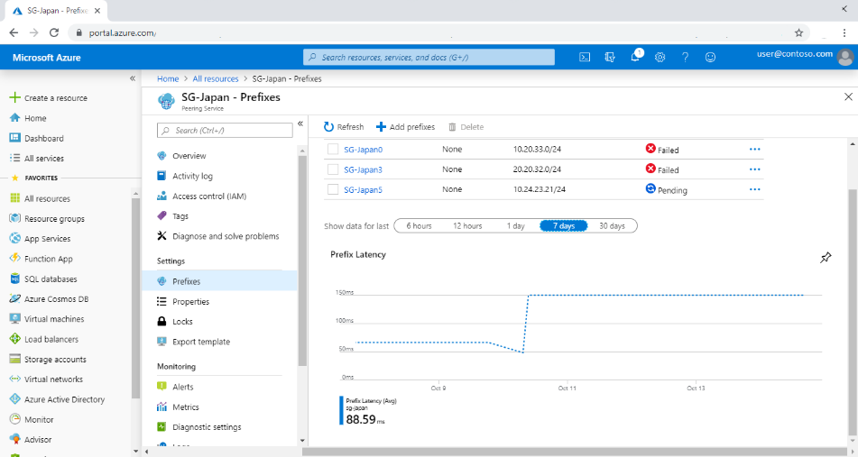
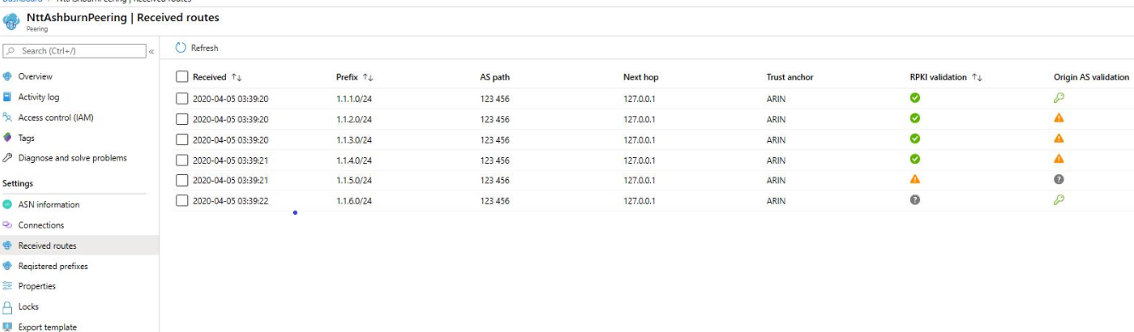
Peering Service Features
Monitoring & Alerts
BGP route anomaly detections (hijacks and leaks) to customer prefixes
Performance Insights
Looking-Glass for Providers
BGP Looking-Glass data from RADAR for prefixes, RPKI Validation
Feed for Trust Anchor, AS Path, Next Hop, etc.

Slide 19
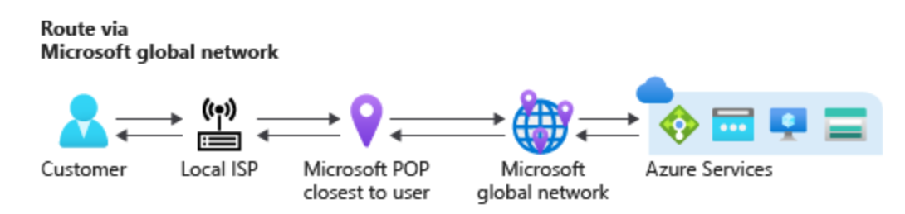
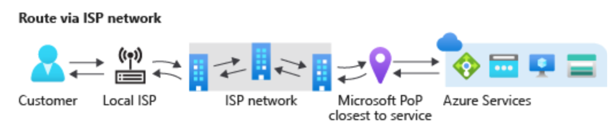
Routing Preference
Enables network choices for internet bound traffic
Status: Public Preview
Provides Azure customers options to choose how their traffic routes between Azure and the Internet.
(1) Routing via Microsoft Global Network (2) Routing over Public Internet (ISP Network)
Microsoft Global Network
Traffic from user is accepted closest to the user and traversed on Microsoft global network to resources in Azure. The return route from Azure follows the same path and exits Microsoft network closest to user.
Internet Route (ISP Network)
Traffic from user is traversed on public internet and enters Microsoft network closest to the hosted service region. The return route from Azure exits Microsoft network in the same hosted service region and takes public internet route to user.
 | Routing via Microsoft Global Network | Routing via public internet
Routing | Cold potato routing on Microsoft global network for bulk of the journey | Hot potato routing via ISP network
Performance | Premium predictable performance, exceptionally high reliability and availability | ISP network performance & reliability
Use case | High network reliability, global customer base | Egress cost optimization
Notes:
Microsoft global network is a premium network with 160,000 fiber miles and 165 edge pops around the world. Provides best networking performance
New cost optimized option is suitable for workload that do not require a private backbone network and is good with ISP network. AWS routes internet bound traffic using ISP network. Azure pricing is cheaper than AWS but performance is comparable with AWS. Google has this product already called “Network service tier”
3. Customer can enable this though public ip, which then can be associated with internet facing resources such as VM, VMSS, internet facing LB, app gateway etc. Also, customer can set this for Storage account and Azure data lake

Slide 20
Configure Routing Preference for Public IP
Create a public IP and select routing choice
Associate the public IP to Azure resources
  Virtual Machine
  VM Scale sets
  Internet facing load balancer
  App Gateway
  Azure firewall
  And more…

Slide 21
Configure Routing Preference for Storage Services
Configure routing option for your storage account
Additional internet end point created
Default is Microsoft Network

Slide 22
Thank you.

