Slide 1
Architect and simplify hybrid networking with Azure Virtual WAN and SD-WAN
Reshmi Yandapalli
Principal Product Manager, Azure Networking

Slide 2
Agenda
1.
2.
3.
4.
5.
6.
Azure Virtual WAN Overview
Key Partner announcements
Monitoring
Transit Routing use cases
Integrated Network Virtual Appliance (Demo)
Summary

Slide 3





Azure Virtual WAN overview
Connectivity
Global transit architecture
Secure virtual hub
Routing
Integrated network virtual appliance
Unified framework for networking, security and routing

Slide 4

Azure Virtual WAN Overview
Site-to-site VPN
  Supports IKEv1, IKEv2 protocol
  VPN/SD-WAN CPE partnerships with signed agreements for configuration and connectivity automation
  Scale : Up to 1000 connections/region (hub), 20 Gbps aggregate throughput /region (hub)
  New : FQDN based IPsec, custom BGP/APIPA
Point-to-Site VPN
  Support IKEv2, OpenVPN protocol, cert based and RADIUS authentication
  Built in traffic management, Integrated with Azure VPN Client
  Scale : Up to 10K users/region (hub ), 20 Gbps aggregate throughput /region (hub)
  New : Custom DNS
Private Connectivity with ExpressRoute
  Support encryption with native site-to-site VPN
  Scale : Up to 20 Gbps aggregate throughput /region (hub)
  New : Up to 8 circuit connection per region (hub), ), Ability to connect Standard circuits
Integrated network virtual appliance
Global transit architecture
Secure virtual hub
Connectivity
Routing

Slide 5



















Virtual WAN Partners
VPN/SD-WAN Device Connectivity automation with Virtual WAN VPN
Partners with Azure Marketplace based network virtual appliance deployable in Virtual WAN hub
SD-WAN
Viptela
SD-WAN
Coming Soon
MSP Partners providing Azure Virtual WAN Services
Coming Soon
Notes:
Growing number of Telcos and SIs are now offering Managed Services for Virtual WAN​
Services include:​
Plan, Design, Implementation and Operations of Enterprise Hybrid Networks based on Virtual WAN ​
Integration with Enterprise SD-WAN​
Non-DIY Enterprises could leverage these Partner offerings to build and operate their Virtual WAN ​
For a full list of offers: See Azure Networking MSP Partners ​

Slide 6
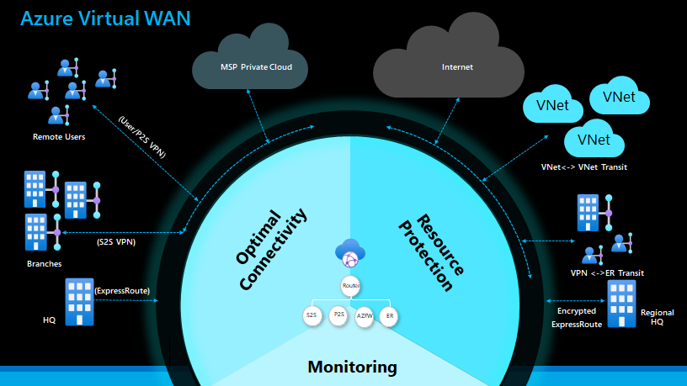
Azure Virtual WAN Overview
Fully meshed hub
Any-to-any connectivity
  Branch to Azure
  Branch to branch
  Users <->Branch
  VNet<->VNet transit
  VPN<-> ExpressRoute transit
Integrated network virtual appliance
Global transit architecture
Secure virtual hub
Connectivity
Routing

Slide 7



Azure Virtual WAN Overview
Virtual Hub Router
  One router per virtual hub
  Controls routes between all gateways
  Provides VNET<->VNET transit
  Scale : Up to 50 Gbps aggregate throughput /region (hub) for VNet to VNet transit connectivity, Up to (500 minus #Hubs) VNet Spoke connections to each hub
Custom Routing
  Custom Route table for VNETs
  Default Route Table for Branches (P2S, S2S, ER)
  Associate Connections to route tables
  Propagate routes from Connections to route tables
  View effective routes on route tables
Integrated Network Virtual Appliance
Global Transit Architecture
Secure Virtual Hub
Connectivity
Routing
Virtual Hub Router
VPN Gateway
ExpressRoute Gateway
User VPN Gateway
Azure Firewall

Slide 8




Azure Virtual WAN Overview
Secure a Virtual Hub with Azure Firewall
Secure with Security-as-a-Service (SECaaS) partners
  Supported Partners : zScaler, iBoss, CheckPoint
  Set up security policies in Azure Firewall Manager
Azure Firewall Manager
  Create policy and apply across multiple firewalls
  Works across regions/subscription/deployments
  Secure Internet traffic (VNET ->Internet and Branch ->Internet)
  Secure Private traffic (VNET <->Branch)
Integrated network virtual appliance
Global transit architecture
Secure virtual hub
Connectivity
Routing
Azure VNet
Datacenter
Remote User
Secure Virtual Hub
Internet
HQ/
branch

Slide 9
Azure Virtual WAN Overview
Deploy Azure Marketplace NVA (BYOL/PAYG)
  Supported Partners : Barracuda, Cisco Viptela (New)
Integrated with Virtual WAN
  Supports transit scenario of SDWAN <-> Azure VPN Site, Remote User, ExpressRoute
  Secure Access Service Edge (SASE) with Secure Virtual Hub (Virtual Hub with Azure Firewall)
  Built-in resiliency (no management overhead)
  No hassle routing – Integrated with Virtual Hub Router
  Supports Network Virtual Appliance Provider’s proprietary features (e.g. Configure SD-WAN policies)
Integrated network virtual appliance
Global transit architecture
Secure virtual hub
Connectivity
Routing
Virtual Hub Router
NVA
VPN Gateway
ExpressRoute Gateway
User VPN Gateway
Azure Firewall

Slide 10


Putting it together
Unified framework for networking, security and routing using the Microsoft Global Backbone
VPN, ER
Throughput : $/scale unit
Connection : $/conn unit
FW : Per hr, Per GB
Virtual Hub : Per hr, Per GB
Hub to hub : Source Destination based Egress only charges
VNet
VNet
VNet
VNet
vWAN pricing
Microsoft managed hub
Virtual Hub Router – automatic hub to hub
Virtual Hub Router – Fully meshed hubs
Transit between VPN and ExpressRoute, VNETs
Custom Routing
Integrated Network Virtual Appliance (NVA)
vWAN
routing
enabled capabilities
Internet
Fully meshed hubs
ER
Encryption
P2S Traffic mgmt
S2S connectivity automation
FW Manager Partners
vWAN unique
8 ckt/Hub
20 Gbps agg
10,000/Hub
20 Gbps agg
1,000/Hub
20 Gbps agg
500/Hub
50 Gbps agg
V<->V
vWAN scale
ExpressRoute
User/P2S VPN
Site/S2S VPN
VNet
Connectivity & Security
Azure FW
ExpressRoute User
P2S User
S2S User
P2S User
S2S User

Slide 11
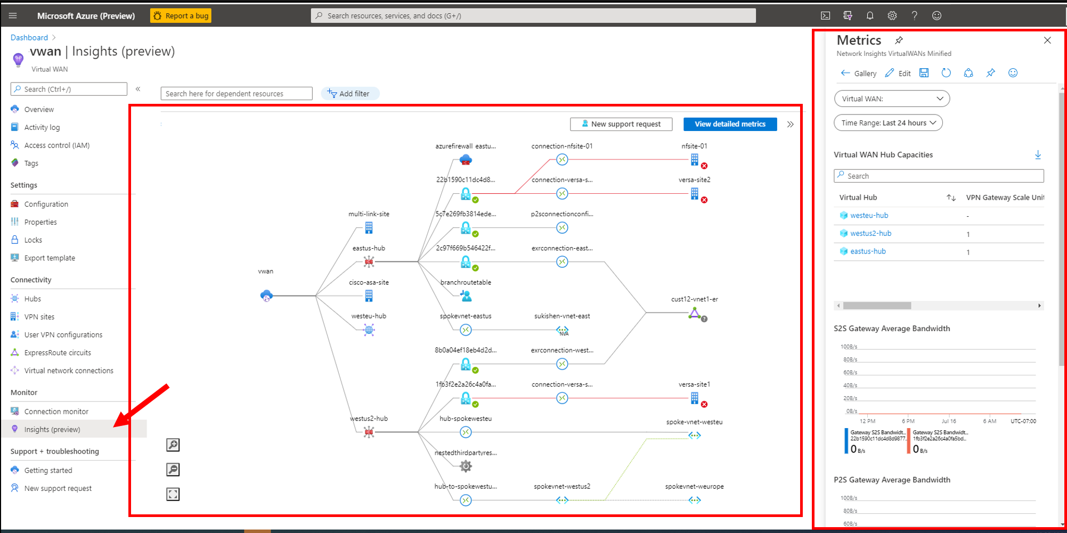
Topology of your network
Metrics
Virtual WAN Monitoring Insights (Preview)

Slide 12
Transit Routing Use Cases

Slide 13
Connection, association & propagation
Connections learn routes from associated route table
VNet1
VNet2
Connections propagate routes to route table
VPN Connection
ExpressRoute Connection
P2S Config Connection
Virtual Network Connection
10.1.0.0/24
10.2.0.0/24
Every hub has a Default Route Table
Default route table
Route | Next hop
192.168.1.0/24 | S2S VPN Conn ID
192.168.2.0/24 | ER Conn ID
192.168.3.0/24 | P2S VPN Conn ID
10.1.0.0/24 | VNet 1 Conn ID
10.2.0.0/24 | VNet 2 Conn ID
Enables any-to-any connectivity
192.168.1.0/24
192.168.2.0/24
192.168.3.0/24

Slide 14
Custom routes, static routes, next hop
VNet1
VNet2
10.1.0.0/24
10.2.0.0/24
VNETs can associate to custom route tables
10.3.0.0/24
VNet3
RT_VNET
Route | Next hop
Route | Next hop
10.1.0.0/24 | VNet 1 Conn ID
10.3.0.5
Route | Next hop
10.2.0.0/24 | VNet 2 Conn ID
Route | Next hop
192.168.0.0/16 | VNet 3 Conn ID
Add a static route to route table
Add a next hop for 10.3.0.5 in VNet3 connection
192.168.1.0/24
192.168.2.0/24
192.168.3.0/24

Slide 15
Custom use case – Isolating VNets
VNet1
VNet2
Branches <->Branches
Branches <->VNet
No VNet <->VNet
10.1.0.0/24
10.2.0.0/24
Default Route Table
Route | Next hop
Custom Route Table RT_VNET
Route | Next Hop
192.168.1.0/24 | S2S VPN Conn ID
192.168.2.0/24 | ER Conn ID
192.168.1.0/24 | S2S VPN Conn ID
192.168.2.0/24 | ER Conn ID
10.1.0.0/24 | VNet 1 Conn ID
10.2.0.0/24 | VNet 2 Conn ID
192.168.1.0/24
192.168.2.0/24

Slide 16
Custom use case – Isolating VNets
VNet1
VNet2
Branches <->Branches
Branches <->VNet
No VNet <->VNet
10.1.0.0/24
10.2.0.0/24
Default Route Table
Route | Next hop
Custom Route Table RT_VNET
Route | Next Hop
192.168.1.0/24 | S2S VPN Conn ID
192.168.2.0/24 | ER Conn ID
192.168.1.0/24 | S2S VPN Conn ID
192.168.2.0/24 | ER Conn ID
10.1.0.0/24 | VNet 1 Conn ID
10.2.0.0/24 | VNet 2 Conn ID
192.168.1.0/24
192.168.2.0/24

Slide 17
Custom use case – Route to shared services VNets
Custom Route Table RT_VNET
Route | Next Hop
VNet1
VNet2
Add a next hop for 10.3.0.5 in VNet3 connection
192.168.1.0/24 | S2S VPN Conn ID
192.168.2.0/24 | ER Conn ID
10.1.0.0/24
10.2.0.0/24
10.3.0.0/24 | VNet 3 Conn ID
10.3.0.0/24
VNet3
10.3.0.5
Shared Services VNET
Default Route Table
Route | Next hop
192.168.1.0/24 | S2S VPN Conn ID
192.168.2.0/24 | ER Conn ID
Branches <->Branches
Branches -> VNET3
Branches -> VNET1,2
VNETs 1, 2 -> VNET3
10.3.0.0/24 | VNet 3 Conn ID
10.1.0.0/24 | VNet 1 Conn ID
10.2.0.0/24 | VNet 2 Conn ID
192.168.1.0/24
192.168.2.0/24

Slide 18
Custom use case – Custom isolation VNets
Branches <->Branches
Blue Vnets <->Branches
Pink Vnets <-> Branches
Blue VNets <-> Blue VNets
Pink VNets <-> Pink VNets
Branches <-> Blue and Pink VNets
Custom Route Table – Label Blue
Route | Next hop
192.168.1.0/24 | S2S VPN Conn ID
192.168.2.0/24 | ER Conn ID
192.168.3.0/24 | S2S VPN Conn ID
192.168.4.0/24 | ER Conn ID
Custom Route Table – Label Pink
Route | Next hop
192.168.1.0/24 | S2S VPN Conn ID
192.168.2.0/24 | ER Conn ID
192.168.3.0/24 | S2S VPN Conn ID
192.168.4.0/24 | ER Conn ID
VNet1
VNet2
VNet3
VNet4
10.1.0.0/24 | VNet1 Conn ID
10.3.0.0/24 | VNet3 Conn ID
10.1.0.0/24
10.2.0.0/24
10.3.0.0/24
10.4.0.0/24
10.2.0.0/24 | VNet2 Conn ID
10.4.0.0/24 | VNet4 Conn ID
Default Route Table – Label Default
Route | Next hop
Default Route Table – Label Default
Route | Next hop
192.168.1.0/24 | S2S VPN Conn ID
192.168.2.0/24 | ER Conn ID
192.168.3.0/24 | S2S VPN Conn ID
192.168.4.0/24 | ER Conn ID
192.168.1.0/24 | S2S VPN Conn ID
192.168.2.0/24 | ER Conn ID
192.168.3.0/24 | S2S VPN Conn ID
192.168.4.0/24 | ER Conn ID
10.1.0.0/24 | VNet1 Conn ID
10.3.0.0/24 | VNet3 Conn ID
10.2.0.0/24 | VNet2 Conn ID
10.4.0.0/24 | VNet4 Conn ID
192.168.1.0/24
192.168.2.0/24
192.168.3.0/24
192.168.4.0/24
10.1.0.0/24 | VNet1 Conn ID
10.3.0.0/24 | VNet3 Conn ID
10.2.0.0/24 | VNet2 Conn ID
10.4.0.0/24 | VNet4 Conn ID

Slide 19
Custom Use Case – Multi-hub and any-to-any
Any-to-any
Routing configuration – VNETs , Branches
Association default
Propagation default
VNet1
VNet2
VNet3
VNet4
10.1.0.0/24
10.2.0.0/24
10.3.0.0/24
10.4.0.0/24
Default Route Table – Label Default
Route | Next hop
Default Route Table – Label Default
Route | Next hop
192.168.1.0/24 | S2S VPN Conn ID
192.168.2.0/24 | ER Conn ID
192.168.3.0/24 | S2S VPN Conn ID
192.168.4.0/24 | ER Conn ID
192.168.1.0/24 | S2S VPN Conn ID
192.168.2.0/24 | ER Conn ID
192.168.3.0/24 | S2S VPN Conn ID
192.168.4.0/24 | ER Conn ID
10.1.0.0/24 | VNet1 Conn ID
10.3.0.0/24 | VNet3 Conn ID
10.2.0.0/24 | VNet2 Conn ID
10.4.0.0/24 | VNet4 Conn ID
192.168.1.0/24
192.168.2.0/24
192.168.3.0/24
192.168.4.0/24
10.1.0.0/24 | VNet1 Conn ID
10.3.0.0/24 | VNet3 Conn ID
10.2.0.0/24 | VNet2 Conn ID
10.4.0.0/24 | VNet4 Conn ID

Slide 20
Custom use case – Azure internet edge with Azure Firewall
VNET -> Internet via AzFW
Branch -> Internet via AzFW
Private traffic (VNet, Branch) to go Direct
VNet1
VNet2
VNet3
VNet4
10.1.0.0/24
10.2.0.0/24
10.3.0.0/24
10.4.0.0/24
Add a static route to route table
0.0.0.0/0 -> next hop AzFW
Add a static route to route table
0.0.0.0/0 -> next hop AzFW
Default Route Table – Label Default
Route | Next hop
Default Route Table – Label Default
Route | Next hop
192.168.1.0/24 | S2S VPN Conn ID
192.168.2.0/24 | ER Conn ID
192.168.3.0/24 | S2S VPN Conn ID
192.168.4.0/24 | ER Conn ID
192.168.1.0/24 | S2S VPN Conn ID
192.168.2.0/24 | ER Conn ID
192.168.3.0/24 | S2S VPN Conn ID
192.168.4.0/24 | ER Conn ID
10.1.0.0/24 | VNet1 Conn ID
10.3.0.0/24 | VNet3 Conn ID
10.2.0.0/24 | VNet2 Conn ID
10.4.0.0/24 | VNet4 Conn ID
192.168.1.0/24
192.168.2.0/24
192.168.3.0/24
192.168.4.0/24
10.1.0.0/24 | VNet1 Conn ID
10.3.0.0/24 | VNet3 Conn ID
10.2.0.0/24 | VNet2 Conn ID
10.4.0.0/24 | VNet4 Conn ID

Slide 21
Custom use case – Route through NVA
Ensure UDR from indirect spoke to the NVA VNETs
10.2.1.0/24
10.2.2.0/24
10.4.1.0/24
10.4.2.0/24
Internet
VNet2a
VNet2b
VNet4a
VNet4b
1
1
Ensure Static route to get to NVA connections
VNet1
VNet2
VNet3
VNet4
10.2.0.5
10.4.0.5
2
Enter the NVA IP in the NVA Connection
10.1.0.0/24
10.2.0.0/24
10.3.0.0/24
10.4.0.0/24
Add a static route
10.2.0.0/16 -> next hop VNet2 conn ID
10.4.0.0/16 -> next hop VNet4 conn ID
VNET2 Connection
Add a static route
10.2.0.0/16 -> next hop VNet2 conn ID
10.4.0.0/16 -> next hop VNet4 conn ID
3
VNET4 Connection
2
3
Default Route Table – Label Default
Route | Next hop
Default Route Table – Label Default
Route | Next hop
192.168.1.0/24 | S2S VPN Conn ID
192.168.2.0/24 | ER Conn ID
192.168.3.0/24 | S2S VPN Conn ID
192.168.4.0/24 | ER Conn ID
192.168.1.0/24 | S2S VPN Conn ID
192.168.2.0/24 | ER Conn ID
192.168.3.0/24 | S2S VPN Conn ID
192.168.4.0/24 | ER Conn ID
10.1.0.0/24 | VNet1 Conn ID
10.3.0.0/24 | VNet3 Conn ID
10.2.0.0/24 | VNet2 Conn ID
10.4.0.0/24 | VNet4 Conn ID
192.168.1.0/24
192.168.2.0/24
192.168.3.0/24
192.168.4.0/24
10.1.0.0/24 | VNet1 Conn ID
10.3.0.0/24 | VNet3 Conn ID
10.2.0.0/24 | VNet2 Conn ID
10.4.0.0/24 | VNet4 Conn ID
Routing Configuration – VNETs , Branches
Association Default
Propagation Default

Slide 22
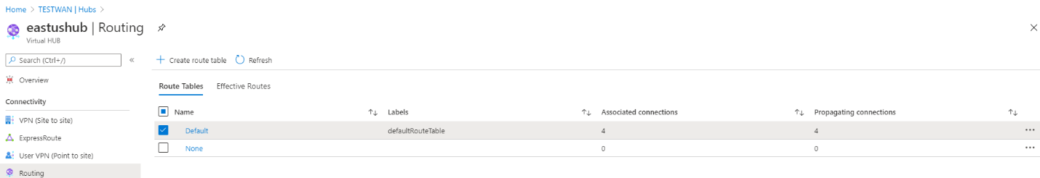
Virtual WAN Portal
Create route table

Slide 23
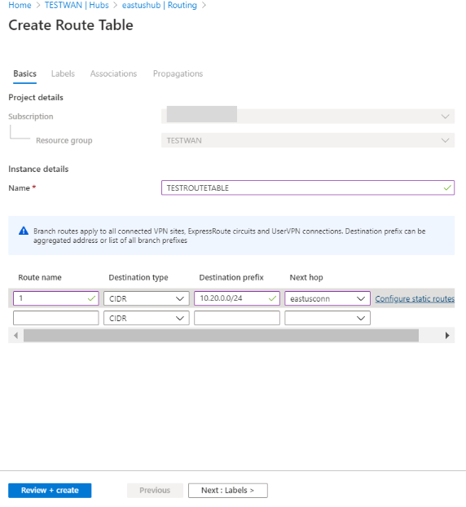
Virtual WAN Portal
Basics : Set up static route in this route table with next hop
Azure Firewall
VNET connection ID

Slide 24
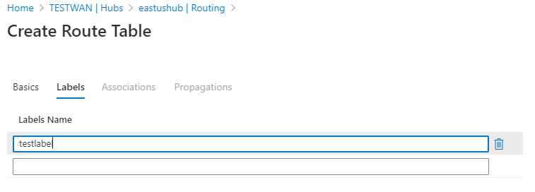
Virtual WAN Portal
Label : Set up label to propagate routes across multiple route tables

Slide 25
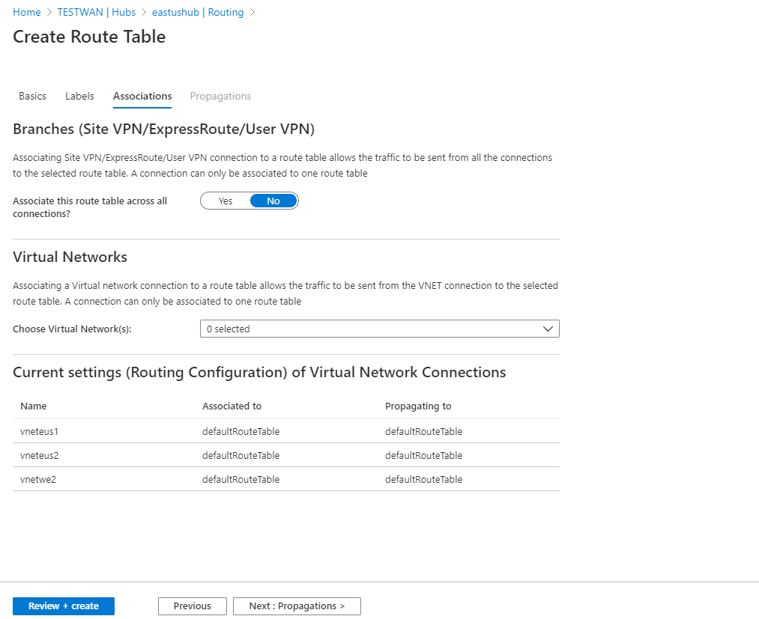
Virtual WAN Portal
Associations : Select connections =>these connections will learn routes from this route table
All connections associate always to a single route table

Slide 26
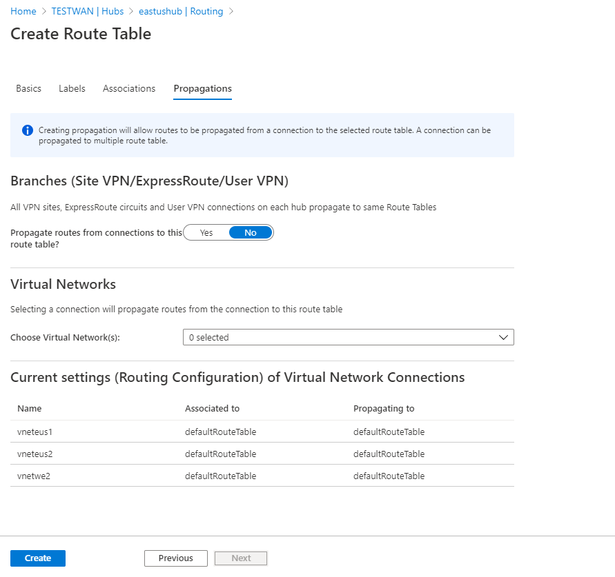
Virtual WAN Portal
Propagations : Select connections to propagate routes to this route table
Connections can propagate to multiple route tables
Branch connections propagate to the ‘same set’ of route tables

Slide 27
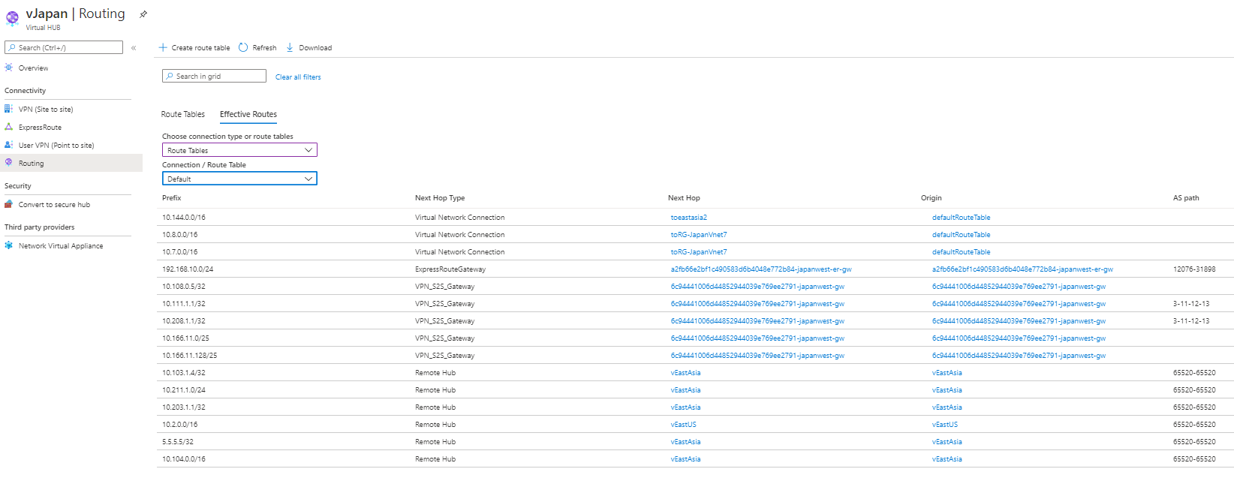
Virtual WAN Portal
View effective routes of a route table

Slide 28
Let’s summarize – Routing
1. S2S, P2S, ExpressRoute connections are considered as branch spokes
Associate to default route table
Propagate to the ‘same set’ of route tables
2. Custom route tables are currently supported only for VNets
3. Connections associate to a route table =>they learn routes from that route table
4. Connections propagate routes to a route table <= the route table learns about the connection
5. Specific routes always win [e.g 10.1.0.0/24 is more specific than 10.0.0.0/16]
6. Set up static route with next hop as AzFW , VNet Connection ID
7. View effective routes on route tables
8. Connections propagate to none (label)/none route table => Black hole

Slide 29
Integrated Virtual Appliance – Cisco Viptela demo
Network Virtual Appliance
Supports transit
SASE : Works with Secure Virtual Hub
Built-in resiliency
No hassle routing
Virtual Hub Router
VPN Gateway
ExpressRoute Gateway
User VPN Gateway
Azure Firewall

Slide 30
Cisco Viptela demo video placeholder
Insert partner video here

Slide 31
To summarize
Azure Virtual WAN provides ubiquitous connectivity, routing and security in a unified framework

Slide 32
Resources
Microsoft announcement blog?
aka.ms/virtualwan-docs

Slide 33
Thank you

