Slide 1
Migrate .NET apps to Azure Kubernetes Service
Bharathram Sivaraman
Senior Product Manager, Azure Migrate

Slide 2
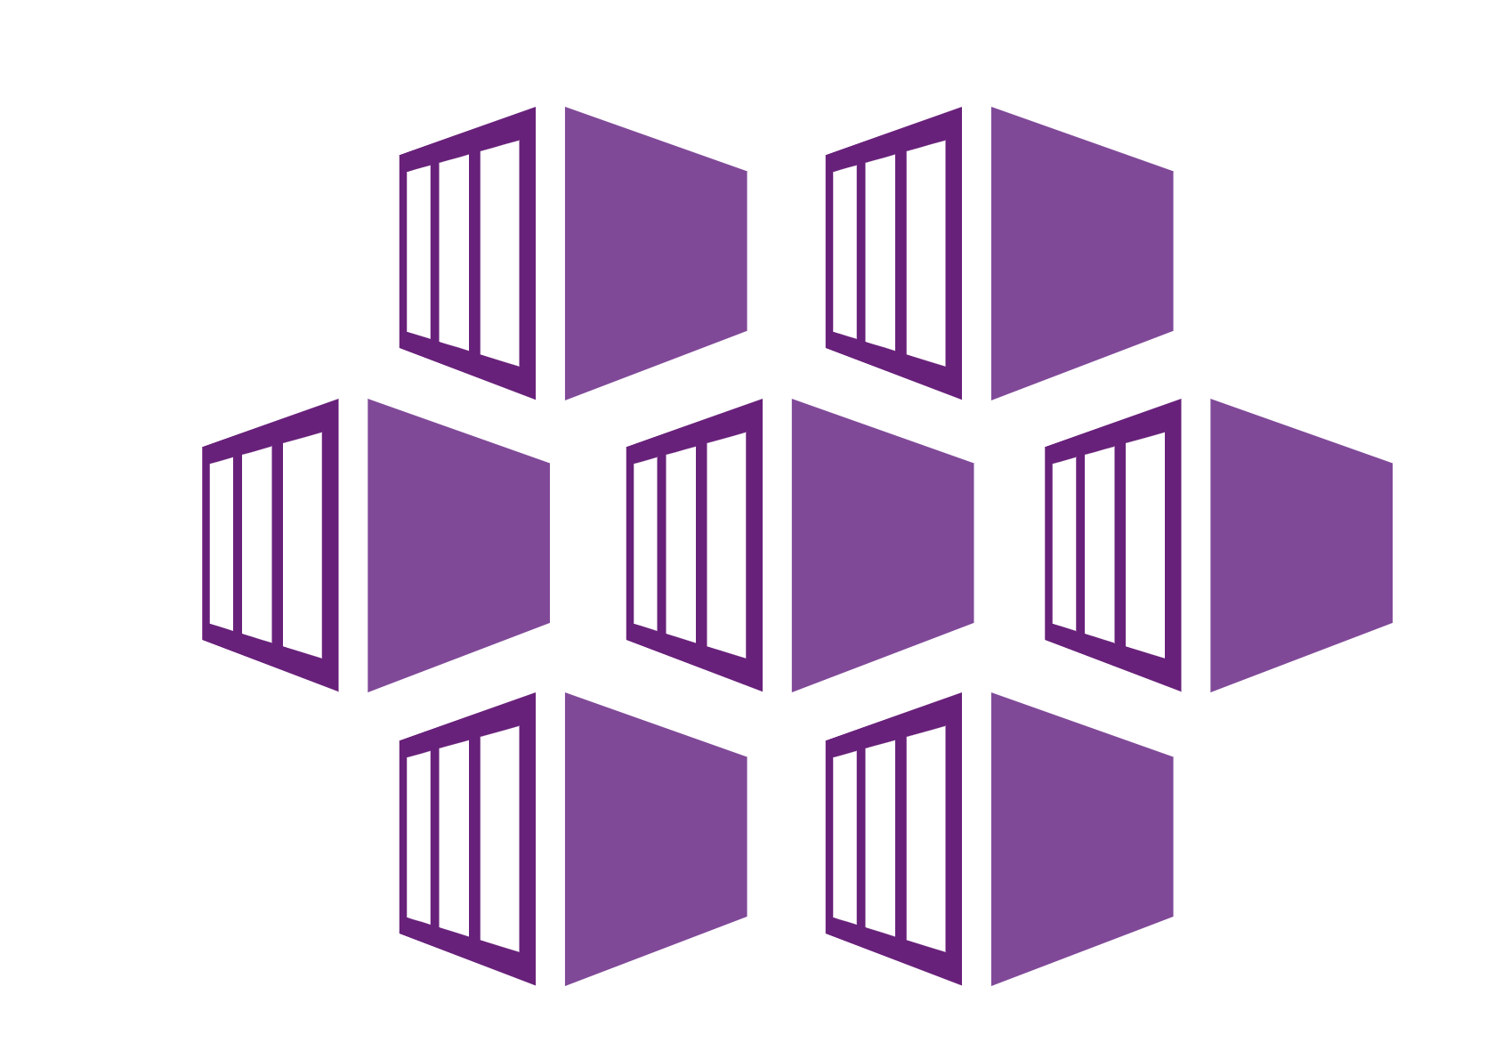
Migrate ASP.NET Apps to Azure
LOB Application
Web and App tier (ASP.NET)
Azure Migrate
Server Migration
Azure IaaS
Azure Migrate
Web App Migration
App Service
Migrate Apps
to AKS
AKS

Slide 3
Migrate ASP.NET apps to AKS Demo

Slide 4
ASP.NET App containerization
LOB App
Azure Container Registry
AKS Cluster
Containerization helper
ASP .NET App
Dockerfile
Create ACR/AKS cluster
Container image
Kubernetes manifests
Publish Image
Deploy to AKS
Parameterized configuration
Data layer
DB migration or test copy

Slide 5
Containerize and migrate ASP.NET applications to AKS
Point and containerize
Convert apps to container images with minimal to no code changes
Parameterize configurations
Parameterize application configurations such as connection strings
Reusable artifacts
Download generated artifacts Dockerfiles, Kubernetes manifests
Customization
Ability to customize at every step of the way

Slide 6
Resources
Migrate Web Apps to App Service: https://aka.ms/AppServiceMigrationAssistant
Migrate ASP.NET apps to AKS: https://aka.ms/MigrateToAKS

