Slide 1
Taking your automation to the next level with PowerShell 7
Joey Aiello Program Manager
Jeffrey Snover Technical Fellow

Slide 2
Agenda
Evolution of PowerShell
Our Sacred Vow
PowerShell 7
7.0 LTS
7.1
7.2 LTS and beyond…
Innovation in PowerShell

Slide 3
Covid-19
Wow!
The world has always been, is, and will always be, messy
Values: adaptability, resilience, robustness, automation
F5 moment
Figure out what serves you and what does not serve you
Invest in what does, drop what does not
Notes:
- At this time, the companies that will succeed are those who are operationally excellent at critical things

Slide 4
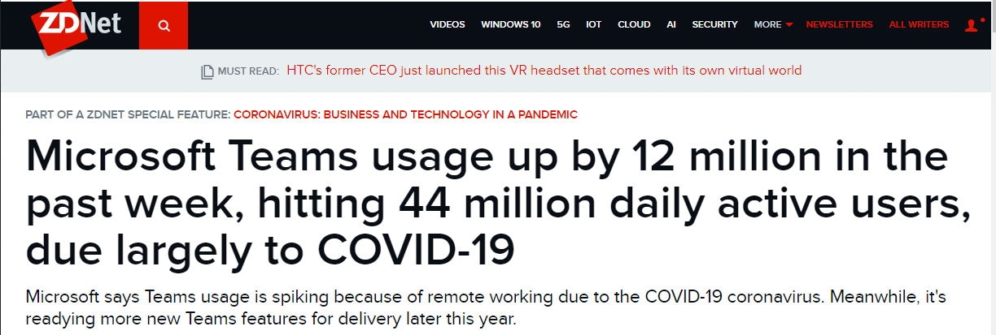

Slide 5
PowerShell Served Microsoft Teams
Exec Incident Manager for European expansion of Teams
PowerShell everywhere!
Diagnostics, operations, repair, provisioning, …
Verbosity and clarity are a gift in stressful periods
Automating up & down
Success!
Notes:
Scaling down was just as critical in order to reclaim resources and compute power

Slide 6
To secure peace is to prepare for war – Clausewitz
To secure calm is to prepare for drama - Snover

Slide 7
PowerShell 7 is a 20-year story of preparing you for drama

Slide 8
Getting to PowerShell 7
Shell of An Idea by Don Jones
https://donjones.com/books/shell-of-an-idea/

Slide 9
Sacred Vow
Learn PowerShell and your value will continue to appreciate over time

Slide 10
Windows PowerShell 1.0 – 2.0
COM
Registry
Win32
Files
.NET
WMI/CIM
Notes:
Windows and Windows Server were messy worlds
All about no-drama
Task-oriented abstractions
Common tasks (-Verbose, -Whatif, -Debug, -Confirm, etc.)
unified disparate Windows APIs for universal Windows management
Technology focus in the early days
Programmatic shell

Slide 11
Windows PowerShell 3.0 – 5.0
Networking
Security
Identity
Storage
COM
Registry
Hyper-V
Win32
Files
.NET
WinRM Remoting
WMI/CIM
Notes:
Move to scenario focus
Feature/role teams joined these technologies together to create simpler units of automation for customers who couldn’t or didn’t want to glue APIs themselves
Shipped in Windows
Distributed automation infrastructure

Slide 12
PowerShell Core 6.x: Ubiquity!
Cloud
Azure/ARM
AWS
GCP
VMware
Distributions
Docker
CI/CD platforms
.NET SDK
Portability
REST / JSON
Networking
SSH
Security
Identity
Storage
OS
Linux
macOS
COM
Registry
Win32
Hyper-V
Files
.NET
WinRM Remoting
WMI/CIM
Notes:
Increased the scope of integration technologies
Introduction of ubiquity: meet all customers where their automation needs already exist
Cross-platform!

Slide 13
PowerShell Core 6.x: Ubiquity!
Cloud
Azure/ARM
AWS
GCP
VMware
Distributions
Docker
CI/CD platforms
.NET SDK
Portability
REST / JSON
Networking
SSH
Security
Identity
Note this portion outside the circle was Windows compatibility that we (temporarily) lost in the transition to .NET / PowerShell Core
Storage
OS
Linux
macOS
COM
Registry
Win32
Hyper-V
Files
.NET
WinRM Remoting
WMI/CIM

Slide 14
PowerShell 7.0
Cloud
Azure/ARM
AWS
GCP
VMware
Distributions
Docker
CI/CD platforms
.NET SDK
Portability
REST / JSON
Networking
With .NET Core 3.1, our own efforts to port inbox Windows modules, and the Windows compatibility layer for the vast majority of these APIs, features, and cmdlets have returned
Security
Identity
SSH
COM
Storage
OS
Linux
macOS
Registry
Win32
Hyper-V
Files
.NET
WinRM Remoting
WMI/CIM

Slide 15
Why PowerShell 7?
Windows PowerShell enabled simple automation and management of Windows servers (and clients!)
PowerShell Core enabled universal automation and management across operating systems and clouds
PowerShell 7 enables automation, management, and deployment of cloud, on-premises, and hybrid resources at larger scale and complexity

Slide 16
PowerShell Startups (normalized for 28 days)
Notes:
Over 5x usage in the last year!

Slide 17
PowerShell Startups by OS
Windows is growing at a steady clip too
Majority usage is on
Linux!
Notes:
Adoption rate of 6.x -> 7.x
Top shows high Windows growth
Bottom shows large upgrade trend from 6.x to 7.x

Slide 18
PowerShell Startups by Version
Within six months, over 90% of 6.x users moved to 7.0
Notes:
Adoption rate of 6.x -> 7.x
Top shows high Windows growth
Bottom shows large upgrade trend from 6.x to 7.x

Slide 19
PowerShell 7 Fulfills the Sacred Vow
7.0 LTS
7.1
ForEach-Object -Parallel
Real world improvements showing between 2x-100x speedup
Easier than ever to diagnose errors
New error views
Get-Error cmdlet
Backwards compatibility with Windows PowerShell
Native compatibility for more modules than ever: aka.ms/PSModuleCompat
Compatibility layer for 99% compatibility on Windows
New operators
Tons of under-the-hood improvements to performance, stability, edge cases, debugging, remoting, logging, etc.
Community release
Closed >1000 community-filed issues since 7.0 RC shipped in December
ARM64 support on Windows
Install and update from the Microsoft Store

Slide 20
PowerShell Innovation and Tooling
PowerShell’s language and runtime need to remain fast and stable
Experimental features let us experiment in PowerShell itself
Get-ExperimentalFeature | Set-ExperimentalFeature
New language features, breaking changes, and features that are subject to change
For everything else, we use modules!
PSReadline
SecretManagement
PowerShellGet 3.0
Notebooks
Microsoft.PowerShell.UnixCompleters
Native tool cmdlet generation

Slide 21
Secret Management
Never put secrets in your code!
SecretManagement allows you to create and retrieve any secrets from anywhere
Notes:
Journey of experimentation
Super important that we get security right
Different architectural approaches
Convenience feature
For other providers, you have to set up the “vault” ahead-of-time
Interface for accessing and storing secrets in existing vaults
“Security is never absolute”
Registration metadata is not treated as sensitive
Allows shareable scripts that work across secret stores
Settled on .NET-based SecretStore
Cross-platform
Install-Module Microsoft.PowerShell.SecretManagement -AllowPrerelease
Install-Module Microsoft.PowerShell.SecretStore -AllowPrerelease

Slide 22
SecretManagement

Slide 23
PowerShellGet 3.0
Benefits
Addresses top customer feedback around ease of installation
Ported to C# for performance and stability
NuGet 3.0 compatibility
NuGet version strings (e.g. “3.0.0-beta.8”) and wildcards (e.g. “[3.0,4)”)
Includes aliases for compatibility with PowerShellGet 2.0
Available now in the PowerShell Gallery
Install-Module PowerShellGet -AllowPrerelease -Force
Default in PowerShell 7.2
Notes:
Repo priority (internal trusted repos first, public Gallery last)
Better cmdlet surface area (e.g. Find-Module -> Find-PSResource)
No dependency on PackageManagement (aka OneGet)

Slide 24
Notebooks
Notebooks are interactive documents that mix executable script and rich text
Great for:
Tutorials, learning, and documentation
Semi-manual runbooks
Mixing multiple execution languages in one file
Two kinds of notebooks
.NET Interactive Notebooks: github.com/dotnet/interactive
Notebook Mode in PowerShell VS Code extension
Notes:
Link to PS notebooks blog, mention Notebook Mode in VS Code extension

Slide 25
Notebooks

Slide 26
What’s next?
Generally Available (GA)
PowerShell 7.1 in November
PowerShellGet 3.0 later this year
SecretManagement TBD based on feedback
7.2 LTS roughly 1 year from 7.1 GA
Expect previews as soon as 7.1 GAs
PowerShell 7 available on Download Catalog / MU / WSUS
Interactive improvements in PSReadline
Dynamic help
Tab completion improvements
Intelligent suggestions
And more! Check out Jeffrey and Jason in PowerShell Unplugged

Slide 27
What can you do?
Download and install PowerShell 7
aka.ms/Get-PowerShell
7.0 LTS, 7.1 RC, or (soon!) 7.2 preview
File issues (or contribute!) at github.com/PowerShell/PowerShell
Check out more projects at github.com/PowerShell
Follow
The PowerShell Team blog: aka.ms/PSBlog
@PowerShell_Team on Twitter
More PowerShell @ Ignite
PowerShell Unplugged w/ Jeffrey Snover and Jason Helmick
Ask The Experts w/ the PowerShell Team

Slide 28
In Summary
PowerShell 7.1 continues to make you more productive
Manage anything from anywhere
We’re 20 years in and the PowerShell journey has only just begun
Thank you!
Enjoy Ignite 2020!

Slide 30
Hidden Slide: Template Details
Version: Aug 21, 2020
Asset | Location
Template | https://aka.ms/Microsoft-Template
Sample Slides | https://aka.ms/Microsoft-Template-Samples
Video Recording Setup | https://aka.ms/Microsoft-Template-Video-Recording
Presenter Setup | https://aka.ms/Microsoft-Template-Presenter-Setup
Feedback Channel | https://aka.ms/Microsoft-Template-Feedback

