Slide 1
Skytap on Azure: Accelerate cloud migration for apps running IBM Power
Wenyi Sun, Microsoft Program Manager
George Stamos, Skytap

Slide 2
Agenda
1.
2.
3.
4.
5.
6.
7.
Skytap on Azure solution overview
Benefits
Solution set
Network architecture
Availability
Demo
Learn more

Slide 3
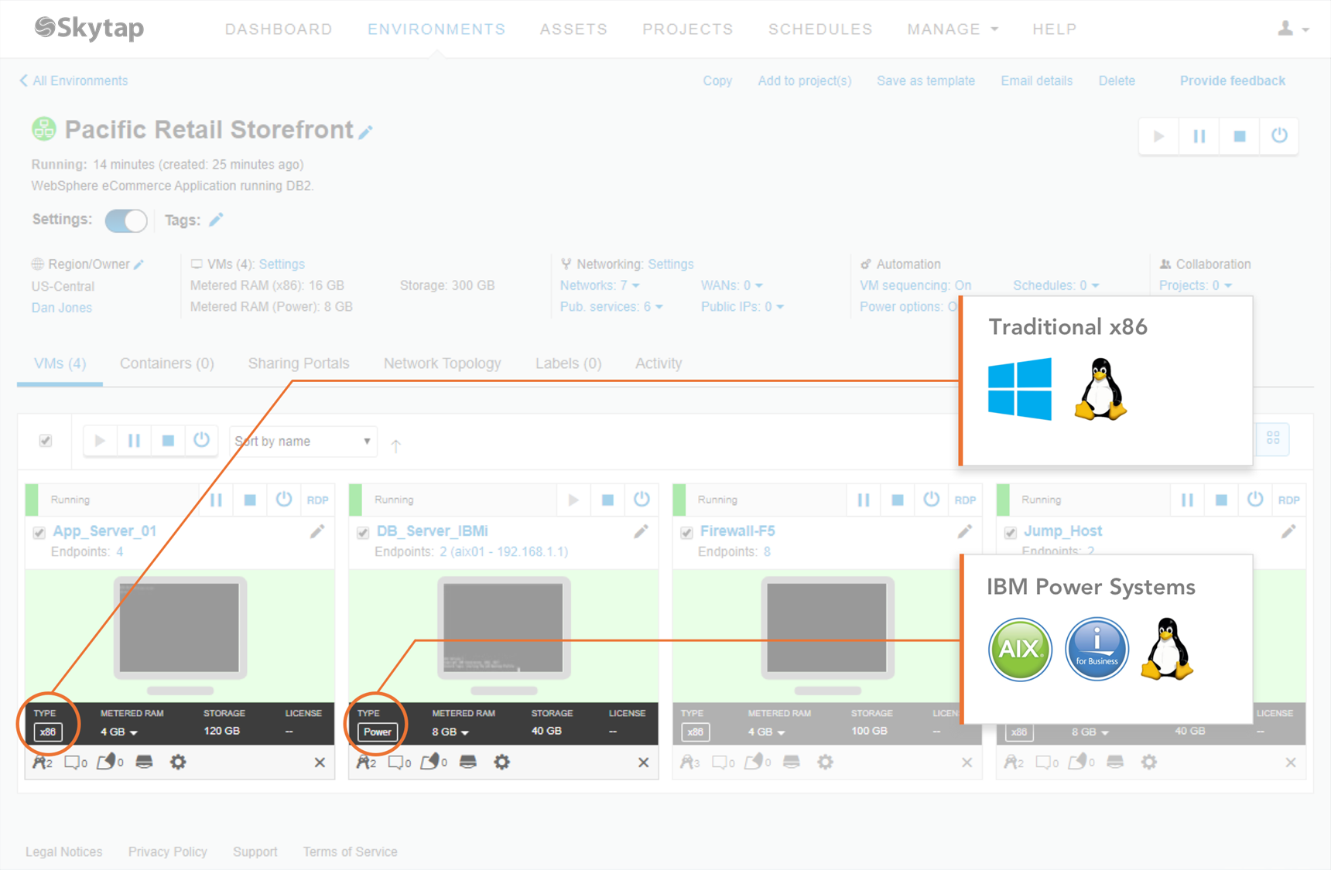
Skytap on Azure solution overview
Designed to seamlessly run IBM Power and x86 enterprise applications on Azure
Supports workloads running AIX, IBM i and Enterprise Linux on IBM Power Systems, together with traditional x86 systems
Enables businesses to accelerate their journey to Azure and increase innovation

Slide 4
Benefits
Compatibility: Migrate and run IBM Power workloads natively in Azure without rearchitecting or re-platforming
Self-service: On-demand access to resources keeps users focused on productive activities
Extensibility: Rich APIs and low latency access to Azure services extend the value of traditional applications
Agility: Full-stack application environments accelerate software delivery, creating more time for innovation

Slide 5
Customer use cases
Dev/test: Increase developer productivity, test coverage, and accelerate DevOps adoption through on-demand application environments
Production: Run production AIX, IBM I, Linux and x86 solutions with 99.95% availability and secure connectivity to on-premises applications
Disaster recovery: Run cold, warm, or hot disaster recovery environments to meet business continuity requirements
Hands-on labs: Educate and train customers and sales teams with on-demand virtual training labs

Slide 6
Solution Set overview Business stability with apps running on the cloud infra
Migrate AIX, IBM i, and Linux applications unchanged
Enable agile development
Rehost applications in Skytap on Azure
without rearchitecting or rewriting
Migrate Power components alongside
x86/Windows components
Choose from multiple migration paths
Provision resources in seconds with self-service
Access production-ready environments
Eliminate configuration drift with cloneable environments that are identical down to MAX and ID addresses
Streamline end-to-end testing with blended environments running on multiple architectures
Automate Skytap functionality with RESTful APIs

Slide 7
Solution Set overview Business stability with apps running on the cloud infra
Secure connectivity with ExpressRoute
Prioritize HA/DR
Securely route traffic between Azure VMs and Skytap VMs/LPARs
Extend and connect your on-premises data center to workloads running in Skytap on Azure
Infrastructure SLA of 99.95% with higher availability attainable when combined with 3rd party HA/DR solutions and redundant application architecture designs
Support for IBM PowerHA, HelpSystems RobotHA, Syncsort Mimix, IBM i BRMS combined with IBM Cloud Storage Solutions for IBM i, and more

Slide 8
Solution Set overview Business stability with apps running on the cloud infra
Maintain visibility and control
Maximize your investment dollars
Create and manage application environment templates that can be self-provisioned, cloned, and shared
Set role-based access permissions and granular quota management
Supports popular IBM i operator functions like Active Boot Modes and Dedicated Service Tools (DST)
Manage IBM i using green screen, Access Client Solutions, or Navigator for i
Choose the right size for your workload and avoid unnecessary overprovisioning
Resize as needed
Mix and match pay-as-you-go and reserved capacity pricing models
Manage your spending for dynamic and always-on workloads with controls to prevent unplanned overages

Slide 9
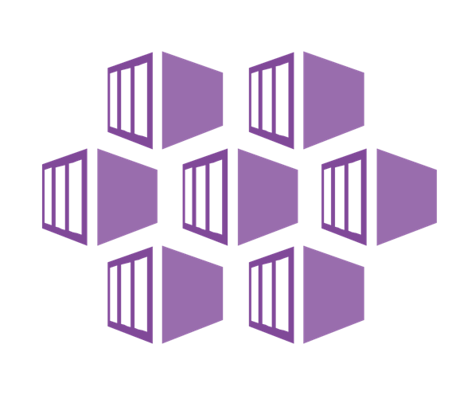
Network architecture
Azure
Azure subscription
Skytap on Azure
On-premises data center
Environments/templates
Admin/visibility/control
Data Plane (Compute/network/storage)
Azure Dedicated
ExpressRoute
MS Edge
Secure connectivity with ExpressRoute
Internet

Slide 10
Availability
Currently available in US East
Plan to expand to South Central US, Western Europe, and Southeast Asia
Available to transact at Azure Marketplace

Slide 11
Demo

Slide 12
Learn more
Find Skytap in the Azure Marketplace​
Visit https://www.skytap.com​
Contact us at https://www.skytap.com/contact-us/​

Slide 13
Thank you

