Slide 1
Azure VMware
Solution – End to End Networking
Amit Aneja
Senior Program Manager, Microsoft

Slide 2
Agenda
Azure Terminology
Azure VMware Solution (AVS) Network Connectivity
Networking in an AVS Software Defined Data Center (SDDC)
AVS Integration with Azure Services
Summary

Slide 3
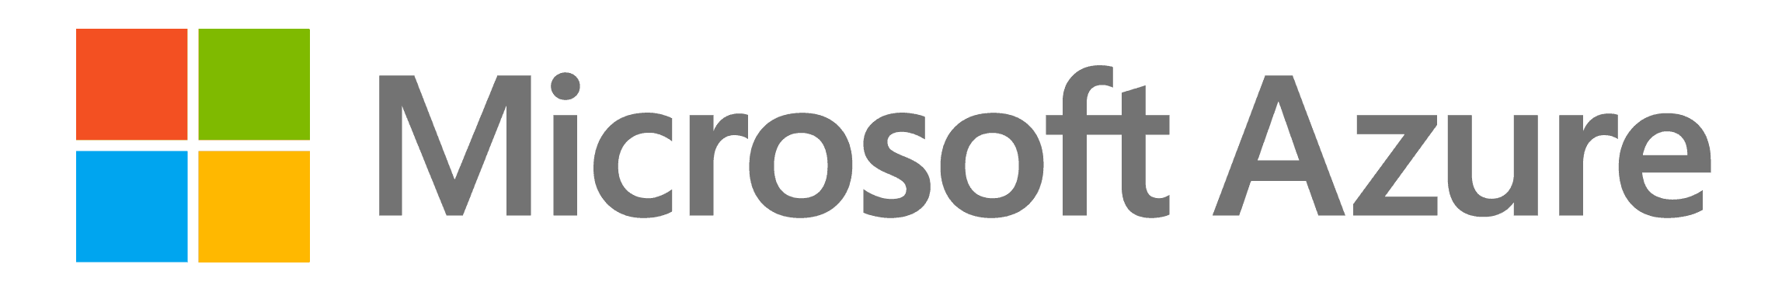
Azure VMware Solution (AVS) – What Is It?
      First party offering from Microsoft that enables you to bring your native VMware workloads to Azure
      AVS is a full VMware SDDC stack (ESXi, NSX, vSAN, HCX) running on top of bare metal dedicated azure infrastructure.
      Access to vSphere, HCX and NSX-T are enabled during the Private Cloud (SDDC) deployment process.
VMware SDDC
vCenter
HCX
NSX and HCX
ESXi
vSAN
NSX
ESXi
vSAN
Azure Bare-Metal Dedicated
Infrastructure
AVS Solution Overview
Session: What's New for Azure VMware Solution to Accelerate Migration and Simplify Management

Slide 4


Azure Terminology
Subscription
A subscription is an agreement with Microsoft to use one or more Microsoft cloud platforms or services
Virtual Network (VNET)
Fundamental building block for your private network in Azure
ExpressRoute
Private connections between Azure datacenters and infrastructure on your premises or in a colocation environment
Microsoft Enterprise Edge (MSEE)
Two routers in an Active/Active highly available configuration. These routers enable a connectivity provider to connect their circuits directly to their datacenter
Virtual Network Gateways – VPN or ER
Connects Azure virtual network and on-premises network via VPN
Connects Azure virtual network and on-premises network via ExpressRoute
Customer Edge Router
Express Route
Microsoft Enterprise
Edge (MSEE)
Azure Subscription(s)
Azure VNET
10.1.1.0/24

Slide 5
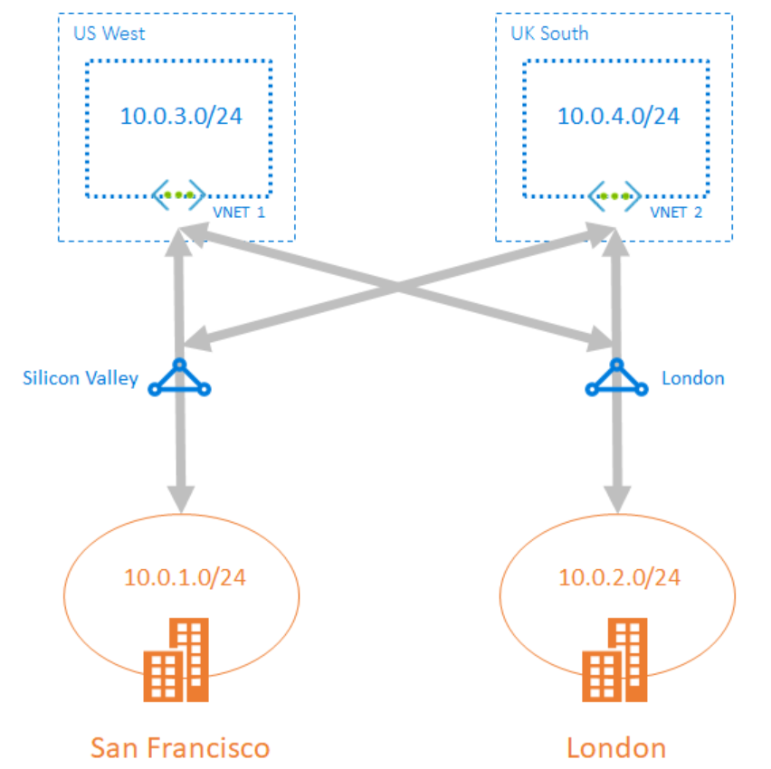
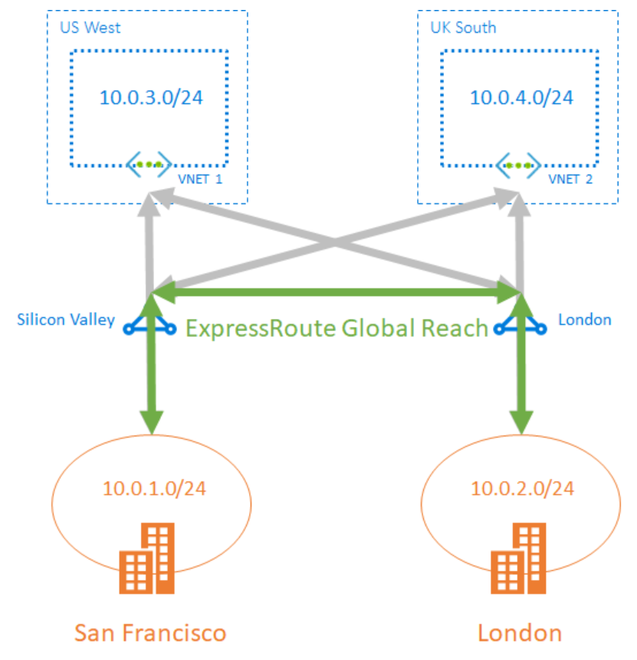
Azure Terminology
Global Reach
Link ExpressRoute circuits together to:
Create a private network between your on-premises networks. GR connection established between the ExpressRoute circuits you own.
Connect your on-premises environment to your AVS private clouds.
Without Global Reach
With Global Reach Enabled

Slide 6
Azure VMware Solution (AVS) Network Connectivity

Slide 7
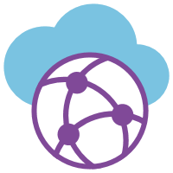

Azure VMware Solution – Connectivity
The ExpressRoute between AVS
D-MSEE and MSEE is part of the AVS service providing backbone connectivity to/from Azure Dedicated
vCenter
Storage
Network
ESXi
Customer Edge Router
Customer Datacenter
ExpressRoute
ExpressRoute
Dedicated Microsoft Enterprise Edge (D-MSEE)
Azure Subscription(s)
Microsoft Enterprise
Edge (MSEE)
vCenter
HCX
NSX
ESXi
vSAN
AVS
Azure VNET
Azure Bare-Metal Dedicated
Infrastructure
Azure Services

Slide 8
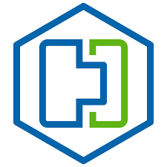
Azure VMware Solution – On-Prem to SDDC
Customer On-Premises to AVS packet flow
vCenter
HCX
Storage
Network
ESXi
Customer Edge Router
Customer Datacenter
ExpressRoute
ExpressRoute
Global Reach
Dedicated Microsoft Enterprise Edge (D-MSEE)
Azure Subscription(s)
Microsoft Enterprise
Edge (MSEE)
vCenter
HCX
NSX
ESXi
vSAN
AVS
Azure VNET
Azure Bare-Metal Dedicated
Infrastructure
Azure Services

Slide 9
Azure VMware Solution – VNET to AVS connectivity (Global Reach or ERG)
vCenter
Storage
Network
ESXi
Customer Edge Router
Customer Datacenter
ExpressRoute
ExpressRoute
Global Reach
Dedicated Microsoft Enterprise Edge (D-MSEE)
Azure Subscription(s)
Microsoft Enterprise
Edge (MSEE)
vCenter
HCX
NSX
ESXi
vSAN
AVS
Azure VNET
Azure Bare-Metal Dedicated
Infrastructure
Azure Services

Slide 10
Azure VMware Solution – VPN Connectivity
Supported for pre-ExpressRoute Testing only (HCX is not supported over VPN)
vCenter
Storage
Network
ESXi
Customer Edge Router
Customer Datacenter
Dedicated Microsoft Enterprise Edge (D-MSEE)
vCenter
HCX
NSX
ESXi
vSAN
AVS
Azure VNET
Azure Bare-Metal Dedicated
Infrastructure
VWAN Hub
Azure Services

Slide 11
Networking in an AVS SDDC
(Software Defined Data Center)
Notes:
So, we have covered AVS underlay connecticity and how to connect to an AVS SDDC. Let’s now look at that AVS SDDC and focus on the networking within an AVS SDDC.

Slide 12
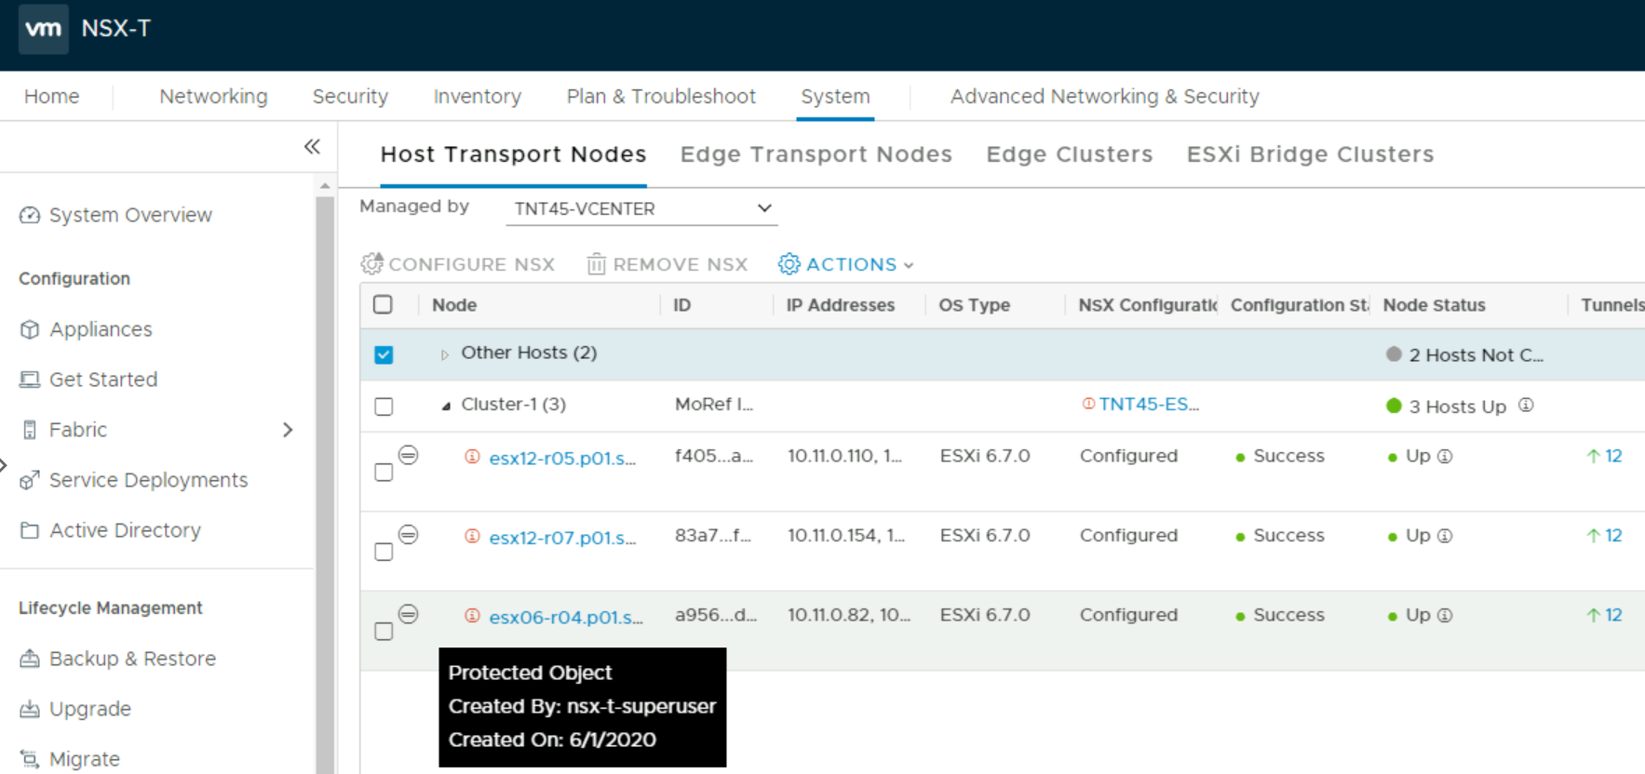
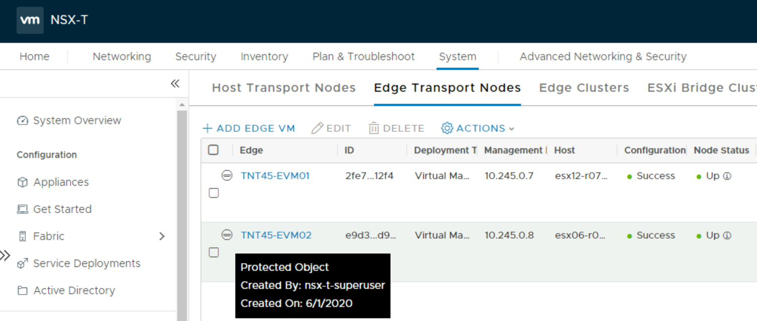
Networking in AVS SDDC
Default Deployment by AVS Control Plane
  NSX-T is the default networking stack in AVS2.0
  NSX-T Manager/Controllers installed, integrated with vCenter
  NSX-T Transport nodes (Host/Edges) ready for consumption
  Clear separation of control between AVS control plane and an AVS tenant admin
  AVS Control plane objects protected via principal identity
ESXi Host

Slide 13
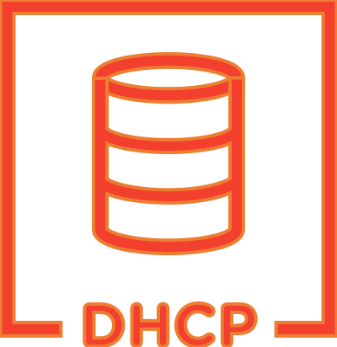
Networking in AVS SDDC
Microsoft Dedicated Enterprise
Edge routers (D-MSEE)
Logical Configuration
AVS
Underlay
  Logical Configuration
  (Pre-provisioned by AVS Control Plane)
  Tier-0 Gateway configured in Active/Active Mode for ECMP
  Northbound connectivity through BGP on Tier-0 Gateway
  Pre-provisioned Tier-1 for workload segments connectivity
  Route Advertisement enabled on pre-provisioned Tier-1 Gateway
  Route redistribution enabled on Tier-0 Gateway
  Default Internet Access for SDDC workloads with an option to enable/disable
  What can you do?
  Create overlay segments (Logical switches) and connect workloads
  Deploy additional Tier-1 Gateways
  Deploy Distributed Services like DFW
  Deploy Stateful services (Load Balancer, Gateway Firewall, DHCP, DNS, etc.) on Tier-1 Gateway
Protected via
Principal Identity
AVS
BGP
Tier-0
(Active/Active)
Tier-1
(Active/Standby)
NSX-T
Web Segment
App Segment
ESXi Host

Slide 14
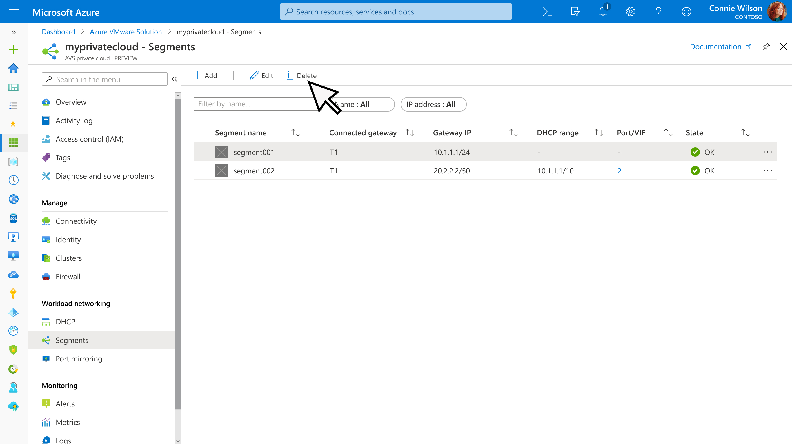
Networking in AVS SDDC
Simplified NSX-T Experience (Preview)
Goals
Simplify NSX-T consumption for VI admins
Provide basic workload networking configuration via Azure Portal
Functionality
Provided through Azure Portal
Segments (Logical Switch)
DHCP
DNS
Port Mirroring

Slide 15
Networking in a hybrid cloud environment – Putting it together
NSX-T in both on-premises and AVS SDDC
Customer
Edge Router
Microsoft Dedicated Enterprise
Edge routers (D-MSEE)
Express Route
On-Premises
WAN infra
AVS
Underlay
On-Premises NSX-T
Top of Rack
Switches
AVS
HCX
BGP
Tier-0
Tier-0
(Active/Active)
1. Site Pairing
Tier-1
Tier-1
(Active/Standby)
2. Hybridity
NSX-T
3. Cold/Bulk Migration or use L2 Extension
NSX-T
Web Segment
App Segment
Web Segment
App Segment
ESXi Host
ESXi Host

Slide 16
Networking in a hybrid cloud environment – Putting it together
VDS on-premises and NSX-T in AVS SDDC
Customer
Edge Router
Microsoft Dedicated Enterprise
Edge routers (D-MSEE)
Express Route
AVS
Underlay
HCX
AVS
On-Premises VDS Deployment
On-Premises
WAN infra
BGP
Tier-0
(Active/Active)
Top of Rack
Switches
1. Site Pairing
Tier-1
(Active/Standby)
2. Hybridity
VDS
3. Cold/Bulk Migration or use L2 Extension
NSX-T
Web DVPG
L2E-Web Segment
ESXi Host
ESXi Host

Slide 17
AVS Integration with
Azure Services

Slide 18
AVS Integration with Azure Services
Integration with Azure App Gateway
Azure App Gateway
Microsoft Dedicated Enterprise
Edge routers (D-MSEE)
Express Route
Frontend Public IP
Backend Pool members in AVS
AVS
Underlay
AVS
Azure VNET
Tier-0
Tier-1
NSX-T
Web Segment
Web1
Web2
Web3
10.1.1.10
10.1.1.20
10.1.1.30
ESXi Host

Slide 19
Summary
Hybrid cloud Connectivity over Express Route (VPN –POC only) to AVS
On-premise networking stack can be VDS or NSX-T
VMware NSX-T is the default networking stack in an AVS SDDC
Full access to NSX-T services (DHCP, DNS, Firewall, Load Balancer, etc.) in an AVS SDDC
Built-in security for AVS using native NSX-T security features and integration with NGFW
Integration with Azure native services for your workloads in an AVS SDDC

Slide 20
Thank you.

