Slide 1

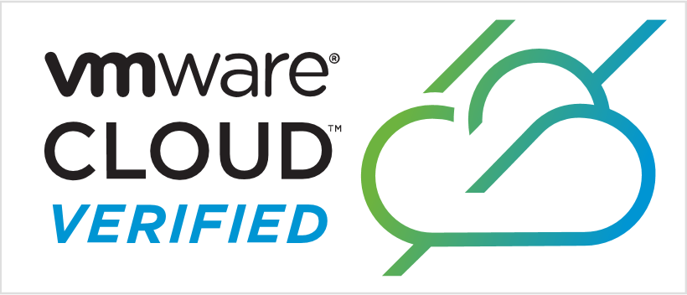
Azure VMware Solution
Azure VMware Solution – Run VMware Natively in Azure
Sai Chaitanya, Principal Program Manager, Microsoft

Slide 2
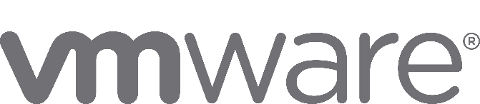
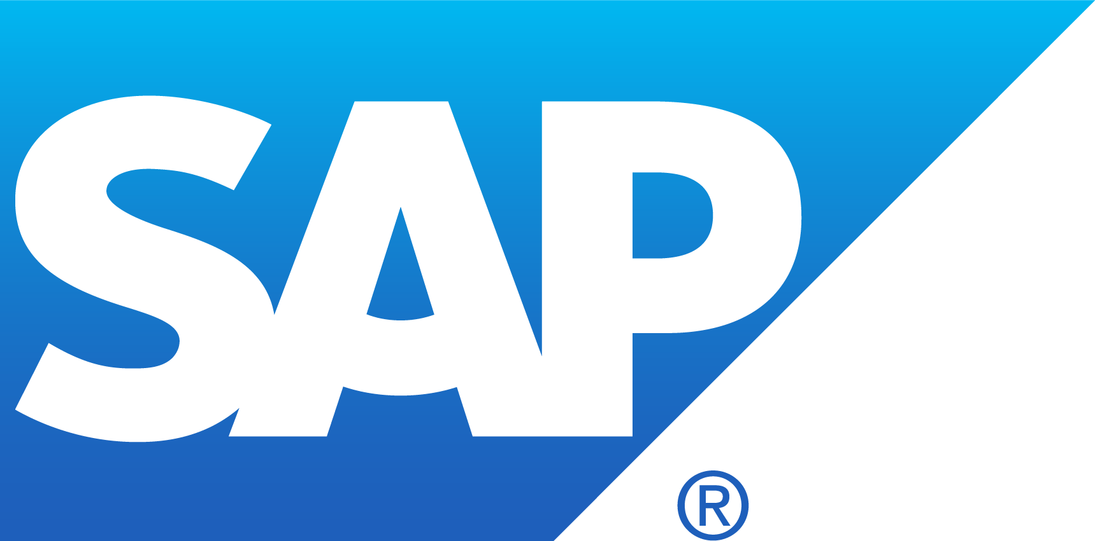

Microsoft Azure - Infrastructure designed for every workloads
Purpose Built
a
Business and Mission Critical
c
Dynamic and Scalable
Modern Apps
Management | Security + Identity | Networking

Slide 3
Azure VMware Solution
      It is a comprehensive VMware environment on dedicated Azure infrastructure. Built by Microsoft.
      It runs your VMware workloads natively on Azure, supported and operated by Microsoft.
      It allows you to manage, and secure applications across VMware environments and Microsoft Azure with a consistent operating framework.
Microsoft Azure
On-Premises VMware vSphere stack
Notes:
Speaker: Ram
Azure VMware Solution delivers a comprehensive VMware environment in Azure allowing customers to run native VMware workloads on Azure.
You can now seamlessly run, manage, and secure applications across VMware environments and Microsoft Azure with a common operating framework. You will be able to capitalize on your existing VMware investments, skills, and tools, including VMware vSphere, vSAN, and vCenter while leveraging the scale, performance and innovation of Azure.
VMware workloads on Azure can easily be modernized through integration with Azure services such as Azure Active Directory, Azure AI, and Analytics enabling new, intelligent experiences.
Seamless Azure experience:
Single portal interface on Azure with no connection to third party service. Take advantage of a consistent Azure experience and continual improvements.
Unified VM management:
Single pane of glass to manage vSphere-based and Azure native VMs, with uniform identities, access control and monitoring
Azure native integration:
Connect to Azure services endpoints. For example leverage Azure Active Directory as VMware vCenter SSO identity source.
Single Point of Support:
Azure VMware Solution is Microsoft developed operated and supported. Microsoft is first and only contact and coordinates support with VMware as required.
Unified licensing and consumption:
Avoid unnecessary complexity and take confidence in managing a single vendor for licensing and resource consumption.
Azure Hybrid Use Benefits :
Maximize the value of existing Windows Server and SQL Server licenses. Save up to 80% with AHUB and Azure Reserved Instances.
Bring Windows Server 2008 and 2008 R2 workloads to Azure and get 3 years of Extended Security Updates at no charge, only upgrading to current version when ready
Simplify migration to Azure with HCX Enterprise features; Replication Assisted vMotion (RAV), Traffic Engineering, Mobility optimized networking, and Mobility groups
Get the latest features of vSphere 6.7 included with the VMware Cloud Foundation stack for Azure VMware Solution. Gain consistency with on-premises vSphere management.
Run on trusted and reliable dedicated hosts. Achieve higher infra performance vs some competitors that use commodity hardware.

Slide 4

Top Customer AVS Scenarios
Datacenter footprint expansion, reduction, or retirement
Disaster recovery
& business continuity
Application Enhancement
modernization
Notes:
Through our experience with customers so far, these three areas are the typical scenarios we see customers addressing with Azure VMware Solutions
Each solution offers unique capabilities; however, in general terms the more popular customer scenarios include:
Datacenter / VMware Infrastructure footprint reduction and retirement, consolidation – Organizations will be able to reduce the datacenter footprint via “one-time re-deployment” of VMware-based virtual machines while decreasing their overall on-premises infrastructure. As part of that they will be able to ‘lift and shift’ vSphere-based workloads to Azure in a non-disruptive, automated, scalable, highly available fashion without changing the underlying vSphere hypervisor.
Datacenter bursting and hybrid cloud – For those organizations looking to seamlessly expand or augment for short periods of time their data center capacity on-demand by relying on the elasticity and flexible payment plans that the public cloud can offer.
Disaster recovery and business continuity – The VMware stack deployed in Azure can be used as a primary or secondary on-demand disaster recovery site for on-premises data center infrastructure.
Application modernization – Application developers will be able to tap into Azure’s ecosystem and modernize their applications without the need to refactor their existing VMware-based workloads.
Note: if customer is looking for DaaS/VDI solutions redirect to Microsoft, Horizon

Slide 5
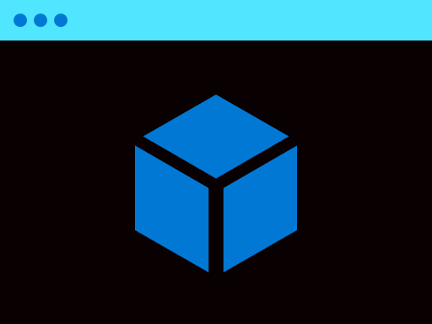


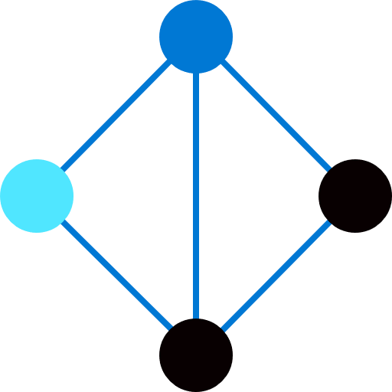




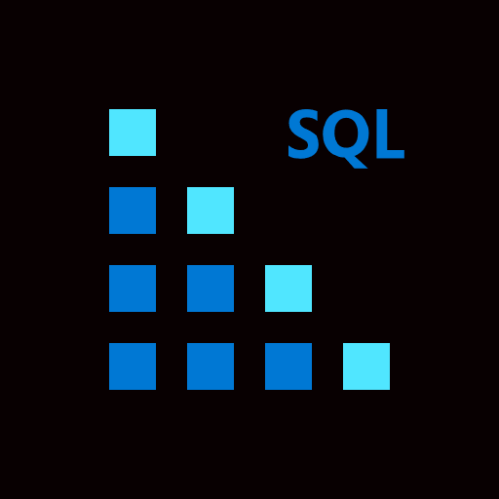



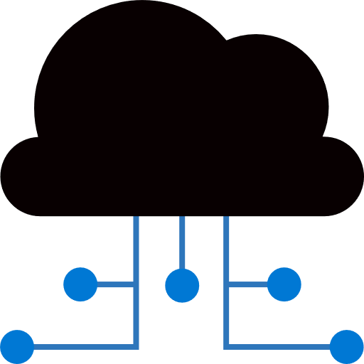



Key features
  Microsoft first party Azure service, cloud certified by VMware
  Seamless Azure experience, native integration
Azure Hybrid Benefit for Windows and SQL server
Free extend security updates for Windows Server 2008
  Single Point of Support
  Latest VMware technology updates
  HCX Enterprise Edition available
  High performance Dedicated hosts
  Unified licensing and consumption
Simplified NSX Interface
Microsoft Azure
Azure
Services
VMware Environment
vSphere and vCenter
NSX and HCX
ESXi
vSAN
HCX
NSX
ESXi
vSAN
Azure Dedicated
Certified Infrastructure
On-Premises VMware vSphere stack
Notes:
Azure VMware Solutions deliver a comprehensive VMware environment in Azure allowing customers to run native VMware workloads on Azure.
You can now seamlessly run, manage, and secure applications across VMware environments and Microsoft Azure with a common operating framework. You will be able to capitalize on your existing VMware investments, skills, and tools, including VMware vSphere, vSAN, and vCenter while leveraging the scale, performance and innovation of Azure.
VMware workloads on Azure can easily be modernized through integration with Azure services such as Azure Active Directory, Azure AI, and Analytics enabling new, intelligent experiences.
Seamless Azure experience:
Single portal interface on Azure with no connection to third party service. Take advantage of a consistent Azure experience and continual improvements.
Unified VM management:
Single pane of glass to manage vSphere-based and Azure native VMs, with uniform identities, access control and monitoring
Azure native integration:
Connect to Azure services endpoints. For example leverage Azure Active Directory as VMware vCenter SSO identity source.
Single Point of Support:
Azure VMware Solution is Microsoft developed operated and supported. Microsoft is first and only contact and coordinates support with VMware as required.
Unified licensing and consumption:
Avoid unnecessary complexity and take confidence in managing a single vendor for licensing and resource consumption.
Azure Hybrid Use Benefits :
Maximize the value of existing Windows Server and SQL Server licenses. Save up to 80% with AHUB and Azure Reserved Instances.
Bring Windows Server 2008 and 2008 R2 workloads to Azure and get 3 years of Extended Security Updates at no charge, only upgrading to current version when ready
Simplify migration to Azure with HCX Enterprise features; Replication Assisted vMotion (RAV), Traffic Engineering, Mobility optimized networking, and Mobility groups
Get the latest features of vSphere 6.7 included with the VMware Cloud Foundation stack for Azure VMware Solution. Gain consistency with on-premises vSphere management.
Run on trusted and reliable dedicated hosts. Achieve higher infra performance vs some competitors that use commodity hardware.

Slide 6

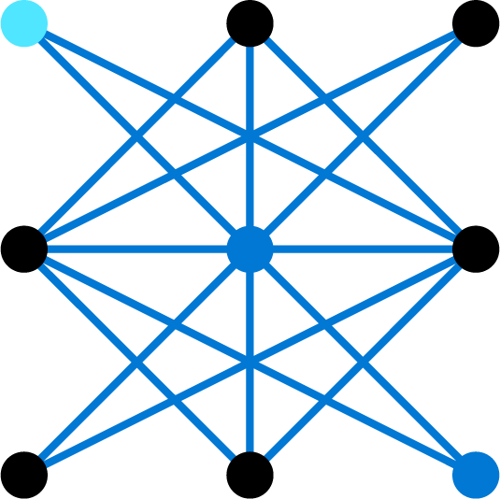
Azure VMware Solution – Run VMware natively on Azure
Microsoft Azure
Azure Portal and Azure Resource Manager
On Premises Datacenter
Azure Private Cloud Infra
Azure Services (e.g.)
VMware Technology Stack
VMware Cloud Foundation
VMware vCenter
vCenter
vSAN
Azure Active Directory
Azure Monitor
VM
VM
VM
NSX-T
vSphere
HCX
Azure Backbone Network.
ESXi Hosts
Compute
Azure Security
Azure SQL Database
Storage
Network
VNet.
ExpressRoute
VNet.
Artificial Intelligence
Azure Lab Services

Slide 7
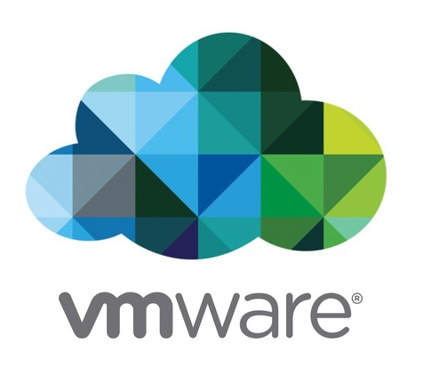

Azure VMware Solution Software and Hardware Package
Software Specifications
Hardware Specifications
ESXi 6.7U3 Enterprise Plus
vCenter 6.7U3 Standard
vSAN 6.7 Enterprise
NSX-T 2.5 Advanced
HCX R139 Advanced
*HCX Enterprise Now Available
Model – AV36 (36 cores)
CPU- Intel Xeon Gold 6140 2.3 GHz
Memory - 576 GB
Storage vSAN Caching - 2 × 1.6 TB NVMe
Storage vSAN Capacity - 8 × 1.92 TB SSD
Network - 2 × Mellanox ConnectX- 2 Lx Dual Port 25 GbE
Hourly PAYG billing monthly currently
1year or 3 year Reserved Instance
Requires min 3 nodes, single nodes added as required
HCX Enterprise is available as a monthly add-on
Notes:
Azure VMware Solutions deliver a comprehensive VMware environment in Azure allowing customers to run native VMware workloads on Azure.
You can now seamlessly run, manage, and secure applications across VMware environments and Microsoft Azure with a common operating framework. You will be able to capitalize on your existing VMware investments, skills, and tools, including VMware vSphere, vSAN, and vCenter while leveraging the scale, performance and innovation of Azure.
VMware workloads on Azure can easily be modernized through integration with Azure services such as Azure Active Directory, Azure AI, and Analytics enabling new, intelligent experiences.
Seamless Azure experience:
Single portal interface on Azure with no connection to third party service. Take advantage of a consistent Azure experience and continual improvements.
Unified VM management:
Single pane of glass to manage vSphere-based and Azure native VMs, with uniform identities, access control and monitoring
Azure native integration:
Connect to Azure services endpoints. For example leverage Azure Active Directory as VMware vCenter SSO identity source.
Single Point of Support:
Azure VMware Solution is Microsoft developed operated and supported. Microsoft is first and only contact and coordinates support with VMware as required.
Unified licensing and consumption:
Avoid unnecessary complexity and take confidence in managing a single vendor for licensing and resource consumption.
Azure Hybrid Use Benefits :
Maximize the value of existing Windows Server and SQL Server licenses. Save up to 80% with AHUB and Azure Reserved Instances.
Bring Windows Server 2008 and 2008 R2 workloads to Azure and get 3 years of Extended Security Updates at no charge, only upgrading to current version when ready
Simplify migration to Azure with HCX Enterprise features; Replication Assisted vMotion (RAV), Traffic Engineering, Mobility optimized networking, and Mobility groups
Get the latest features of vSphere 6.7 included with the VMware Cloud Foundation stack for Azure VMware Solution. Gain consistency with on-premises vSphere management.
Run on trusted and reliable dedicated hosts. Achieve higher infra performance vs some competitors that use commodity hardware.

Slide 8
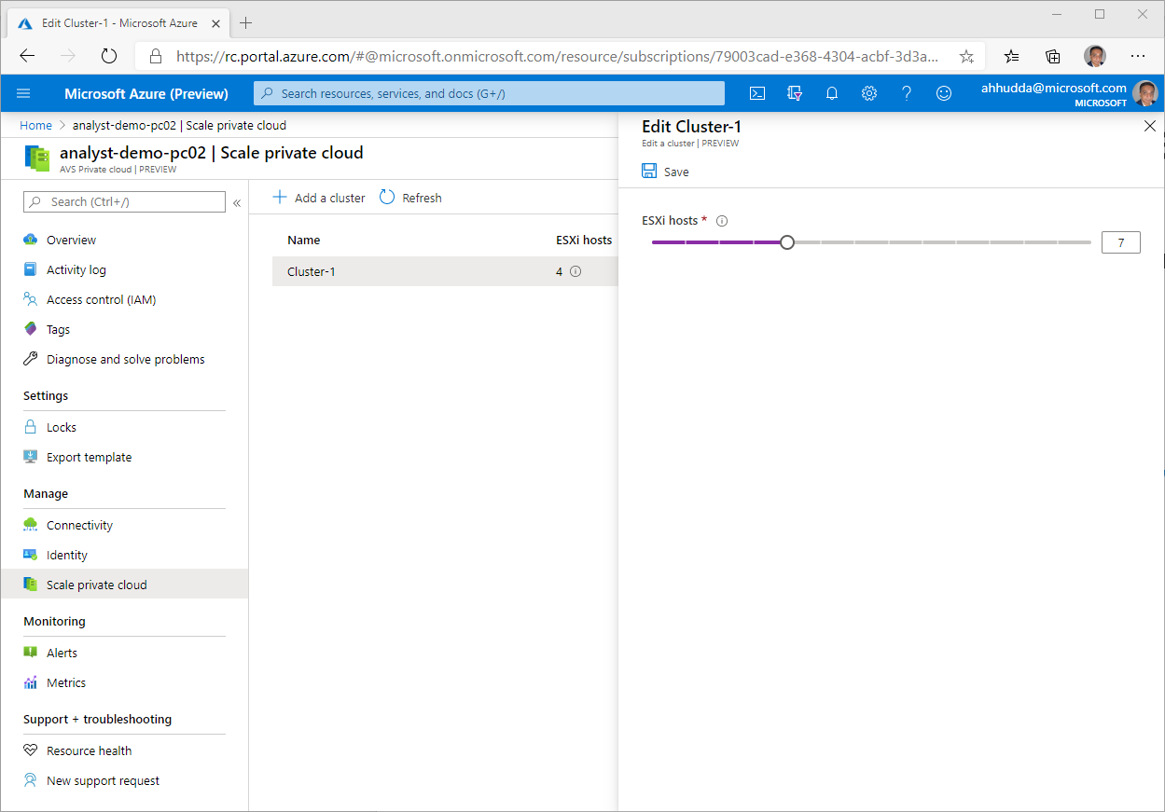
Seamless management for Azure infrastructure resources
Easily scale infrastructure as your business needs it through the Azure Portal.
Add new nodes as required to increase compute and storage during peak times. And delete nodes seasonally when infrastructure demands are lower.
Add and delete new clusters as required:
Min 3 nodes per cluster
Max 16 nodes in a vSphere cluster
Max 64 nodes to an Azure Private Cloud instance

Slide 9
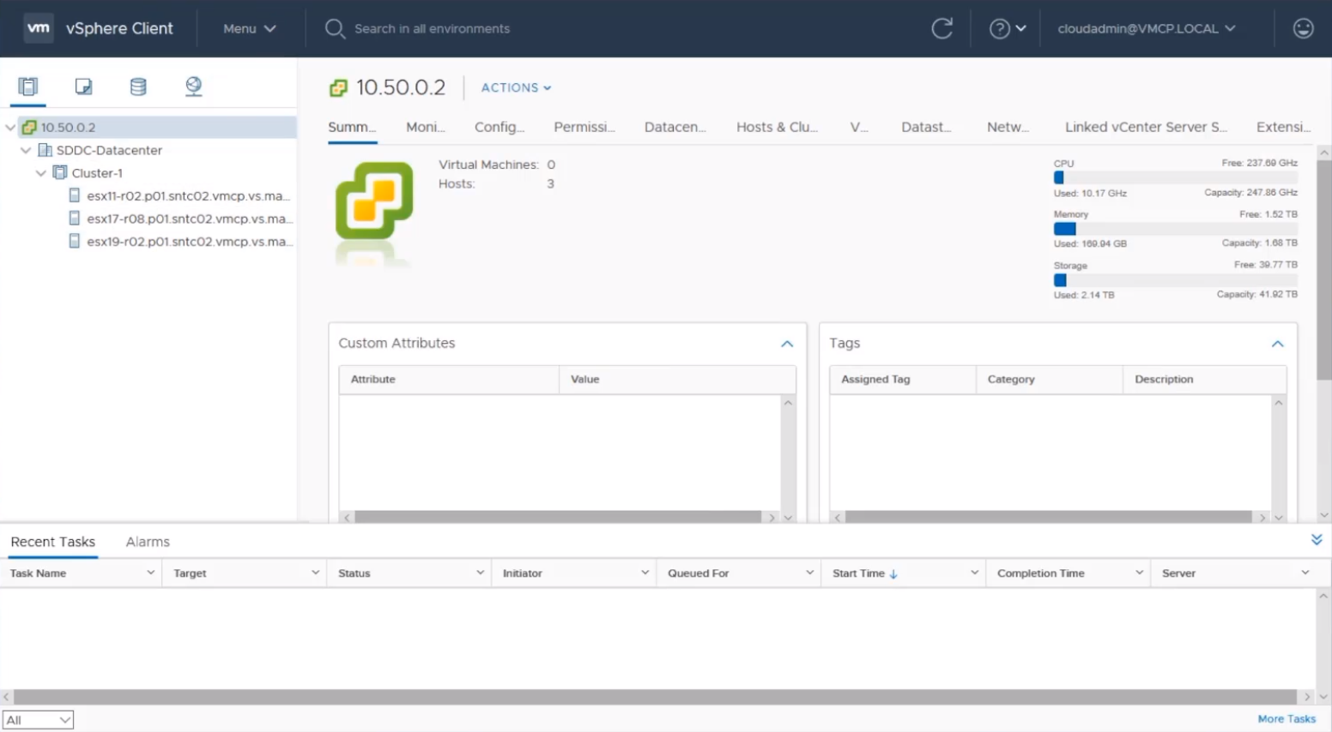
Familiar and consistent VMware tools and technology
Create operational consistency for admins as you continue to use VMware for resources running on Azure infrastructure including vSphere Client and NSX-T Manager.
Access to vSphere, HCX and NSX-T are enabled during the Private Cloud deployment process. Credentials registered in Azure connect to the private cluster hosts.

Slide 10







Targeted Compliance Certifications at General Availability
Global, Regional, Industry and US Government certified compliance standards available at general availability
More underdevelopment and aligned to regional rollout of Azure VMware Solution
ISO
27001
ISO
27018
ISO
27017
ISO
22301
GDPR
Compliant
SOC 1
Type 2
SOC 2
Type 2
HIPAA
/HITECH Act
PCI DSS
Level 1
High
DOD-IL4

Slide 11
Application High Availability with AVS
Failure Mode | Protection Available?
Disk Failure Protection | ✅
Fan Failure Protection | ✅
NIC Failure Protection | ✅
Host Power Failure Protection | ✅
ESXi Host Failure Protection | ✅
VM Failure Protection | ✅
Switch Port Failure Protection | ✅
Switch Failure Protection | ✅
Rack Failure Protection | ✅
Datacenter Failure Protection | ✅
Regional Failure Protection | ✅
Modern well managed Azure Infrastructure designed for end-to-end High Availability
No single Point of failure, built in redundancy
Robust infrastructure you can have trust and confidence in

Slide 12



Microsoft support – single point of contact
  Azure VMware Solution is validated, supported, and certified by VMware and Microsoft.
  Built with VMware, delivered by Microsoft
  VMware cloud verified
Problem Management
    Microsoft is first contact and will make decision based on problem type.
    Azure-related issues are addressed by Microsoft.
When VMware support is required
    Microsoft coordinates with VMware for product-specific support.
    Microsoft continues to be central point to resolution.

Slide 13
Compute and Storage

Slide 14


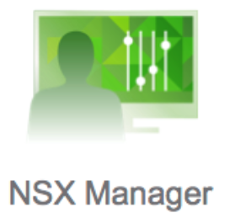
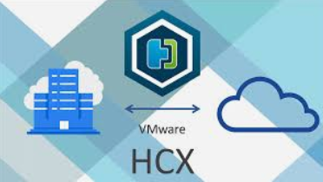
AVS admin
Azure VMware Solutions Overview
Admin manages Private Cloud using ARM and VMware tools
Enables an Azure admin to use ARM to provision and scale a VMware Private Cloud (PC)
Every PC has its own local vCenter, NSX-T and HCX Manager
PC can optionally be connected to Azure IaaS/PaaS and Data via an internal AVS managed Express Route
Support for multiple vSphere clusters per Private Cloud & scale up/down of a cluster
PC can optionally be connected to customer’s on-premise infrastructure via VPN or Global Reach
AVS manages Deployment, Monitoring, Repair, Upgrades, Billing and Compliance for the Private Cloud
Azure
Azure Resource Manager – Portal, CLI, Templates
AVS
IaaS, PaaS and Data
AVS Control Plane (RP)
VMW Private Cloud
VMware Management
vCenter
NSX Mgr.
HCX Mgr.
Express Route
VM
VM
ESX (Compute)
Cluster 1
Cluster n
BM1
BM2
BM3
BM4
BM5
BM6
vSAN (Storage)
NSX-T (Networking)
AVS Bare Metal Hardware

Slide 15
AVS Compute Overview
Software versions at AVS 2.0 GA – vCenter 6.7u3 and ESXi 6.7u3
Host Monitoring – hosts are continuously monitored for failures both at the infrastructure layer and vSphere layer.
Host Remediation – when failures are detected, hosts are automatically remediated i.e. new host/s are added into the cluster and failed hosts are taken out of the cluster for repair
  Manual Remediation – SRE driven
  Automated Host Remediation – fully automated process
  AEO Customer Notifications during remediation
Ability for the tenant to retrieve and rotate credentials on SDDC appliances
Customers can access vCenter, NSX-T Manager and HCX logs via Azure Monitor and Log Analytics integration
vRealize Operations for monitoring SDDC appliances. Two deployment options – vROPs on prem or vROPS on AVS

Slide 16
AVS Compute Overview
AVS SLA – 99.9% availability for
  “VMW Management VMs”
  “All VMW VMs”
  Customers required to maintain required configurations to qualify for AVS SLA – e.g. maintain free vSAN space, right vSAN policy
AVS Maintenance
  “AVS Control Plane” and “VMware SDDC” update triggers– major/minor releases and patch updates
  Cadence – quarter updates (patch and major/minor) initially. Monthly patch updates over time.
  Private Cloud Upgrade coordinated with customers pro-active SRs
  SLA regulations don’t apply during planned maintenance
Key Post GA Features
  Placement Policy – ability to define VM-Host affinity, VM-VM affinity and anti-affinity policy, disable DRS vMotion, ..
  Custom Core Counts – ability to define active CPUs on any node in the cluster
  Terraform based AVS operations – private cloud and cluster operations

Slide 17
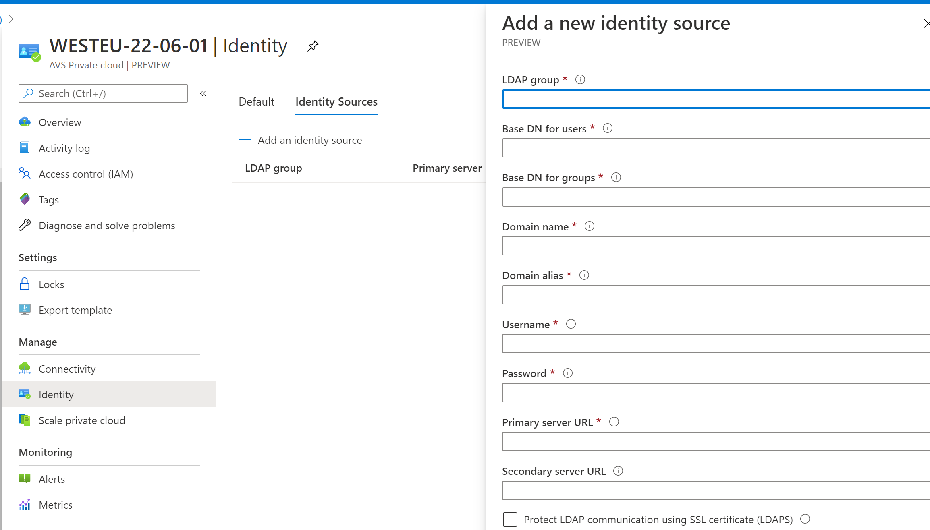
AVS vCenter IAM
3
No vCenter administrator access to AVS tenant admin
AVS implements custom vCenter role called “CloudAdmin” with permissions required for tenant operations
Ability to configure vCenter with remote Active Directory users and groups
Customer’s Active Directory could be running either on-prem, customer’s Azure vNET or on AVS
2
1

Slide 18
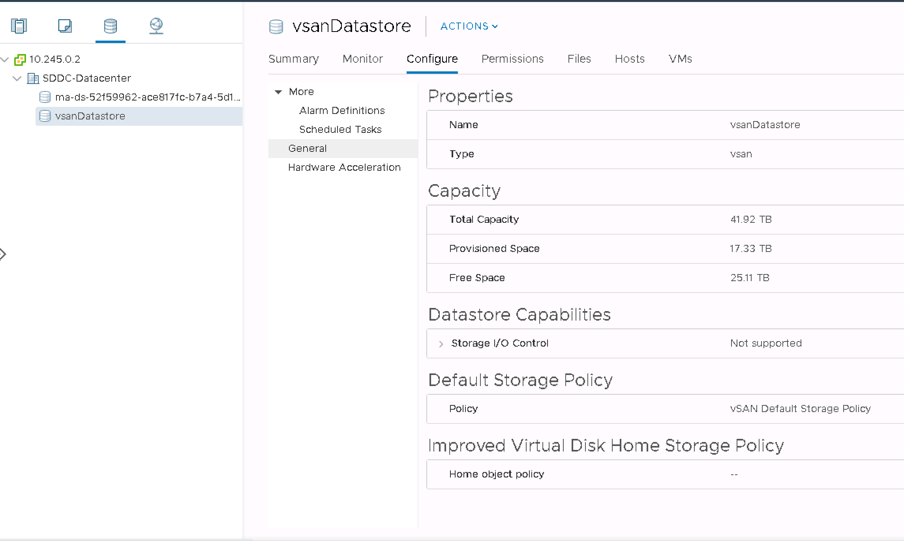
AVS vSAN Overview
"VMware vSAN" is the primary storage for AVS VMs
Based on Hyper Converged architecture – i.e. pools disks from all compute nodes to present a vSphere datastore
Two tiered architecture
  Cache Disks and Capacity Disks
  AVS uses 3.2-TB NVMe for Cache and 15.36 TB Raw for Capacity drives
Requires customers to always maintain 25% slack/free space on the cluster to qualify for SLA
vSAN Key Features
  Encryption – FIPS 140-2 validated native encryption
  De-duplication and Compression
  Storage Policy Management – Failures to Tolerate, Failure Tolerance Method, IOPS per object, ..
AVS enables encryption by default on all AVS clusters – provider managed encryption

Slide 19
Azure VMware Solution – Shared responsibility Matrix
Control boundaries
Physical Infrastructure | Physical Security | Azure/AVS Portal | Hardware Failures | ESXi Host | Host Patching | NSX-T | Identity Management | vCenter | VSAN | Guest OS | Applications | Virtual Machines
Deployment
Life-Cycle
Configuration
– Microsoft Responsibility
– Customer Responsibility

Slide 20
Migration

Slide 21
Using VMware HCX for Migration to Azure VMware Solution
Large scale bulk migration using HCX
Replication Assisted vMotion
Any vSphere to vSphere migration
vSphere version upgrade: vSphere 5.0+ to any current vSphere version
HCX for site pairing and DR
Parallel VM migration threads
No change in IP, no NAT
Secure proxy for vMotion and replication traffic
    vSphere 6.7
Microsoft Azure
Leveraging
HCX
    vSphere >5.0
VMware On-Premises

Slide 22
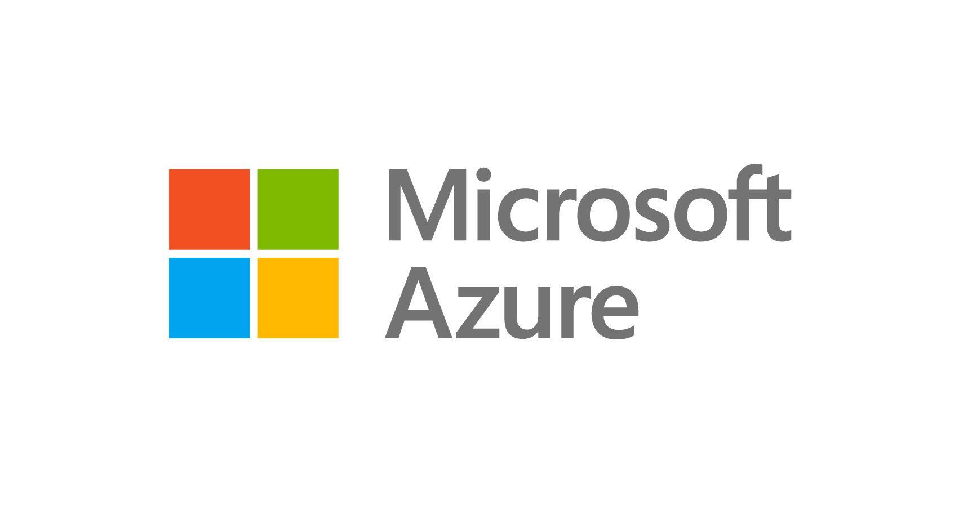

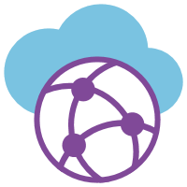

Azure VMware Solutions – Networking (Logical)
Customer
Edge Router
Customer Datacenter
Express Route
IPSec Tunnel between
HCX Appliances
Microsoft Enterprise
Edge routers (MSEE)
Microsoft Dedicated Enterprise
Edge routers (D-MSEE)
Leveraging VMware
Hybrid Cloud Exchange (HCX)
to extend layer 2
(use the same IP addresses)
Azure VNET
AVS Network
Azure Region

Slide 23
Networking

Slide 24
Key Networking Features
Advanced Networking Session
Session Name: Azure VMware Solution - End to End Networking
ExpressRoute based connectivity to Azure and On-Prem
      Global Reach used to connect On-Prem ER to AVS ER
      ExpressRoute Gateways for AVS to Azure Vnets
NSX-T only for SDDC Networking
    Simplified NSX-T interface for workload segments
Public to AVS
    Compatible with Azure Application Gateway for http/https traffic
    L4 Dnat for non-http(s) traffic
Site to Site Routed VPN support
    Built on Azure VWAN technology
    HCX over VPN enabled in limited mode only for POC’s/customer trials of AVS. No SLA from Microsoft or VMware for production use
    ExpressRoute is the only supported way to use HCX
Automated SDDC network connectivity
      SDDC creation to first Azure Vnet
      Future – Global reach to on-prem ER circuit(s)
      Future – Automated VPN VWAN deployment

Slide 25
Backup and Disaster Recovery

Slide 26

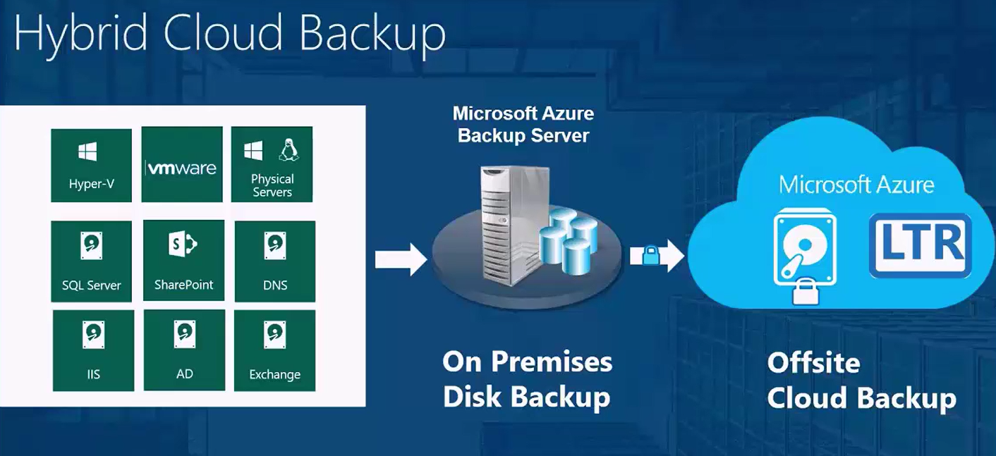
Microsoft Azure Backup Server (MABS)
Microsoft Azure Backup Server is included as a free download with Azure Backup that enables cloud and disk backups for production workloads like SQL server, SharePoint, and Exchange – irrespective of how they are hosted: on Hyper-V, VMware ESXi or on physical servers.
Notes:
As we started looking at native service integration for AVS, one of the first things we explored was backup. As you are aware, backup needs spread between local, short-term snapshot retention and longer-term off-site retention. Microsoft Azure Backup Server, which is included as a free download with Azure Backup Service, is the current in-house product that Microsoft offers for backing up on-premises VMware workloads into Azure.
MABS combined with the Azure Recovery Services Vault, can provide you a geo-redundant, longer-term, off-site storage for compliance purposes, and at the same time, address short-term-retention needs for restoring your data. It offers a cost-effective scalable solution for your backup needs, and we are now extending that functionality to AVS.

Slide 27
DR using HCX
Customer
Edge Router
Customer Datacenter
Express Route
IPSec Tunnel between
HCX Appliances
Microsoft Enterprise
Edge routers (MSEE)
Microsoft Dedicated Enterprise
Edge routers (D-MSEE)
Leveraging VMware HCX
for Disaster Recovery
Azure VNET
AVS Network
Azure Region
Notes:
The first one is to leverage HCX. As you are aware, AVS includes HCX advanced as a part of the offer. Once the HCX virtual appliance is deployed in your on-prem datacenter and in the corresponding “peer” AVS site, you should be in a position to use the replication-based protection that HCX advanced offers on a per-VM basis. However, if you need protection groups and runbooks to test, validate and automate your failovers and failbacks, you will need to upgrade HCX to HCX enterprise and bring your own SRM license. HCX enterprise with SRM takes advantage of the HCX interconnect and Network extension components for protection and recovery operations from the SRM interface.

Slide 28



Protect on-prem workloads with AVS, using SRM and vSphere Replication
VCSA
SRM-S
VRM-S
VRS
Customer
Edge Router
Azure Subscription(s)
Customer Datacenter
Express Route
Express Route
Using Global Reach
Dedicated Microsoft Enterprise
Edge routers (D-MSEE)
Microsoft Enterprise
Edge routers (MSEE)
Customer On-Premises to AVS replication with SRM and vSphere Replication
AVS Network
VCSA
SRM-S
VRM-S
VRS
Azure Region
Notes:
The other approach, which does not require you to upgrade to HCX Enterprise, is to use SRM with vSphere Replication. In this case, you bring your own SRM license to AVS, and we can assist you with the installation of SRM and vSphere replication on the AVS SDDC. Once you have the SRM server along with the vSphere Replication components deployed on both the sides, you can set up peering between the sites, and start replicating your protected workloads to AVS.

Slide 29
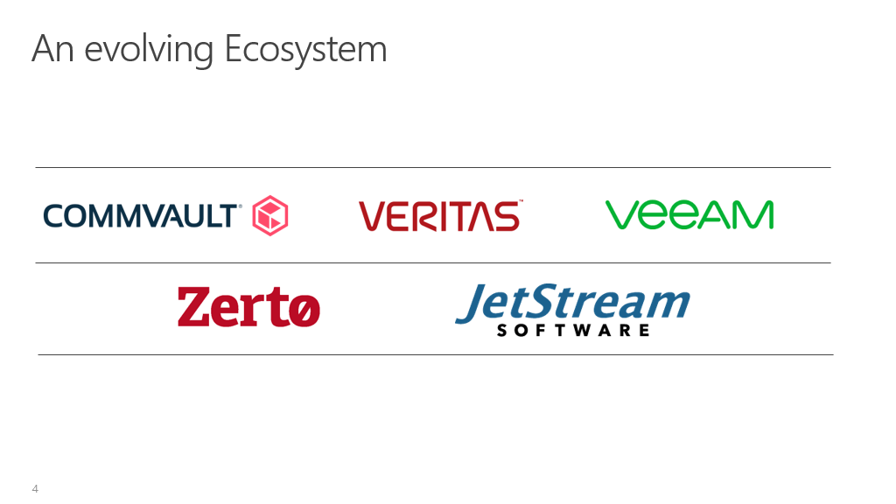


Slide 30
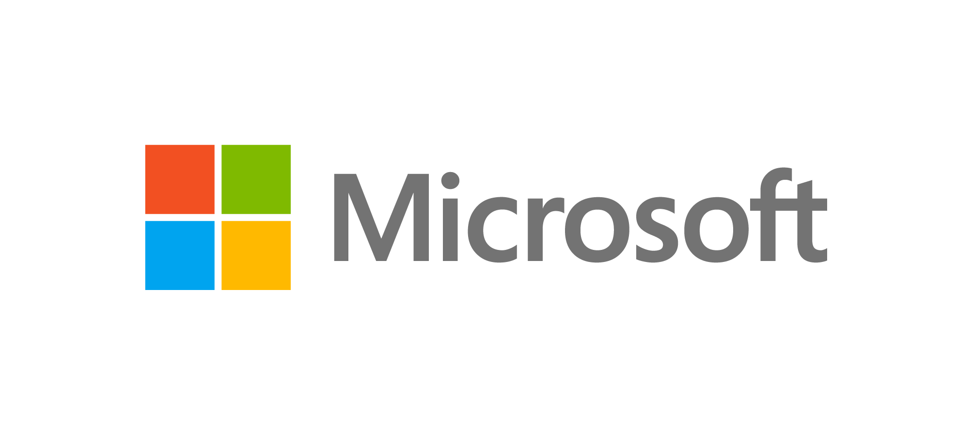

VMware Global Partner of the Year
for Technology Innovation
2020
Microsoft recognized for excellence and innovation applying VMware technologies to breakthrough solutions that deliver high levels of customer satisfaction.

Slide 31
Thank you.

