Slide 1
New admin capabilities to modernizing servicing of the Office client
Amesh Mansukhani | Principal Program Manager
@ameshm

Slide 2
Agenda
Our vision for Microsoft 365 Apps servicing
Intelligent insights & controls
Predictable cadence & servicing automation
Proactive app health & remediation

Slide 3
Challenges of staying up-to-date
41%+
of enterprise organizations have a difficult time keeping their Office client up-to-date within the first 30 days of a monthly release
Findings based on a Microsoft internal study

Slide 4
Benefits of staying up-to-date Achieve business and IT value with exclusive Office 365 features
Business benefits Get the latest productivity, security, and performance improvements
Higher user satisfaction from the latest productivity tools
Increased teamwork when users have the latest collaboration features
Less downtime and fewer productivity disruptions with incremental, gradual updates
Greater consistency across app and platforms, including PC, Mac, web and mobile
IT benefits Streamline updates and lower costs with modern cloud servicing and insights
Fast yet predicable update cadence through the Monthly Enterprise Channel, which is delivered as one automated, network-friendly package on a known schedule
Rapid feedback loop with Microsoft
Quick issue identification and resolution using proactive health monitoring
Efficient pilot validation process through servicing automation and safety-net controls

Slide 5
What we’ve heard
Enable enterprise to easily stay current
Reduce admin workload
Not require on-prem infrastructure

Slide 6
New wave of innovation to streamline Office servicing
Intelligent insights & controls
Predictable cadence & servicing automation
Proactive app health & remediation

Slide 7
Microsoft 365 Apps channels
Choosing the right update channel that best fits the needs of your organization
Current Channel
Monthly Enterprise Channel (new)
General-purpose devices, any type and size organization
Semi-Annual Enterprise Channel
General-purpose apps, large enterprises
Most current Office features, latest security value, and performance improvements as soon as they are ready
Specialized and business-critical
For customers who need the latest features on a predictable monthly cadence, additional tools and controls
All new features, security value, and performance improvements ship once a month
For select devices in an org where extensive testing is needed before rolling out new Office features (e.g., to comply with regulatory, governmental, or other org requirements)
Notes:
We recommend Current Channel. The newest Office features as soon as they are ready, paired with the latest Microsoft 365 capabilities.
If you need additional predictability, we recommend Monthly Enterprise Channel, with features every Patch Tuesday.
For select devices that require extensive testing before receiving new features, Semi-Annual Enterprise Channel remains available
Starting June 9th, new tenants will default to Current Channel for new self-service installations.
Applies to all Microsoft 365 Apps plans
Admin can change the channel to MEC or SAC
Updates delivered exactly once per month on Patch Tuesday after stabilizing in CC
Customers can rollback to LKG and snooze until next update while issues are addressed
110K devices since its launch on May

Slide 8
Intelligent insights & controls

Slide 9
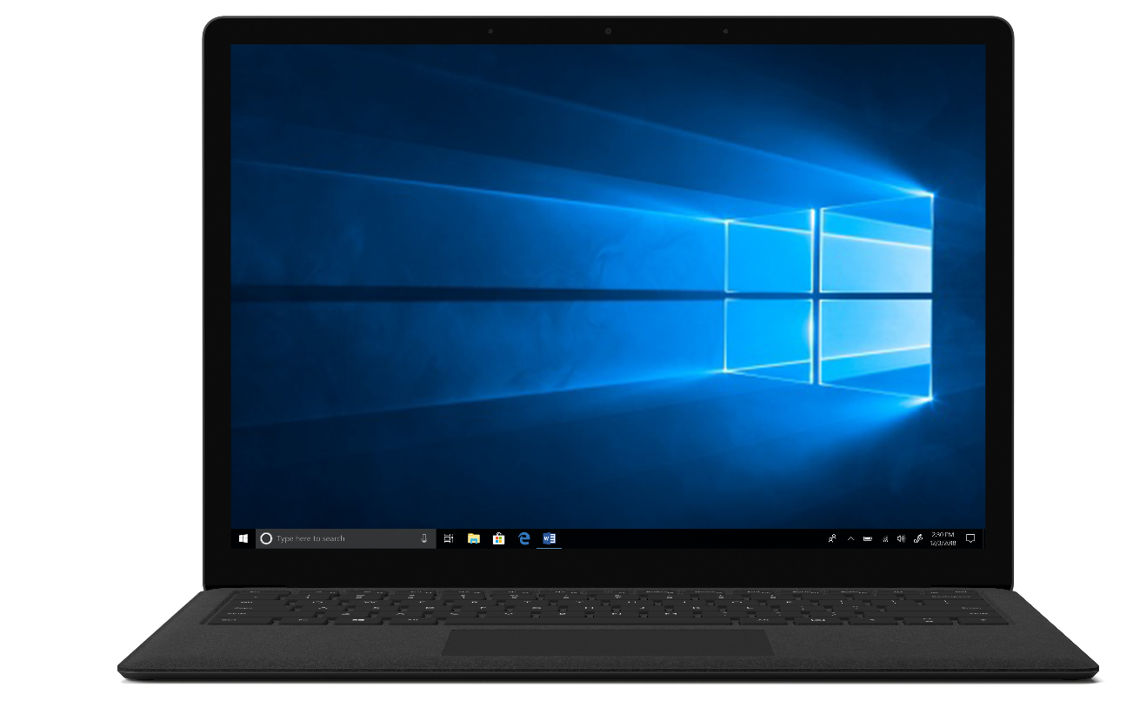
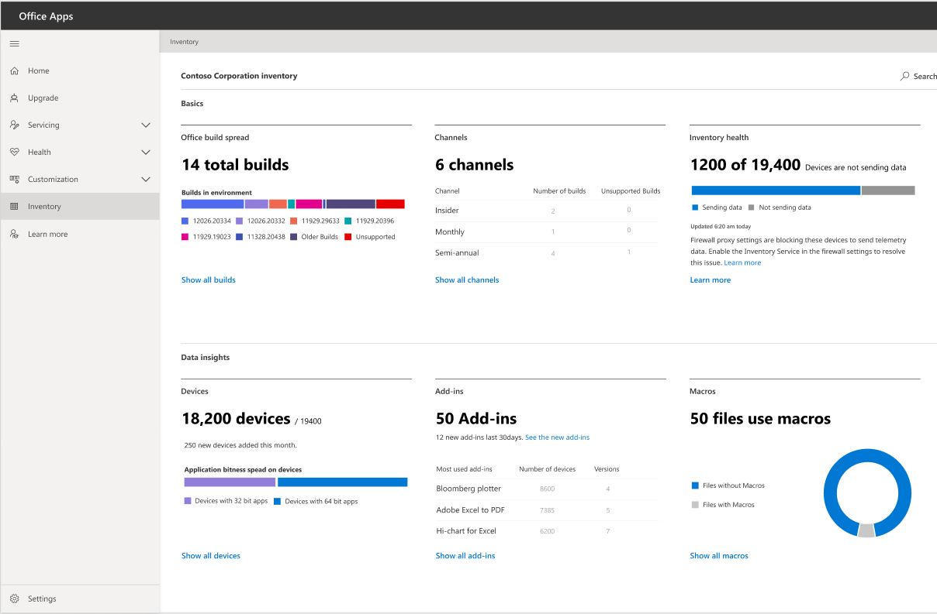
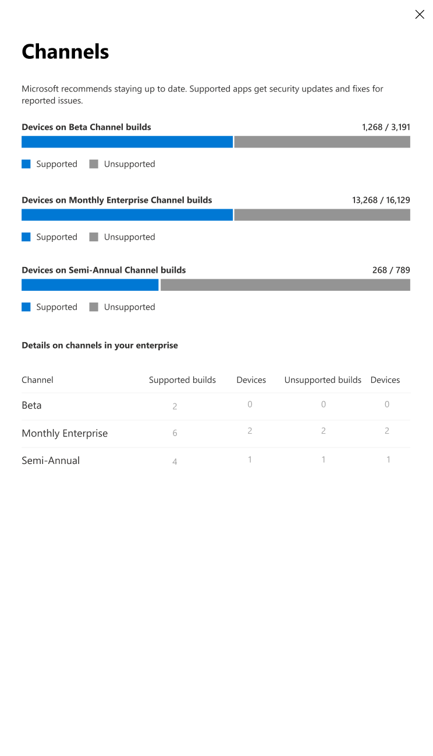
Office inventory
Drill into detailed views of Office devices and add-ins information
Insights like channel/build spread, add-in diversity and much more
Data is exportable for your own specific needs
Data is stored securely and compliantly
New insights refined over time

Slide 10
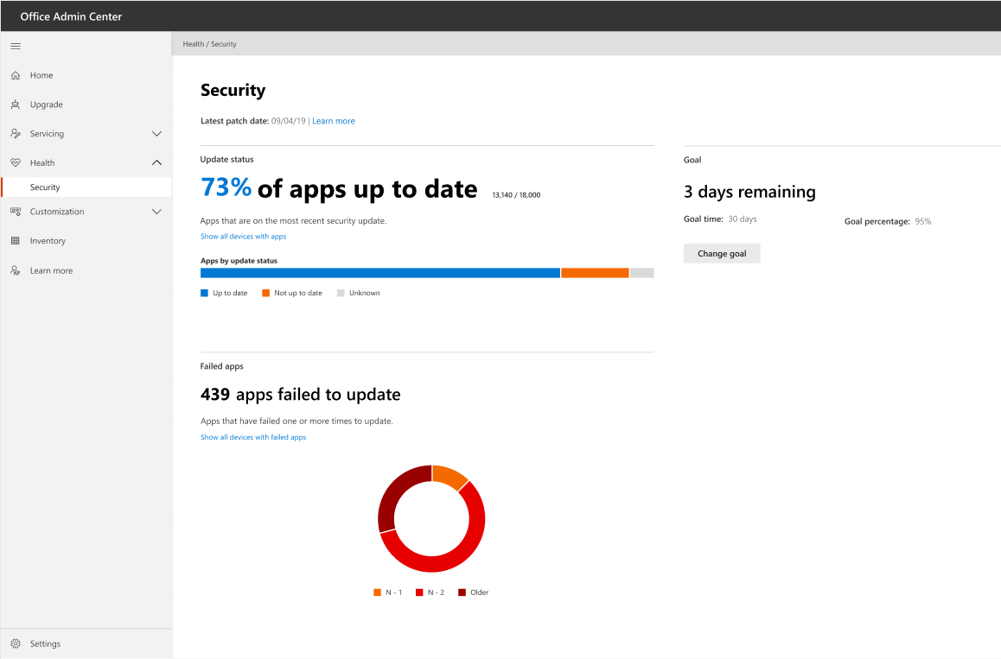
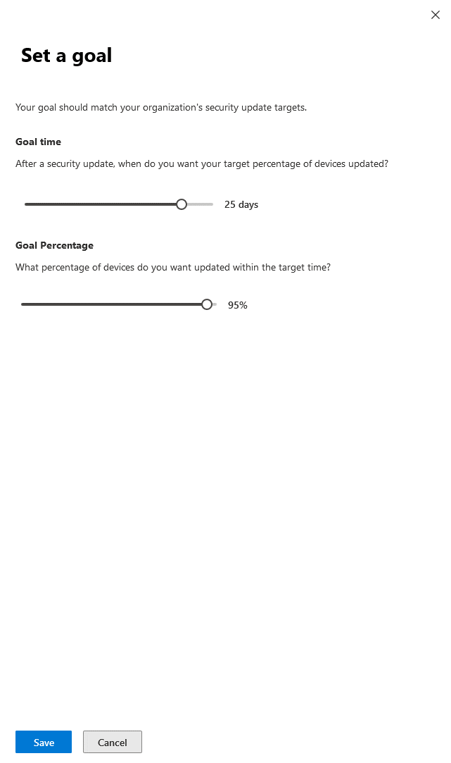
Security currency
Dashboard of your security update compliance status across channels
Set you target goal and timeline for your needs to track and report out on
See devices failing to take an update so you can action them

Slide 11
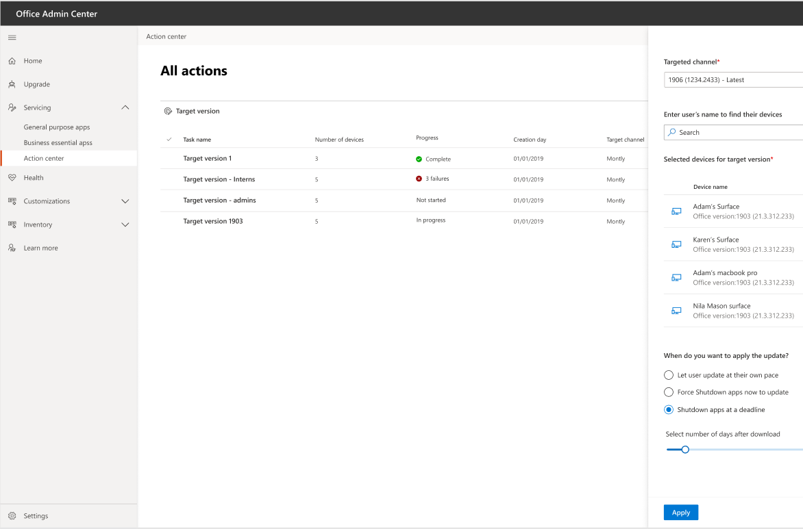
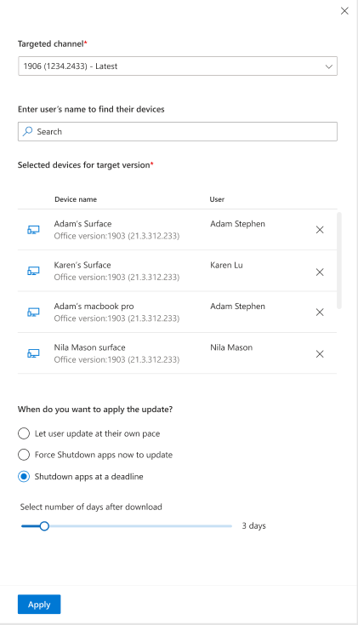
Target version
Change Channel easily by targeting a user or AAD Group
Update Version
Easy rollback or roll forward

Slide 12
Demo

Slide 13
Predictable cadence & servicing automation

Slide 14
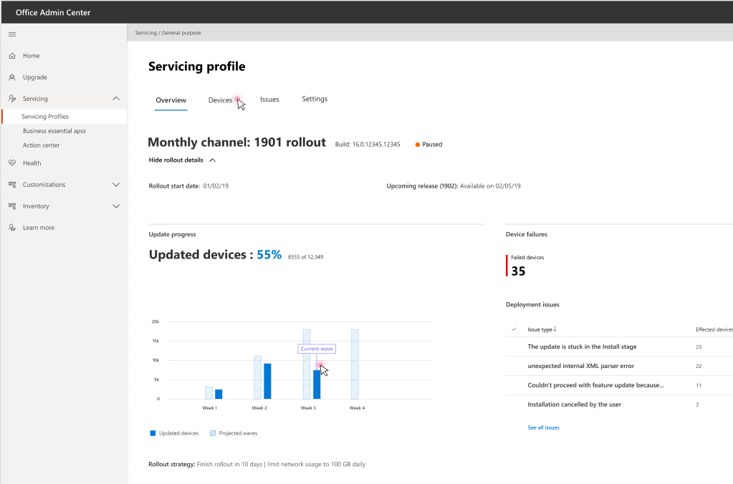
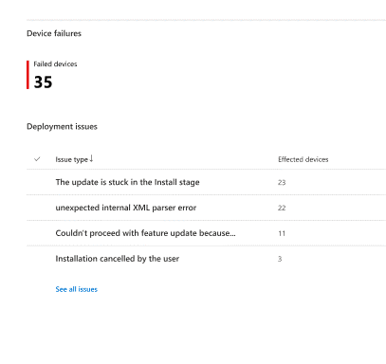
Introducing Office apps Servicing Profiles
Setup for devices to automatically delivery updates based on your IT’s needs
Throttle based on network congestion and by location
Takes advantage of Win10 DO
Take action using common requested tool to Pause, Restore & Snooze
Ensure high compliance with deadline and Update date exclusions

Slide 15
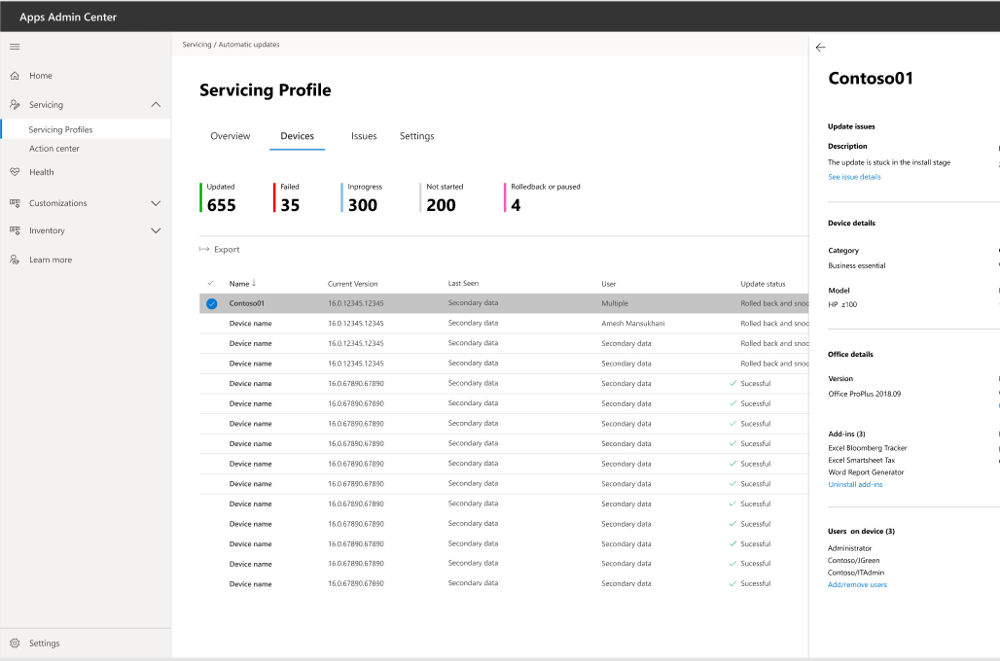
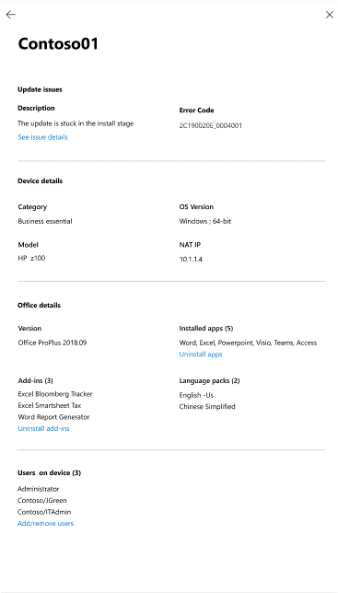
View and control Office apps
Export data for your specific needs
Take action using common requested tool
Pause/resume Office update
Restore to previous version
Snooze until fix is available

Slide 16
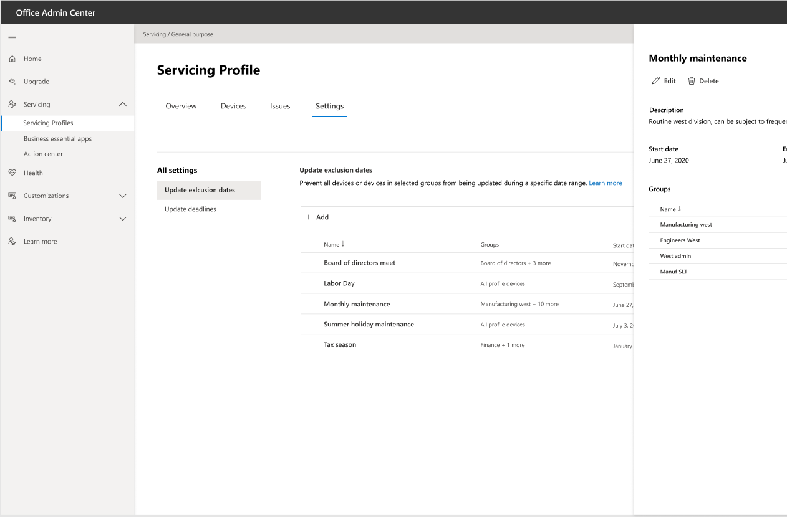
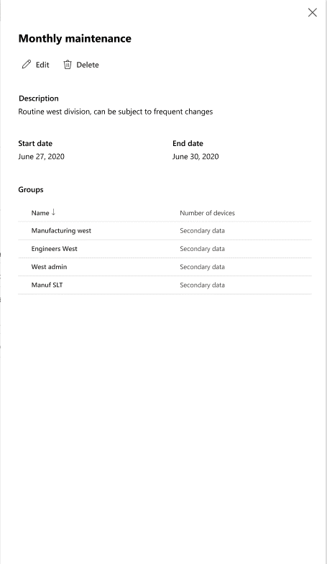
Control update behavior
[Auto]magically stop updates during known dates
Do it once or setup reoccurrence
Target Azure AD group or entire servicing profile

Slide 17
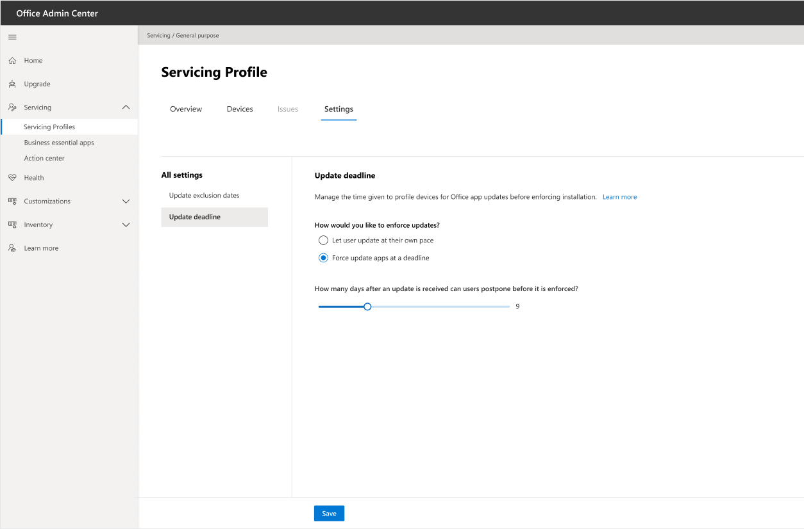
Ensure compliance
Enforce a rolling deadline
Leverages existing C2R experience

Slide 18
Demo

Slide 19
Proactive app health & remediation

Slide 20
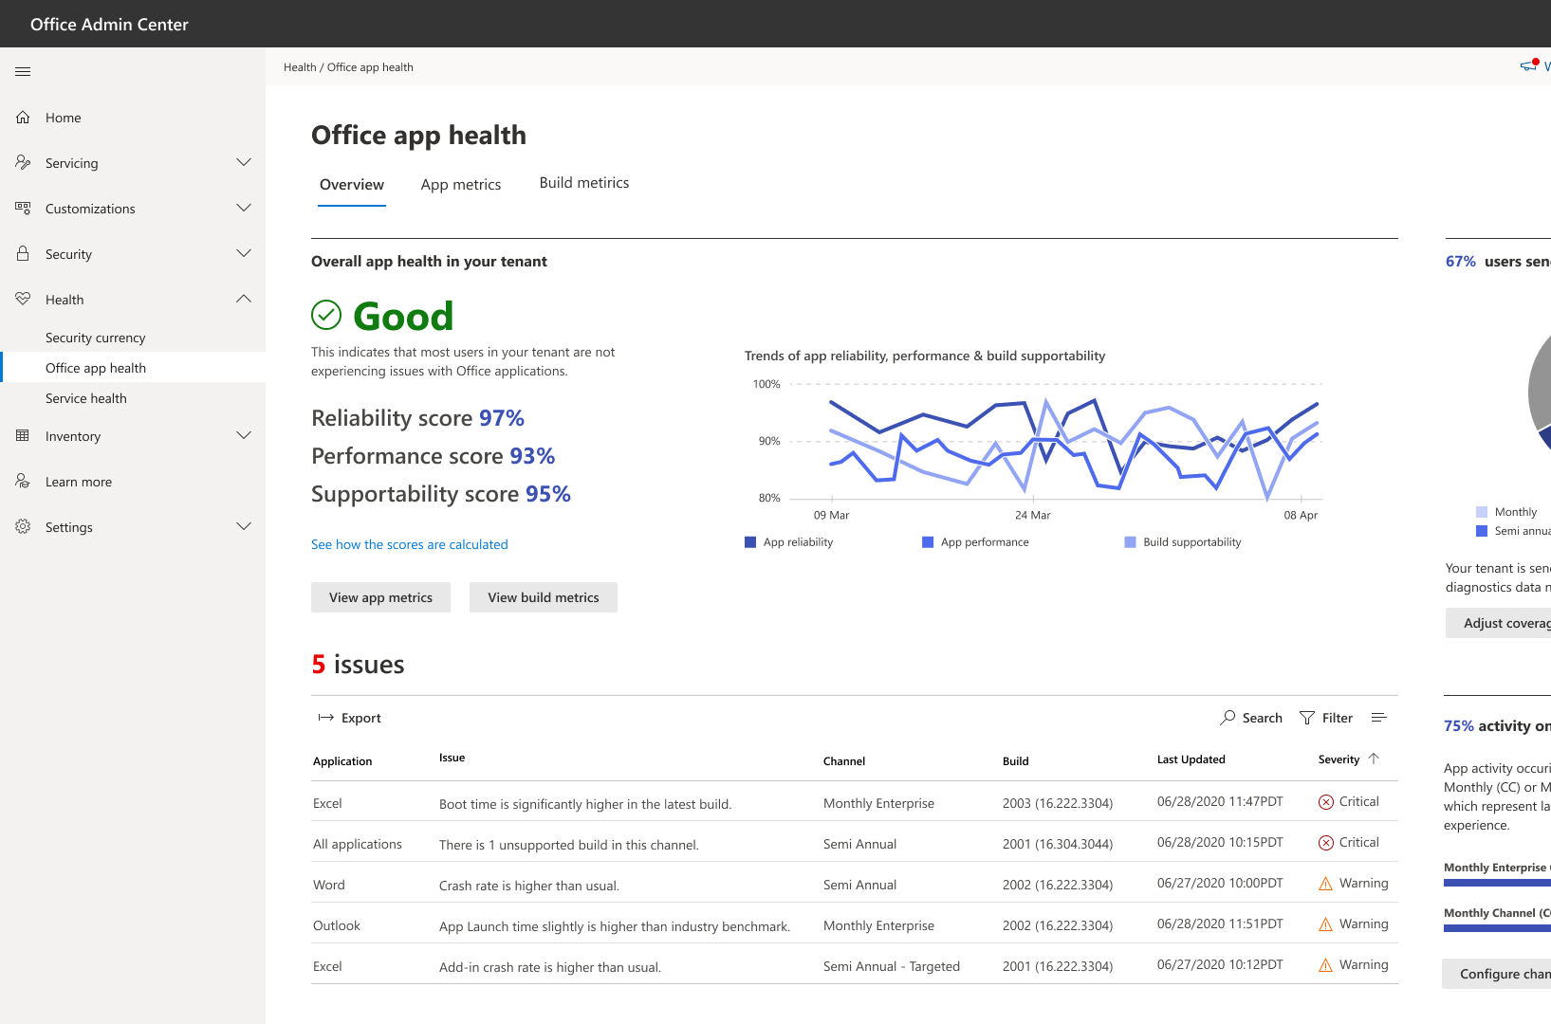
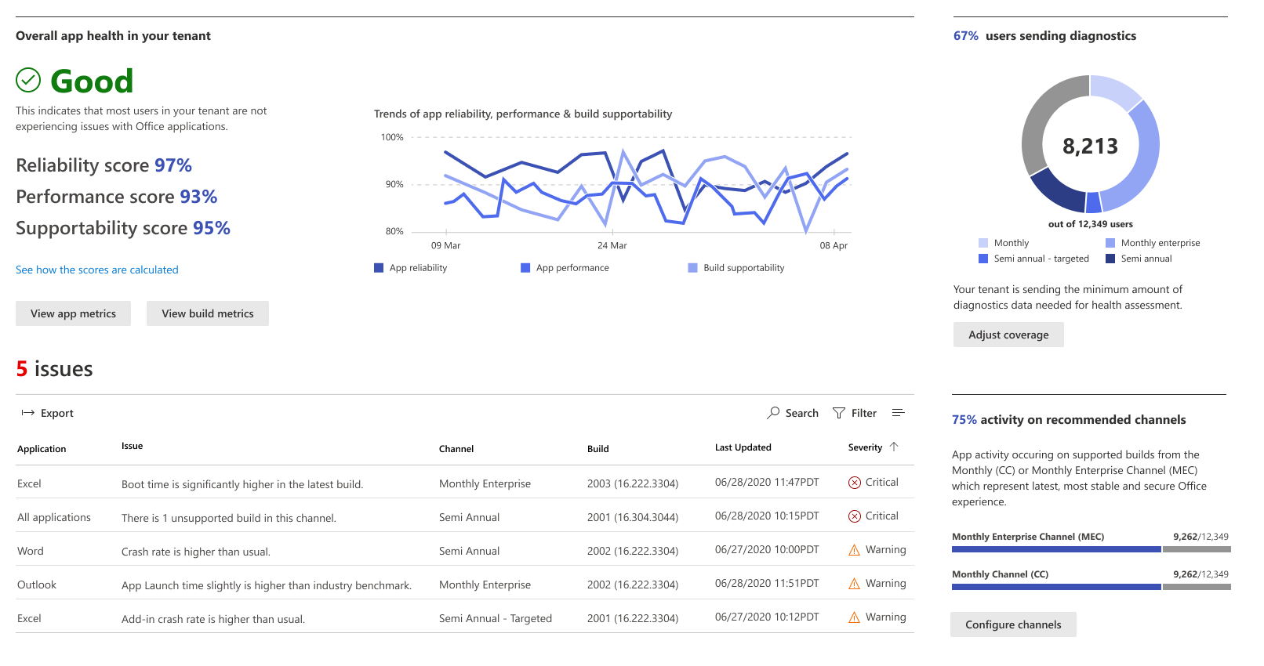
Insights and alerting
Tenant health overview and trends
Regressions of performance or reliability
Diagnostics data coverage
Activity in recommended channels

Slide 21
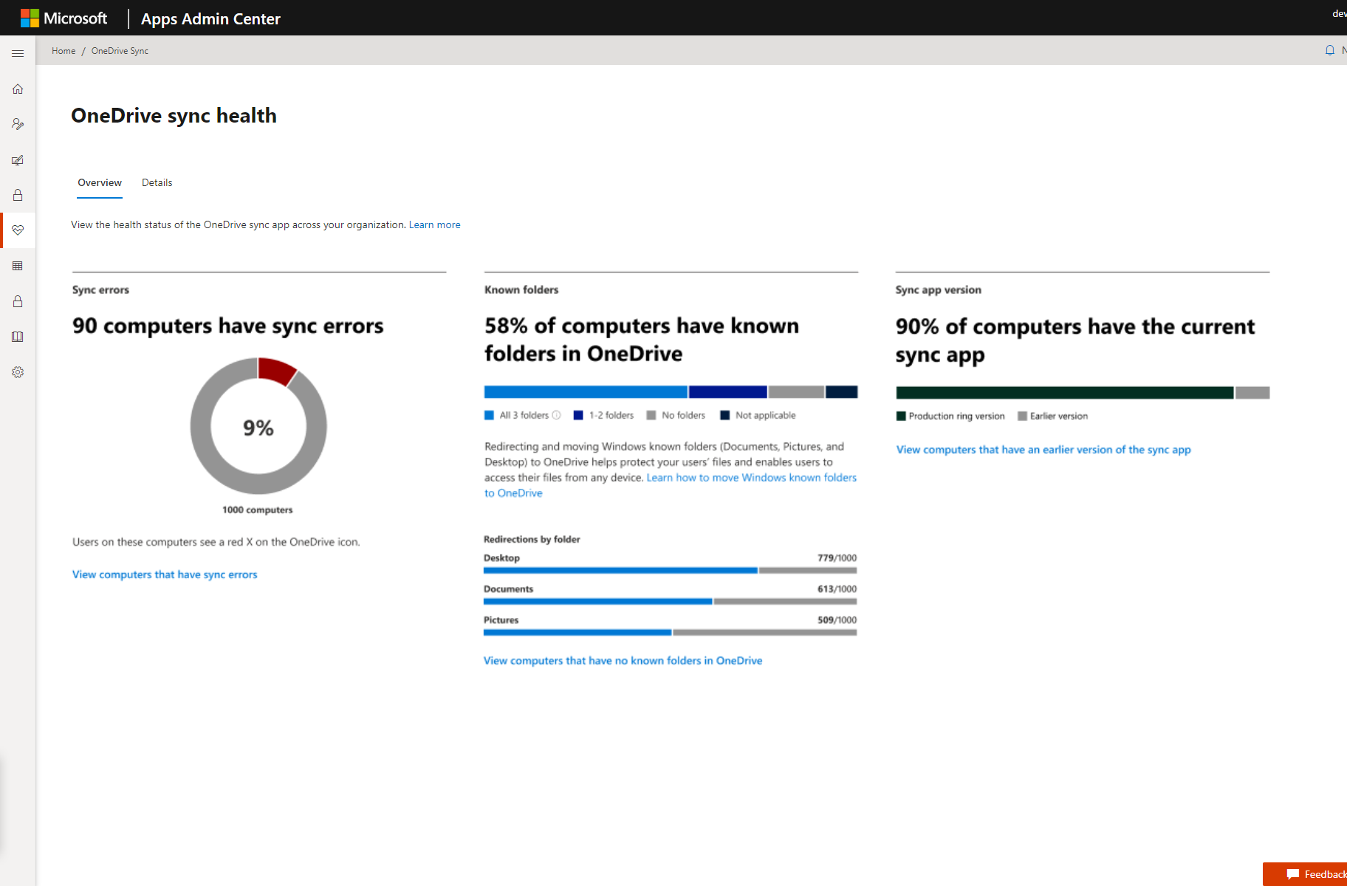
OneDrive deployment reports
Monitor your KFM rollout See which devices are successfully opted into Known Folder Move
Notes:
Many of you have already enabled the Known Folder Move, are actively deploying it, or are in the process of planning how you’re going to roll it out.
As part of that, you’ve told us there isn’t a good way to monitor progress during the rollout.
Which users are opted in? Have their file finished uploading? Can you safely reimage their machine or give them a new laptop without them losing files?
We want to make it really easy for you to know which users have their Desktop, Documents, and Pictures folders protected by OneDrive, meaning if something were to happen to their laptop, all of those files are safe in the cloud.

Slide 22
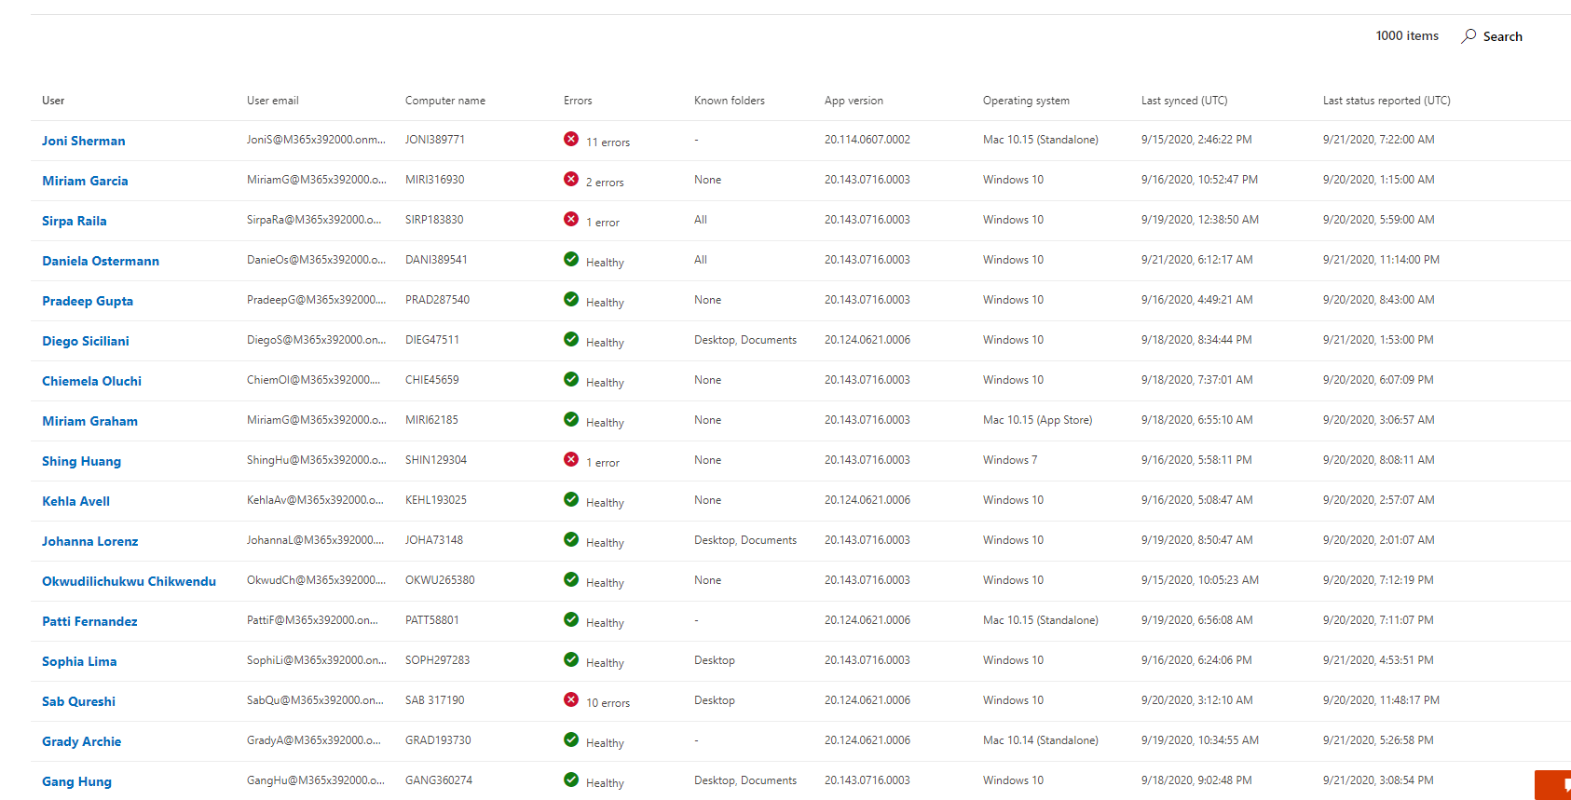
OneDrive operational reports
Look up device insights Check sync status of individual devices
Drive down sync errors See errors on each device to proactively solve end user problems
Public Preview coming this year
Notes:
At this point, let’s assume you’ve deployed Known Folder Move to all of your users and you’re in steady state.
It’s a Monday morning, you’re at home and you are just connecting into work on your laptop. As soon as you open Outlook, you see a red bang email from Joni, an exec at the company.
She is working on a deck for a review later in the afternoon and is running into some sync issues. She hasn’t given many details beyond the fact that there’s an error but it’s clear that it’s preventing her changes from syncing to the cloud.
Until now, you probably would have started by reaching out to her, maybe on Teams, asking for more details and hopefully a screenshot of the error she is seeing. Of course, that would take some back and forth, wasting precious time both for her and for you.
We want to make it easy for you to get insights into Sync errors so you can reactively help users who reach out like Joni and proactively drive down the most common errors, for example through education or by reaching out to users directly.
This is super important because OneDrive Sync is kind of like electricity or your internet service. When it works, everything is great and you take it for granted, but when there is an issue and you’re in the middle of something, it’s disruptive and frustrating. That’s even more the case now, when we are all working from home and we depend on OneDrive and SharePoint more than ever to get our work done.

Slide 23
Demo

Slide 24
Public preview availability
Office apps service
Inventory
Security Currency report
Servicing Profile
Target Version (Action Center)
Rollout starts
Oct 2020
Oct 2020
Oct 2020
Oct 2020

Slide 25
Keep in touch
https://aka.ms/ODInsidersTechCommunity
https://aka.ms/ODInsidersFeedback
https://aka.ms/ODInsidersVideos
@ameshm

Slide 26
Learn more: https://aka.ms/MicrosoftIgnite2020/Office
Notes:
[Talk Track]
We have dozens of demos and step-by-step Microsoft Endpoint Manager videos, from Windows Autopilot to Zero Touch Security, to Productivity Score and Universal Print. To access those (and more!), visit aka.ms/MicrosoftIgnite2020/MEM. We’ll see you there!

