Slide 1
New capabilities to advance the health of your Office client environment​
Javier Carrillo | Senior Program Manager

Slide 2
Agenda
Staying up-to-date
Client health challenges
Microsoft 365 Apps health on Apps Admin Center
Microsoft 365 Apps health on Productivity Score

Slide 3

Benefits of staying up-to-date
Achieve business and IT value with exclusive Office 365 features
Business benefits
Get the latest productivity, security, and performance improvements
Higher user satisfaction from the latest productivity tools
Increased teamwork when users have the latest collaboration features
Less downtime and fewer productivity disruptions with incremental, gradual updates
Greater consistency across app and platforms, including PC, Mac, web and mobile
IT benefits
Streamline updates and lower costs with modern cloud servicing and insights
Fast yet predicable update cadence through the Monthly Enterprise Channel, which
is delivered as one automated, network-friendly package on a known schedule
Rapid feedback loop with Microsoft
Quick issue identification and resolution using proactive health monitoring
Efficient pilot validation process through servicing automation and safety-net controls

Slide 4
Staying up-to-date with the right channel
Choosing the right update channel that best fits the needs of your organization
Current Channel
Monthly Enterprise Channel (new)
General-purpose devices, any type and size organization
Semi-Annual
Enterprise Channel
General-purpose devices, large enterprises
Most current Office features, latest security value, and performance improvements
as soon as they are ready
Specialized and business-critical
For customers who need the latest features on a predictable monthly cadence, additional
tools and controls
All new features, security value, and performance improvements ship once a month
For select devices in an org where extensive testing is needed before rolling out new Office features (e.g., to comply with regulatory, governmental, or other org requirements)

Slide 5
Client health challenges
What we’ve heard from you
Business disruption
Lack of visibility
Complex tooling
Complex data
Troubleshooting
Low confidence

Slide 6

Staying up-to-great with confidence with Microsoft 365 Apps health
Help you update faster with confidence
Optimize Office clients to meet industry benchmarks and be more productive
Troubleshoot and remediate issues

Slide 7
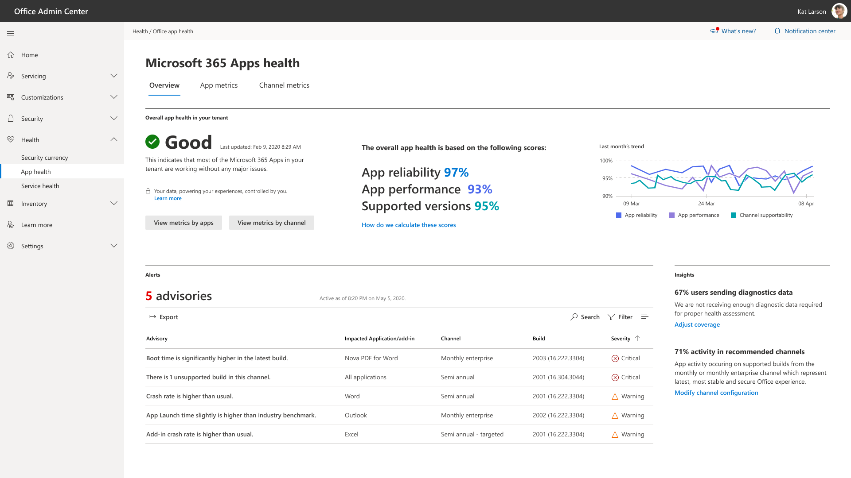
Microsoft 365 Apps health

Slide 8

Microsoft 365 Apps health principles
Zero barriers
Simple setup (just enable diagnostics), no additional agents to deploy, no maintenance (cloud solution)
Boost diagnostics
Give customer value back for their diagnostics data, to increase diagnostics coverage to continually improve the apps
Insightful
Process raw data into useful insights that help customers discover and understand issues to optimize their tenants (no “sea of data” to analyze)
Actionable
Identify issue and provide recommended troubleshooting steps, with on-ramps to modern servicing (OCPS, Microsoft 365 Apps Admin)

Slide 9
Overview of Microsoft 365 Apps health in your organization
Performance, reliability, and support insights
Advisories on performance and reliability issues
Insights on monitoring coverage and adoption of Monthly Enterprise and Current channels
Optimization recommendations
Notes:
We understand that the Microsoft 365 apps play a key role in your daily operations and productivity and that, staying current with the latest versions means ensuring that there are no business disruptions. As such, we are going to deliver a new solution, Microsoft 365 App Health, that will help you discover and troubleshoot issues related to the Microsoft 365 apps in your organization.
App Health is powered by your diagnostics data, the one you already share with Microsoft, that we are now using not just to improve the products but also give value back to you and help you stay healthy.
App Health will provide you with an overview of the reliability and performance of (M365) apps in your organization as well as the recent active issues that might have been detected. Additionally, we will show you the activity across your channels (to help you track adoption of Monthly Enterprise Channel and Current Channels) and an indicator of the number of devices and users that are being monitored for health issues in your organization.

Slide 10
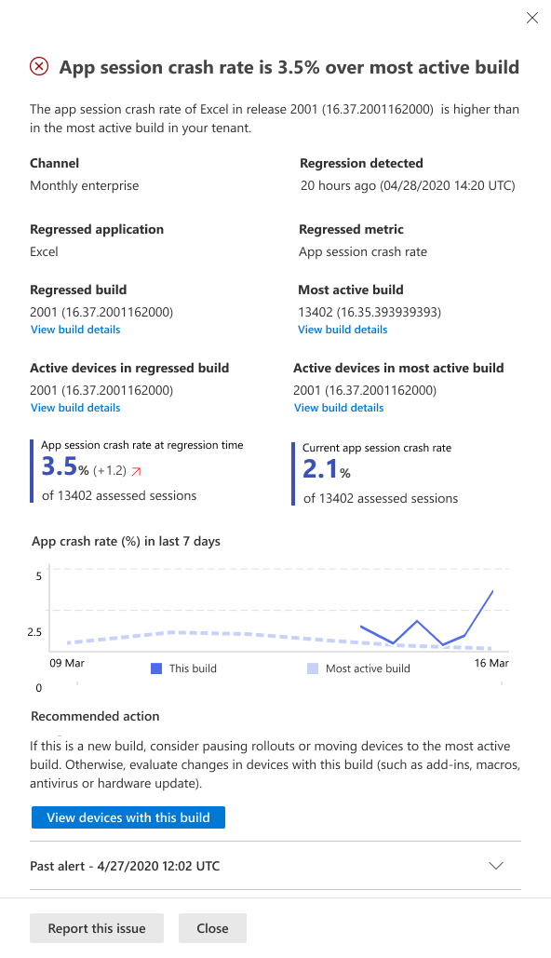
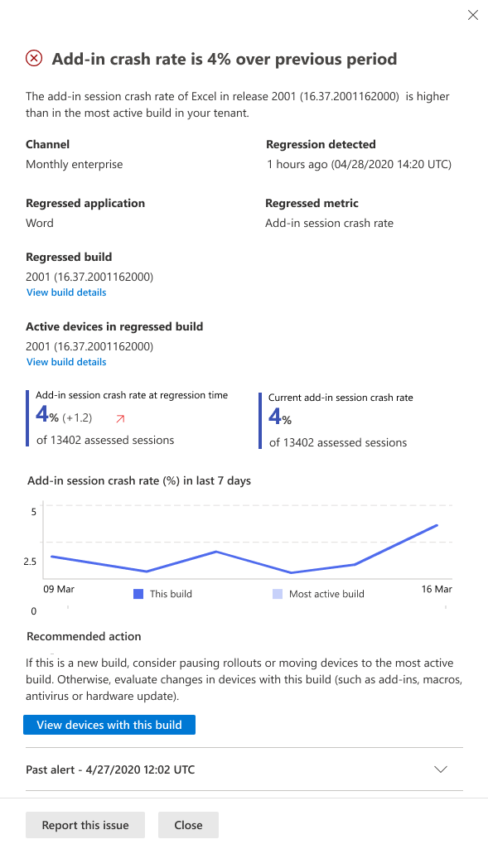
Delve into your data and take action
Get technical details and impact on advisories
Recommended actions and troubleshooting guidance
Root cause analysis (coming soon)
Explore and compare
performance and reliability
evolution across your organization by application, version, and build

Slide 11
Demo
Microsoft 365 Apps Health

Slide 12

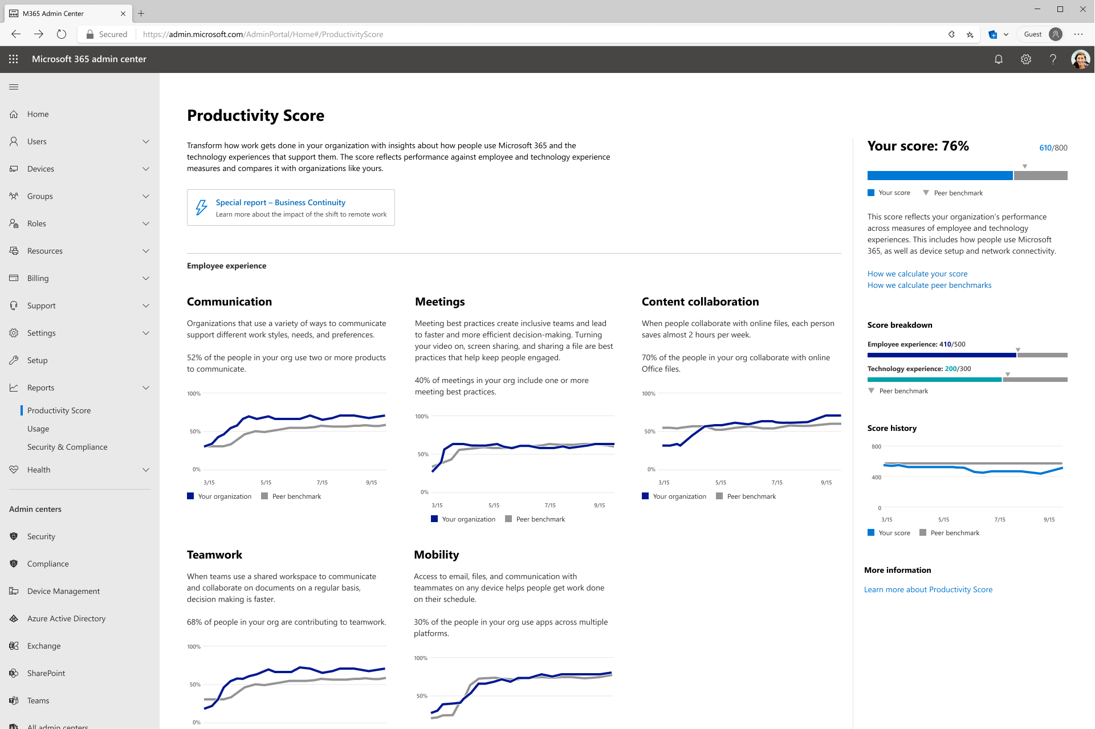
Productivity Score
Insights that transform
how work gets done
Visibility
Understand how your
organization works
Insights
Identify where you can enable improved experiences
Actions
Update skills and systems
so everyone can do their
best work
Notes:
To empower organizations with insights that transform how work gets done we have Microsoft Productivity Score. Productivity Score focus on three core areas. The first is visibility. We want you to see how the organization works by helping you understand the employee experience in categories like content collaboration, communication, and mobility. To have a better picture of productivity you also need visibility into how the technology you use affects how work gets done. That is why we also provide information on the technology experience which helps you see how your devices and network connectivity enable productivity. Across both these areas of employee and technology experience there are also benchmarks to help you see how you are doing compared to your peers.
It’s great that we give you visibility, but you need more than just understanding where you are today. That is why we give you insights to help enable improved experiences. For example, in content collaboration within the employee experience you can see how many people are collaborating in the cloud and how they are doing that. One of my favorite insights here is around the use of attachments vs links to documents in email. They both allow you share content, but using a link helps keep that one version of the truth, so I don’t merge all the changes I get from having multiple copies of the document coming back. All of this is moot though if my network connectivity is so bad that it takes me 20 minutes to upload a file into SharePoint. This is why you need insights around connectivity like are you sending all your SharePoint traffic to a service front door that is near by or thousands of miles away due to the organization’s networking setup.
Lastly, we want to help you enable everyone to do their best work by taking actions like providing training and optimizing configurations. In the technology and employee experience there are actions for IT to help them enable features or services that will help people be more productive. You can also find Microsoft sourced training content and documentation to help end users up skill within the employee experience.

Slide 13
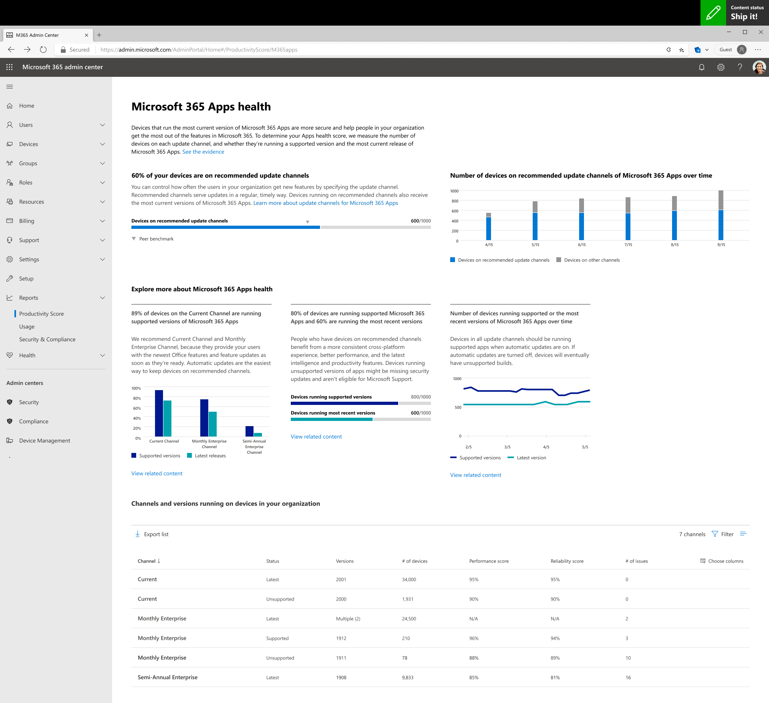
Microsoft 365 Apps health on Productivity Score
Devices on recommended Current and Monthly Enterprise channels
Devices on the most recent versions
Devices running supported versions
Performance and reliability scores across channels

Slide 14
Learn more: https://aka.ms/MicrosoftIgnite2020/Office
Notes:
[Talk Track]
We have dozens of demos and step-by-step Microsoft Endpoint Manager videos, from Windows Autopilot to Zero Touch Security, to Productivity Score and Universal Print. To access those (and more!), visit aka.ms/MicrosoftIgnite2020/MEM. We’ll see you there!

