Slide 1
Please Read:
FY21 skilling videos will be used throughout the fiscal year as a resource for customers looking for technical training. Please do not use specific event branding or make references to specific events or moments in time within your presentation. In addition, please ensure the content is globally relevant.

Slide 2
Simplify your Firstline work with low-code solutions in Teams
Daniel Hidalgo & Addy Quirk

Slide 3
Agenda
Challenges serving your Firstline workers
Teams + Power Platform solutions for the Firstline
Customers putting digital tools to work for Firstline workers

Slide 4
Firstline workers are essential
First to engage with customers
First in line of production
First to represent your brand

Slide 5
Firstline workers are underserved
78%
of business leaders see empowering Firstline Workers as critical to their long-term strategy
67%
say increasing productivity and efficiency are the primary investment drivers
24%
of Firstline Workers indicate they have right technology to do their jobs
Source: Making Firstline workforces the new focus for digital transformation, HBR Pulse Survey, January 2020 survey

Slide 6
Challenges serving your Firstline Workers
Disconnected
From corporate communication and business goals
< 25%
of Firstline Workers have the right tools to do their jobs
Outdated
Legacy tools, apps and devices
Fragmented
Fragmented systems and manual processes
At risk
Growing security and compliance challenges with shadow IT
During these challenging times, virtual communication, digital processes and security continue to be essential for Firstline Workers and business continuity

Slide 7
Where to start?
Experiences
1
It all starts by providing simple and intuitive experiences that appeal to Firstline Workers
2
As workers have good experiences, they feel ownership over their work and drive business value
Partner apps
4
The link between Firstline Workers and business results hasn’t gone unnoticed
3
This allows organizations to better engage customers, optimize operations, reduce employee turnover and deliver results
Results

Slide 8
Teams + Power Platform empowers your Firstline
Seamlessly manage shifts and tasks Access shift management and task tracking apps in Teams to save time and ease workforce management
Modernize processes with apps, flows, and bots
Capitalize on Power Apps, Power Automate, and Power Virtual Agents to digitize and automate processes across your organization.
Protect your organization
Take advantage of built-in security and compliance features that safeguard your business without slowing Firstline performance.

Slide 9
Teams + Power Platform empowers your Firstline
Power Automate
Automate intelligent workflows to improve agility and productivity
Power Apps
Create custom apps to modernize processes to meet your needs, enhancing efficiency and collaboration
Microsoft Teams
Power Virtual Agents
Build and deploy low-code chatbots to provide a conversational AI-driven insights and information

Slide 10
[Show first part of demo, with Shift + Power Automate]

Slide 11
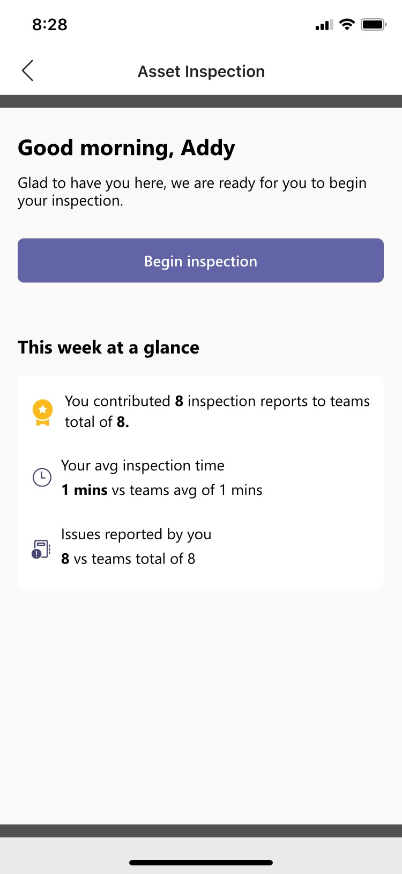
Teams + Power Platform empowers your Firstline
Power Automate
Automate intelligent workflows to improve agility and productivity
Power Apps
Create custom apps to modernize processes to meet your needs, enhancing efficiency and collaboration
Microsoft Teams
Power Virtual Agents
Build and deploy low-code chatbots to provide a conversational AI-driven insights and information

Slide 12
[Show first part second demo, with App

Slide 13
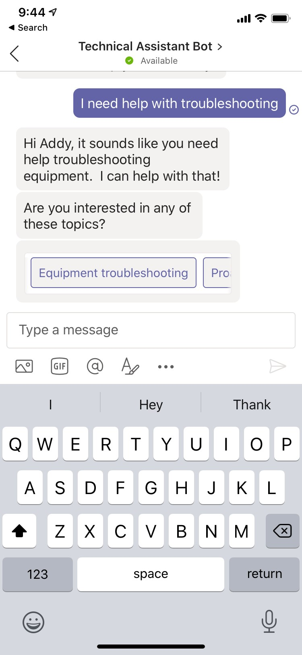
Teams + Power Platform empowers your Firstline
Power Automate
Automate intelligent workflows to improve agility and productivity
Power Apps
Create custom apps to modernize processes to meet your needs, enhancing efficiency and collaboration
Microsoft Teams
Power Virtual Agents
Build and deploy low-code chatbots to provide a conversational AI-driven insights and information

Slide 14
[Show third part of the demo, chatbot]

Slide 15
Other solutions for your Firstline
Power Automate
Notifications about new sales promotions
Reminders about outstanding tasks
Messages to new employees with onboarding resources
Power Apps
Submit and track customer feedback
Documenting on-site repairs
Inventory requests
Power Virtual Agents
Get contact and location information for clients
Answers to questions on company policies
Retrieve documents from large file systems

Slide 16
Firstline workers putting digital tools to work
“
“
“
Microsoft Teams and Power Apps represents a real shift in how we communicate, how reporting works, and the ways in which employees can build upon the tools they have at their disposal”
I probably save 90 minutes a day using the app, and I no longer have to carry a stack of papers around …Everything I need to know is right in the app, and the tasks required for each patient on my floor are clearly laid out”
Power Apps and Power Automate in Teams are easy to use and adaptable enough to solve a lot of problems. If I can make our CSTs and my life easier as we work for customers, that’s a good thing”

Slide 17
[Telstra video]

Slide 18
Resources to help empower your firstline workers
Ignite sessions
Product resources
Training resources
Modernize business processes with the low-code Teams + Power Platform integration
Digitally Transform an Essential Part of your Organization, the Firstline Workforce ​
Enable Business Continuity for your Firstline Workforce with Microsoft Teams​
Teams Tech Community https://aka.ms/TeamsTC_blog
Customer stories https://aka.ms/TeamsCustomerStories
Teams + Power Apps whitepaper https://aka.ms/PowerAppsTeams_whitepaper
Microsoft Teams for Firstline workers aka.ms/FirstlineTeams
Power Platform https://aka.ms/PP_Learning
App In a Day training content https://aka.ms/appinaday

