Slide 1
Success kit for building a
Microsoft 365 Champion Program
Karuana Gatimu
Principal Manager, Customer Advocacy Group
Microsoft Teams Engineering
@Karuana

Slide 2

The successful adoption of any service represents a change in behavior.
You are delivering more than a set of products—you are creating a fundamentally different way of working.
This change is about people.
We are here to help.
The successful adoption of any service represents a change in behavior.
You are delivering more than a set of products—you are creating a fundamentally different way of working.
This change is about people.
We are here to help.

Slide 3

Champions drive skills and business outcomes
Session objective
1
Understand the role of champions in your service management strategy.
2
Understand best practices and resources for building your own Champion Program.
Join our community
Use our resources
Free monthly training on Microsoft 365
Online forum to learn from your peers
Regular email communications (community topics, latest news, tips and resources).
Partnerships with Microsoft at premier events and meetups in your industry.
Monthly content to re-deliver with your champions
A library of assets to accelerate your adoption work.
Access to Microsoft subject matter experts and unique Microsoft 365 training.

Slide 4



Evolving adoption for our times
#HumansFirst approach
Modern Collaboration Architecture (MOCA)
Microsoft 365 adoption framework
Prioritize employee health and wellness
Evolve the “What tool when?” conversation
Deliver on business outcomes

Slide 5
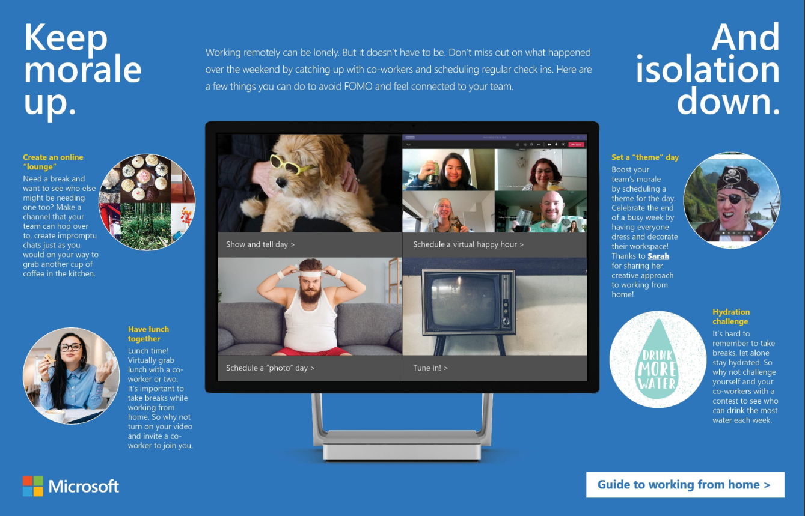
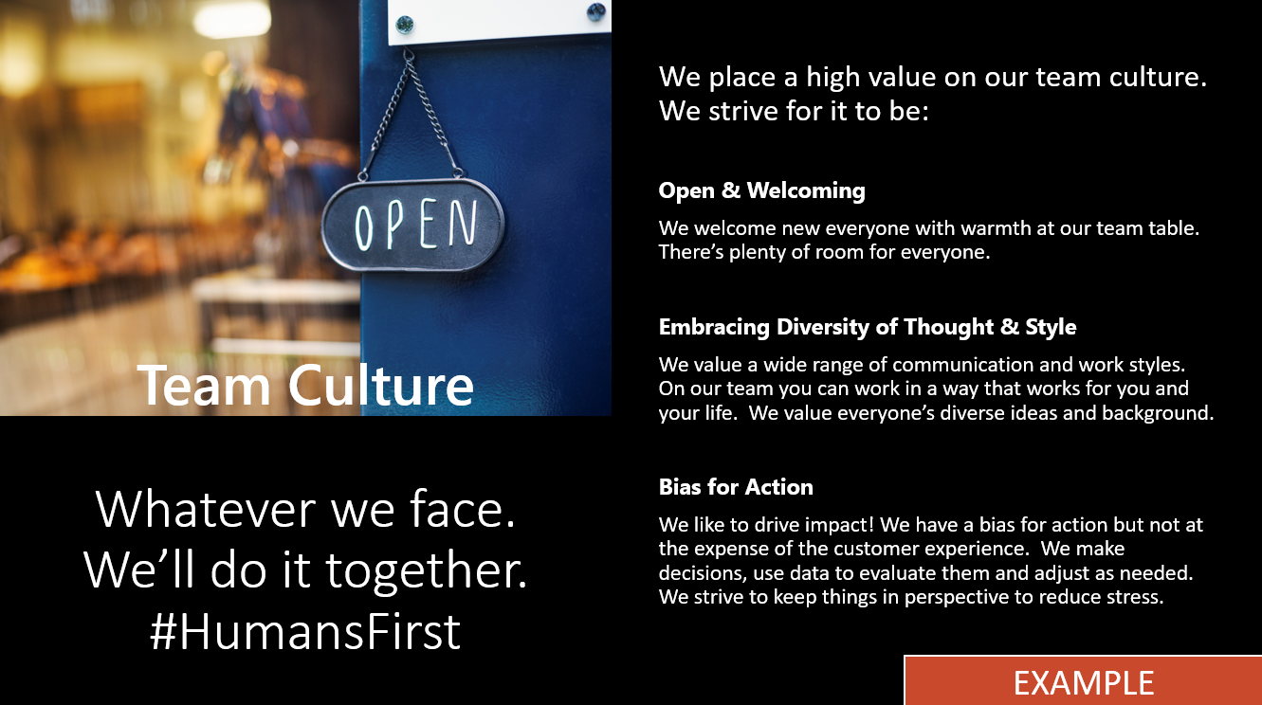
#HumansFirst
Prioritizing the health and well being of employees
Engage with co-workers & customers beyond work topics
Formalize online social engagement
Encourage champions to support work/life balance
Alter meeting practices to allow for mental rest & context switching
Learn more at https://adoption.microsoft.com/humansfirst

Slide 6
Skills required to drive adoption
Organizational development
Business
acumen
Technical competence
Marketing and communications
Portfolio management
Leadership
capability

Slide 7


Who are Champions?
Champions evangelize and help train their teams on the new ways of working.
They build awareness, understanding, and engagement throughout the community.
Champions will:
Create the groundswell of enthusiasm that grows adoption.
Build a circle of influence among their teams.
Bring the new ways of working to life across teams.
Identify business challenges and possible solutions.
Provide feedback to the project team and sponsors.
Reduce strain on core project team through active, ongoing engagement.
“We connect with an adoption champion in each business unit, who sends out weekly emails on Office 365. Each Office 365 tool has core benefits and by taking users on a smooth journey through them, we are able to unlock the value in each one.”
Join the free Microsoft 365 Champion program at https://adoption.microsoft.com/become-a-champion
Nick Lamshed
Change Consultant, Qantas

Slide 8
Build a sustainable champions community
  Champions:
  Champions help build, grow, and sustain your Microsoft 365 rollout by evangelizing and helping their peers with the new solutions.
1
  Should be formally trained to increase their depth and breadth of knowledge.
2
  Should be encouraged and empowered to guide, teach, and train their peers.
3
  Need consistent positive reinforcement that affirms the impact of their efforts.
Customer story:
Best Buy: The rise of the ninjas—a SharePoint 2013 user adoption story (SPC296)
http://aka.ms/bestbuyninjas
4
  Need a clear plan upon which to execute.

Slide 9

Five steps to developing a champions community
1
  Set the context.
2
  Design and align the champions community to organizational objectives and vision for Microsoft 365.
3
  Identify champions and get buy-in.
4
  Build a plan with champions.
5
  Execute and iterate.

Slide 10
How do champions fit into overall launch planning?
Adoption
Approach
Identify key stakeholders
Identify/Prioritize business scenarios
Create and execute a success plan
Measure, share success,
and iterate
Business
scenarios
Early adoption program with champions
Identify and launch additional solutions
Highlight and share success
LAUNCH
Communications
and training
Organize and develop Champions Community
Organization-wide launch: communications,
training, events, success stories
Inform stakeholders
Identify champions
Execute Champions Community
IT and social
governance
Participate in security and social governance discussions
Support global launch
Assess viability of third parties
Assist in reporting
Support mobile apps

Slide 11
The Champions program checklist
✓
  Find enthusiastic and committed champions.
  Build a Microsoft Team to share updates and successes.
  Provide support materials for teams and individuals (e.g., brown bag sessions).
  Ensure a regular rhythm for discussions with the champions on what’s working and what’s not.
  Design programs to recognize and reward their efforts.
✓
  Communicate about the champions role and how to engage with them – remember, they are not an IT support function but business representatives.
  Incorporate Microsoft’s Microsoft 365 training resources and Microsoft 365 Learning Pathways solution into your own internal training site.
  Create contests between departments to encourage interaction using Microsoft Teams.
  Encourage champions to continue to build their skills (https://aka.ms/Microsoft365Champions)
✓
✓
✓
✓
✓
✓
✓

Slide 12
Lessons from the field
Listen Listen Listen – Champion feedback is critical for success
Have consistent champion leadership
Reward your champions for maximum impact
Create themes to focus champions and end users
Join the Microsoft Champion Program to gain access to resources for additional content

Slide 13


































Navigate the “What tool when?”
Modern collaboration architecture (MOCA)
Perform
Grows
Individual
Team
Community
Organization

Slide 14
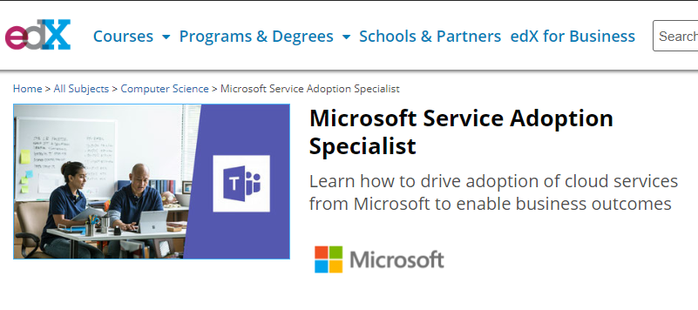



Formalize your knowledge
Earn your certificate at https://aka.ms/AdoptionCert
Understand the six knowledge areas required for service adoption professionals
Learn strategies and tactics for adoption implementation
Expand your career to include verified service adoption skills

Slide 15
Example Success Story:
Building Microsoft’s
Teamwork Champions Program

Slide 16
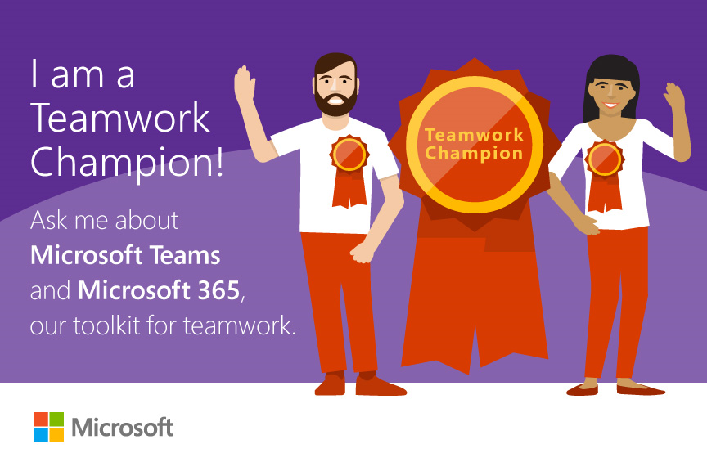
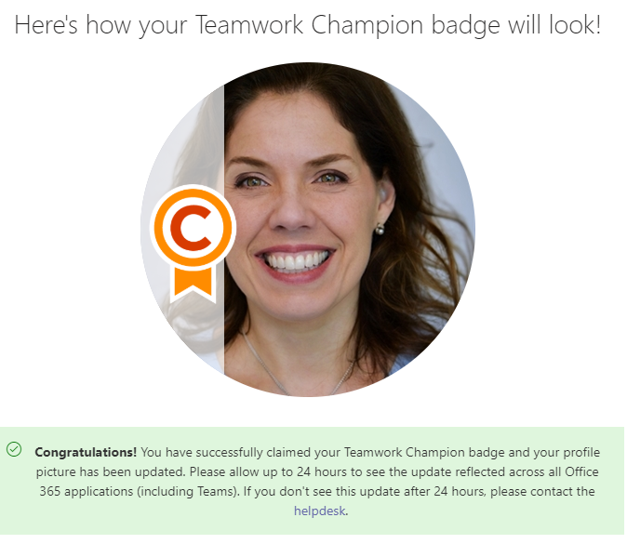
The fundamentals
Recruit well
  Find your evangelists
  Early adopters hold a pool of evangelists
  Teach and convert
  #1 membership enabler—other champions
Scale fast
  Go global
  Make champions deliverables turn-key
  Make champions local SMEs
  #1 awareness enabler—make champions identifiable

Slide 17

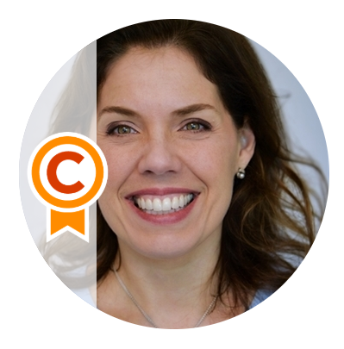




Champions operationalized
Bring users and champions together
Find a champion
Become a champion

Slide 18
Champions operationalized
Make explanations simple and clear
Champion Gives | Champion Gets
Help your organization adopt Microsoft Teams | Access to SMEs, CSEO, and PG
Engage in the Teams Yammer group | Early knowledge of new features
Host Art of Teamwork training | Community access
Participate in White Glove onboarding | Badge, email signature, branded signage
Host office hours | Leaderboard and prizes
Join monthly champion events | Recognition as an expert

Slide 19
What can champions do? Move mountains…
# of teamwork champions
% of adoption active usage
Month-over-month
Month-over-month in buildings with Champions
100
74.9%
400
April
May
June
July
August
September
October
November
93.6%
450
94.9%
541
96.1%
640
98.4%
750
98.5%
906
98.8%
997
99.2%

Slide 20
What’s next for our champions
The elements of healthy teamwork
Teamwork happens in Teams Channels
The team prioritizes transparency, aligns on best practices and creates an environment where all voices are heard.
Communicate
The team openly shares work, provides feedback, and ensures information is discoverable, accessible, and secure.
Share
The team agrees on priorities, accountabilities and goals; they share a strategy for success and have a plan to get there.
Collaborate

Slide 21
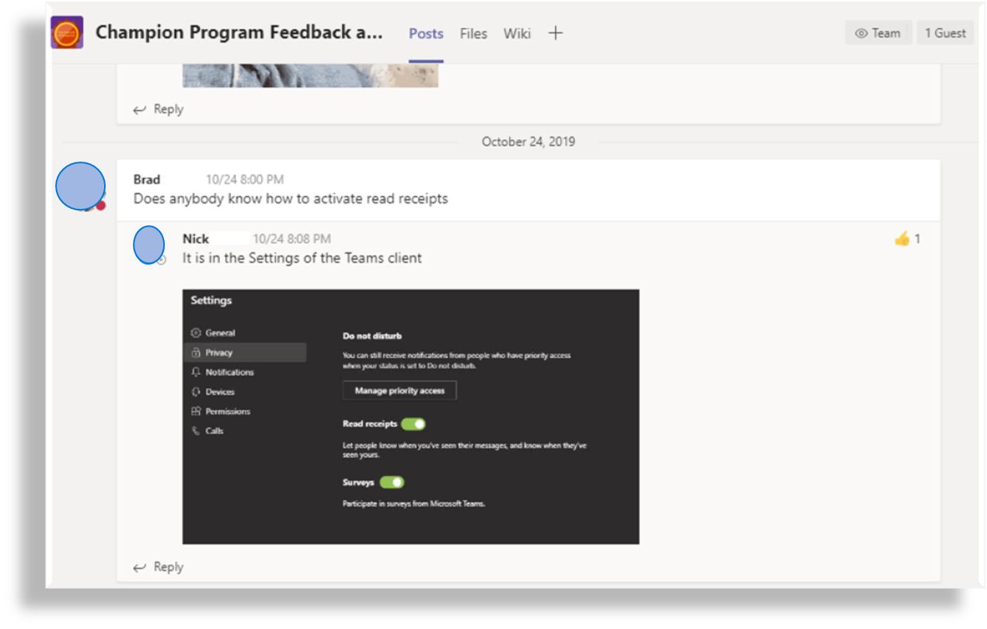
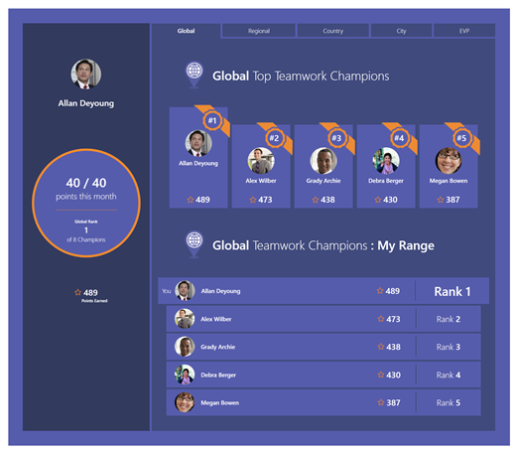
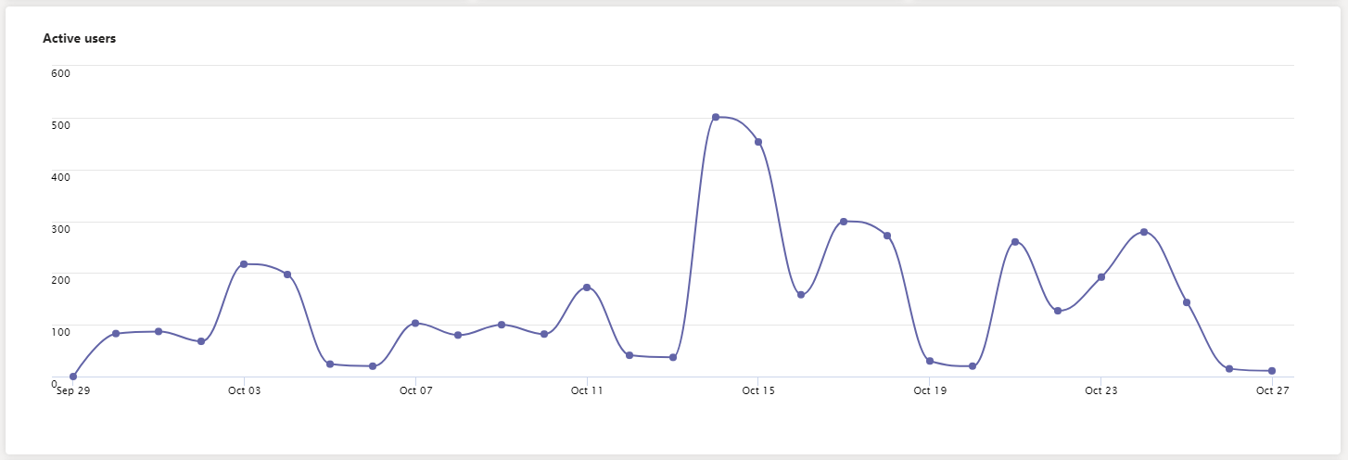
Keeping the community relevant and engaged
“
True Community: Champions helping Champions
I’ve made new virtual ‘friends’ as I find people with common questions and comments to mine
“
“
Teamwork Champions Leaderboard
“
Keep doing what you’re doing. This is a great program!
“
I love the Q&A that happens in the champions community. I’ve learned a lot in double-checking answers to questions that come up.
“
Hundreds of active users on daily basis
“
Champion community is AWESOME! Great job bringing the community together.
“

Slide 22

Make a difference – Become a champion
  Get more from Microsoft 365
  Help others do the same
  Enhance your career
Get started at https://adoption.microsoft.com/become-a-champion/

