Slide 1
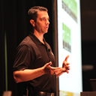
Making IT more efficient with improvements to Microsoft 365 Groups
Mike McLean
Principal Program Manager
mmclean@microsoft.com | @mikemcleanlive
Microsoft 365 Groups
Ramya Rajasekhar
Senior Program Manager
rarajase@microsoft.com
Microsoft 365 Groups

Slide 2
Agenda
Group management in Microsoft 365 Admin Center
Groups and Roles at scale in Azure Active Directory
Yammer All Company backed by Microsoft 365 Groups
Group Driven Membership

Slide 3
Microsoft 365 Admin Center
Mike McLean

Slide 4
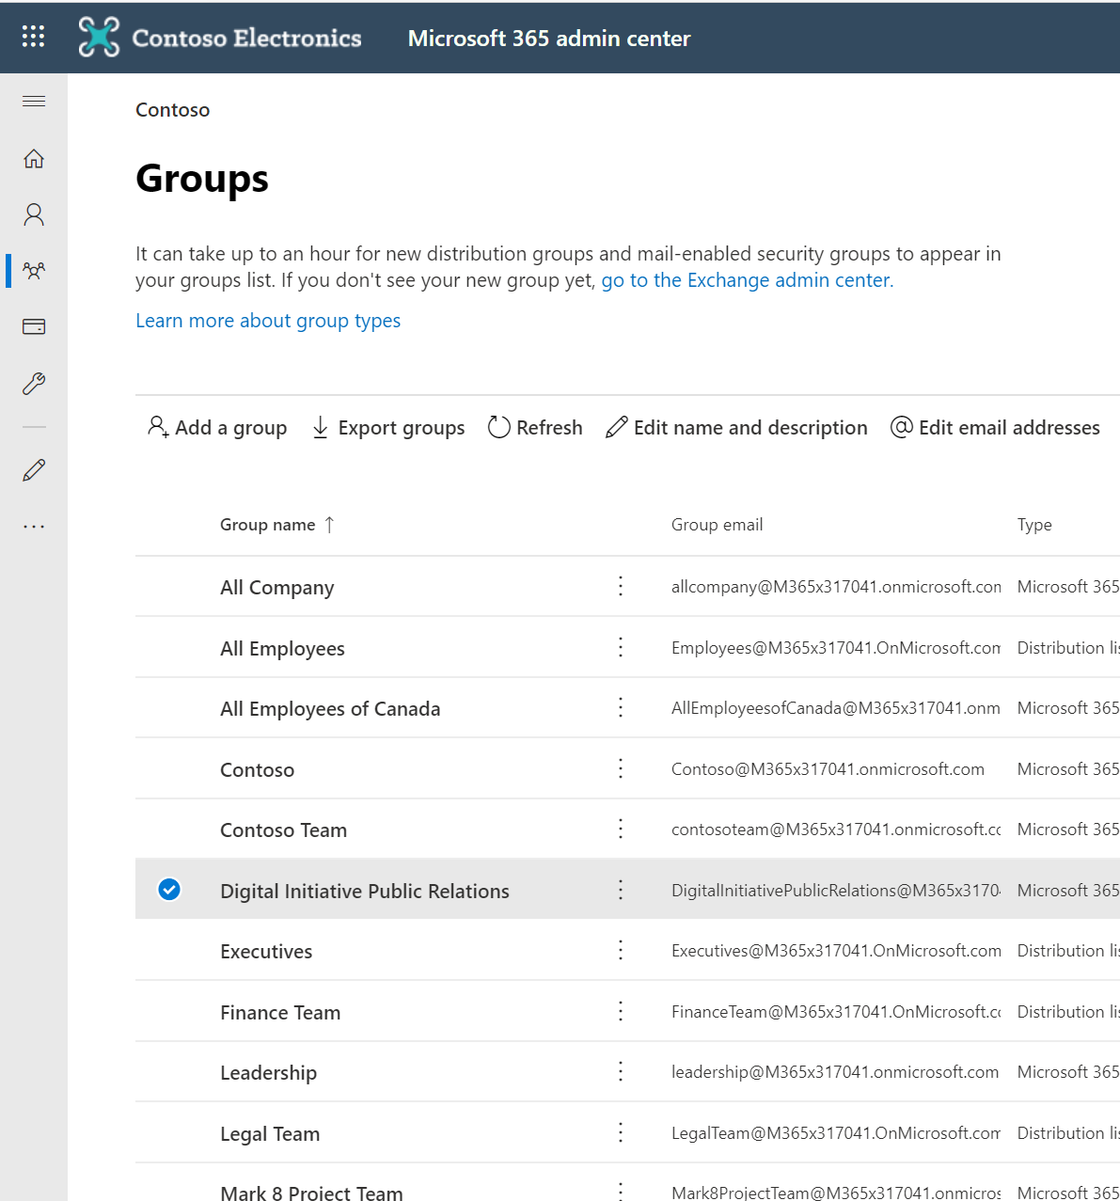
Microsoft 365 Admin Center
Export group list
Restore deleted groups
Improved Teamify experiences
Edit Group Email address
Ownerless groups

Slide 5
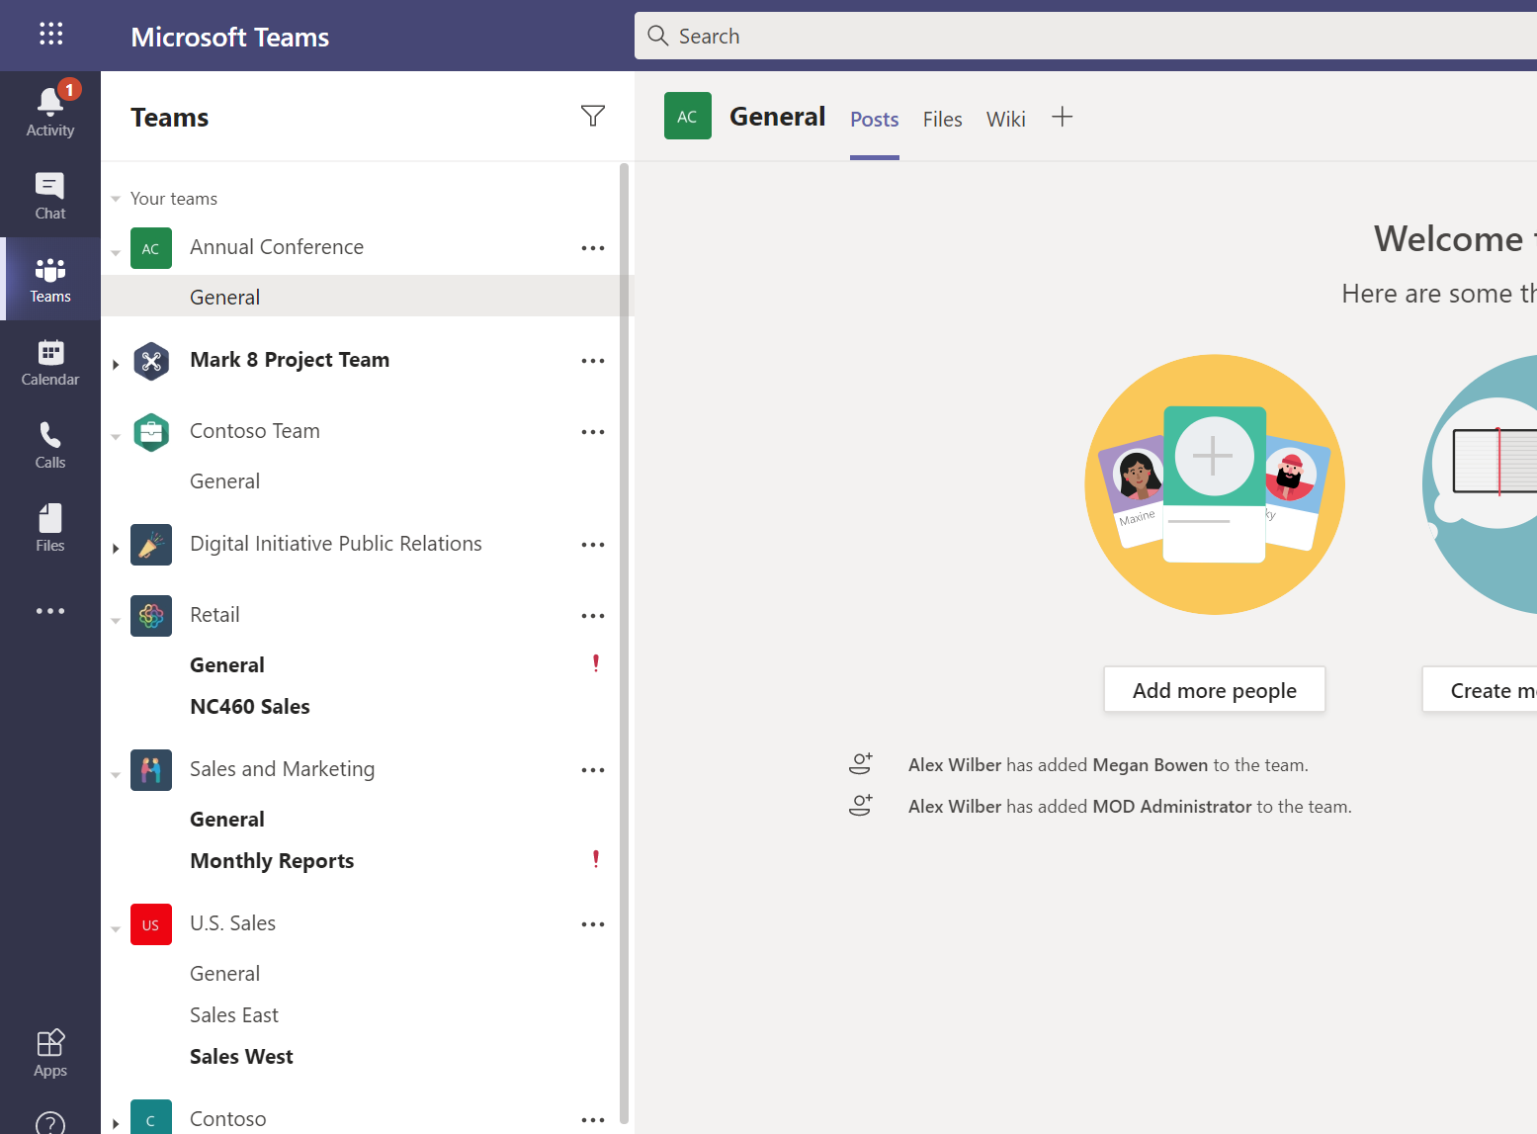
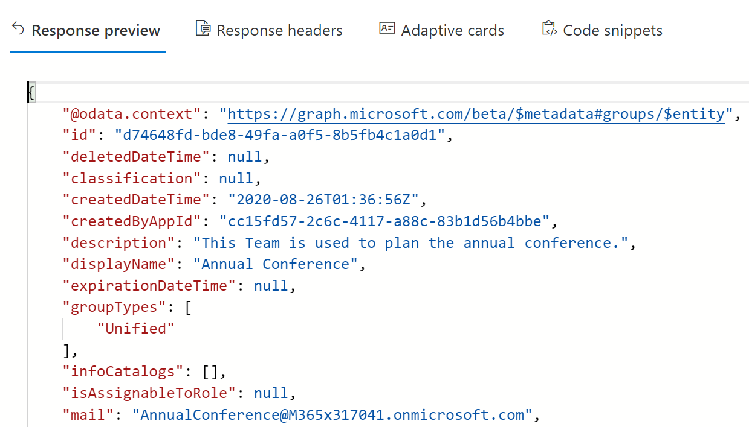
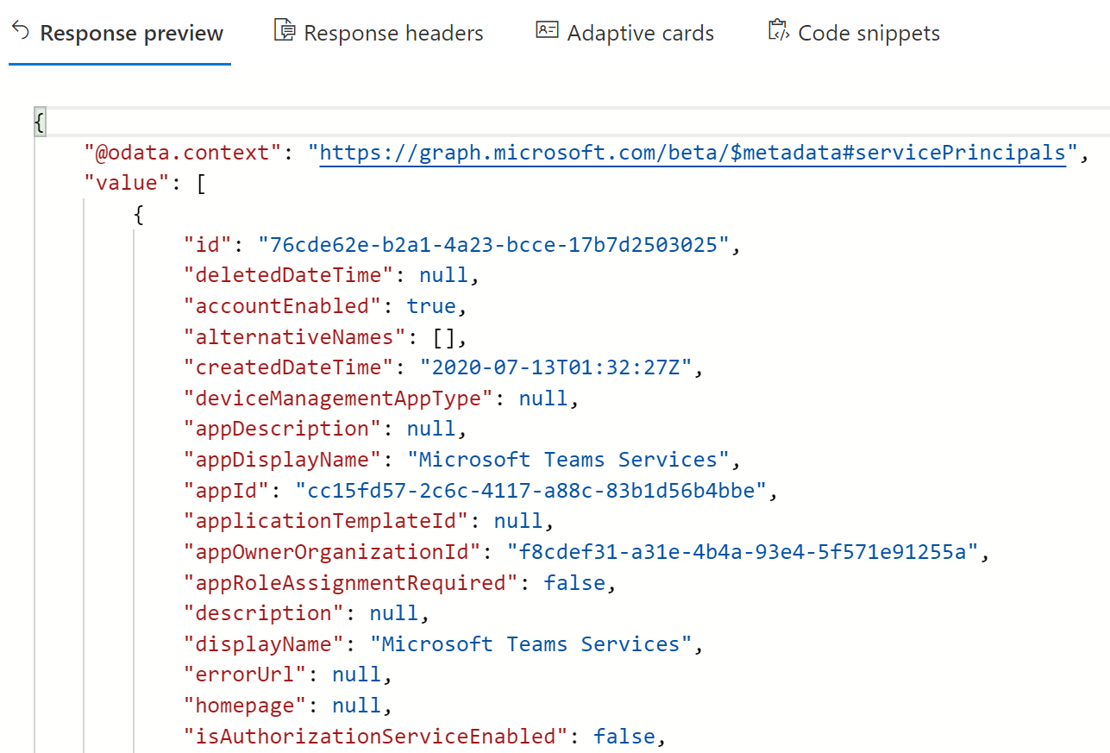
Group Creation Source
Added createdByAppID to group object
Supports all 1st party apps and registered 3rd party apps
Retrieve App Display Name using Service Principals query
Shipped to Beta on /Beta endpoint.
Example: https://graph.microsoft.com/beta/groups/d74648fd-bde8-49fa-a0f5-8b5fb4c1a0d1 https://graph.microsoft.com/beta/servicePrincipals?$filter=appId eq 'cc15fd57-2c6c-4117-a88c-83b1d56b4bbe'

Slide 6
Microsoft 365 Admin Center - Demo
Mike McLean

Slide 7
Azure Active Directory
Mike McLean

Slide 8
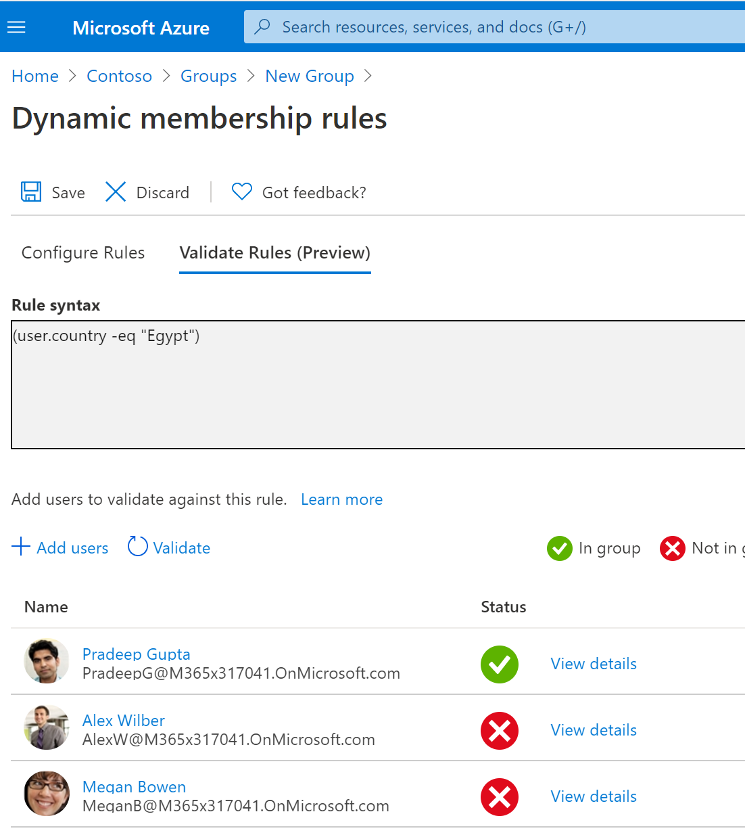
Azure Active Directory
Export Group Membership
Assign groups to Azure roles (preview)
Dynamic Groups Rule Validation (preview)
Dynamic Groups at Scale (preview)

Slide 9
Improvements to Dynamic Groups at scale
Challenges |  |  | Improvements
Performance | Time to process group is relative to size of tenant. Tenant processing and group update is slow and can take up to 24 hours. |  | Time for new group creation is proportional to the size of group. Deliver SLA in minutes for dynamic group membership updates. Optimized performance for these operators: -eq, -in, -startsWith.
Reliability | Single object failure blocks whole tenant processing. In case of machine failure, tenant processing is blocked. |  | Single object failure won’t block tenant processing. Other objects will continue to be processed. No machine dependency. If one machine fails, other machines will pick up and continue tenant processing.
 | In case of machine failure, tenant processing is blocked |  | No machine dependency. If one machine fails, other machines will pick up and continue tenant processing.
Scalability | Customer demand for dynamic groups in market segments such as EDU. |  | Support for 5,000 dynamic groups per tenant. Increased size of dynamic group extended to 10K+ members.

Slide 10
Azure Active Directory - Demo
Mike McLean

Slide 11
Yammer All Company Community
Ramya Rajasekhar

Slide 12
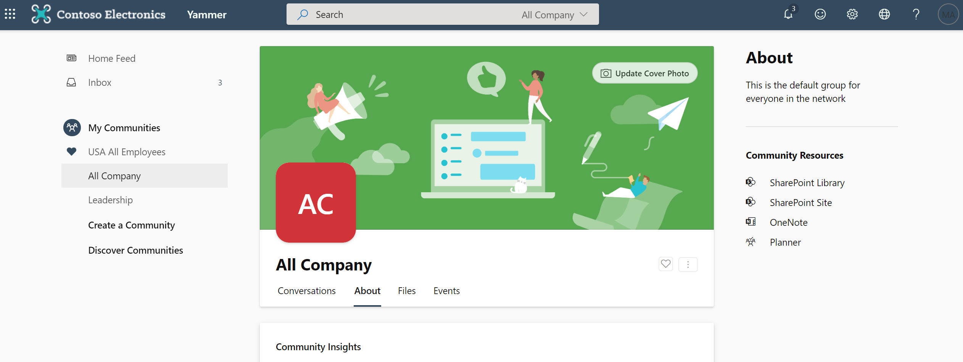
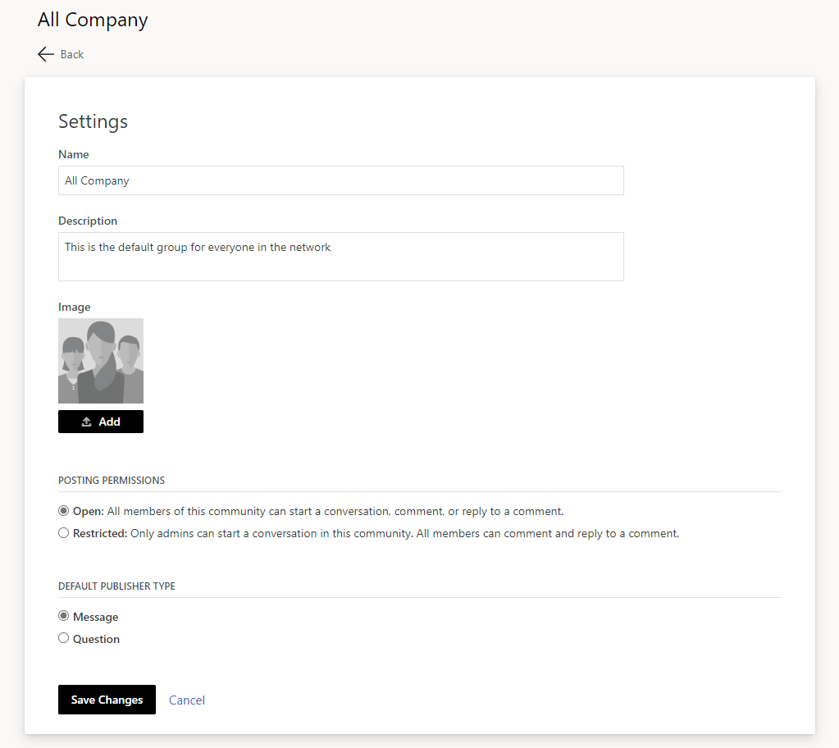
All Company backed by Microsoft 365 Group
Edit name, description, avatar, cover photo
Restrict posts to admins only
Promote other members as admins of the community
Host Live Events
Select ‘Enforce Office 365 Identity’ in the network admin settings

Slide 13
All Company Yammer Community - Demo
Ramya Rajasekhar

Slide 14
Group Driven Membership
Ramya Rajasekhar

Slide 15
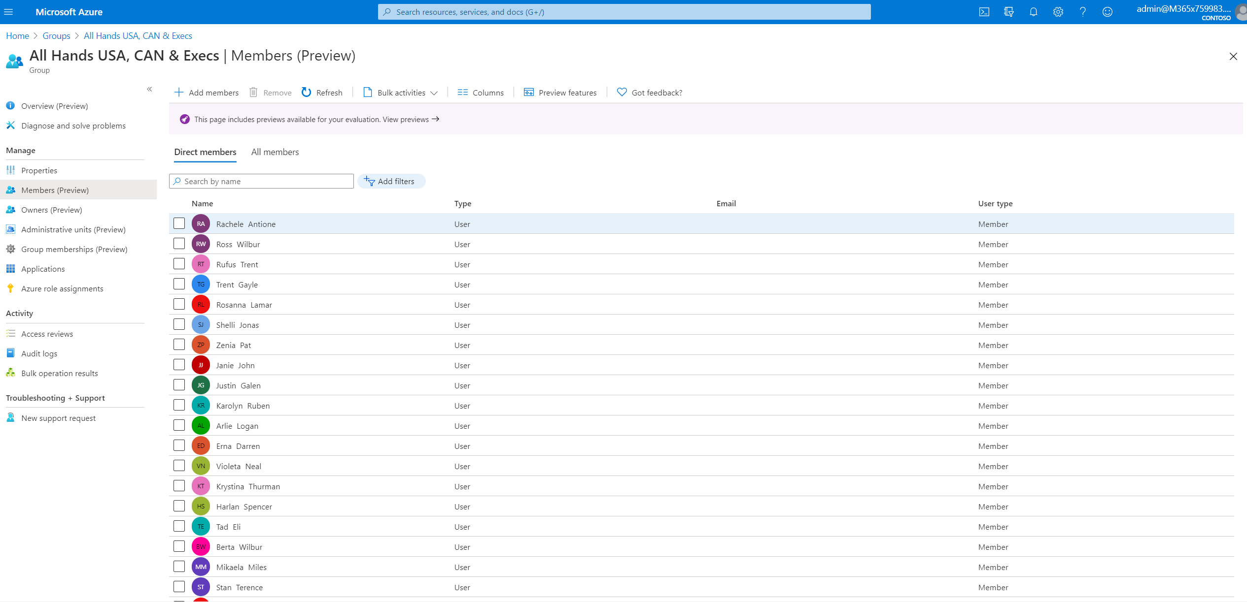
Group Driven Management using Group Membership Management (GMM) tool
Built on Microsoft Graph APIs
Based on .Net, Azure Functions and Azure Table Storage
Supports Azure AD based Security Groups (SGs) as members of Microsoft 365 Groups
Membership shown as direct members in parent group
Membership synchronized with source groups at set frequency

Slide 16
Demo - Scenario
Contoso has an upcoming All Hands Teams meeting
Corp comms manager Megan sets up Teams group All Hands USA, CAN & Execs
Membership of the group is limited to
US and Canada employees and
VPs and Directors from all locations
Megan identifies the security groups that satisfy the membership criteria and submits request to Admin
All Employees USA
All Employees Canada
All Company Execs (which in turn has other security groups as its members)
Admin runs GMM. Now, All Hands USA, CAN & Execs membership remains in sync with the membership of the security groups

Slide 17
Group Membership Management Tool - Demo
Ramya Rajasekhar

Slide 18
Recap
Group management in Microsoft 365 Admin Center
Groups and Roles at scale in Azure Active Directory
Yammer All Company backed by Microsoft 365 Groups
Group Driven Membership

Slide 19
Related Content for Microsoft 365 Admins
#SIDETRACKED @ IGNITE
Improved IT Efficiency and Agility
Role-based Access Control in Microsoft 365 | https://aka.ms/Admin1008
Microsoft 365 admin mobile app: administration on-the-go with productivity with flexibility | https://aka.ms/Admin1009
Improve IT efficiency and agility and stay informed as you enable self-service tasks | https://aka.ms/Admin1010
Making IT more efficient with improvements to Microsoft 365 Groups | https://aka.ms/Admin1011
Leveraging user feedback about Microsoft 365 in your organization | https://aka.ms/Admin1015
Drive external collaboration for your organization using Microsoft 365 Groups | https://aka.ms/Admin1007
Modern Cloud Management
How to manage Microsoft 365 in a remote work world | https://aka.ms/Admin3010
Transform change management by syncing Message Center posts to Planner | https://aka.ms/Admin1019
Managing updates of Microsoft 365 Apps using servicing automation | https://aka.ms/Admin1016
Microsoft 365 Groups roadmap updates | https://aka.ms/Admin1013
Microsoft 365 Groups architecture overview and deep dive | https://aka.ms/Admin1017
Governance and management best practices for Microsoft 365 Groups | https://aka.ms/Admin1018
Effective controls for Microsoft 365 Apps in the Microsoft 365 admin center | https://aka.ms/Admin1120
Managing work and life with Microsoft 365 Groups | https://aka.ms/Admin1022
Complex Org Investments
Multi-tenant management in the Microsoft 365 admin center | https://aka.ms/Admin1004
Supporting Mergers, Acquisitions, and Divestitures in Microsoft 365 | https://aka.ms/Admin1002
Aggregated views of Service Health and Message Center for admins that manage multiple tenants | https://aka.ms/Admin1006
How Microsoft manages Microsoft 365 Groups for its employees | https://aka.ms/Admin1003

Slide 20
Thank you!
Key resources
Tech Community | aka.ms/M365GroupsTC
User voice | aka.ms/M365GroupsUV
Microsoft Graph | aka.ms/M365GroupsGraph
Roadmap | office.com/roadmap
FastTrack | microsoft.com/fasttrack
Mike McLean
Principal Program Manager
mmclean@microsoft.com | @mikemcleanlive
Microsoft 365 Groups
Ramya Rajasekhar
Senior Program Manager
rarajase@microsoft.com
Microsoft 365 Groups

