Slide 1



External collaboration with Microsoft 365 Groups in Microsoft Teams, Outlook, Yammer and SharePoint
Salil Kakkar
Senior Program Manager, Microsoft 365 Groups
salil.kakkar@microsoft.com | @salil_kakkar
Nandini Bhavasar N A
Program Manager, Microsoft 365 Groups
bnandini@microsoft.com

Slide 2
Agenda
Introduction and what is new with external collaboration using Microsoft 365 Groups
Guests lifecycle and adoption
Best practices for managing guests at scale
Case study: How Microsoft manages
guests

Slide 3





External Collaboration
A key ingredient for the success of your organization
Global Teams
Gig Economy
Work From Home
Need for open and dynamic collaboration across your organization and partners
Communication Applications in Microsoft 365
Outlook
Teams
Yammer

Slide 4
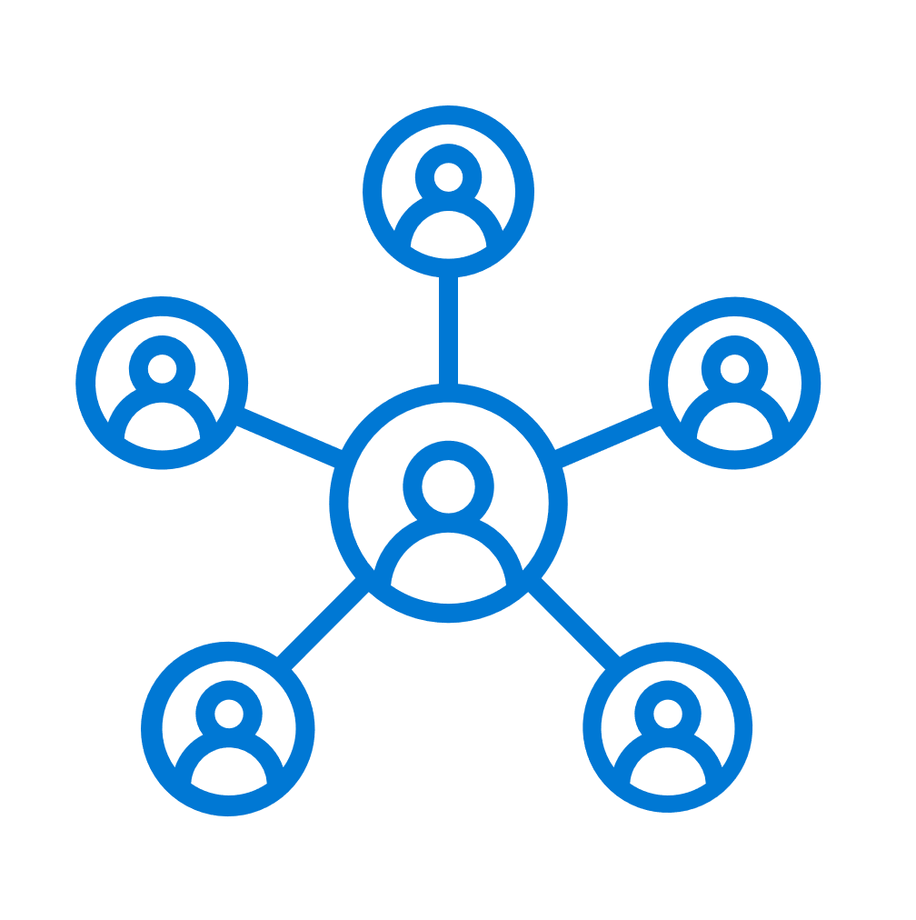


Guests by the numbers…
30M
Guests provisioned through Microsoft 365 Groups
7.5M
Active guests through Microsoft 365 Groups
98%
Tenants have guest access enabled
207%
Annual increase in guest activity across Microsoft 365 Groups

Slide 5


Guest management – A balancing act
Information Asymmetry
Administrators do not know which external user activity is legit
Prevent Unauthorized Access
Unfettered Collaboration

Slide 6

Guest lifecycle & adoption
Enable Guest Access at Groups/ Apps/ Tenant level
Fix Policy Violations – Remove Unwanted Guests
05
Scale
01
04
Policies: Allow/ Block Domains & Guest Inviter Role
Periodic Guest Attestation – Access Reviews
Guest Lifecycle
Listen & Align
02
03
Monitoring – Guest Invites and Redemptions via Audit Logs
Productivity
Tenant-wide Rollout
Controlled Rollout
Establish Guest Terms Of Use
Identify Allow/ Block Guest Domains
End user education
Assess
Pilot
Test Guest Lifecycle
Evaluate Guest Access Needs
Exploration
Review External Collaboration Concepts
Guest Governance

Slide 7























Powering collaboration across work and life
Membership service for 22+ Microsoft 365 teamwork apps
Advanced sharing
Partner ecosystem
Microsoft 365 Groups
Azure Active Directory
Centrally managed, secured, and governed

Slide 8
Demo
Yammer

Slide 9
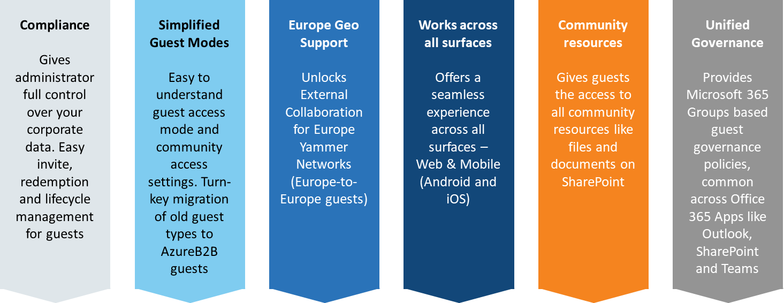
Private preview now live! aka.ms/AcceptAzureB2BGuestsYammerPreview

Slide 10
Managing Guests at scale
Allow/block guest domains
Guest inviter role
Access reviews
Terms of use
Reporting
Policies and information protection
Access packages (Entitlement Management)

Slide 11

Guest access – key questions
Who can invite guests?
Everyone or a selected group of employees
Guest Access using Microsoft 365 Groups
Who can be invited as a guest?
Email domains permitted for guests
Which resources can be shared with guests?
Microsoft 365 Groups open for external access

Slide 12



User Permissions
Provides a “Guest Inviter” role
Limits users who can invites guests
Can be configured using Active Directory
Helps prevents accidental invites for unwanted guests
Enables safe teamwork with external users
Guests
Member
Only users with the “Guest Inviter” role can invite guests
Admins can assign users to the role
Enables guest invite capability only for a selected set of users.

Slide 13

Domain Restrictions
Allow/deny list of external partner domains from which guests can be added
Available via both PowerShell and Azure Active Directory
Any existing domain policy in SharePoint can be easily migrated
Guests
Member
IT approved list of domains
Blocks guest invites to external users from deny domain list
Works at group level

Slide 14
Group Level Guest Policy
Granular group level control for guest access
Helps block guests access for sensitive groups
Mutable setting for Microsoft 365 Group
Can be modified based on evolving external collaboration needs
Guests
Member
Group level guest configuration
Can be configured via PowerShell
Mutable property stored on Microsoft 365 Groups
Documentation: Guest Access in Microsoft 365 Groups

Slide 15
Demo
Guest Policies

Slide 16
Sensitivity labels for guest governance
Benefits
Restrict who can create external and other high privilege groups
Labels helps you regulate guest access across your organization
Automatically enforce policies based on labels
Guidance
Start with new labels and define associated guest access privileges
Educate end users to think about scenario first instead of public/private/ guest enabled
Single set of labels across documents, emails and groups gives unified guest control
Documentation: Microsoft IP Labels for Groups

Slide 17
Demo
Sensitivity Labels for Guest Access

Slide 18

Entitlement management
  Guests are automatically
  invited after being approved
  Guests provisioned with
  time-limited access across
  apps, groups, Teams and sites
  Guests removed when they
  no longer need access
Resource access scoped to specific partners
Guests deprovisioned after project ends
Ongoing auditing
& reporting
Guests request
Access reviewed & revised
Access approved and provisioned

Slide 19

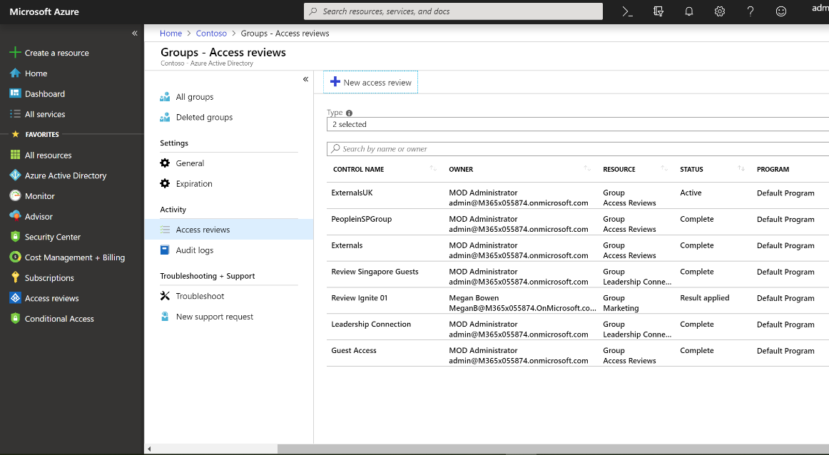
Guest access reviews
Define actions on your terms
Create policies per group
Actions are active immediately:
Guest is deleted from Azure AD
Guest sign-in is blocked

Slide 20
Demo
Entitlement Management

Slide 21
How does Microsoft manage guests
Empower employees while protecting content, keeping compliant and holding employees accountable
Guest Access is enabled for the tenant
      All full-time employees can invite guests
      No allow/deny domains configured for guests
Guest Usage guidelines shown in simple language
Guests Lifecycle
Membership reviews for groups with external members (access reviews)
Classification configured in Azure AD to manage guest access; Highly Confidential, Confidential (default), General
Custom jobs set Privacy to Private and disable external membership/sharing based on classification

Slide 22
Key resources
Manage who can invite guests
Allow or deny invitations to specified domains
Manage guest access at group level
Entitlement Packages
Thank you!
Salil Kakkar
Senior Program Manager, Microsoft 365 Groups
salil.kakkar@microsoft.com | @salil_kakkar
Nandini Bhavasar N A
Program Manager, Microsoft 365 Groups
bnandini@microsoft.com

