Slide 1
How to keep users secure and productive with Microsoft 365 Apps
Sriram Iyer

Slide 2
Agenda
Secure defaults
Secure configuration
Integrated protection

Slide 3
Most secure
Most secure
Protect your information and identities, detect threats earlier, and better adhere to compliance standards with Office 365¹
Safeguard company data
Combat malicious activity | ATP Safe Links • Application Guard • Safe Documents
Help prevent data leaks | Office 365 Message Encryption
Be proactive
Follow best practices | Security Policy Advisor • Security baseline
Run analytics | Secure Score • Compliance Score
Stay compliant
Keep files, email compliant | Sensitivity labels
Maintain company compliance | Advanced eDiscovery • Compliance Manager
¹Partial list of exclusive Office 365 security and compliance features

Slide 4
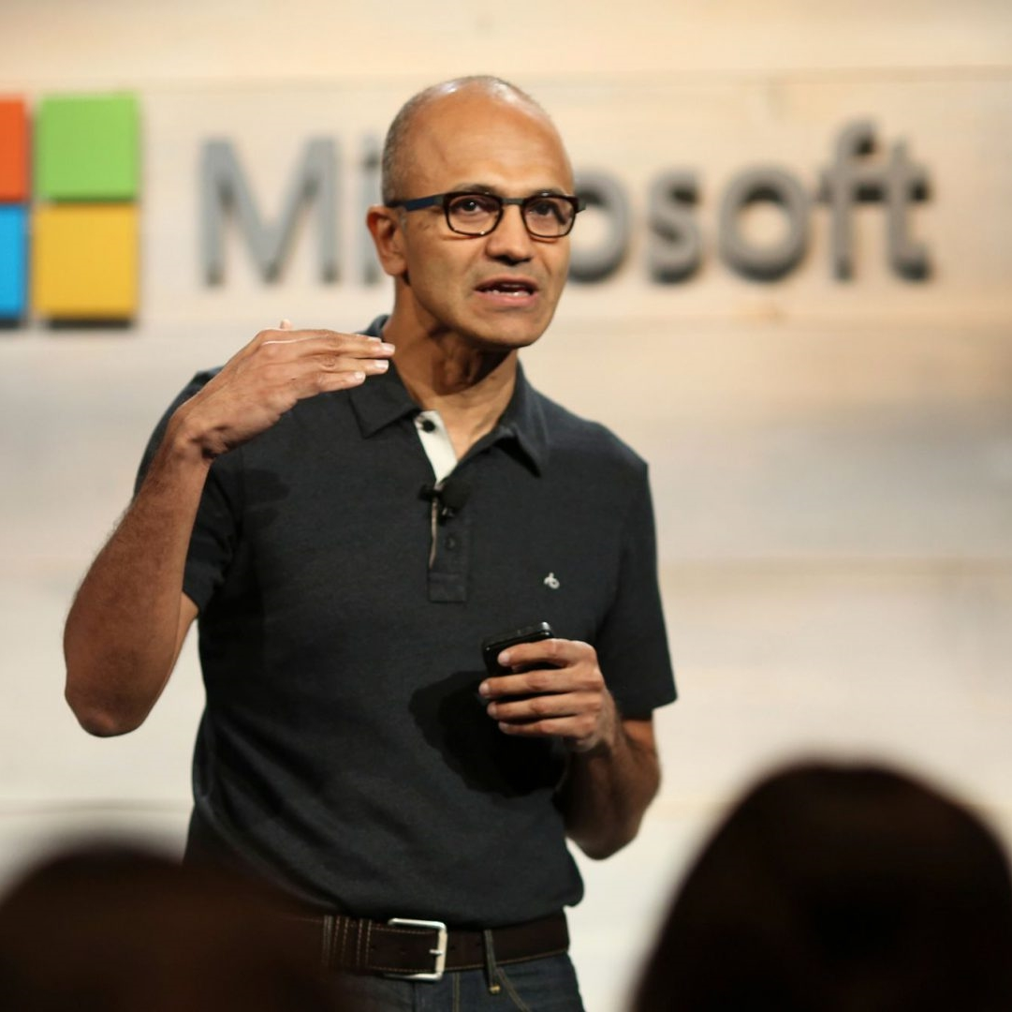
Two years worth of digital transformation in two months.
Satya Nadella
Earnings call, April 2020
www.microsoft.commicrosoft-365/blog/2020/04/30/2-years-digital-transformation-2-months/
Notes:
https://www.microsoft.com/en-us/microsoft-365/blog/2020/04/30/2-years-digital-transformation-2-months/

Slide 5
COVID-19 has accelerated security challenges
Enterprise perimeter has disappeared
Work and personal intermingled
Attacks exploiting fear and uncertainty
Keeping users productive

Slide 6
Microsoft 365 Apps keep users safe wherever they are
Secure defaults
Secure configuration
Integrated protection

Slide 7
Secure defaults

Slide 8
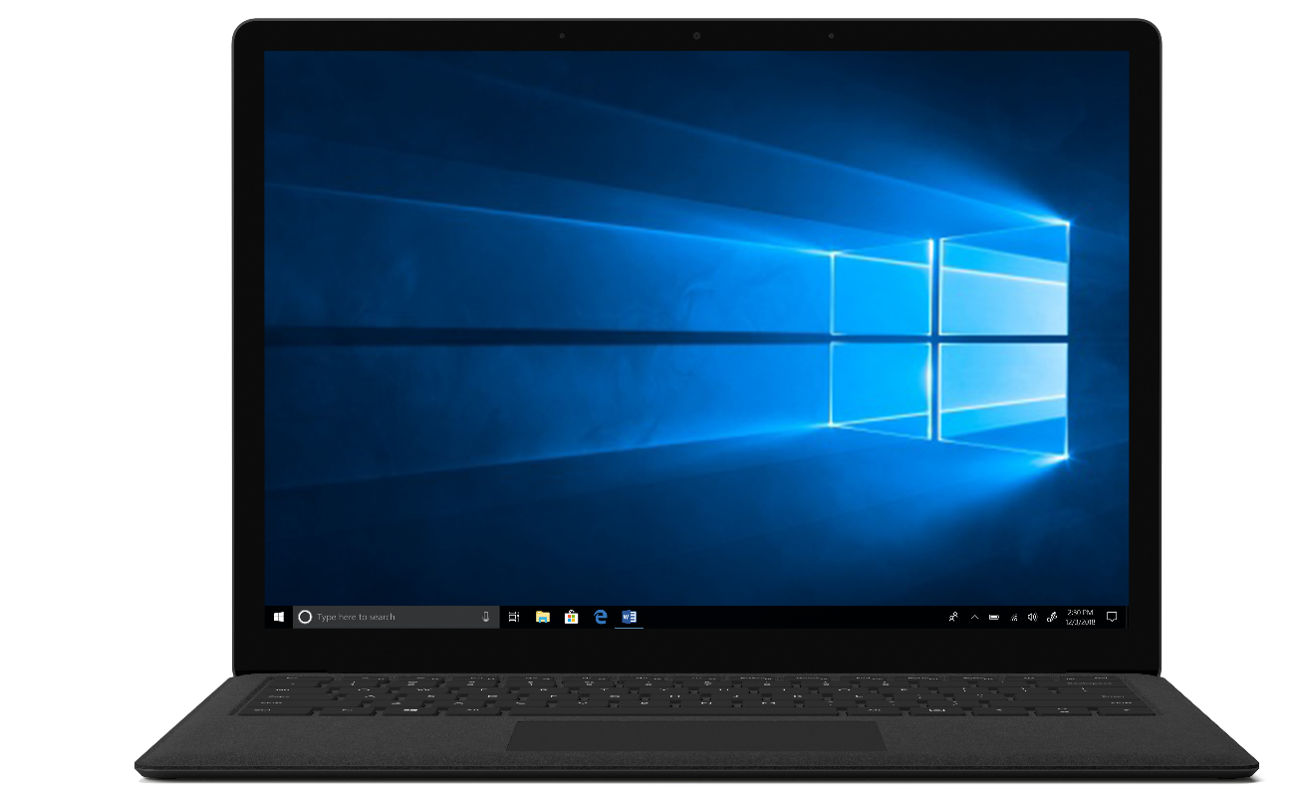
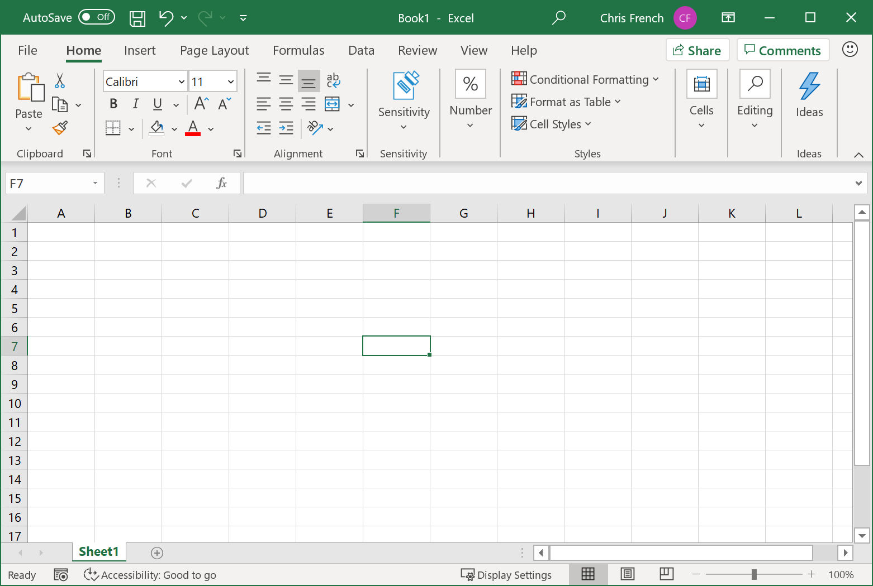
Product security improvements
Ongoing improvements for Microsoft 365 customers
Security assurance following the SDL for features and products in development
Security improvements for existing features to counter contemporary threats
What’s New
AMSI integration for Excel 4.0 (XLM) macros

Slide 9
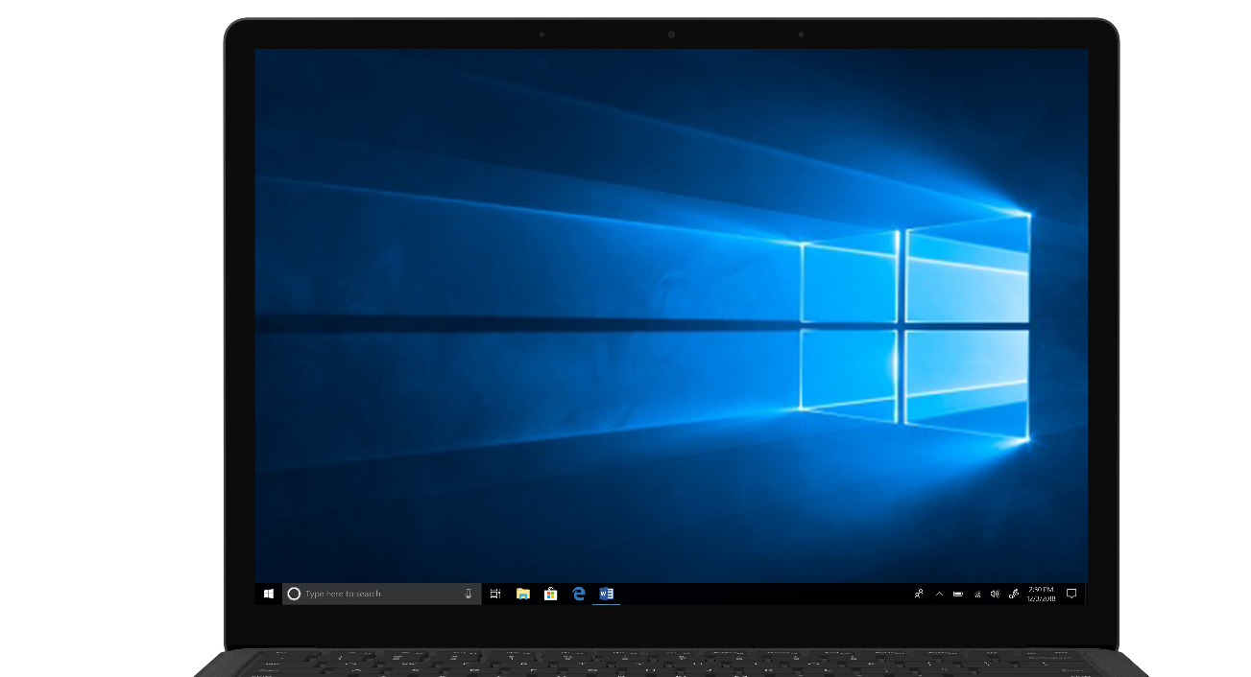
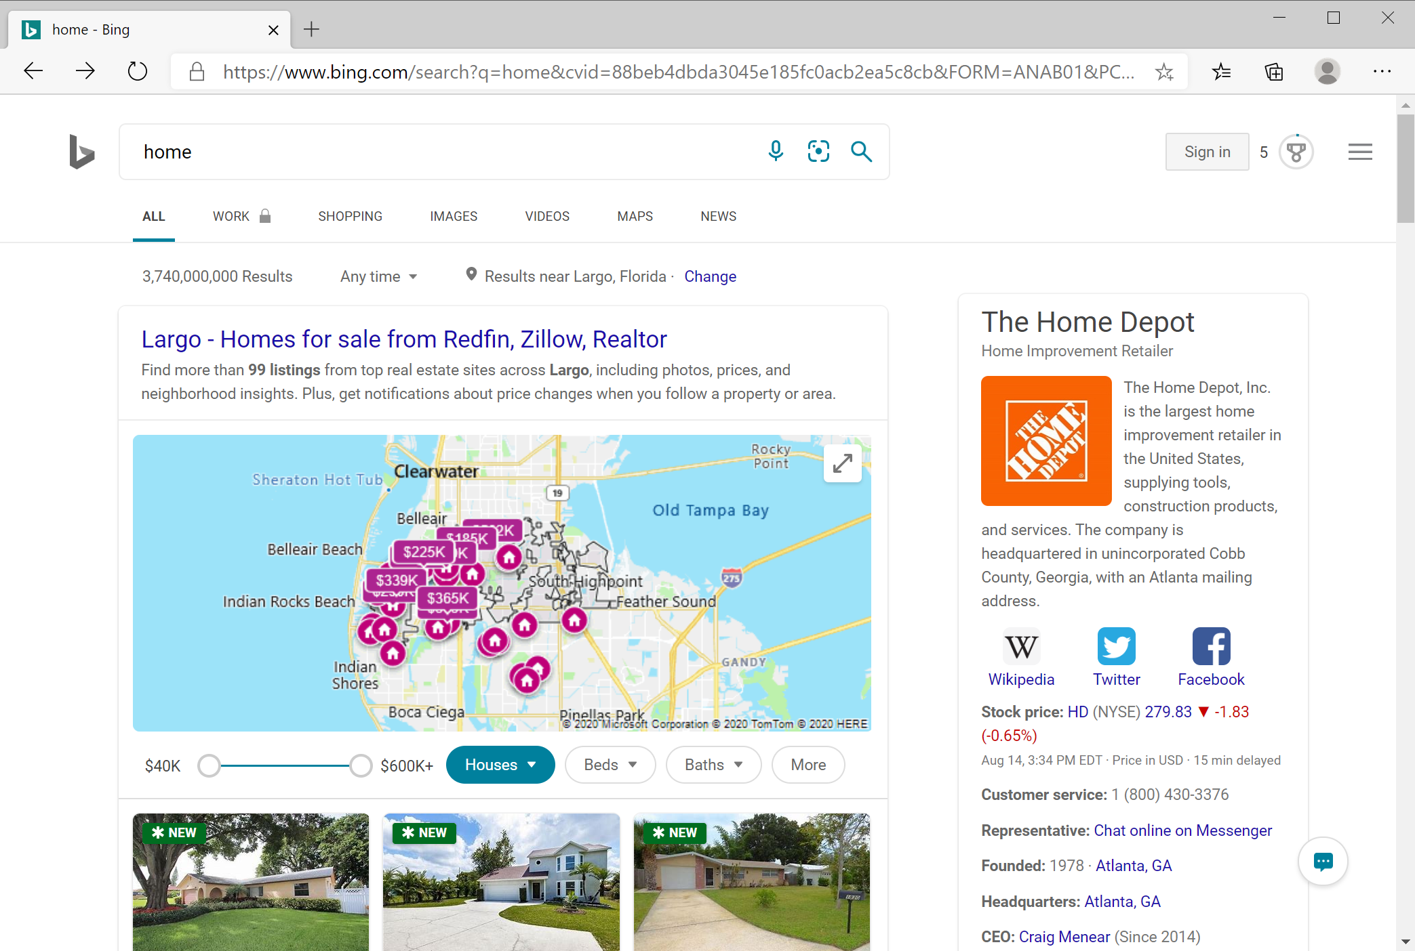
XL4 Macros are a popular vector of attack

Slide 10
Runtime verification via AMSI
1. Log
2. Trigger
3. Alert
4. Block execution
4.
1.
2.
AMSI
Anti-Virus
3.
Obfuscated macro
Behavior Log
Excel
Notes:
Needs polish.
Illustrates how macros are verified at runtime for malicious behavior. Macro are arbitrary code that can run inside Office. They are typically obfuscated so security solutions scanning the document cannot detect the malicious behavior, the code constructs itself on execution.
AMSI helps look past this obfuscation by providing a log of actual behavior that can help a locally installed anti virus determine when a malicious action is happening and stop the macro from execution.

Slide 11
Demo - AMSI integration for XLM macros

Slide 12
Secure configuration

Slide 13
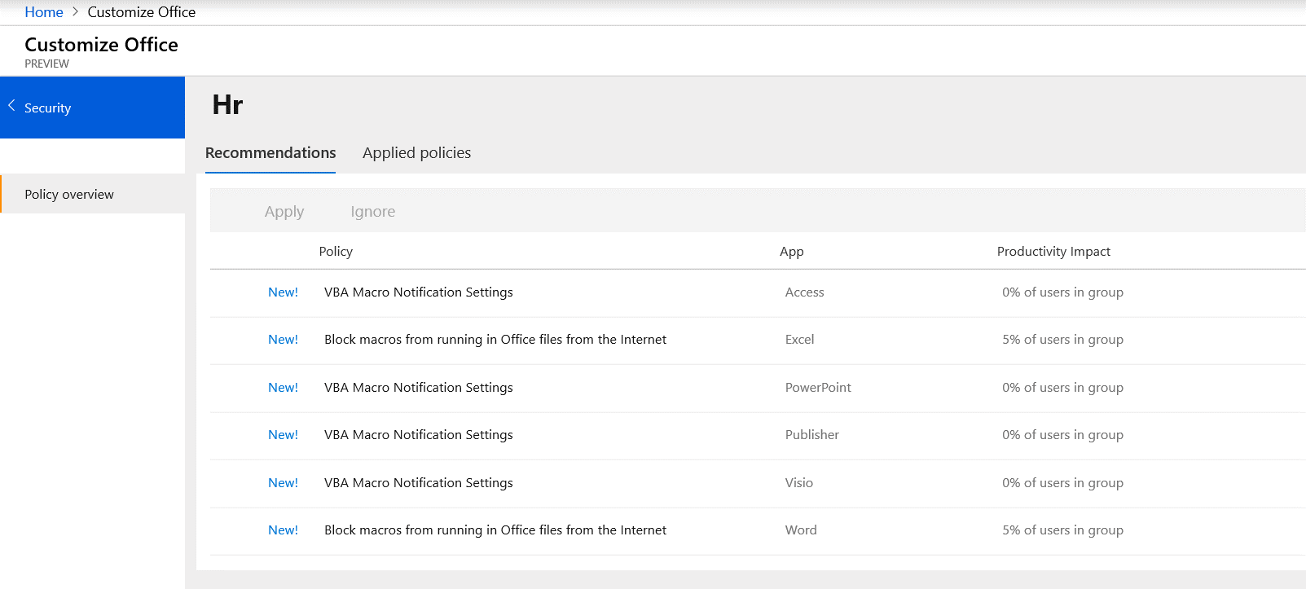
Security Policy Advisor Generally available for Microsoft 365 Enterprise customers
View intelligent security policy recommendations based on Office app feature usage
Easily deploy security policies and scope to specific features, apps, or groups
Monitor policy health to evaluate impact on user productivity
What’s New
Drastically reduced latency and time to detect high impact policies
“Show all recommendations” including high impact
Learn more about Security Policy Advisor.
Notes:
Learn more
https://docs.microsoft.com/en-us/deployoffice/overview-of-security-policy-advisor

Slide 14
Safe configuration anywhere
App usage
Admin
Security Policy Recommendations
User
At work
Security Policy
OCPS + SPA
Security Policy
Office Admin Portal
At home
Security Policy
config.office.com

Slide 15
Demo – Security Policy Advisor recommendations

Slide 16
Integrated protection

Slide 17
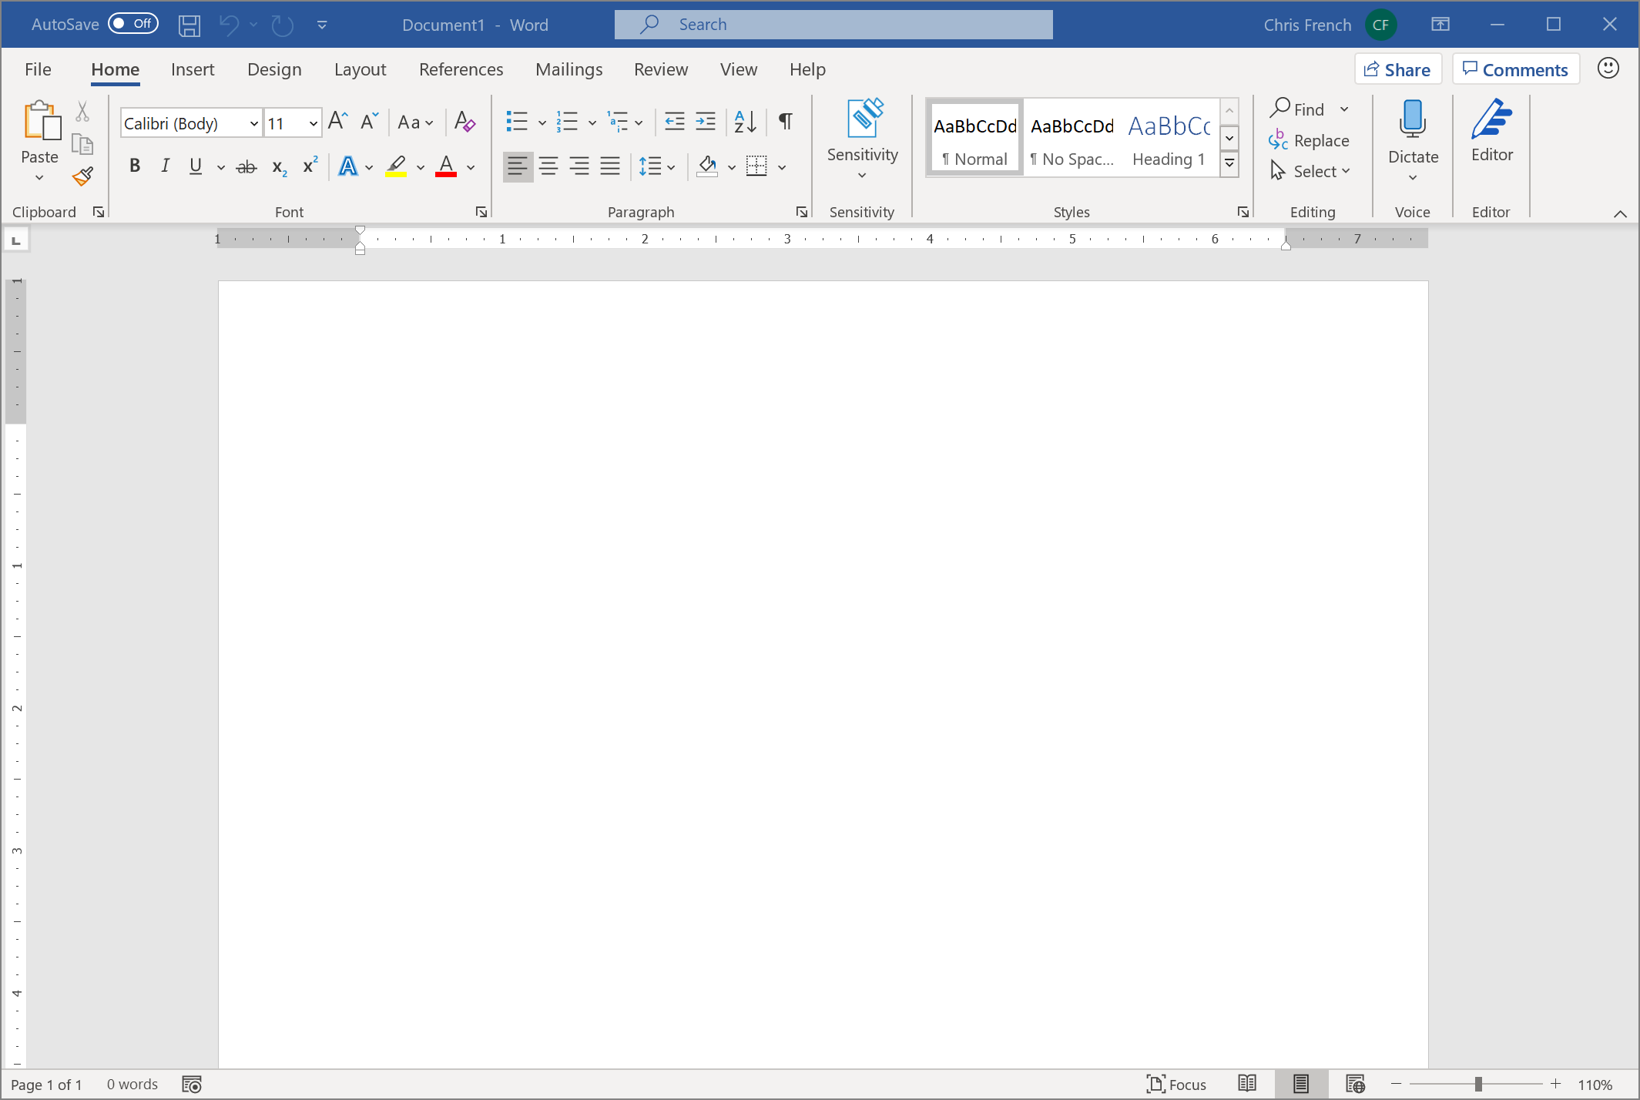
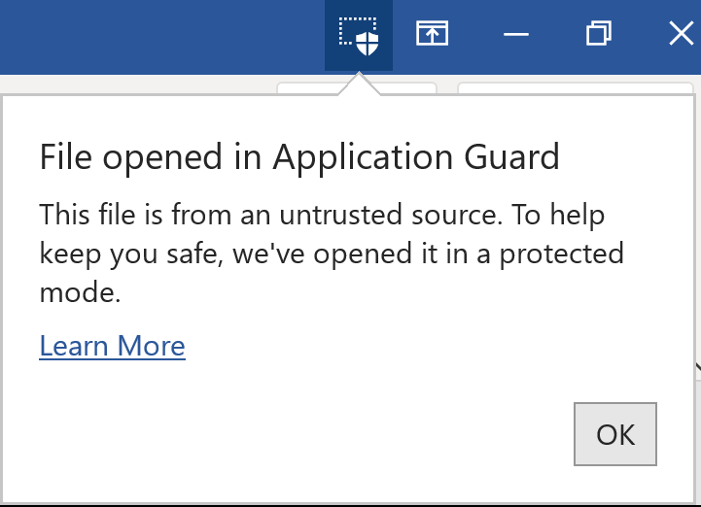
Application Guard for Office Public preview for Microsoft 365 E5 and Microsoft 365 E5 Security customers
Users stay protected and productive with container-based isolation
Protect users against zero-day exploits and advanced attacks
Microsoft Security Graph gets stronger with every malicious attack contained, benefiting everyone
What’s New
Public preview
Experience improvements
Learn more about Application Guard. Requires CPU virtualization extensions, Windows 10, and Microsoft Edge. Learn more about system requirements.
Notes:
First truly Microsoft 365 experience that combines the best of Windows 10 + Microsoft 365 Apps + MD ATP

Slide 18
Safe Documents Generally available for Microsoft 365 E5 or Microsoft 365 E5 Security customers
Desktop users can verify external documents are safe no matter the source
Leverage Microsoft 365 Defender cloud for the latest detections
Verify documents are safe before leaving Protected View or Application Guard
What’s New
Generally available
Integrated with Application Guard
Learn more about Safe Documents

Slide 19
Application Guard isolation
Office
Office
Windows Platform
Services
Windows Platform
Services
Kernel
Hypervisor (Hyper-V)
Kernel
Device Hardware
Application Guard Container
Host
Notes:
Document shows how Office isolates
Green document is a trusted document, for example, an email attachment from your colleague or a file opened from your SharePoint. These documents open directly on device and have full access to the system
Red documents are untrusted documents, for example, attachments in an email coming from someone outside the company or a document downloaded from a site on the internet. When Office encounters such documents, it opens them into Application Guard which is a fully virtualized environment on the same machine that is isolated from the device. Documents in the container have restricted access to the system and low privileges.

Slide 20
Safe Documents verification
No threats
Office
Office
Safe Documents
Windows Platform
Services
Windows Platform
Services
Kernel
Kernel
Hypervisor (Hyper-V)
Device Hardware
Application Guard Container
Host
Notes:
Slide illustrates how a document inside Applictation Guard container is verified before a user is allowed to open it directly on device.

Slide 21
Safe Documents verification
Threat detected
Office
Office
Document not allowed outside container
Safe Documents
Windows Platform
Services
Windows Platform
Services
Kernel
Kernel
Hypervisor (Hyper-V)
Device Hardware
Application Guard Container
Host
Notes:
Slide illustrates how a document is confined in container if a threat is detected (when a user tries to open it outside the container)

Slide 22
Demo – Application Guard for Office + Safe Documents

Slide 23
Availability
Available
Feature
To
Where
When
Runtime AMSI scan for XLM Macros
M365 apps
(all SKUs)
Beta channel
(preview)
Coming soon
Secure Defaults
Security Policy Advisor
M365
Enterprise
All channels
(Generally available)
Now
Secure
Configurations
Safe
Documents
M365 E5,
M365 E5 Security
Monthly Enterprise channel
(Generally available)
Now
Integrated
Protection
Application Guard for Office
M365 E5,
M365 E5 Security
Beta channel
(preview)
Now

Slide 24
Microsoft 365 Apps keep users safe wherever they are
Secure defaults
Secure configuration
Integrated protection

Slide 25
Next steps
Stay current, stay secure
Boost security configuration with Security Policy Advisor and Office Cloud Policy Service
Enable Safe Documents and Application Guard for Office for integrated protection

Slide 26
Resources
Security Policy Advisor
Microsoft Defender Application Guard Platform
Application Guard for Office
Safe Documents

