Slide 1
What is SharePoint and how can I use it?
Dave Cohen, Nicole Woon

Slide 2
Agenda
What are SharePoint sites?
Team site vs. communication site
Team site demo
Communication site demo
Resources

Slide 3
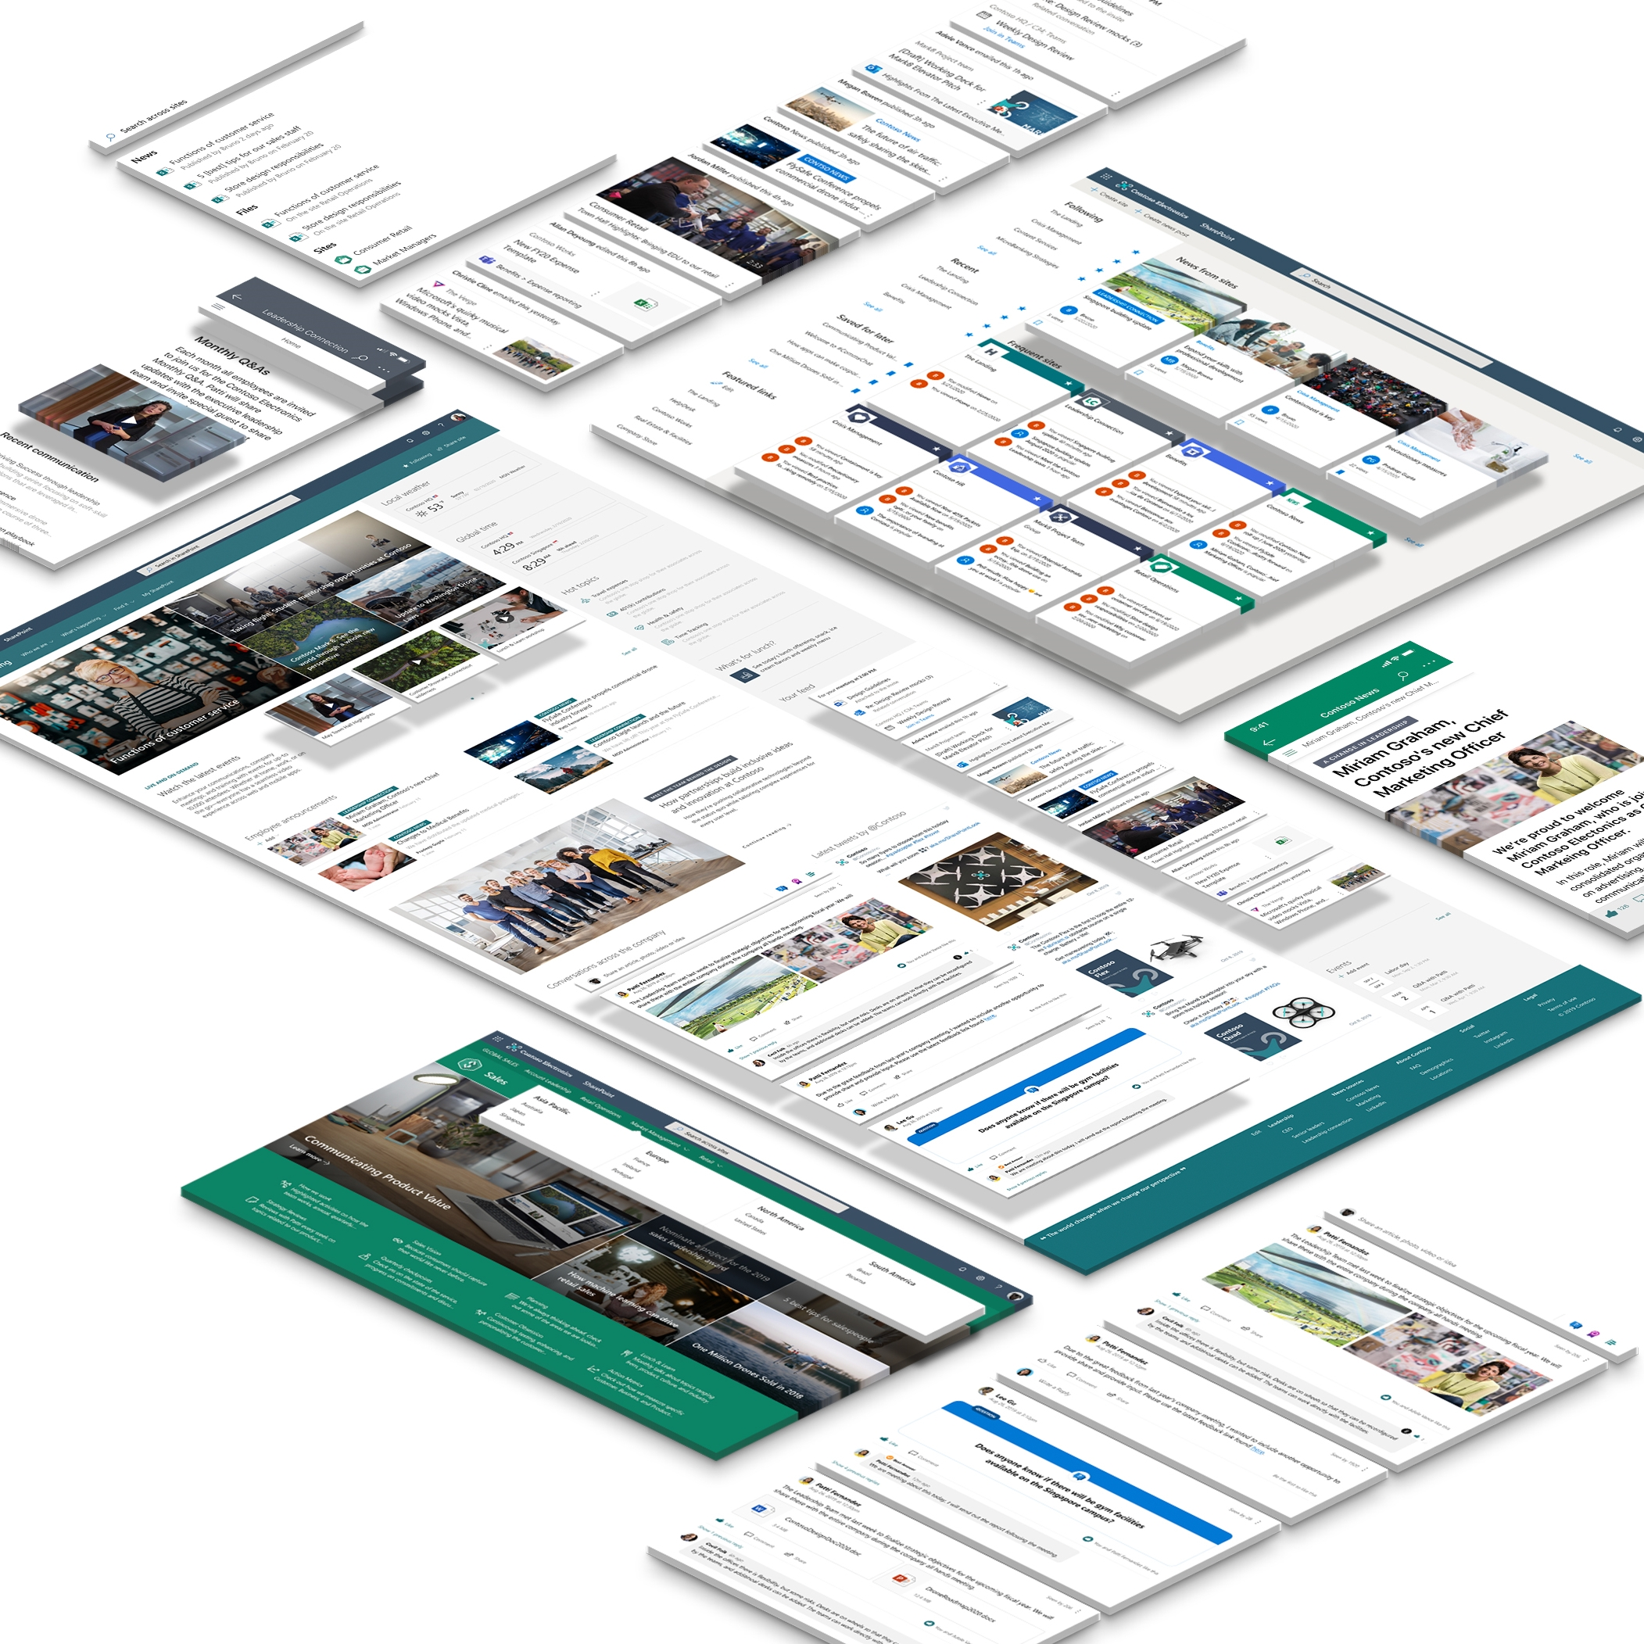
What are SharePoint sites?
A SharePoint site is a site on your organization’s intranet that helps people and teams work together and stay informed
Sites are easy to create and edit, and they’re flexible enough to address a variety of needs
Two types of sites to choose from – team site or communication site

Slide 4
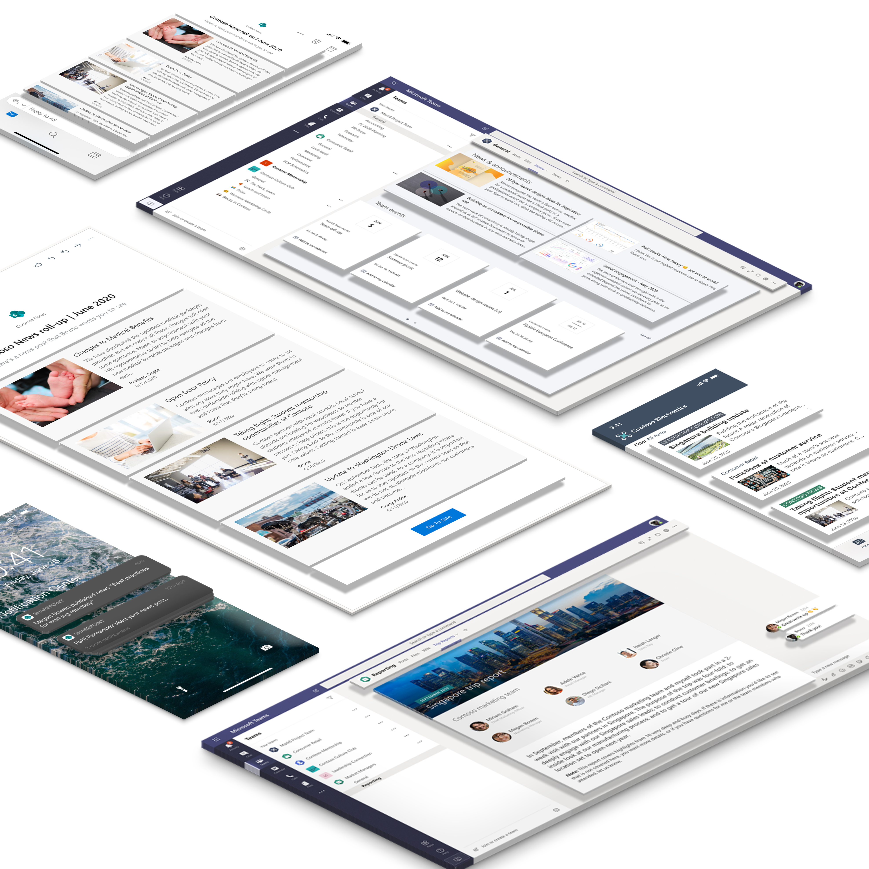
Team site overview
A SharePoint team site connects you and your team to the content, information, and apps you rely on every day
Designed to optimize for team or project collaboration with Microsoft 365 group integration
Includes the option to connect to Microsoft Teams

Slide 5
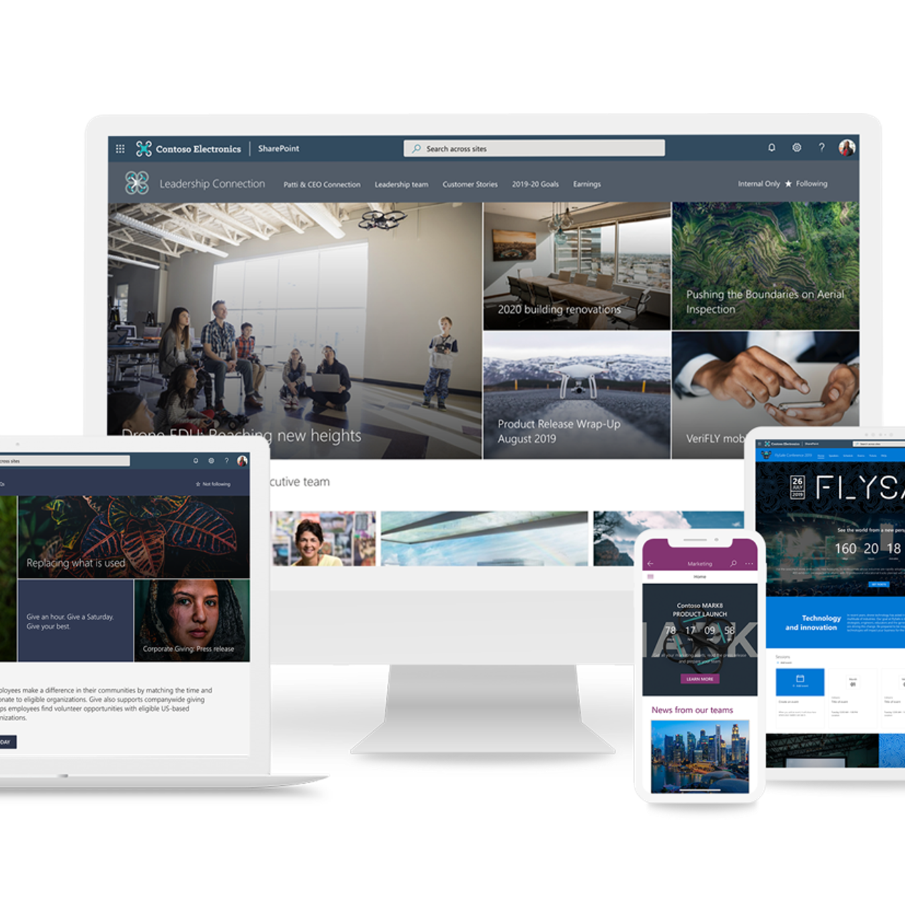
Communication site overview
A SharePoint communication site is a great place to share information with a broad audience in a visually compelling format
Optimized for a small number of authors and includes out of the box homepage designs to help you get started
Not connected to a Microsoft 365 group

Slide 6
When to use team site vs. communication site
 | Team Site | Communication Site
Scenario | Space optimized for a team of people to collaborate on a project or content together | Space designed for a small group of editors/authors to broadcast or publish content to a wider audience
Default home page | Includes webparts for productivity and team activity/updates | Includes webparts for showcasing information and images
Navigation | Navigation designed to help you get to and interact with content | Navigation (like header and footer) geared towards browsing information
Lifecycle | Can be short-lived or long-lasting
Connection to other apps | Typically connected to a Microsoft 365 group and can be connected to Microsoft Teams | Not connected to a Microsoft 365 group nor Microsoft Teams

Slide 7
Example team site vs. communication site scenarios
Team site scenarios
Project team working together to complete deliverables and manage tasks
Holiday party planning committee planning the annual get-together
Extranet site to work with a partner
Human Resources team members – everyone who works in HR
Communication site scenarios
"Official" corporate news
Travel team publishing guidelines about corporate travel
Policies and procedures
HR team communicating benefits and compensation information

Slide 8
Key components of a site
Pages and News Posts
Libraries
Lists
Navigation
Branding
Permissions

Slide 9
Basic site lifecycle
Create site
Add content (pages with web parts, files, lists, branding, navigation, etc.)
Add permissions
Broadcast your site!

Slide 10
Team site demo

Slide 11
Communication site demo

Slide 12
Resources

Slide 13
SharePoint look book: get inspired
lookbook.microsoft.com

Slide 14
Additional Resources
💻 Team site vs. Communication site: docs.microsoft.com/en-us/microsoft-365/community/team-site-or-communication-site
🔨 Virtual hub for additional digital skilling videos: aka.ms/VirtualHub
📣 SharePoint UserVoice: sharepoint.uservoice.com

