Slide 1
Personal productivity insights in Microsoft 365 – enhancing employee wellbeing
Last updated: Sept. 2020

Slide 2
The new world of work
After hours work
Blurred boundaries
Collaboration fatigue
Social isolation
Teams chats outside of the typical workday, from 8-9 a.m. and 6-8 p.m., have increased over 15%, on Saturday and Sunday have increased over 200%.
Elimination of physical boundaries and temporal boundary offered by commute leading to a feeling of “always-on”
People find remote collaboration more mentally challenging, overwork and stress are significantly higher in video meetings
Nearly 60% of people we surveyed feel less connected to their colleagues since working remotely more often
Sources: https://aka.ms/WTrend2 and https://insights.office.com/workplace-analytics/balancing-work-and-life-under-one-roof/

Slide 3
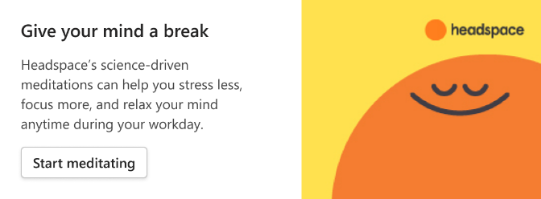
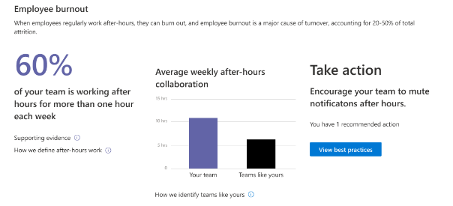
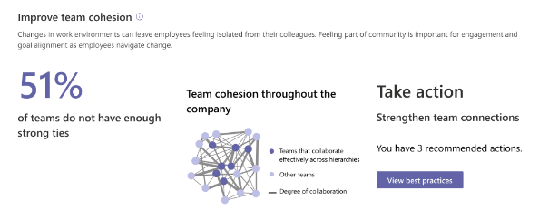
Insights for individuals, teams, and leaders
Personal
Manager
Leader
IT Leader

Slide 4
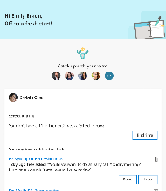
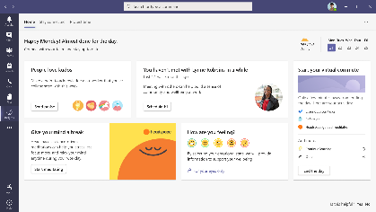
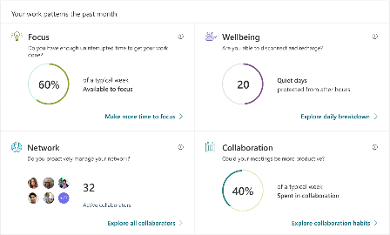
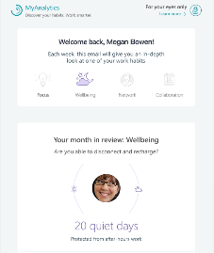
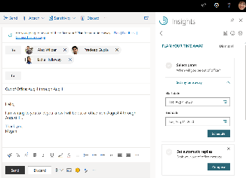
Personal productivity and wellbeing insights
Take action in the flow of your work
to be more effective every day
Understand how you work
to improve your work patterns over time
Briefing email from Cortana
Personal insights in Teams (Coming in 2021)
MyAnalytics dashboard
MyAnalytics digest emails
Outlook inline suggestions & Outlook insights add-in
Privacy by design:
Only you can view personal data and insights

Slide 5
Personal insights in Teams
New wellbeing experiences coming in 2021

Slide 6
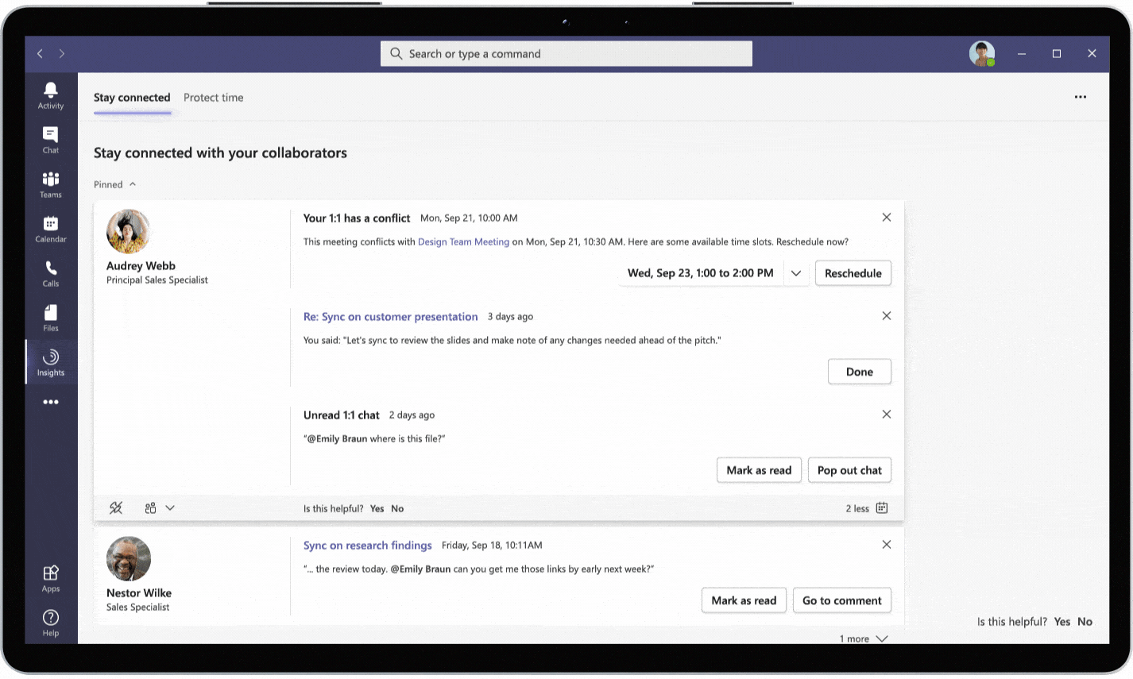
Personal insights in Teams
Targeted release for MyAnalytics users starting in October 2020

Slide 7
Personal productivity and wellbeing insights
Take action in the flow of your work
to be more effective every day
Understand how you work
to improve your work patterns over time
Briefing email from Cortana
Personal insights in Teams (Coming in 2021)
MyAnalytics dashboard
MyAnalytics digest emails
Outlook inline suggestions & Outlook insights add-in
Privacy by design:
Only you can view personal data and insights

Slide 8
Briefing email from Cortana to help you prepare for the day
Generally available for Microsoft 365 Enterprise users with Exchange Online mailboxes in English

Slide 9
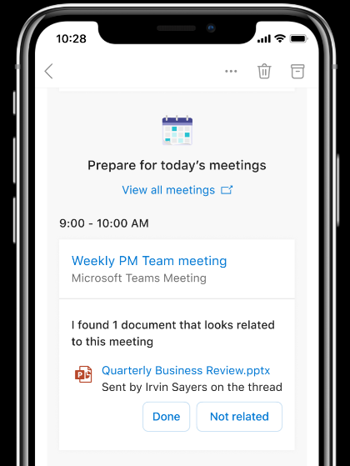
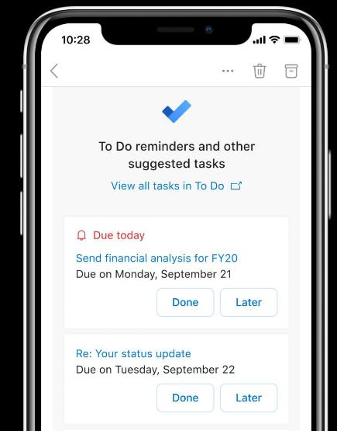
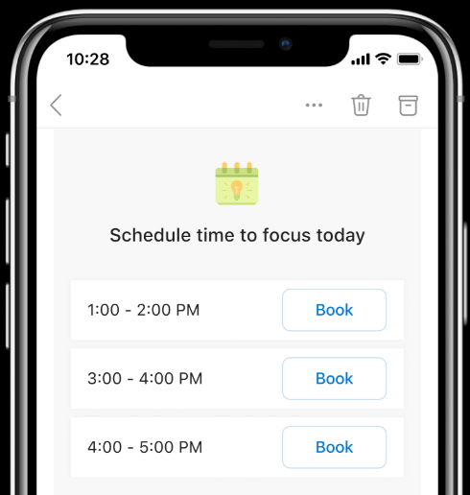
Briefing email from Cortana to help you prepare for the day
Generally available for Microsoft 365 Enterprise users with Exchange Online mailboxes in English
Streamline meeting preparation
Suggested pre-reads
Timely reminders to add meeting agendas, add a Teams meeting link
Stay on top of tasks
Intelligent reminders of tasks due today
Mark tasks as done or add to To Do
Book time for uninterrupted work
Easy to add focus time to your day
Available slots suggested

Slide 10
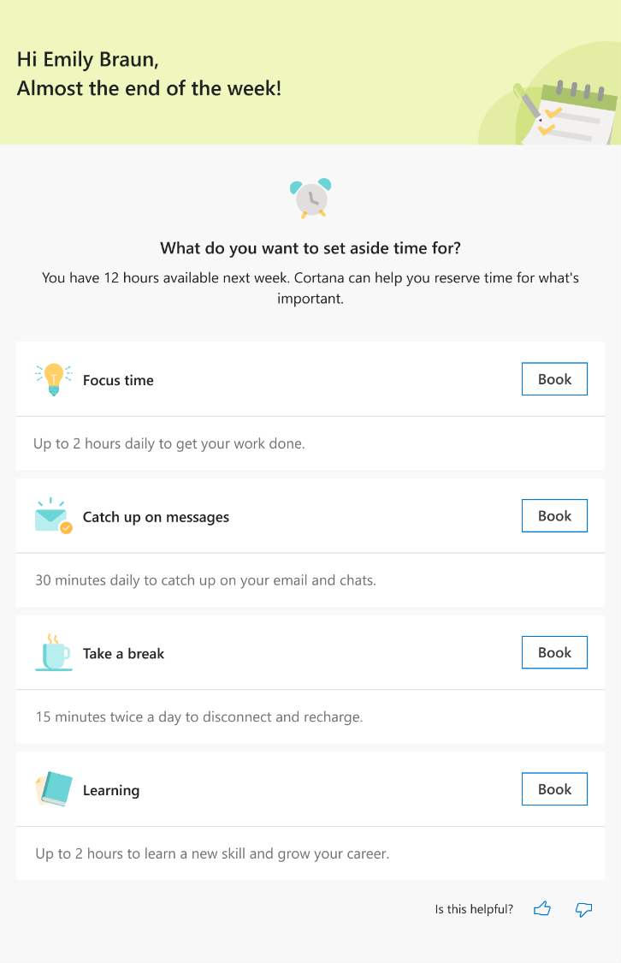
Reserve time for what’s important - coming by end of 2020

Slide 11
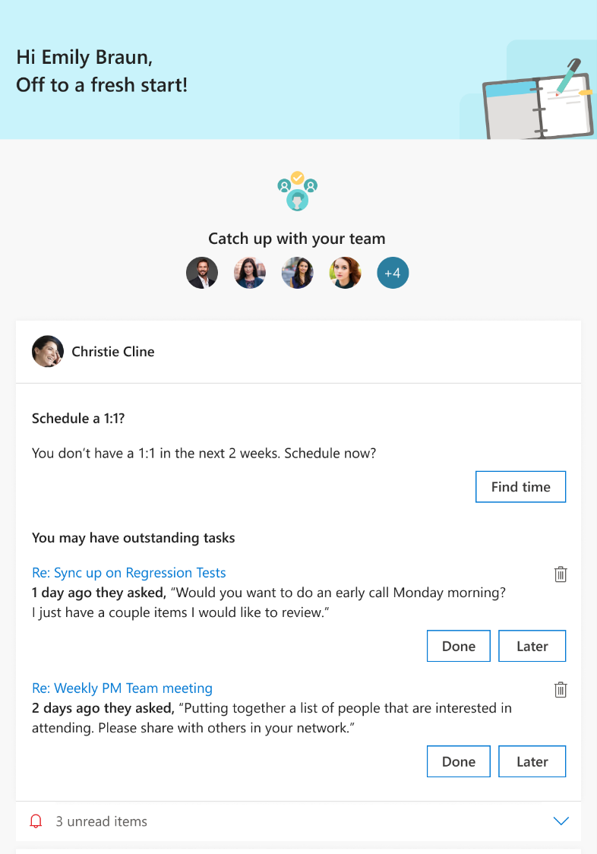
Insights for people managers coming by end of 2020

Slide 12
Personal productivity and wellbeing insights
Take action in the flow of your work
to be more effective every day
Understand how you work
to improve your work patterns over time
Briefing email from Cortana
Personal insights in Teams (Coming in 2021)
MyAnalytics dashboard
MyAnalytics digest emails
Outlook inline suggestions & Outlook insights add-in
Privacy by design:
Only you can view personal data and insights

Slide 13
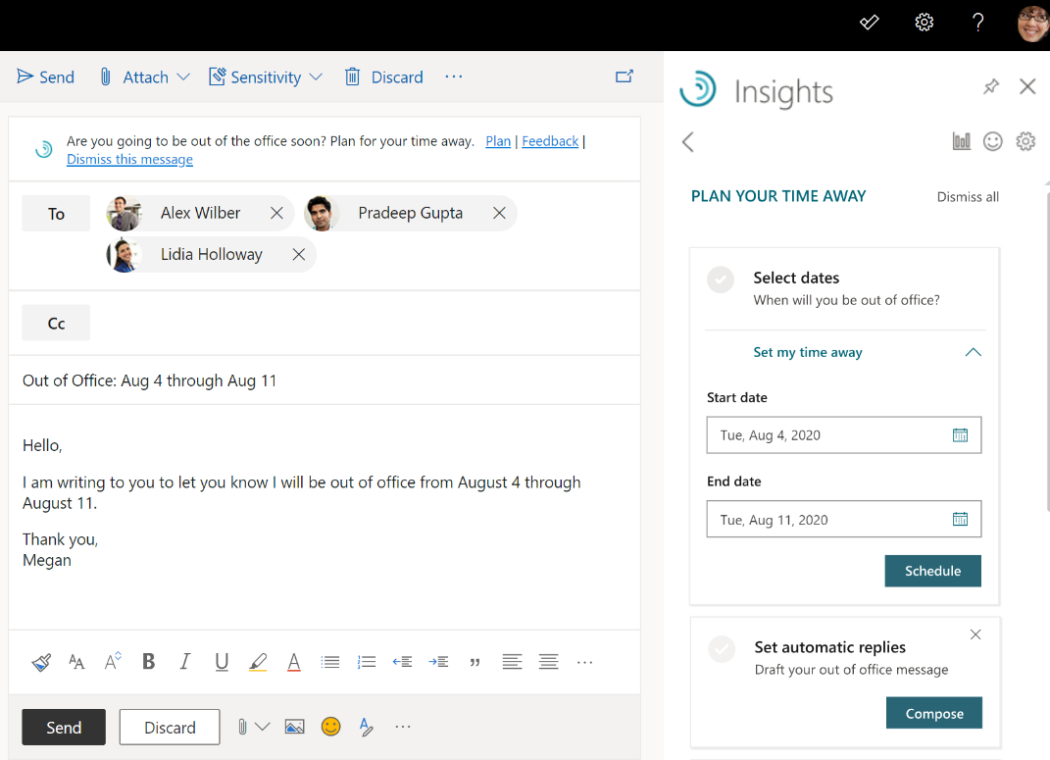
Outlook inline suggestions
Generally available with MyAnalytics for all commercial customers*
Note* Delay Delivery and Plan your time away inline suggestions are available now for Microsoft 365 E5 customers, coming soon to more customers.

Slide 14
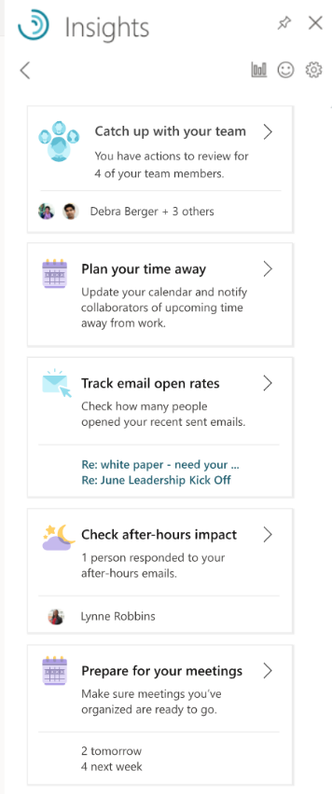
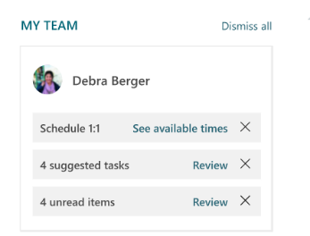
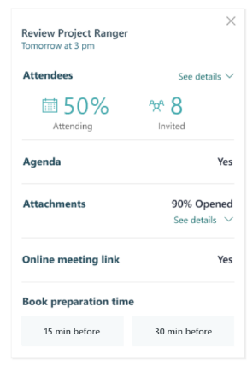
Outlook Insights Add-in
Generally available with MyAnalytics for all commercial customers
Extension of your Outlook experience to help you manage your time, maintain work relationships and improve your overall work-life balance.
Provides specialized insights to people managers to stay in close contact with their team and quickly respond to important requests.

Slide 15
Personal productivity and wellbeing insights
Take action in the flow of your work
to be more effective every day
Understand how you work
to improve your work patterns over time
Briefing email from Cortana
Personal insights in Teams (Coming in 2021)
MyAnalytics dashboard
MyAnalytics digest emails
Outlook inline suggestions & Outlook insights add-in
Privacy by design:
Only you can view personal data and insights

Slide 16
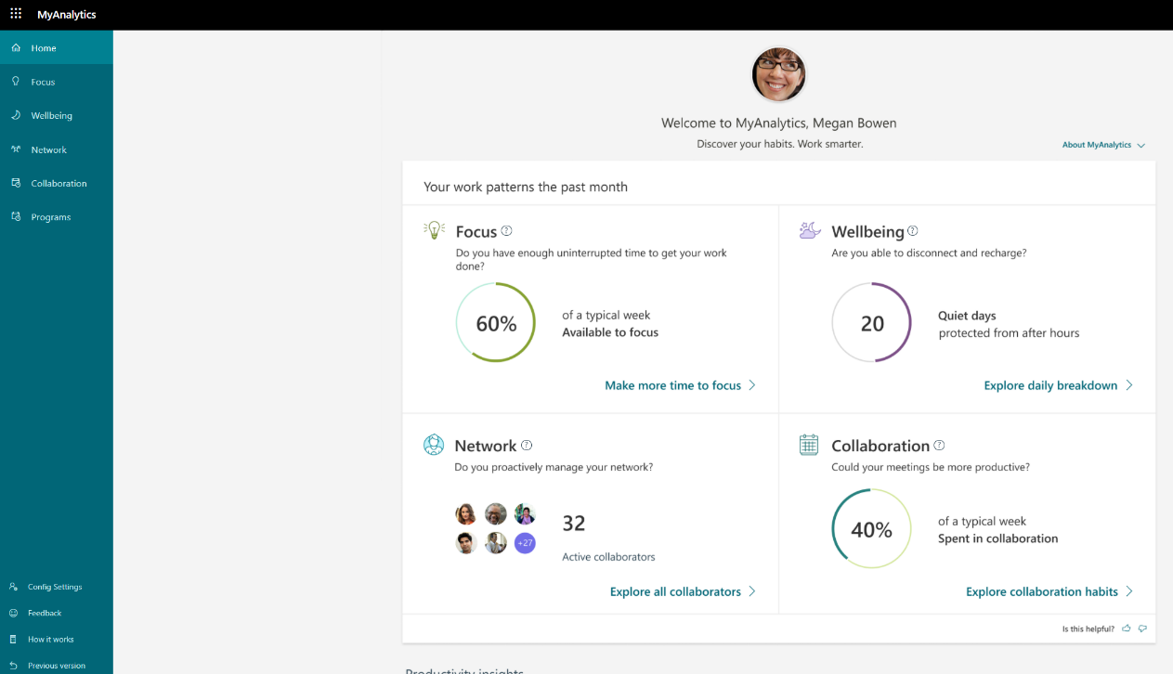
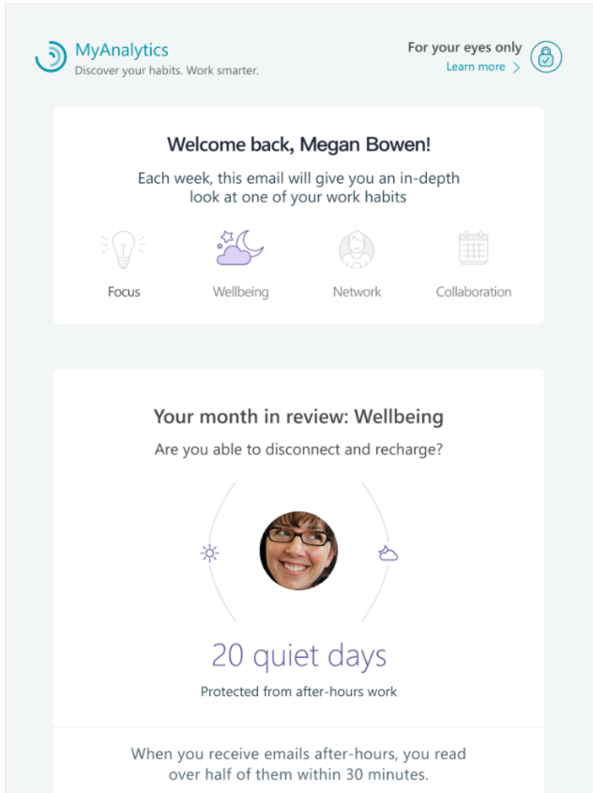
MyAnalytics Digest Emails and Dashboard
Generally available with MyAnalytics for all commercial customers

Slide 17
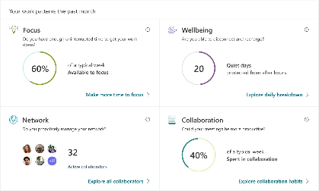
Productivity and wellbeing insights in Microsoft 365 - highlights
2020 Q1
2020 Q2
2020 Q3
Coming next
In Outlook
Delay delivery inline suggestion
Set lunch hours and plan your time away experiences within the Insights add-in
Catch up with your team experience for people managers within the Insights add-in
Briefing email first release for Microsoft 365 Enterprise users in English
Meeting prep experience enhanced to assist in establishing quorum and suggest pre-reads within the Insights add-in
Briefing email generally available for Microsoft 365 Enterprise users in English
Briefing email updates including:
an integration with Microsoft To Do
enhancements for meeting prep that make it easier to address conflicts or low attendance and follow best practices such as adding an agenda or a Teams link
proactive time management to help you set aside time in the week ahead to catch up on your email/chats, take a break to disconnect and recharge, or take out time for learning
specialized insights for people managers
In Microsoft Teams
Starting October: Targeted release of personal productivity insights in Microsoft Teams to help you stay connected and schedule focus time.
In 2021: Personal wellbeing experiences in Microsoft Teams including virtual commute, emotional check in, praise, and meditation app integrations.
MyAnalytics Dashboard
Focus plan available for all MyAnalytics users
Leadership Insights

Slide 18
Additional Resources
Learn more about insights in Teams: Aka.ms/ProductivityAndWellbeing
Learn more about the Briefing Email: Aka.ms/BriefingEmail
Learn more about MyAnalytics: Aka.ms/MyAnalyticsAdminGuide

