Slide 1
Cortana – what’s new and what’s next for your personal productivity assistant in Microsoft 365
Last updated: Sept. 2020

Slide 2
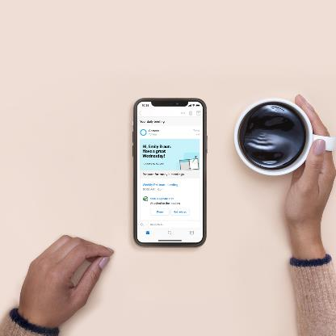
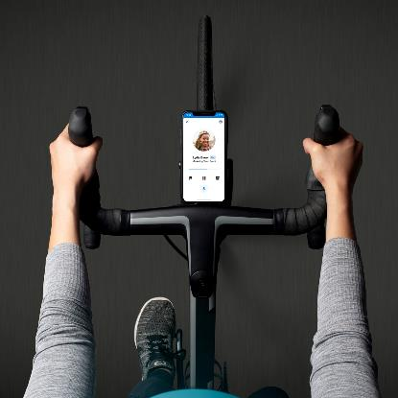
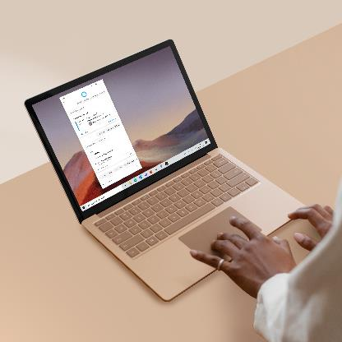
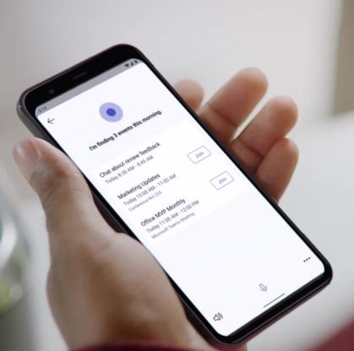

Get time back and focus on what matters with Cortana, your personal productivity assistant in Microsoft 365
Start the day on track with your daily briefing email from Cortana
Stay caught up and organized hands-free with Play My Emails
Save time and stay on track with Cortana in Windows 10
Streamline collaboration with voice assistance from Cortana in Teams

Slide 3
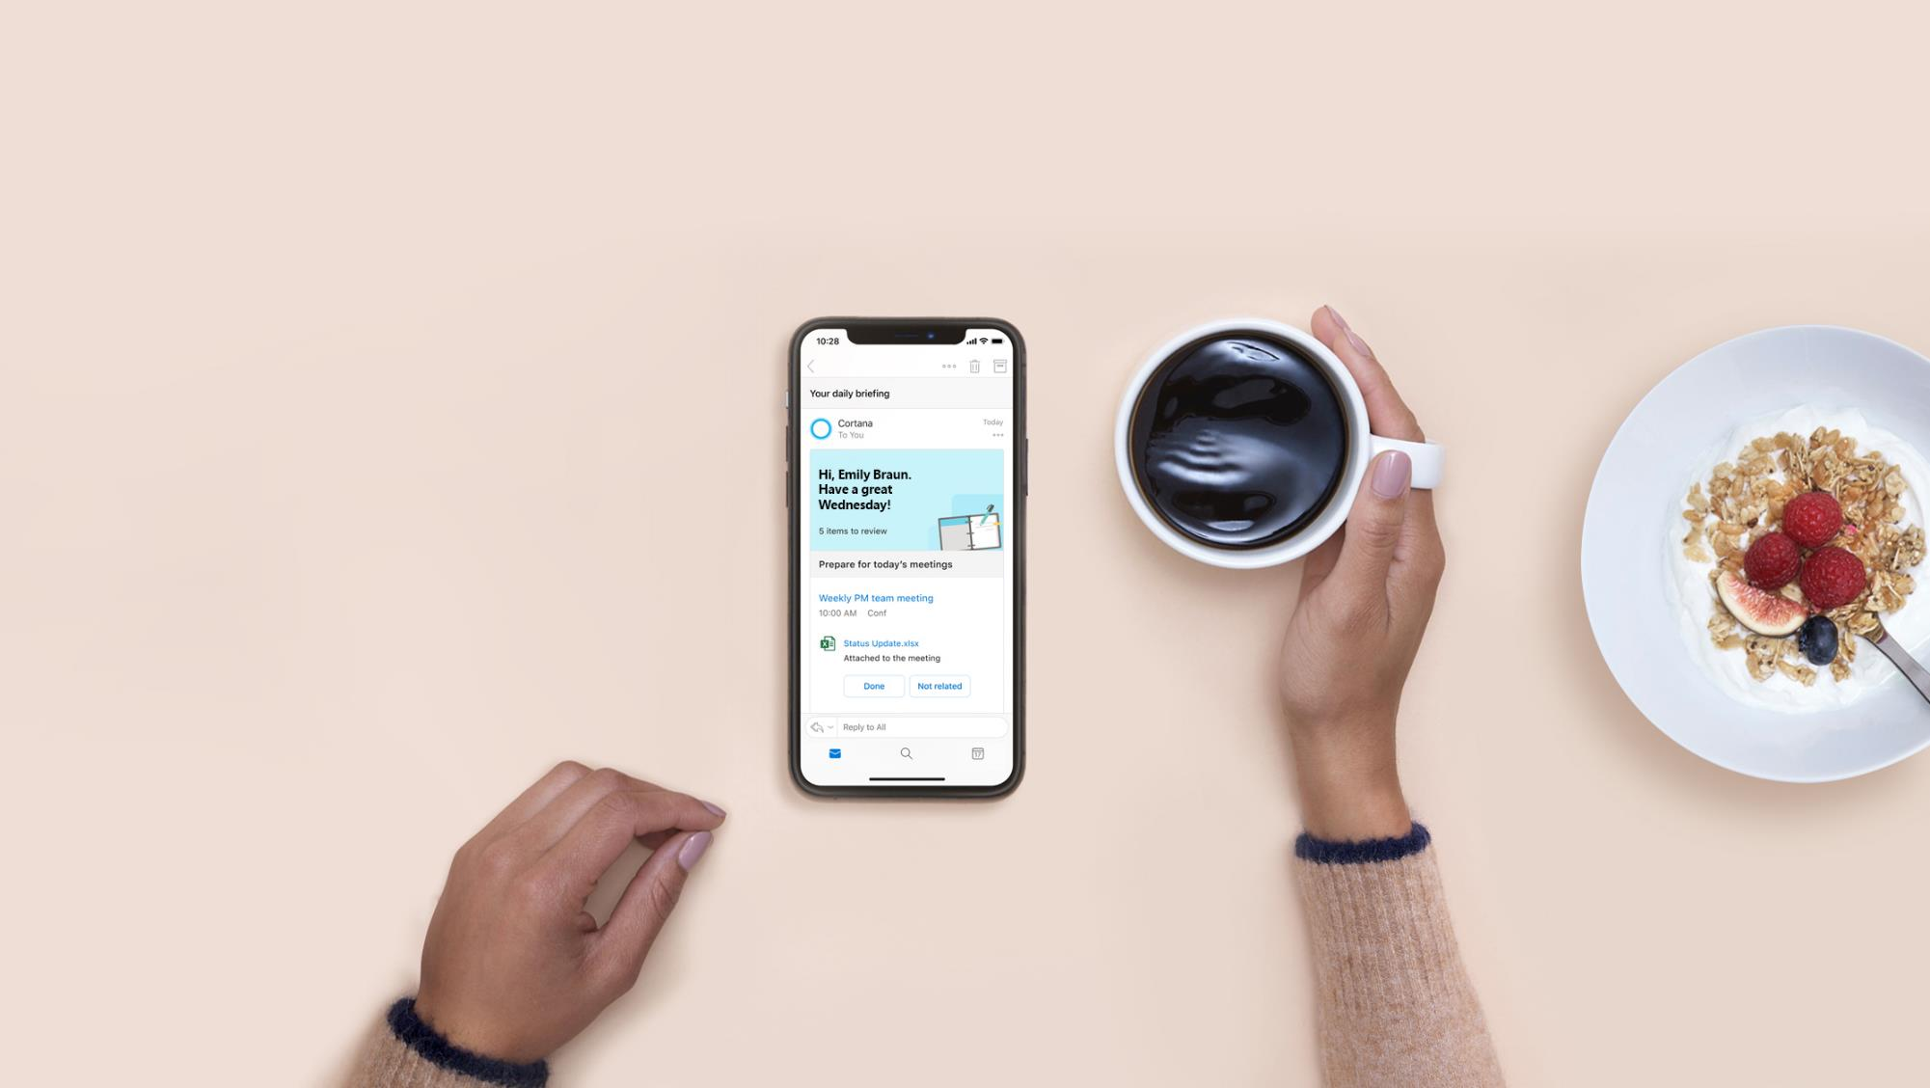
Start the day on track with your
Briefing email

Slide 4
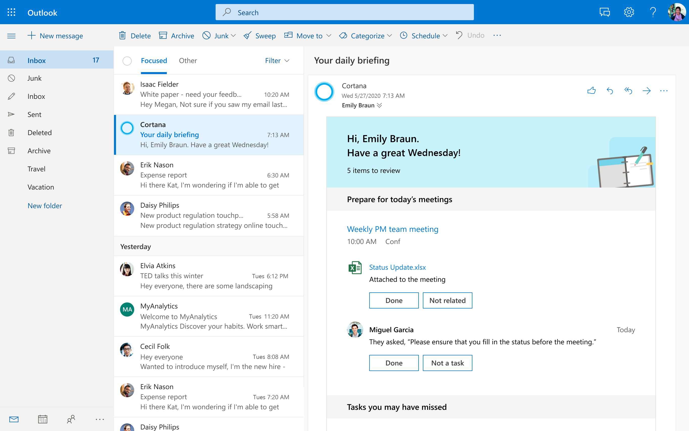
Briefing – a personalized email from Cortana to help you prepare for the day
Generally available for Microsoft 365 Enterprise users with Exchange Online mailboxes in English

Slide 5
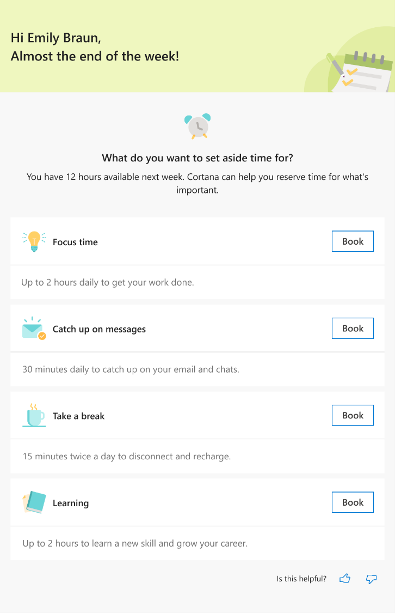
Assistance to plan for the week coming by end of 2020

Slide 6
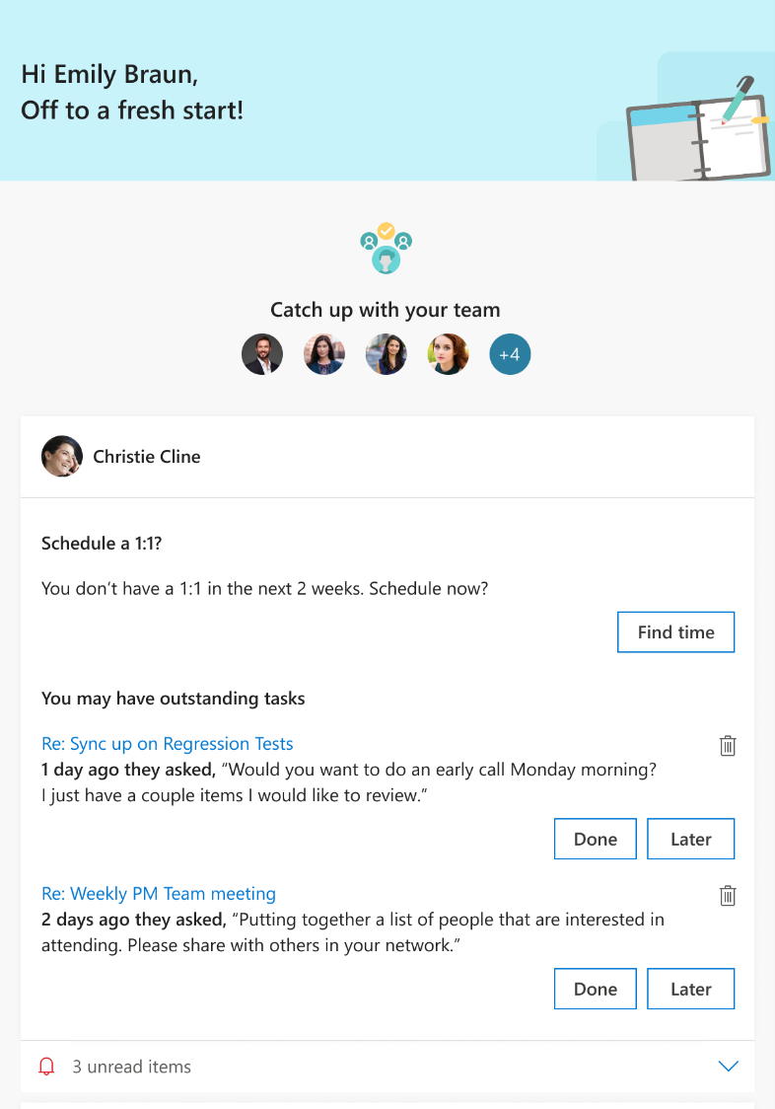
Insights for people managers coming by end of 2020

Slide 7
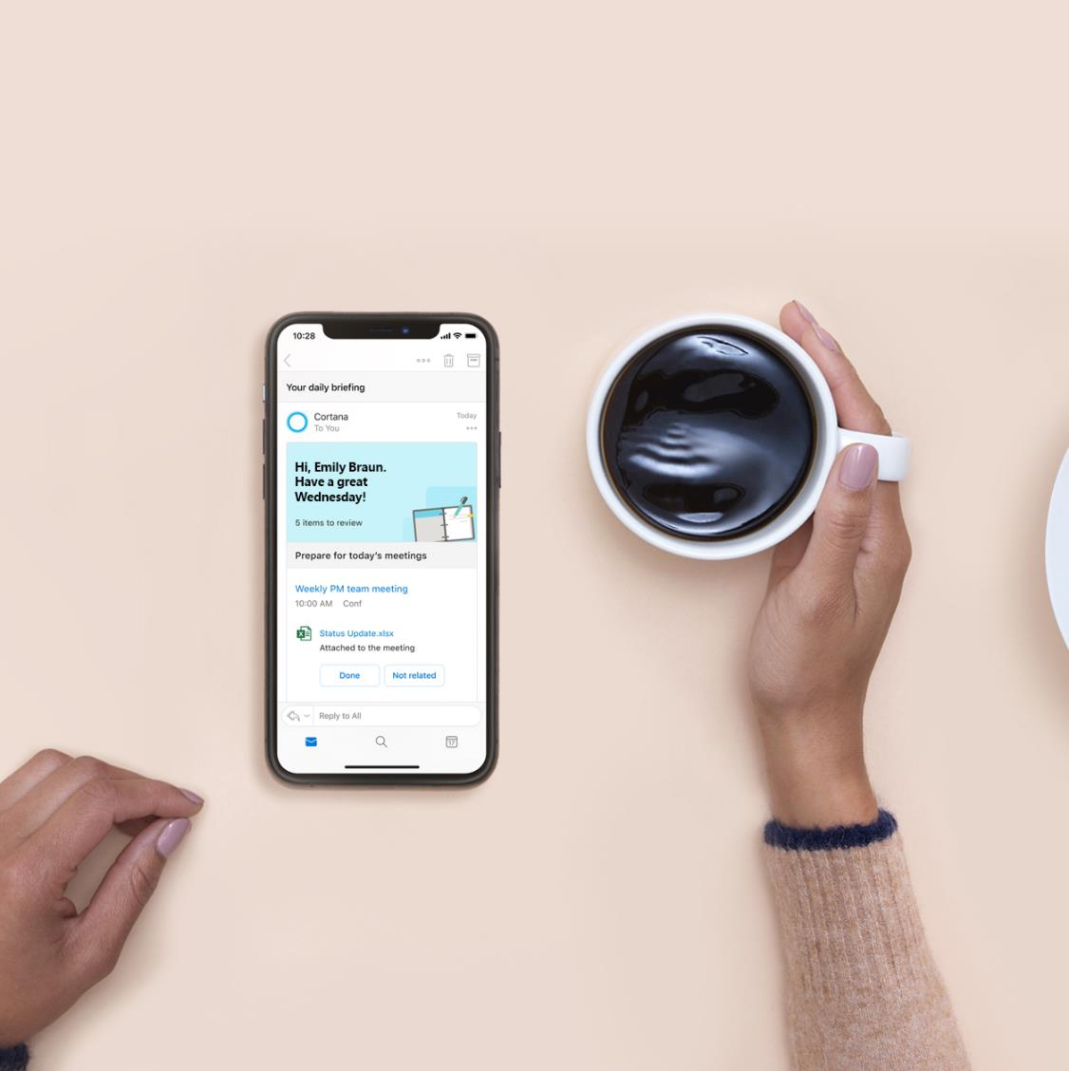
Learn more: Aka.ms/BriefingEmail

Slide 8
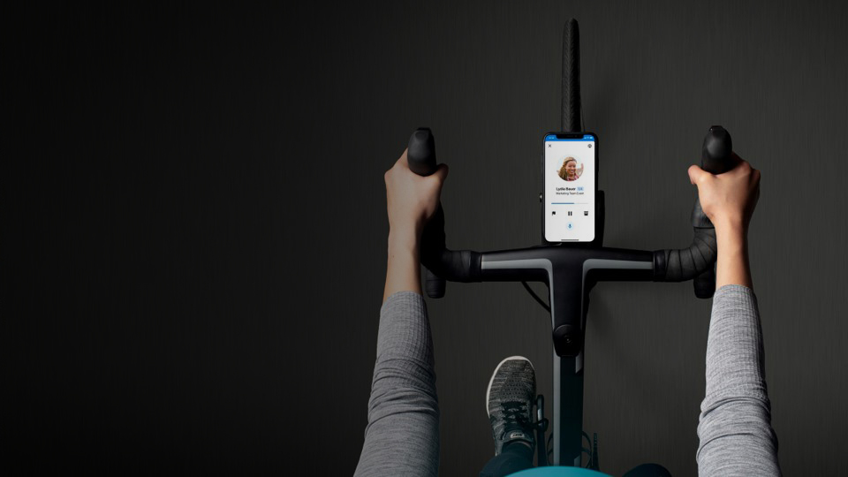
Stay caught up with Play My Emails in Outlook mobile

Slide 9
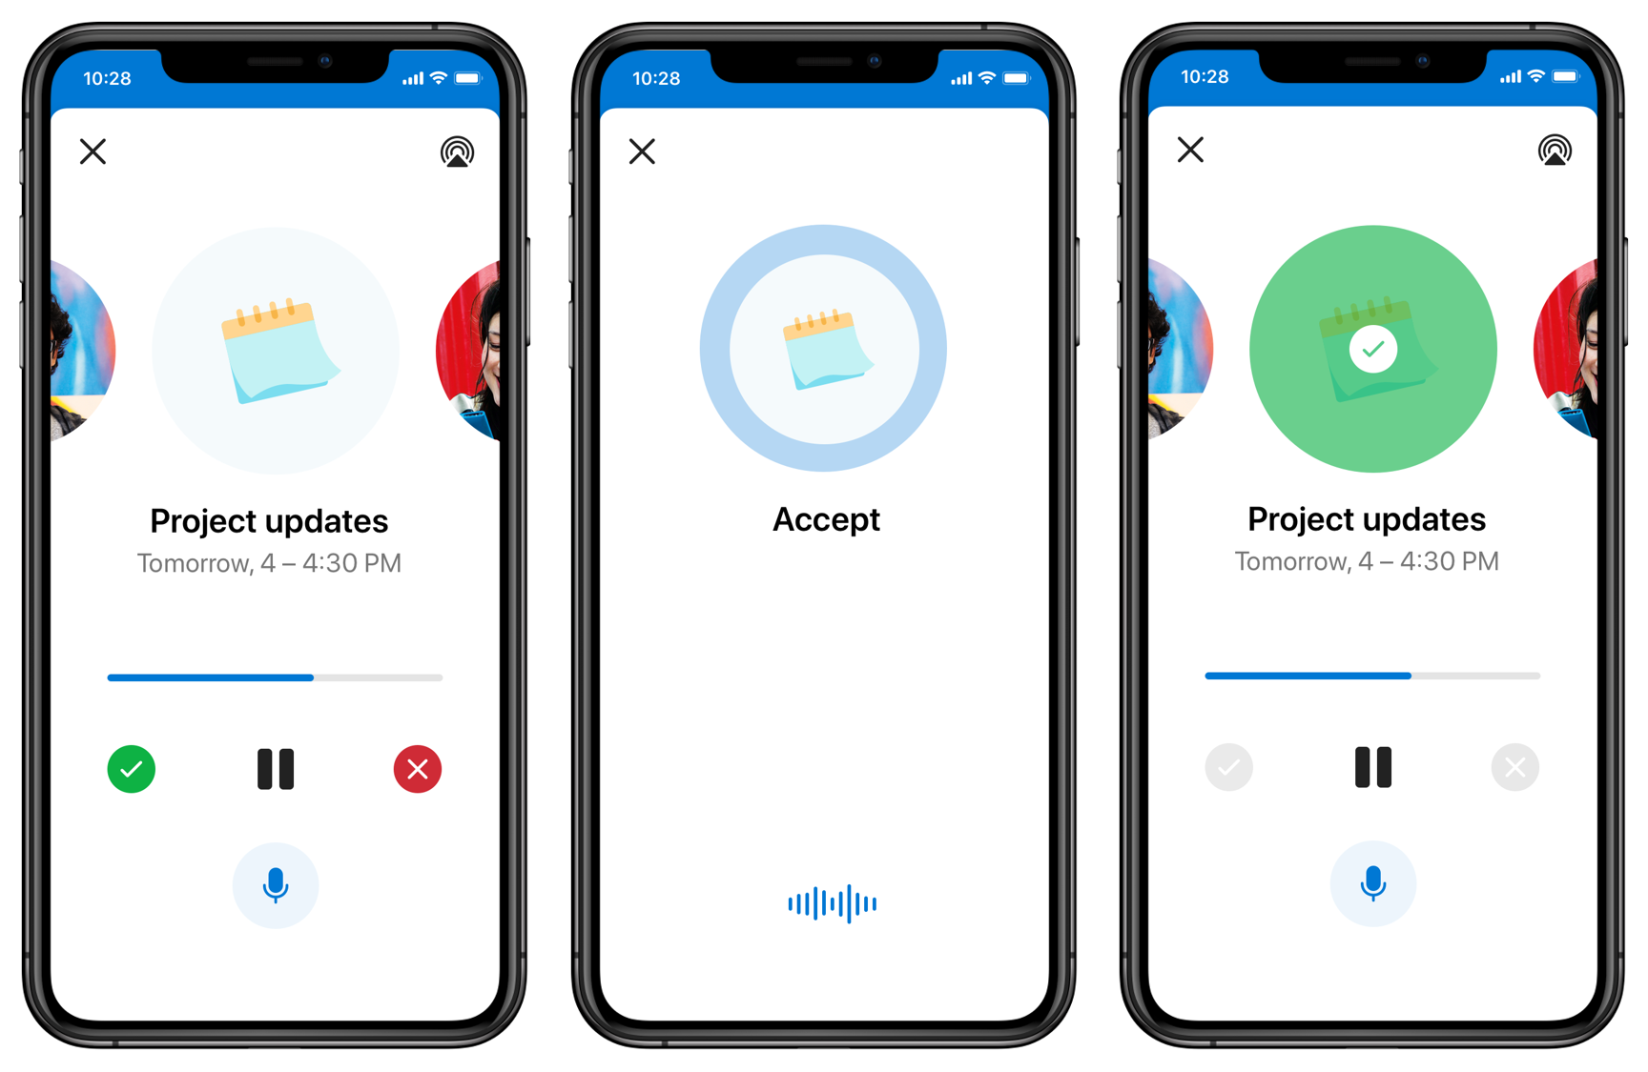
Organize your time and tasks hands-free with Play My Emails in Outlook

Slide 10
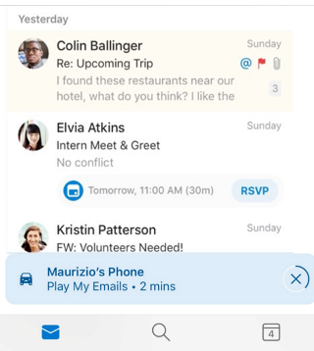
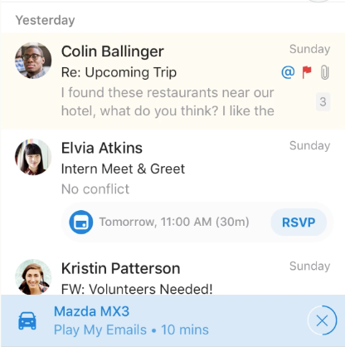
Play My Emails – stay caught up with what’s new in your inbox hands-free with Cortana
Generally available in Outlook for iOS/Android in English in the U.S.; coming next to Australia, Canada, United Kingdom and India
Updates coming in Outlook for iOS in September 2020
New personalization options
Multiple Accounts
Read from favorite people only
Read already read emails
Ask Cortana anytime to read a specific email
Car & headphone optimization
Start/Navigate with steering wheel
Interact using voice with phone in the pocket
More contextual actions
Call
Setup a meeting
Add a task
Improved readout
Better Signature Ignore Model
Table Readout
Long Email Readout

Slide 11

“I really like how Cortana keeps me informed of my upcoming calendar appointments and incoming messages with Play My Emails in Outlook.
I was surprised to discover Cortana could help me reach the right John vs Jon based on the contacts I communicate with often.
I am looking forward to getting more done with Cortana during my commute!”
Joel Espinoza
Director of Social Media, NJ Advance Media

Slide 12
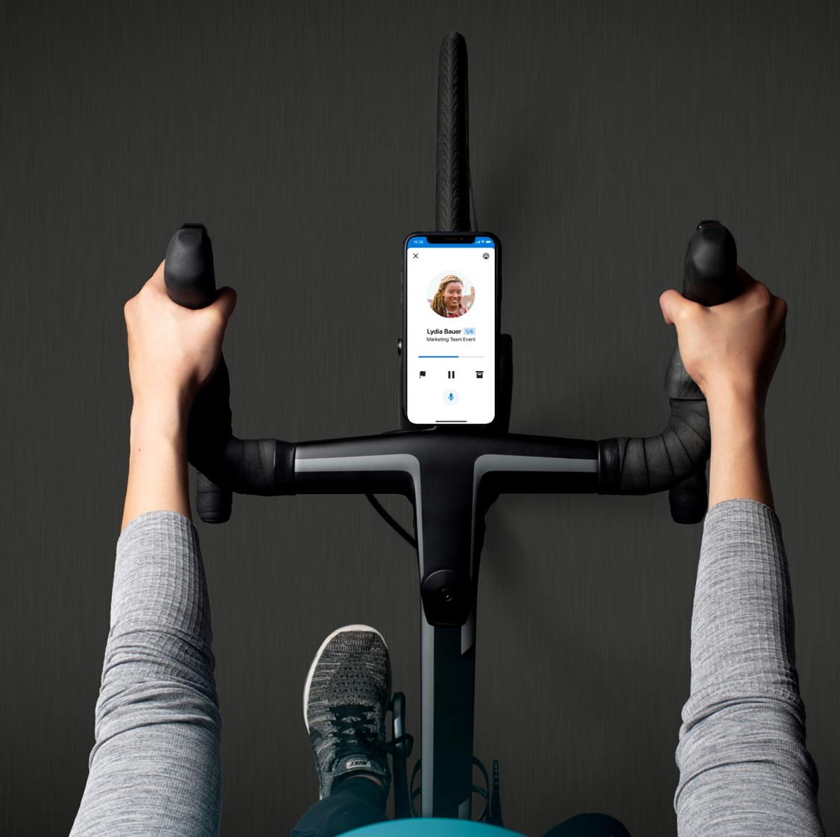
Learn more: Aka.ms/PlayMyEmailsExp

Slide 13
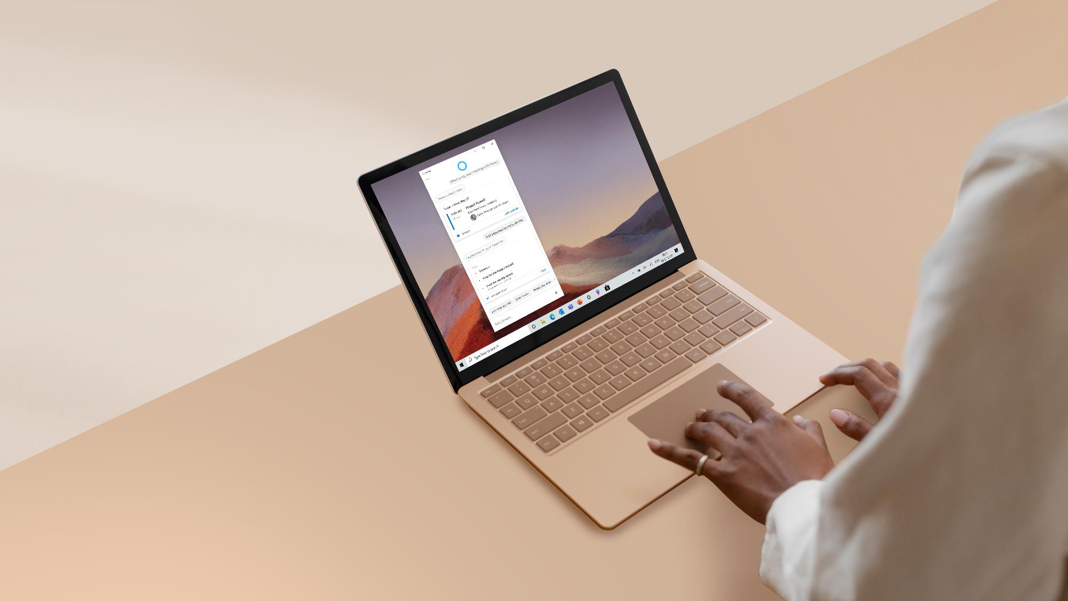
Save time and stay on track with Cortana in Windows 10

Slide 14
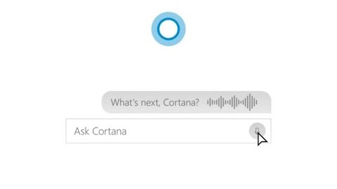
Stay on track with Cortana in Windows 10

Slide 15
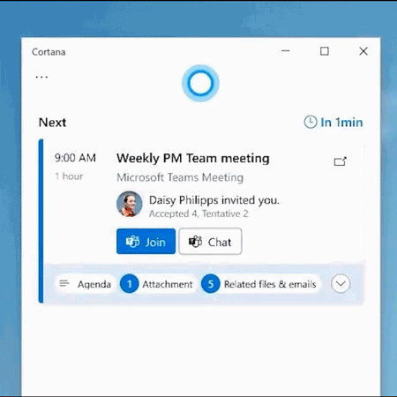
Coming in 2021: Assistance before you even ask
Save time and stay on track leveraging the power of
- AI & Microsoft Graph
- Natural language
- Voice commanding

Slide 16
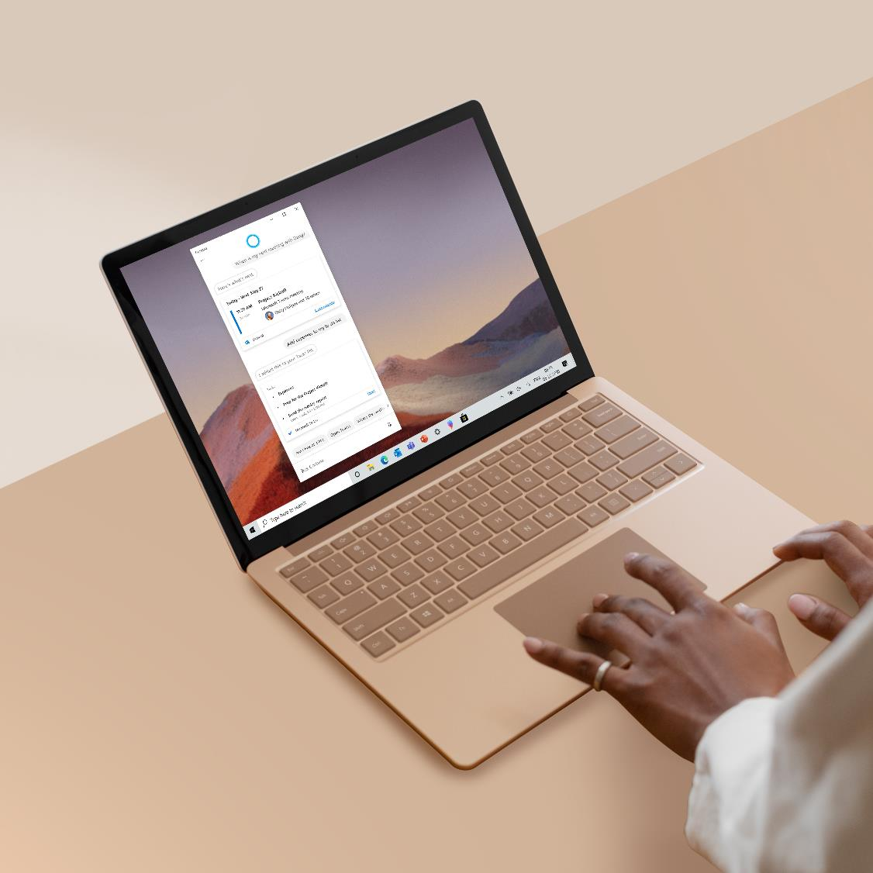
Learn more:
Aka.ms/CortanaInWindows10

Slide 17
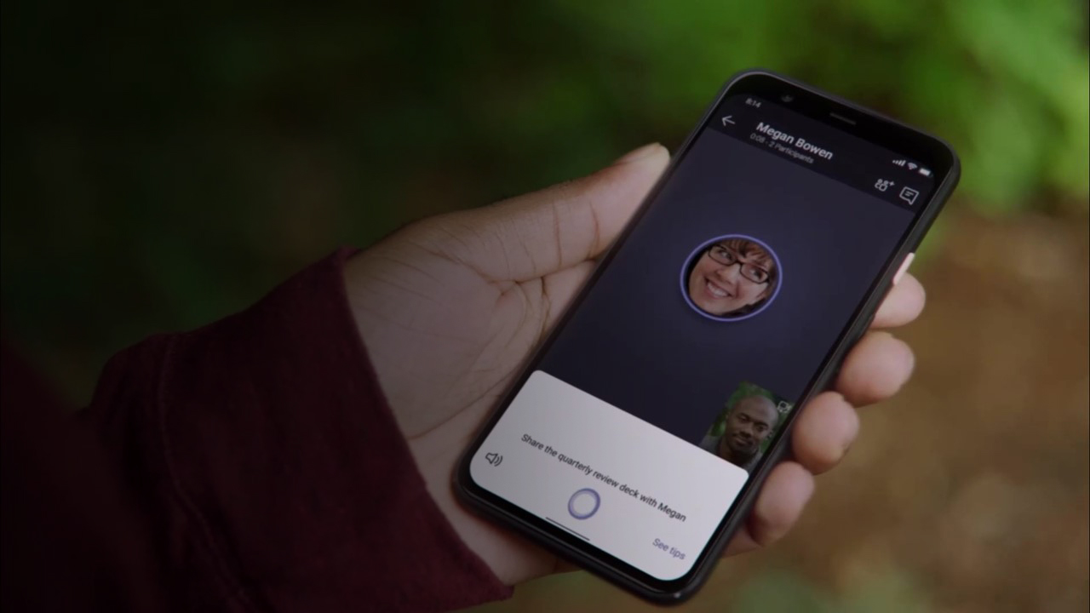
Streamline collaboration with Cortana in Teams

Slide 18
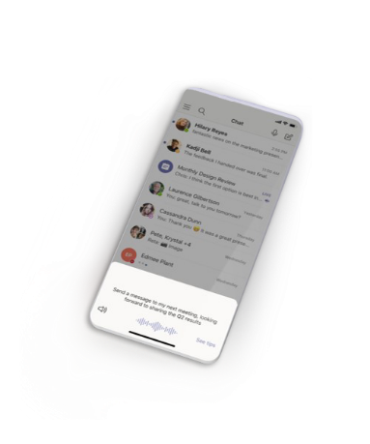
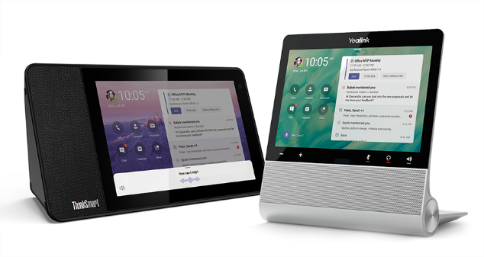
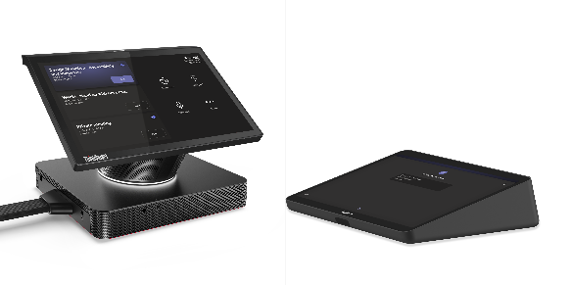

Cortana in Teams – streamline collaboration
Teams mobile apps
Microsoft Teams displays
Microsoft Teams Rooms
Supports spoken, natural language requests to join a meeting, make a call, send chat messages, share files, and more.
Leverages AI and the Microsoft Graph to efficiently and securely connect you to the right people, meetings and files when you ask.
Delivered using Cortana enterprise-grade services.

Slide 19
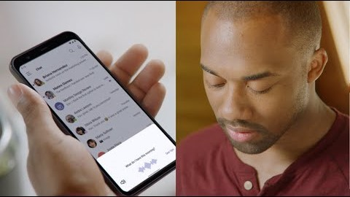
Cortana in Teams mobile and Microsoft Teams displays
Generally available in English in the U.S.

Slide 20

”For supporting others in a distribution center, Microsoft Teams with Cortana voice assistance is a major win. I am able to communicate within a few seconds with any of the associates in my organization, regardless of where I am.
Cortana's transcription and responses are accurate, allowing me to stay focused, even in a busy warehouse. I am looking forward to the new hands-free possibilities."
Justin Bigwood
DC IT Associate, Ferguson

Slide 21

”Microsoft Teams is simply superb! It gives us the ability to connect with remote co-workers and practice social distancing with those who are at work.
With Cortana in Teams, I can see what’s on my calendar, chat with someone, and even share a status report – just by giving voice commands on my mobile device.”
Sai Venkata
Crew Scheduling System – QA, Alaska Air

Slide 22
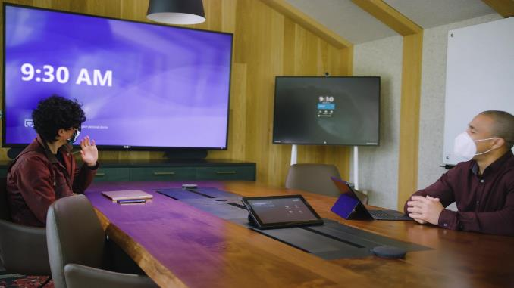
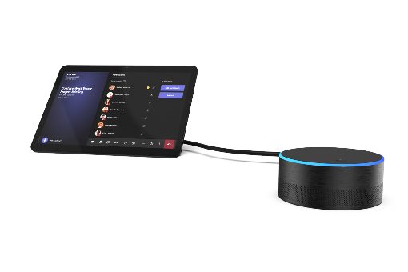
Cortana in Microsoft Team Rooms -
Touchless meeting experiences in shared spaces
Coming to Microsoft Teams Rooms devices and intelligent speakers in English in the U.S.
Will support spoken, natural language requests to join and leave a meeting, add a participant from the address book to a meeting using their name or phone number, and more.
For reference only, not real devices

Slide 23


Join and leave meetings hands-free
“Hey Cortana, join my meeting”
“Hey Cortana, end my meeting”

Slide 24
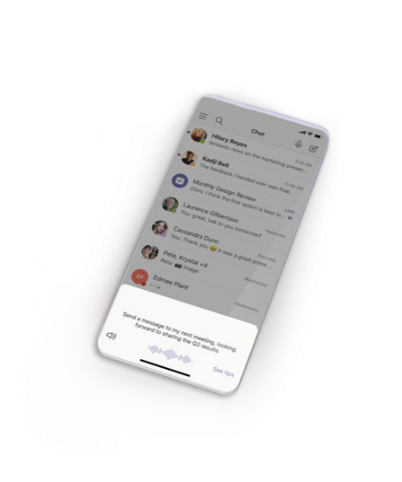
Cortana in Teams – streamline collaboration
Voice assistance in the Teams mobile apps
Hands-free experiences for
Microsoft Teams displays
Touchless interactions in Microsoft Teams Rooms
Generally available in Teams mobile apps in English in the U.S.
Coming soon in Microsoft Teams displays in English in the U.S. and next in Australia, Canada, U.K. and India.
Coming to Microsoft Teams Rooms devices and intelligent speakers in English in the U.S.

Slide 25

Learn more
Aka.ms/CortanaInTeams
Aka.ms/MicrosoftTeamsDisplays
Aka.ms/TeamsDevicesHybridWorkplace

Slide 26
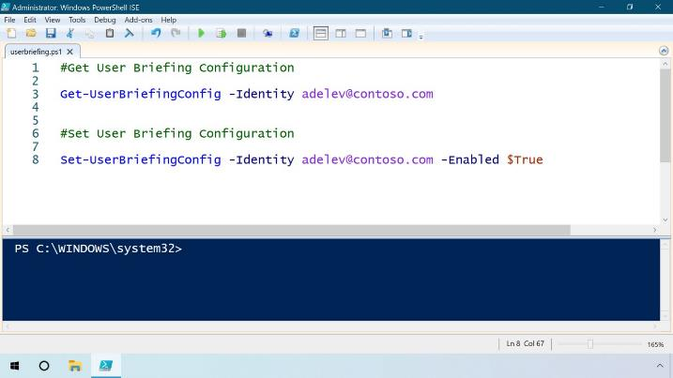
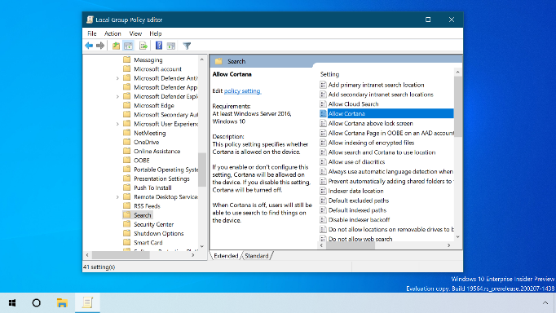
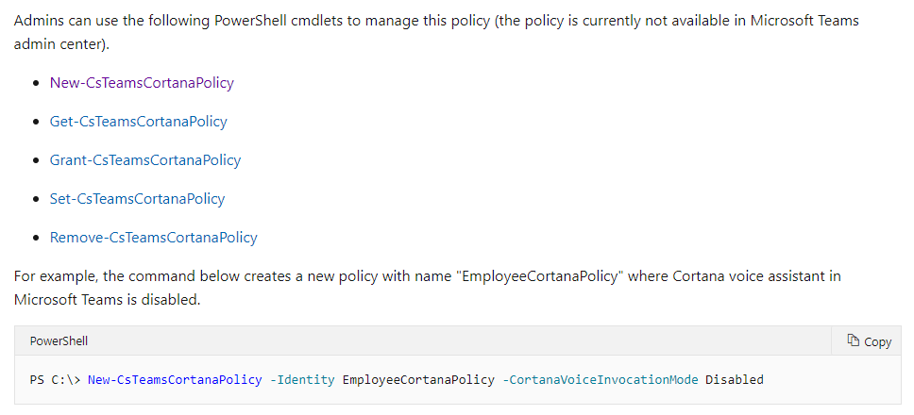
Assisting you while keeping your data private on a trusted platform
As a natural part of Microsoft 365 for enterprise, Cortana experiences are enabled by default and process data safely and securely to fulfill your requests.
Cortana is a Core Online Service: These experiences are delivered using services that fully comply with Office 365’s enterprise-level privacy, security, and compliance promises in the Online Services Terms.
Cortana enterprise-grade services process queries from the user, Office data needed to deliver results to the user, and other telemetry generated by Microsoft systems to run the service.
Text transcriptions (auto-generated) of the user queries are only used to develop and improve machine learning models. The data is not viewed, reviewed, or labeled by humans, and it always remains in the Office 365 trust boundary.
Learn more: Aka.ms/CortanaAdminGuide

Slide 27
Cortana in Microsoft 365 highlights
Jan – Mar 2020
Apr – June 2020
July – Sept 2020
Coming next
In Outlook
In Windows 10
In Microsoft Teams
Play My Emails in Outlook for iOS in English in the U.S.
Play My Emails time and task management updates in Outlook for iOS in English in the U.S. Briefing Email first release for Microsoft 365 Enterprise users in English
Cortana chat-based app available with the Windows 10 May Update Productivity capabilities such as checking schedules, setting reminders or adding tasks supported in English in the U.S.
Play My Emails in Outlook for Android in English in the U.S. and in Outlook for iOS in English in Australia, Canada, U.K. and India. Play My Emails updates in Outlook for iOS to initiate a call, play specific emails, use while your phone is in your pocket, and connect multiple eligible accounts to the experience. Briefing email generally available for Microsoft 365 Enterprise users in English
Wake word invocation for hands-free use in English in the U.S. and U.K.
Cortana voice assistance in Microsoft Teams mobile apps in English available for Microsoft 365 Enterprise users in the U.S.
Briefing email updates including: an integration with Microsoft To Do enhancements for meeting prep that make it easier to address conflicts or low attendance and follow best practices such as adding an agenda or a Teams link proactive time management to help you set aside time in the week ahead to catch up on your email/chats, take a break to disconnect and recharge, or take out time for learning specialized insights for people managers
Support for file search and email queries in English in the U.S. Proactive experiences such as surfacing relevant emails and documents to help you prepare for meetings in English in the U.S.
Cortana voice assistance in Microsoft Teams Rooms devices and intelligent speakers in English in the U.S. Cortana in Microsoft Teams displays in English available in Australia, Canada, U.K., U.S. and India.

Slide 28

Additional Resources
Learn more about your personal productivity assistant: Microsoft.com/EN-US/Cortana
Get Cortana as a natural part of Microsoft 365: Microsoft365.com/Enterprise
Download the Outlook and Teams mobile apps: Aka.ms/GetOutlookMobile Aka.ms/TeamsMobile

