Slide 1
Microsoft 365 Network Connectivity Video Series
Microsoft 365 Networking Partner Program
John Mighell
Sr. Product Marketing Manager
Microsoft 365

Slide 2
Microsoft 365 Networking Partner Program (NPP)
01 Network Connectivity Principles
02 Why?
03 Program overview
04 Entrance criteria
05 Partner benefits
06 Partners currently in the program
07 Partner solution showcase
08 Resources and engagement opportunities

Slide 3

Microsoft 365 Network Connectivity Principles
Microsoft 365 endpoints
{REST:API}
SSL
B&I
Datacenter
Branch
Branch
ISP
aka.ms/o365ip
Optimize Microsoft 365 traffic
Use the endpoint categories to differentiate Microsoft 365 traffic from generic Internet traffic for more efficient routing.
Enable local egress
Egress Microsoft 365 data connections through Internet as close to the user as practical with matching DNS resolution.
Enable direct connectivity
Enable direct egress for Microsoft 365 connections. Avoid network hairpins and minimize network latency (RTT) to Microsoft’s global network.
Modernize security for SaaS
Avoid intrusive network security for Microsoft 365 connections. Assess bypassing proxies, traffic inspection devices, and duplicate security already available in Microsoft 365.
Learn more at: aka.ms/PNC

Slide 4

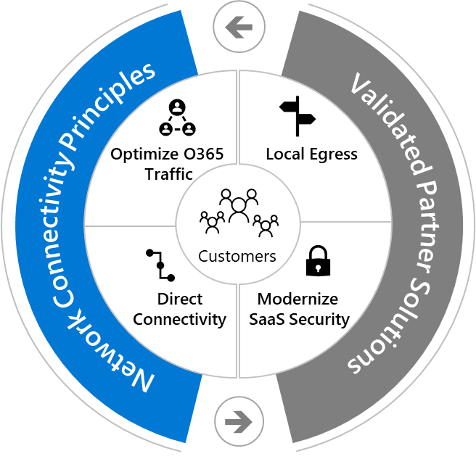
Why?
My video freezes
and then the connection just drops.
Network performance is directly influenced by network solutions in the path between the user and Microsoft 365
Need to identify key products and solutions that follow Microsoft 365 networking requirements, recommendations, and best practices
It takes forever
to see the free/busy information on people’s calendar.
Real-time collaboration? More like “lag-time” collaboration.

Slide 5

Microsoft 365 Networking Partner Program
Program overview
Goal: Facilitate customer ability to improve their Microsoft 365 experience through easy discovery of validated partner solutions that align to key principles for optimal Microsoft 365 connectivity.
Identify solutions
Engage partners with high quality solutions Ensure strategic alignment with the Microsoft 365 Network Connectivity Principles Progress to solution validation and testing
Onboard to program
Sign NDA and program terms Pass program requirement vetting and testing process Become program member & engage in benefits
Measure Impact
Success measured across 3 metric categories
aligned to core program components
Partner Engagement
Principles Adherence
  # validated
  partner solutions
# customers with network config aligned to principles
Network Performance
  Post solution deployment network performance improvement

Slide 6

Microsoft 365 Networking Partner Program
Entrance criteria
Partner solutions are thoroughly vetted through a 5 step process in order to gain entrance into the program.
1
2
3
4
5
Signed NDA
Partners must have an active NDA in place with Microsoft.
NPP partners have the opportunity to engage with Microsoft for deep product alignment and advanced roadmap visibility, which necessitates a NDA.
Demonstrate strategic alignment
Partners must engage in a series of strategic alignment syncs with Microsoft architects to ensure solution alignment with Network Connectivity Principles.
Sometimes this results in solution adjustments needed before progressing to step 3.
Sign program terms
The NPP has distinct program terms that should be reviewed by legal teams and must be signed before progressing to step 4.
Pass 3rd party testing
Partners must submit their solution to our authorized 3rd party testing vendor.
The testing vendor will perform a series of functional tests, and determine solution adherence to each Network Connectivity Principles on a pass/fail basis.
This generally involves physically mailing a device with software installed to the testing vendor.
Publish customer facing content
Partners must publish a webpage, blog, whitepaper, or similar document clearly articulating solution architecture and adherence to the Network Connectivity Principles

Slide 7




Microsoft 365 Networking Partner Program
Partner benefits
Partner solutions that fulfill the 5 step validation process gain access to a suite of benefits below
Marketing and promotional
Solution displayed on Networking Partner Program page Authorized to use the ‘works with Microsoft 365” designation to stand out in sales and marketing material Promotional opportunities during Microsoft core events (Inspire, Ignite, etc) Co-branding opportunities for customer case studies Social media amplification for customer case studies
Technical engagement
Opportunity to engage with engineering teams and product group for deep product alignment Content reviews Custom quotes from Microsoft Architects for marketing material Advanced visibility for roadmap features, tools, and product strategy
Customer and Microsoft field engagement
Designation allows customers and Microsoft field to identify validated solutions Solution promoted to customers during FastTrack deployments

Slide 8








Microsoft 365 Networking Partner Program
The following partner solutions have passed rigorous testing to be included in the Microsoft 365 Networking Partner Program. Each solution has proven adherence to the Microsoft 365 Network Connectivity Principles.
Partner | Solution | Contact (follow up with dedicated contacts for more info) | Solution status by Microsoft 365 Network Connectivity Principles
 |  |  | Differentiate Microsoft 365 traffic by using endpoint API (FQDNs | IPs | ports) | Enable local egress for Microsoft 365 Avoid backhauling | Enable direct connectivity to Microsoft 365 Minimize latency and avoid hairpins | Whitelist/Bypass intrusive network security for Microsoft 365 connections
 | VeloCloud Solution Brief | Joseph Chung chungj@vmware.com | ☑ | ☑ | ☑ | ☑
 | Silver Peak Unity EdgeConnect Solution Brief | Fraser Street fraser@silver-peak.com | ☑ | ☑ | ☑ | ☑
 | Zscaler Internet Access Solution Brief | Luis Mendoza lmendoza@zscaler.com | ☑ | ☑ | N/A | ☑
 | Citrix SD-WAN Solution Brief | Glenn Williams Glenn.Williams@citrix.com | ☑ | ☑ | ☑ | ☑
 | NetFoundry for Microsoft O365 Solution Brief | Mario Camaj mario.camaj@netfoundry.io | ☑ | ☑ | ☑ | ☑
 | NTT SD-WAN Service Solution Brief | Chinami Tamura c.tamura@ntt.com | ☑ | ☑ | ☑ | ☑
 | 128T Routing and SD WAN Solution Brief | Tony Sanchez tsanchez@128technology.com | ☑ | ☑ | ☑ | ☑
Microsoft 365 endpoints
{REST:API}
Branch
SSL
B&I
Datacenter
Branch
ISP

Slide 9
Partner solution showcase:
EdgeConnect SD-WAN by Silver Peak
Fraser Street (fraser@silver-peak.com)
VP Technical Alliances
Silver Peak

Slide 10

Partner solution showcase: Optimizing Microsoft 365 by 128 Technology
Ritesh Mukherjee
Vice President – Product Management
128 Technology

Slide 11
Partner solution showcase:
VeloCloud by VMware
Joseph Chung
Director Strategic Alliances
VMware

Slide 12
Additional resources (in video description)
Networking Partner Program Resources
Learn more about the Microsoft 365 Networking Partner program here
View our catalogue of validated partner solutions
Indicate your interest in participating in the program by filling out this form
Microsoft 365 Network Connectivity Resources
Join the network connectivity discussion on TechCommunity
View our Microsoft 365 Network Connectivity video series page
Partner Solution Resources
Learn more about the 128 Technology solution
Learn more about the Silver Peak solution
Learn more about the VMWare VeloCloud solution

