Slide 1
Microsoft 365 Network Connectivity Video Series
How Microsoft does Zero Trust
Mark Simos
Lead Cybersecurity Architect
Lesley Kipling
Chief Security Advisor

Slide 2
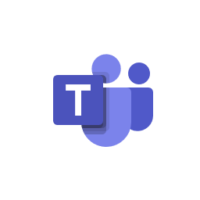
COVID has changed where & how we work
Daily active users
Microsoft Teams
75M
users
COVID-19 has shown that employees can complete more work remotely than previously believed
Employees working remotely from home will continue even after the COVID-19 crisis is resolved
44M
32M
20M
13M
Jul 2019
Nov 2019
Mar 2020
Apr 2020
75M+
daily active users
200M+
daily meeting participants
4.1B
daily meeting minutes

Slide 3







Legacy security creates friction and latency, incentivizing shadow IT (and policy circumvention)
Slow is the new broken
On Premises
Cloud Proxy
Hairpin Networks - Add significant latency and cost for every packet
Agent Overload - degrades endpoint performance and user experience

Slide 4

Microsoft 365 Network Connectivity Principles
Microsoft 365 endpoints
{REST:API}
SSL
B&I
Datacenter
ISP
aka.ms/o365ip
Optimize Microsoft 365 traffic
Use the endpoint categories to differentiate Microsoft 365 traffic from generic Internet traffic for more efficient routing.
Optimize Microsoft 365 traffic
Use the endpoint categories to differentiate Microsoft 365 traffic from generic Internet traffic for more efficient routing.
Enable local egress
Egress Microsoft 365 data connections through Internet as close to the user as practical with matching DNS resolution.
Enable direct connectivity
Enable direct egress for Microsoft 365 connections. Avoid network hairpins and minimize network latency (RTT) to Microsoft’s global network.
Modernize security for SaaS
Avoid intrusive network security for Microsoft 365 connections. Bypass proxies, traffic inspection devices, and avoid duplicating security controls already available in Microsoft 365
Learn more at: aka.ms/PNC

Slide 5
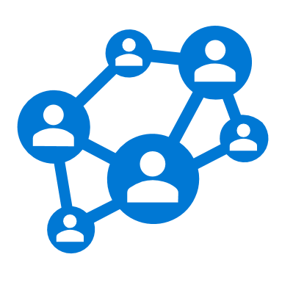




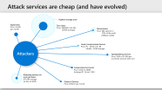
Why Zero Trust?
Security Goal: Keep Assets away from Attackers
IT Security is Complex
  Many Devices, Users, & Connections
“Trusted network” security strategy
  Initial attacks were network based
  Seemingly simple and economical
  Accepted lower security within the network
Assets evolving beyond the network
  Off-network Assets - BYOD, WFH, Mobile, and SaaS
  Service/Protocol Changes - Outpace tools & expertise
Attackers shift to identity attacks
  Phishing and credential theft
  Security teams often overwhelmed

Slide 6
Attack services are cheap (and have evolved)
Exploit kits:
Price: $1,400
per month
Highest average price
Zero-days:
Price: $50,000 to $3.5M
($180k average)
Ransomware:
Price: $66 upfront or
30% of the profit
(affiliate model)
Loads (compromised device):
Price: PC - $0.03 to $1.80
Mobile - $0.68 average
Attackers
Spearphishing services:
Price: $100 to $1,000 per successful account take over
Compromised accounts:
Price: $150 for 400M Averages $1.14 per 1,000
Breaching services on a per job basis:
$10,500 average
(as low as $250)
Denial of Service:
Price: $766.67 per month

Slide 7
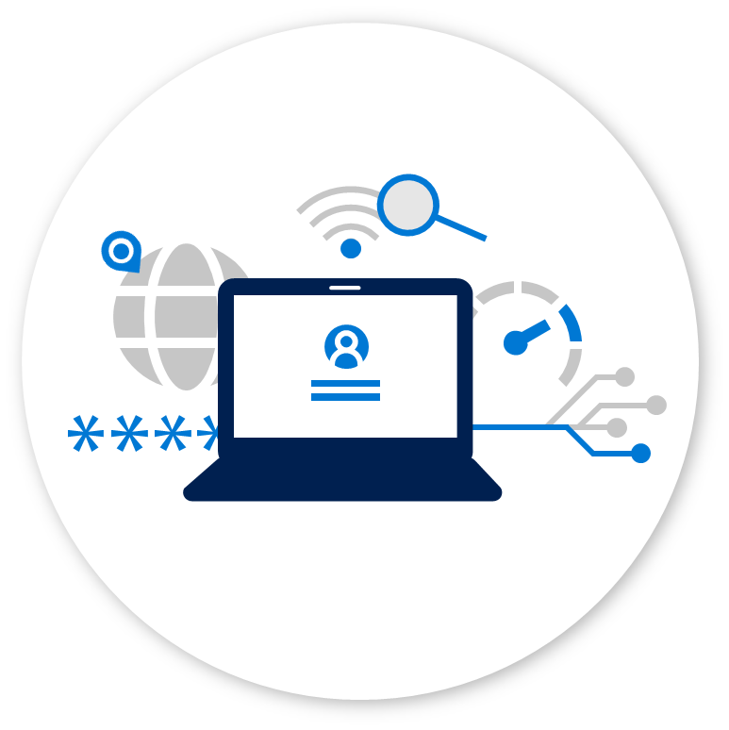
Zero Trust
Strategy that builds security assurances
for business data and applications
on a public or untrusted network.
Leads to
Productivity Security
Policy Driven Access Architecture for Employees & Partners:
Explicitly validate trust
of access requests
Dynamically address
insufficient trust
Modern SOC
Pervasive detection & response
Deep asset visibility inside & outside the firewall
Rapid remediation with automation and integrated workflows
And More
Datacenter Access & Isolation Architecture
Internet of Things / Operational Technology
And more…
Increases security
Increases productivity

Slide 8
Zero Trust benefits everyone
by securing users and business assets where they are
Increases security
Increases productivity
Reduce risk of compromised users & endpoints
  Remove user endpoints from enterprise network
  Reduce VPN usage / attack surface
Improves security visibility
  No blind spots for remote devices
  Centralized view of risk, policy exceptions, and access requests
  Deep insight into device risk and
  user session activity
Can work anywhere you want
  Apps & Data available anywhere
  Empowers everyone including security
Can choose your own device
Single Sign On (SSO) across enterprise apps and services
Improved “Access Denied” experience:
    Prompt to increase trust (e.g. MFA)
    Limited access to apps/data
Better user experience and security from “Password-Less" authentication

Slide 9










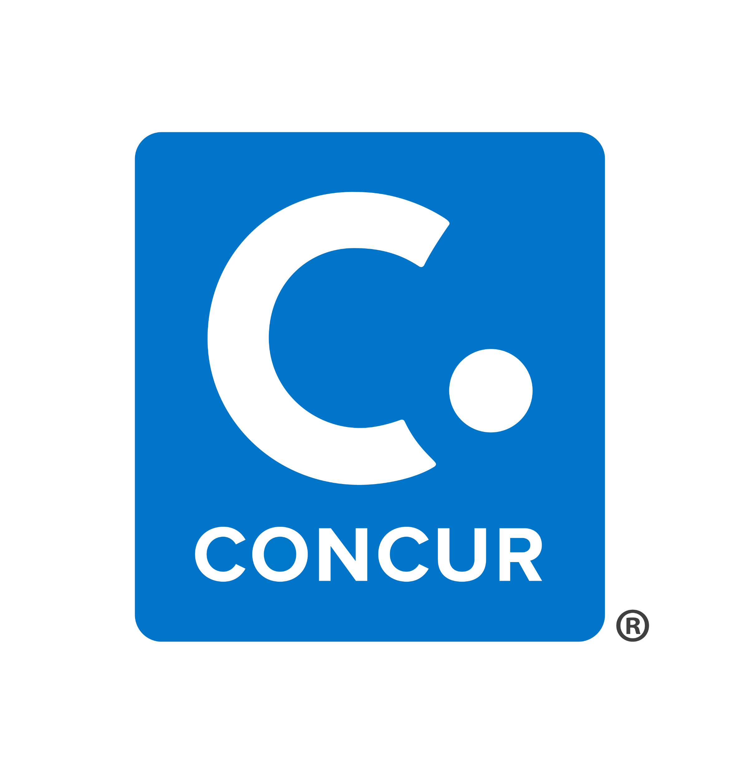
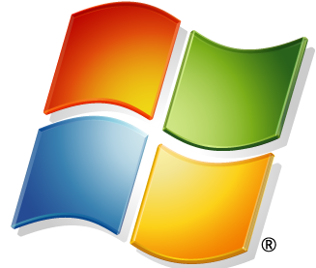

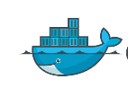
A typical flat network
…
All Corporate Devices
and Access
Managed CORP

Slide 10
Zero Trust – network segment transformation
…
User Access Devices
Controlled / Sensitive Devices
Unmanaged Internet
Sponsored Access
Event Access
BYOD
Business Critical Segment(s)
Sensitive Business Units/Apps
Access Varies based on trust & management level
Managed Internet
Managed Devices
Authenticated Devices
High Impact IoT/OT
IoT/OT With Life/Safety Impact
Low Impact IoT/OT
Printers, VoIP phones, etc.
Validated Resource Access
All Devices can access internet
Managed and Compliant devices
can access corporate resources
Managed CORP
Specialized Segments
Isolate well-defined Life/Safety and
Business critical assets as possible

Slide 11







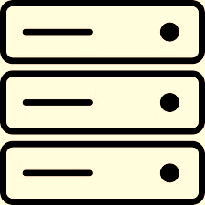


Zero Trust enables new segmentation & differentiation
Differentiated Workloads
Sanctioned and Managed Services
Internet and Unsanctioned/Unmanaged Apps
Private and Managed in the cloud or on-premises
Differentiated Devices
Differentiated Identities
Managed devices
Strongly managed identities
Policy based segmentation
MFA User
Admin
Managed identities
Access Varies based on trust & management level
Unmanaged devices
BYOD
User
Partner
Network Segments
Anonymous and Consumer identities
Business Critical Segment(s)
Sensitive Business Units/Apps
High Impact IoT/OT
IoT/OT With Life/Safety Impact
Low Impact IoT/OT
Printers, VoIP phones, etc.

Slide 12
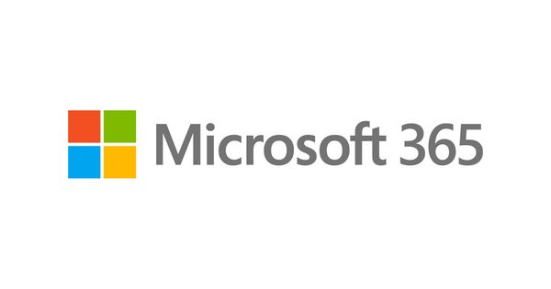
Native controls replaced classic traffic interception
Native Microsoft 365 Controls
Strong encryption in transit (TLS)
DDOS protection
Data Loss Prevention (DLP)
Multi-Factor Authentication (MFA)
Advanced Threat Protection (ATP)
Customer Lock Box
Advanced Security Management
Anti-Virus
Secure Score
Threat Intelligence
Advanced Data Governance
Regional Data Residency
Conditional Access
Tenant restrictions
X-Tenant access policies
Activity APIs
Customer Controlled Keys
Vulnerability Scanning
Intrusion Detection
Encryption at Rest
Zero Standing Rights
Certifications (ISO, SOC, FEDRAMP, FISMA ...)
Go-local and Sovereign Clouds
eDiscovery
Regulatory Hold
Audit Logs
Next Gen Privacy …
NETWORK OVERHEAD
(Cost, Complexity, Latency)
Level of trust
Unsanctioned
Internet Web Site
Sanctioned and Verifiably Trusted Application

Slide 13
Zero Trust Rapid Modernization Plan (RaMP)
Do the most important stuff first
Align teams & strategy to prioritize zero trust activities & create enterprise segmentation strategy spanning network, identity, app, etc. (aligns naturally to Cloud adoption)
Build modern (identity-based) perimeter
Roll out critical path to IT Admins first
Targeted by Attackers
High potential impact
Provide technical feedback
Critical Path
User - Require Passwordless or MFA to access modern applications
Device - Require Device Integrity for Access (critically important step)
Finish Strategy
Apps - Modernize Apps + Retrofit strong assurances to legacy on-premises assets via App Proxy
Data - Increase discovery/protection for sensitive data (CASB, CA Access Control, Azure Info Protection)
Legacy - Retire legacy/insecure protocols (ActiveSync, LM, NTLM, SMBv1)
Refine segmentation and network perimeter
Network segmentation – isolate assets with business critical, life safety,
and operational/physical impact.
Microsegmentation - Additional network restrictions (dynamic trust-based and/or static rules)
Legacy - Retire or isolate legacy computing platforms (Unsupported OS/Applications)

Slide 14

Challenges of a transformational change
Consistent security outcomes, principles, methods
Technology & processes shifting rapidly
Empathy & training
critical to success
Reduce risk to the organization
Least privilege access
Rapid detection and remediation
Visibility and Control
Threat Context for Decisions
Engage and inspire people, discover and address fears
Encourage training and learning on new technologies & methods
Recruit, retain, and include
diverse perspectives
Waterfall to DevOps release cycles
Architecture continuously evolves
Increasing automation and integration
Asset-specific security controls diminishing role of network security

Slide 15
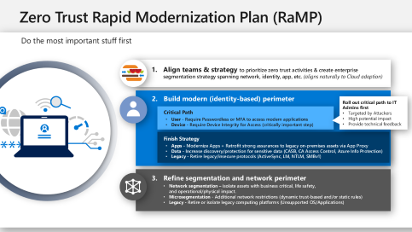
Key takeaways
Enable users to connect directly to cloud resources (optimized and secure)
  Use native controls rather than traffic interception
  Measure and enforce security of users, devices, and apps/workloads/services
Engage and Train your IT and Security Teams on Zero Trust and associated technology changes
Follow the Zero Trust Rapid Modernization Plan (RaMP)

Slide 16
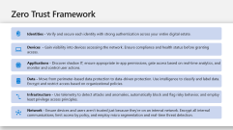
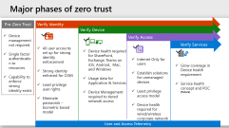
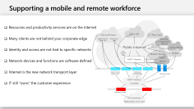
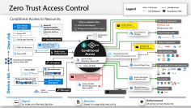
Additional resources and recommended actions
Zero Trust Home Page – Overview and links to resources
  https://aka.ms/zerotrust
Maturity Model – Vision Paper discussing the Zero Trust journey
  https://download.microsoft.com/download/f/9/2/f92129bc-0d6e-4b8e-a47b-288432bae68e/Zero_Trust_Vision_Paper_Final%2010.28.pdf
Zero Trust Assessment Tools
  https://go.microsoft.com/fwlink/p/?LinkID=2118058&clcid=0x409
Zero Trust Strategy & Architecture - CISO Workshop Videos + Slides
  https://docs.microsoft.com/microsoft-365/security/office-365-security/ciso-workshop-module-3
Microsoft’s IT Learnings - from ongoing Zero Trust journey
  https://www.microsoft.com/en-us/itshowcase/implementing-a-zero-trust-security-model-at-microsoft
Reference Slides

Slide 17






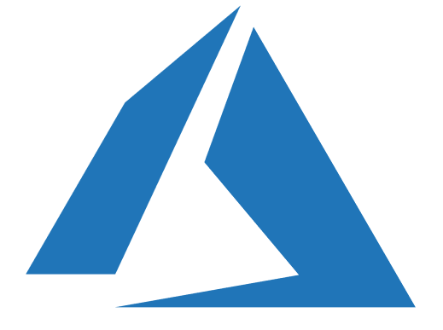










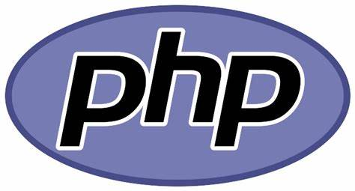
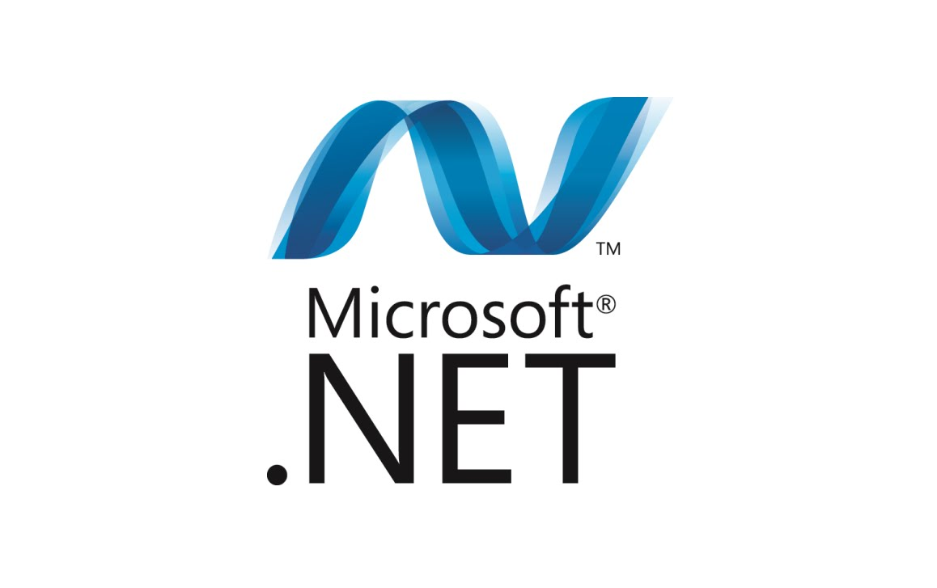
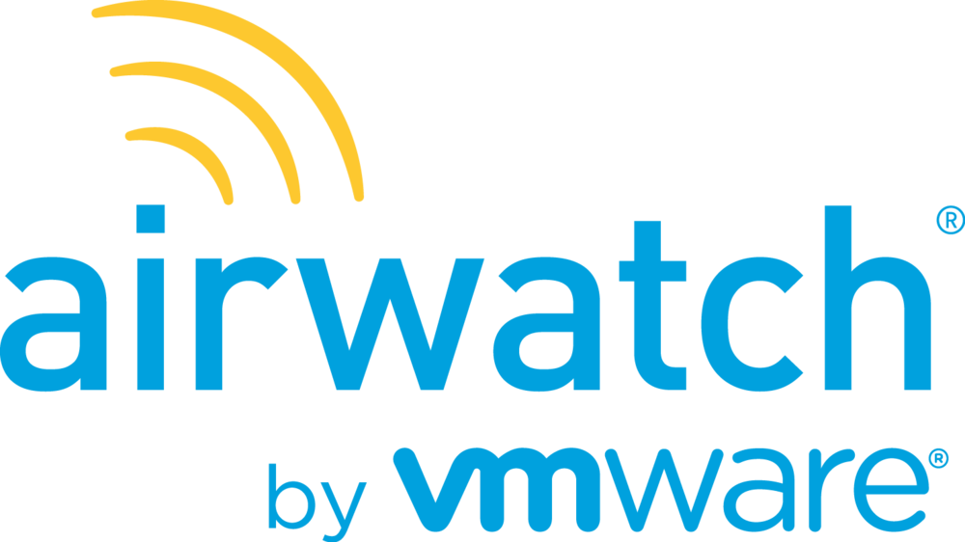



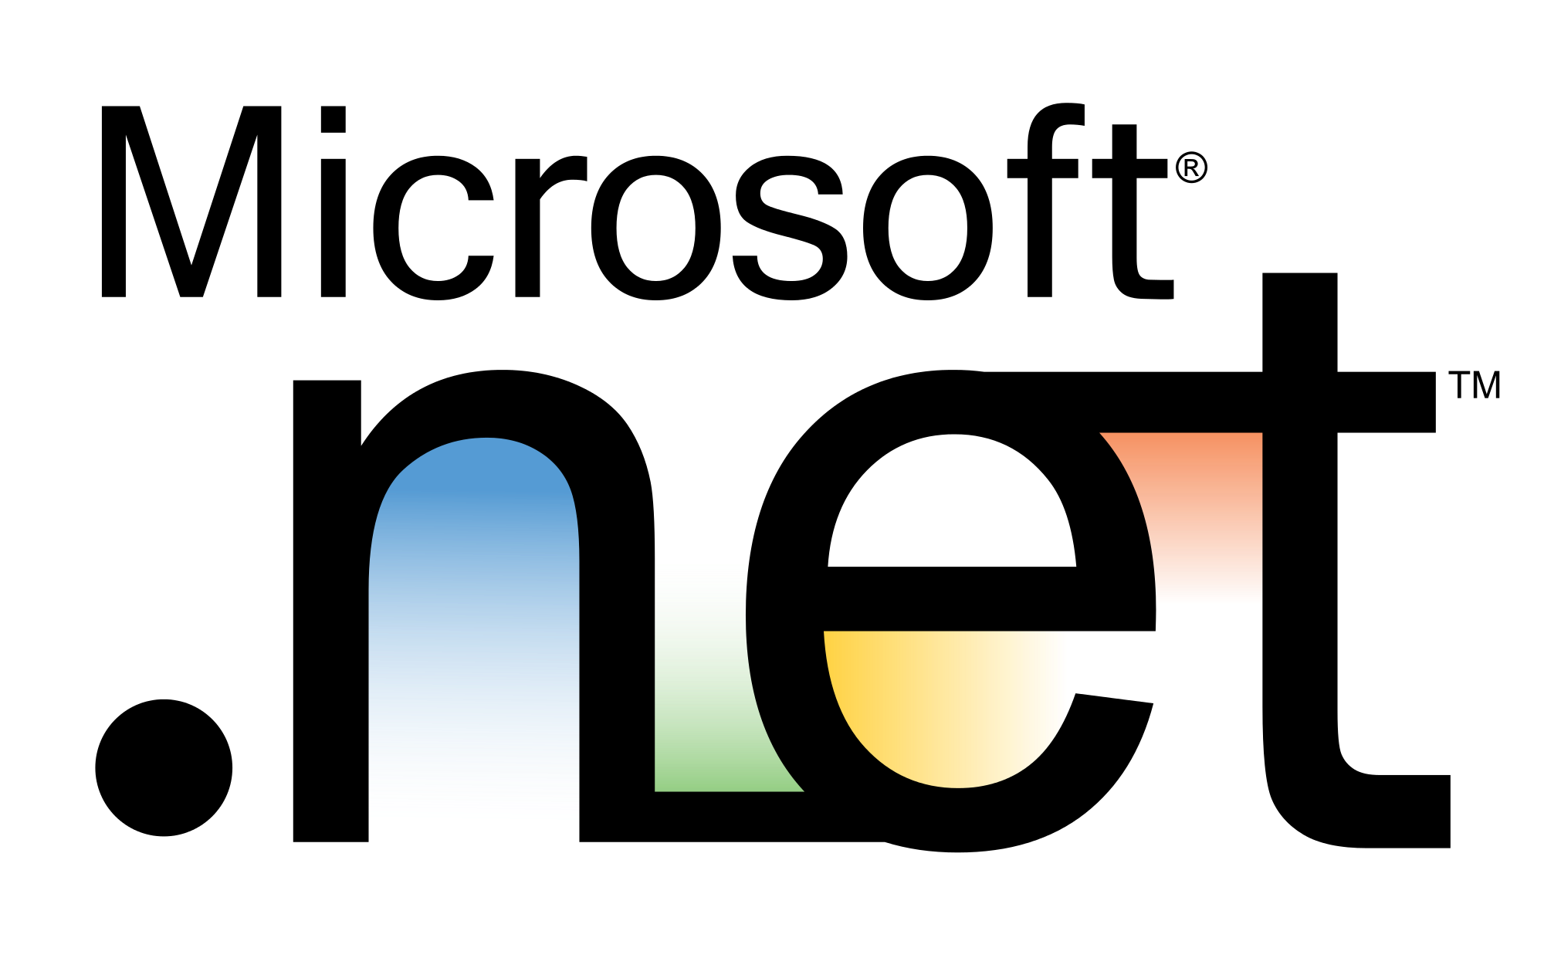
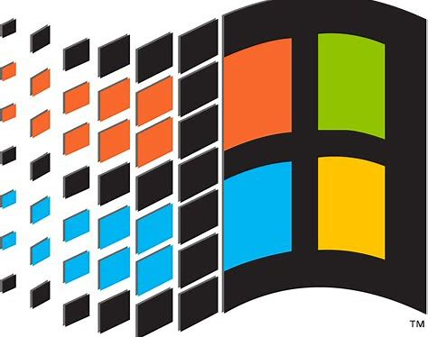



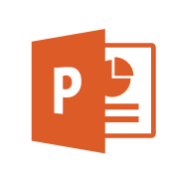
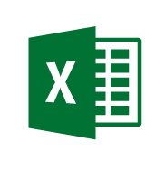


Legend
Zero Trust Access Control
Full access
Limited access
Risk Mitigation
Remediation Path
Conditional Access to Resources
Policy is evaluated when
Initial Access Request
Change in posture (AADIP signal)
Microsoft Applications
User Threat/
Risk Signals
Azure AD
Identity Protection
Leaked cred protection
Behavioral Analytics
Lower Access
Restricted session
Office 365
Dynamics 365
Azure ATP
Azure Resource Manager
Cloud Infrastructure
Organization Policy
Cloud App Security
User/Session Risk
Azure Portal
Linux Login
User risk
Conditional Access
Modern Applications
Hello for Business
Increase Trust by requesting MFA
Monitor & Restrict Access
Azure MFA
Multi-Factor Authentication
Cloud App Security
Conditional Access App Control
SaaS Applications
Powered by the Intelligent Security Graph (ISG)
Azure Active
Directory (Azure AD)
IsCompliant
Azure AD App Proxy
Azure AD B2B
Legacy Apps (Secure VPN Replacement )
Partner MDM
Microsoft Intune
{LDAP}
Remediate Leaked Credential (Requires MFA)
Azure Information Protection (AIP)
Microsoft Defender ATP
Device Threat/
Risk Signals
Documents
Device risk
Azure AD Self Service Password Reset (SSPR)
Microsoft Intune
(MAM functionality)
Mobile Apps
Active Directory
IsManaged
Approved Apps
Signal
to make an informed decision
Decision
based on organizational policy
Enforcement
of policy across resources

Slide 18
Supporting a mobile and remote workforce
Resources and productivity services are on the Internet
Many clients are not behind your corporate edge
Identity and access are not tied to specific networks
Network devices and functions are software defined
Internet is the new network transport layer
IT still “owns” the customer experience
Microsoft Azure
Office 365
3rd Party SaaS
Hybrid Cloud
Edge (Far)
Pure Cloud
Edge
Internet
Connected
Offices
Public Internet
Distributed
Internet Edge
Home Office
New
Internet
Edge
Modern Devices
Mobile
MSFT Internet
MSFT
WLAN
Hybrid Cloud
Edge (Near)
Traditional
Internet Edge
Remote access
MSFT Intranet
“CorpNet”
Datacenter Edge
On-premises
Datacenters and Labs

Slide 19









Major phases of zero trust
Verify Identity
Pre-Zero Trust
Verify Device
Device management not required
Single factor authentication to resources
Capability to enforce strong identity exists
Verify Access
Verify Services
All user accounts set up for strong identity enforcement
Strong identity enforced for O365
Least privilege user rights
Eliminate passwords – biometric based model
Device health required for SharePoint, Exchange, Teams on iOS, Android, Mac, and Windows
Usage data for Application & Services
Device Management required to tiered network access
Internet Only for users
Establish solutions for unmanaged devices
Least privilege access model
Device health required for wired/wireless corporate network
Grow coverage in Device health requirement
Service health concept and POC (Future)
User and Access Telemetry

Slide 20
Zero Trust Framework
Identities - Verify and secure each identity with strong authentication across your entire digital estate.
Devices - Gain visibility into devices accessing the network. Ensure compliance and health status before granting access.
Applications - Discover shadow IT, ensure appropriate in-app permissions, gate access based on real-time analytics, and monitor and control user actions.
Data - Move from perimeter-based data protection to data-driven protection. Use intelligence to classify and label data. Encrypt and restrict access based on organizational policies.
Infrastructure - Use telemetry to detect attacks and anomalies, automatically block and flag risky behavior, and employ least privilege access principles.
Network - Ensure devices and users aren’t trusted just because they’re on an internal network. Encrypt all internal communications, limit access by policy, and employ micro segmentation and real-time threat detection.

