Slide 1
Microsoft 365 Network Connectivity Video Series
Network connectivity for remote users
Roshan Padmanabhan
Program Manager – Microsoft 365 Customer Experience
July 2020

Slide 2
Network connectivity for remote users
01 Microsoft 365 Network Connectivity Principles
02 Understanding remote user expectations in terms of connectivity & experience
03 What is VPN Split Tunneling & why is this relevant for remote user connectivity?
04 Office 365 network connectivity guidance for remote users
05 Support from VPN vendors & solution providers to split tunnel Office 365 traffic
06 What tool can you use to verify VPN split tunneling for Office 365 connectivity?

Slide 3

Microsoft 365 Network Connectivity Principles
Microsoft 365 endpoints
{REST:API}
SSL
B&I
Datacenter
ISP
aka.ms/o365ip
Optimize Microsoft 365 traffic
Use the endpoint categories to differentiate Microsoft 365 traffic from generic Internet traffic for more efficient routing.
Enable local egress
Egress Microsoft 365 data connections through Internet as close to the user as practical with matching DNS resolution.
Enable direct connectivity
Enable direct egress for Microsoft 365 connections. Avoid network hairpins and minimize network latency (RTT) to Microsoft’s global network.
Modernize security for SaaS
Avoid intrusive network security for Microsoft 365 connections. Assess bypassing proxies, traffic inspection devices, and duplicate security already available in Microsoft 365.
Learn more at: aka.ms/PNC

Slide 4



Remote user expectations: best experience, reliable & productive.
Best experience
  When Microsoft 365 traffic is routed directly using the users Internet connection it provides the shortest path and the best experience for the user.
Reliable
  When the connectivity path is Direct, it stays on the Internet or un-managed network only for a short duration thus making the path more reliable.
  A private path that’s longer and limited in bandwidth is often unreliable due to congestion.
Productive
  Users want to focus on the task in hand rather than spending time on addressing quality or experience issues that impacts collaboration.

Slide 5
VPN – Virtual Private Network
Pros & cons of a remote user using VPN
Pros:
Users can connect to Corporate Network from a remote location
Users can access applications or services hosted within the corporate network, typically not accessible via the internet
Cons:
Designed for small percentage of overall workforce working remotely
Limited in bandwidth and scale
Situations like COVID-19 pandemic adds enormous stress on the VPN infrastructure when more than 80% of your workforce is working remotely
Degrades user experience while accessing Microsoft 365 services like Office 365 that are accessible via the Internet directly

Slide 6

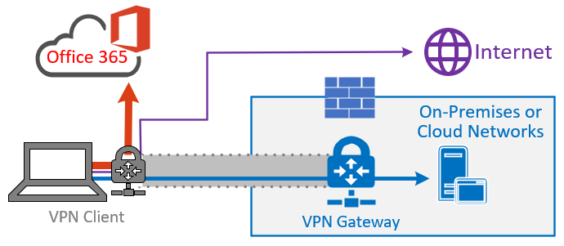
VPN – selective tunnel
Office 365
#4 – VPN Selective Tunnel
  Default path = Local Interface
  Exceptions = VPN interface
  Doesn’t matter if the VPN is on or off

Slide 7
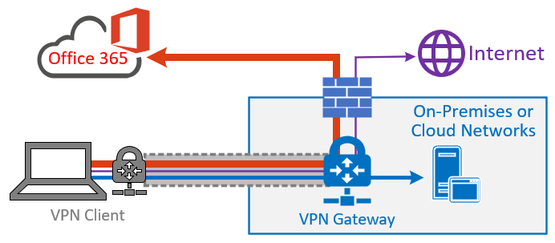
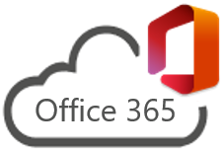
VPN – forced tunnel with no exceptions
Not recommended
Default path = VPN interface

Slide 8
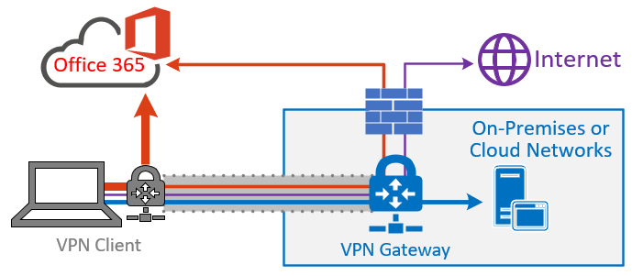
VPN – forced tunnel with exceptions
Common customer deployment model (forced tunnel with exceptions)
#2 – VPN Forced tunnel with small number of trusted exceptions
  Default path = VPN interface
  Exceptions = Local interface
  If the VPN is forced or on always you need the exceptions configured
  If the VPN is not forced, then switching off the VPN may help but needs user education

Slide 9
Office 365 VPN split tunneling guidance
Strategy and approach (treat remote user as branch office user)
  https://docs.microsoft.com/en-us/Office365/Enterprise/office-365-vpn-split-tunnel.
Implementation (IP based split tunneling for Optimize category endpoints)
  https://docs.microsoft.com/en-us/Office365/Enterprise/office-365-vpn-implement-split-tunnel

Slide 10
How-To guides for Office 365 VPN split tunneling
Windows 10 VPN client: Optimizing Office 365 traffic for remote workers with the native Windows 10 VPN client
Cisco Anyconnect: Optimize Anyconnect Split Tunnel for Office365
Palo Alto GlobalProtect: Optimizing Office 365 Traffic via VPN Split Tunnel Exclude Access Route
F5 Networks BIG-IP APM: Optimizing Office 365 traffic on Remote Access through VPNs when using BIG-IP APM
Citrix Gateway: Optimizing Citrix Gateway VPN split tunnel for Office365
Pulse Secure: VPN Tunneling: How to configure split tunneling to exclude Office365 applications
Check Point VPN: How to configure Split Tunnel for Office 365 and other SaaS Applications
All available at https://docs.microsoft.com/en-us/Office365/Enterprise/office-365-vpn-implement-split-tunnel

Slide 11
What traffic should be split tunneled?
Optimize Category URL’s or IP’s | Protocol / Port / Direction | Purpose
https://outlook.office365.com | TCP 443 Outbound | Outlook connectivity
https://outlook.office.com | TCP 443 Outbound | Outlook web access
https://<tenantname>.sharepoint.com | TCP 443 Outbound | SharePoint Online and OneDrive for Business
https://<tenantname>-my.sharepoint.com | TCP 443 Outbound | SharePoint Online and OneDrive for Business
*13.107.64.0/18, 52.112.0.0/14, 52.120.0.0/14 | UDP 3478-3481 Outbound | Teams media traffic (audio, video, screen-sharing)
  Implementation Guide has the details
  https://docs.microsoft.com/en-us/Office365/Enterprise/office-365-vpn-implement-split-tunnel
Optimize endpoint category
IP Ranges are bound to change, please check https://aka.ms/o365ip , use https://aka.ms/ipurlws endpoints web service to keep up with the changes automatically
TCP 80 outbound is required for redirection to 443, OCSP protocol used for CRL verification relies on TCP port 80
For complete list of IP’s for Optimize category endpoints use the following Powershell script
  (invoke-restmethod -Uri ("https://endpoints.office.com/endpoints/WorldWide?clientrequestid=" + ([GUID]::NewGuid()).Guid)) | ?{$_.category -eq "Optimize" -and $_.ips} | select -unique -ExpandProperty ips

Slide 12
VPN & split tunnelling detection with Network Onboarding tool
https://connectivity.office.com (Short link – http://aka.ms/netonboard)
VPN Detection
Split tunnel detection for Optimize endpoints
Requires .NET Desktop Runtime 3.1.3 (https://dotnet.microsoft.com/download/dotnet-core/3.1)

Slide 13
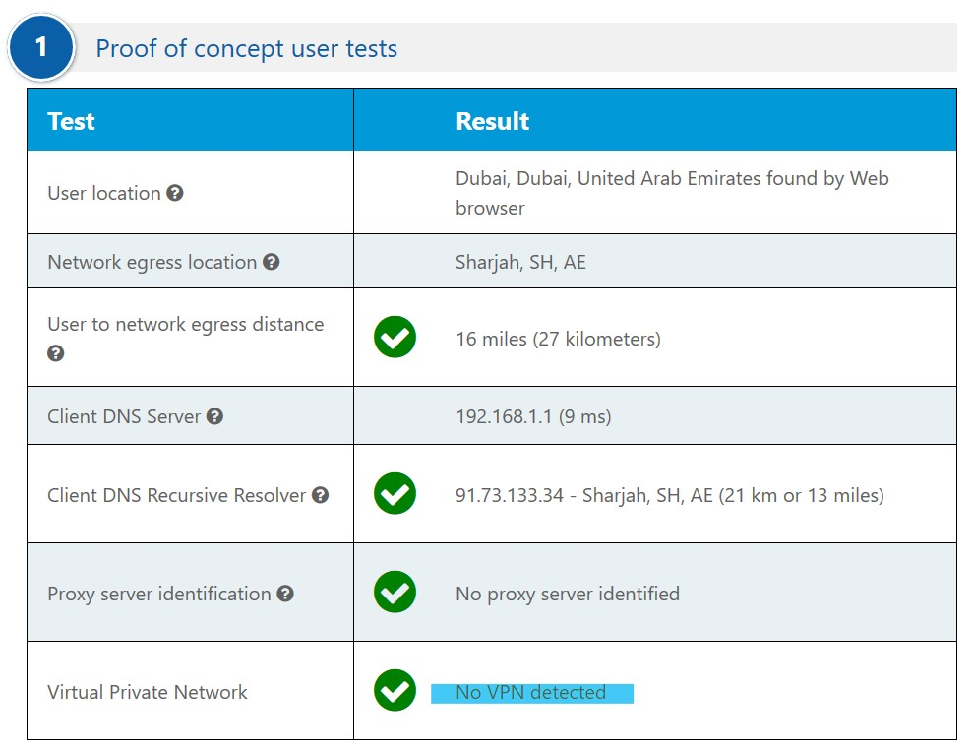
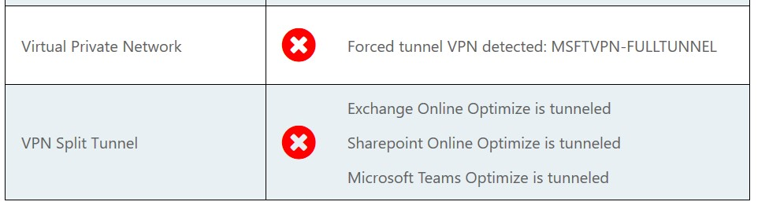
aka.ms/netonboard: VPN and split tunnel detection
Connectivity.office.com
Browser based tool set
VPN presence detected
Name of VPN displayed
Split tunnel check for Optimize set

Slide 14
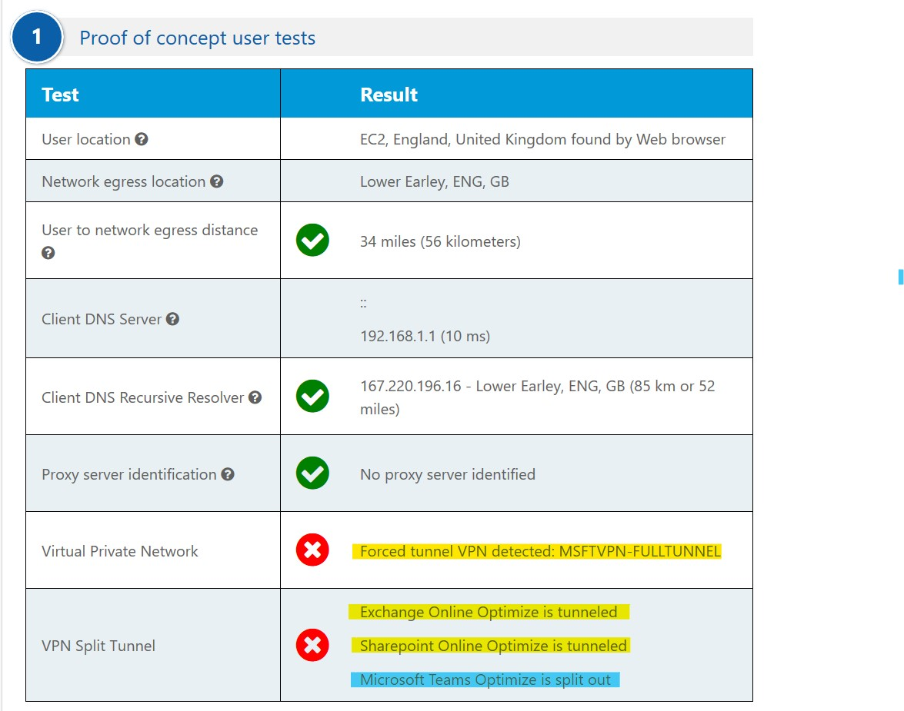
aka.ms/netonboard: VPN and split tunnel detection
Connectivity.office.com
Notice Teams Optimize traffic split out
Static routes added to split tunnel Teams media traffic

Slide 15
Demos

Slide 16
Summary & resources
Network connectivity for remote users is important to facilitate productivity
Remote user network expectations: best experience, reliable & productive
Microsoft 365 Network Connectivity Principles helps you deliver to these expectations
Office 365 VPN split tunneling guidance
Target ‘Optimize’ category endpoints to split tunnel Office 365 traffic
Verify VPN split tunneling using connectivity.office.com
Microsoft 365 Network Connectivity Resources
View our Microsoft 365 Network Connectivity video series page
VPN Split Tunneling guidance: Strategy and approach
https://docs.microsoft.com/en-us/Office365/Enterprise/office-365-vpn-split-tunnel
VPN Split Tunneling guidance: Implementation
https://docs.microsoft.com/en-us/Office365/Enterprise/office-365-vpn-implement-split-tunnel
Principles of Network Connectivity
https://aka.ms/pnc
Network onboarding Tool
https://aka.ms/netonboard
https://connectivity.office.com

