Slide 1
Microsoft 365 Network Connectivity Video Series
Overview of Network Connectivity Principles
Konstantin Ryvkin
Partner Architect
Microsoft 365

Slide 2
Network Connectivity Principles for Microsoft 365
01 SaaS driven network transformation
02 Optimal SaaS connectivity
03 Microsoft 365 network architecture
04 Network connectivity principles
05 Connectivity principles in action
        Customer network architecture
        Branch offices
        Remote workers
        ISP and other partner solutions
        Microsoft 365 admin and user tools

Slide 3
In the world of cloud
powered productivity
Great User Experience
WAN
=
Great Product
+
Optimal User Connectivity

Slide 4
SaaS
IaaS
SaaS
PaaS
IT professionals building solutions in the cloud
Cloud tenancy is at (virtual) infrastructure/network levels
Location specific (virtual datacenter) experience
Customer picks location(s)
Infrastructure concepts: region, compute, VNET, GB
Virtual extension of customer own internal network
Optimized for private network connectivity
Users consuming finished cloud applications
Cloud tenancy is at the application level
Highly distributed, global application experience
Focus on scale-out across the planet
Experience concepts: Collaboration, Productivity, User
Network is multi-tenant across all customers and users
Optimized for public (Internet) connectivity

Slide 5
Why network connectivity and SaaS
Efficient connectivity is one of the key challenges on the path of SaaS adoption for enterprises
  On-premises network solutions
  Remote worker network solutions
  3rd party network-as-a-service and security-as-a-service offerings
Customers report
  Connectivity is the leading cause of user performance issues
  Network being a bottleneck to fast and easy onboarding into the cloud
  Customer or connectivity provider network failures affecting SaaS experience availability for broad set of users
  Customer security teams are challenged to secure SaaS and not impacting experience by intrusive network solutions
IT teams are looking to
  Modernize their network architecture for SaaS, without compromising security
  Demonstrate return on investment in networking by delivering most optimal user experience
  Make their network designs future proof for the evolving nature of the cloud

Slide 6
SaaS and networking trends
Before
Now
SaaS continues to disrupt networking models /performance expectations, scalability, cost, efficiency/
Internet to major clouds becomes
shorter and faster
Enterprises start adopting Zero Trust
for their SaaS scenarios
Network solutions provide application differentiation close to the user device
Networking and security are moving to the cloud too
MPLS
SaaS
ISP 2
ISP 2
ISP 3
ISP 1
ISP 3
ISP 1
Internet
Internet
ISP 4
ISP 4
Identity
Device
Network Perimeter
Data
Services
WAN

Slide 7

When it comes to SaaS experience – slow is the new broken
Latency - main currency in the world of cloud performance
First mile optimization is done within the cloud and by the cloud
Last mile and Middle mile efficiency is largely driven by the customer choices
  [1] Backhauling distances
  [2] Processing overhead at the perimeter
  [3] Choice of ISP or NSP and their peering and routing policies
1
2
3
WAN
Customer On-Premises
ISP/NSP
Microsoft Global Network
Mobile
ISP
(Enterprise) Last Mile
Middle Mile
First Mile
Customer
Ability to influence
Microsoft

Slide 8
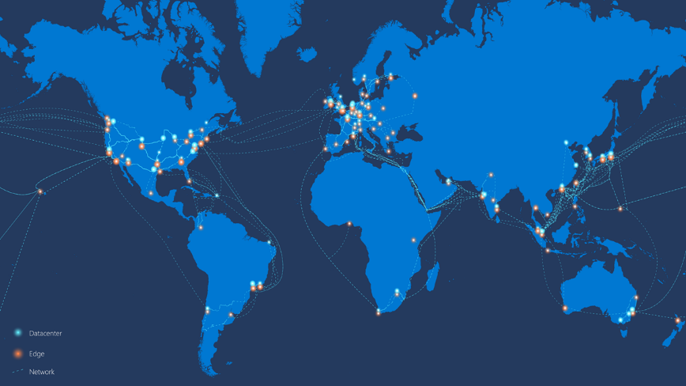
Microsoft 365 location = everywhere
Microsoft 365 is getting closer to all users
  Microsoft Global Network (AS8075): Points of Presence | Peering | Backhaul
  Highly Distributed Service Front Door infrastructure
  Intelligent content and business logic placement optimized for performance
Customer network imperative:
  Allow your users to connect through the closest Microsoft network edge as efficiently as possible
50+ datacenter regions
10-100s of branches per customer
100+ Front Door locations
160+ network edge sites
200+ peering locations
4000+ networks
WAN
ISP/IX
Customer On-Premises
Network
POP
Service
Front Door
1000s of home
offices
Microsoft Global Network
Data
/Datacenter/
Remote/Mobile
ISP

Slide 9

Microsoft 365 Network Connectivity Principles
Microsoft 365 endpoints
{REST:API}
SSL
B&I
Datacenter
ISP
aka.ms/o365ip
Optimize Microsoft 365 traffic
Use the endpoint categories to differentiate Microsoft 365 traffic from generic Internet traffic for more efficient routing.
Enable local egress
Egress Microsoft 365 data connections through Internet as close to the user as practical with matching DNS resolution.
Enable direct connectivity
Enable direct egress for Microsoft 365 connections. Avoid network hairpins and minimize network latency (RTT) to Microsoft’s global network.
Modernize security for SaaS
Avoid intrusive network security for Microsoft 365 connections. Assess bypassing proxies, traffic inspection devices, and duplicate security already available in Microsoft 365.
Learn more at: aka.ms/PNC

Slide 10
Principle #1
Optimize Microsoft 365 traffic
Microsoft 365 endpoints: FQDNs and IP addresses
REST API (http://aka.ms/ipurlws) for automating customer network settings for Microsoft 365
Priority driven endpoint taxonomy (http://aka.ms/ipurlblog) for network differentiation and optimizations
Growing support for native integration across partner community
Microsoft 365 endpoints
{REST:API}
aka.ms/o365ip
Optimize Microsoft 365 traffic
Use the endpoint categories to differentiate Microsoft 365 traffic from generic Internet traffic for more efficient routing.

Slide 11
Principle #2
Enable local egress
Avoid backhauling of Microsoft 365 connections across private WANs
Local egress maximizes the chance that connection is going to be routed through the closes Microsoft network POP for best performance
Local DNS egress for Microsoft 365 domains and proximate LDNS RRs ensures most optimal traffic management to the closest Front Doors
Datacenter
aka.ms/o365ip
Enable local egress
Egress Microsoft 365 data connections through Internet as close to the user as practical with matching DNS resolution.

Slide 12

Principle #3
Enable direct connectivity
Allow routing Microsoft 365 connections directly to Microsoft, without network intermediation [3]
Intermediation limits achievable performance, availability, interoperability compared to direct connection [1, 2]
Microsoft 365 cloud expansion and performance improvements best accrue to non-intermediated topologies [3→4]
ISP
Enable direct connectivity
Enable direct egress for Microsoft 365 connections. Avoid network hairpins and minimize network latency (RTT) to Microsoft’s global network.
User to Office 365 Service Front Door Latency
CDF: F
(x)=P(X≤x)
100%
X
2
90%
IaaS
80%
70%
Service
Front Doors
60%
50%
40%
3
30%
4
Service
Front Doors
20%
Service
Front Doors
Service
Front Doors
10%
0%
0
20
40
60
80
100
120
140
160
180
200
220
240
RTT ms
4
3
2
1
1
SECaaS

Slide 13



Principle #4
Modernize security for SaaS
Network security solutions struggle to keep up with rich and constantly evolving SaaS applications
  Growing impact on user experience
  Limited security effectiveness
Shift security focus towards Zero Trust architecture using security dimensions natively built into/optimized for SaaS
  User Identity, Device, Workloads and Data “lenses”
  Richer and more meaningful security outcomes
Differentiate connections as close to source (user) as possible
  Best security and user experience
  High value for performance sensitive apps (like Microsoft 365)
  Differentiation built in most SD-WAN platforms
SSL
B&I
Network
Perimeter
Inspection
aka.ms/o365ip
User
Identity
Device
Modernize security for SaaS
Avoid intrusive network security for Microsoft 365 connections. Assess bypassing proxies, traffic inspection devices, and duplicate security already available in Microsoft 365.
Data
Workloads

Slide 14
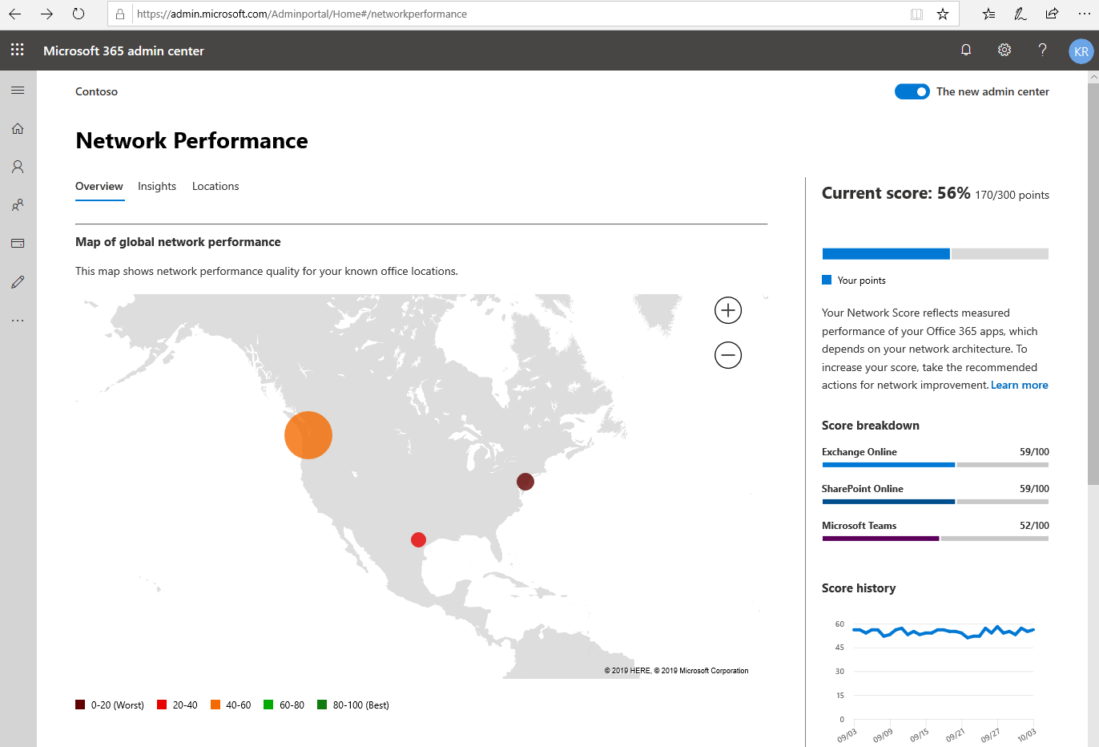
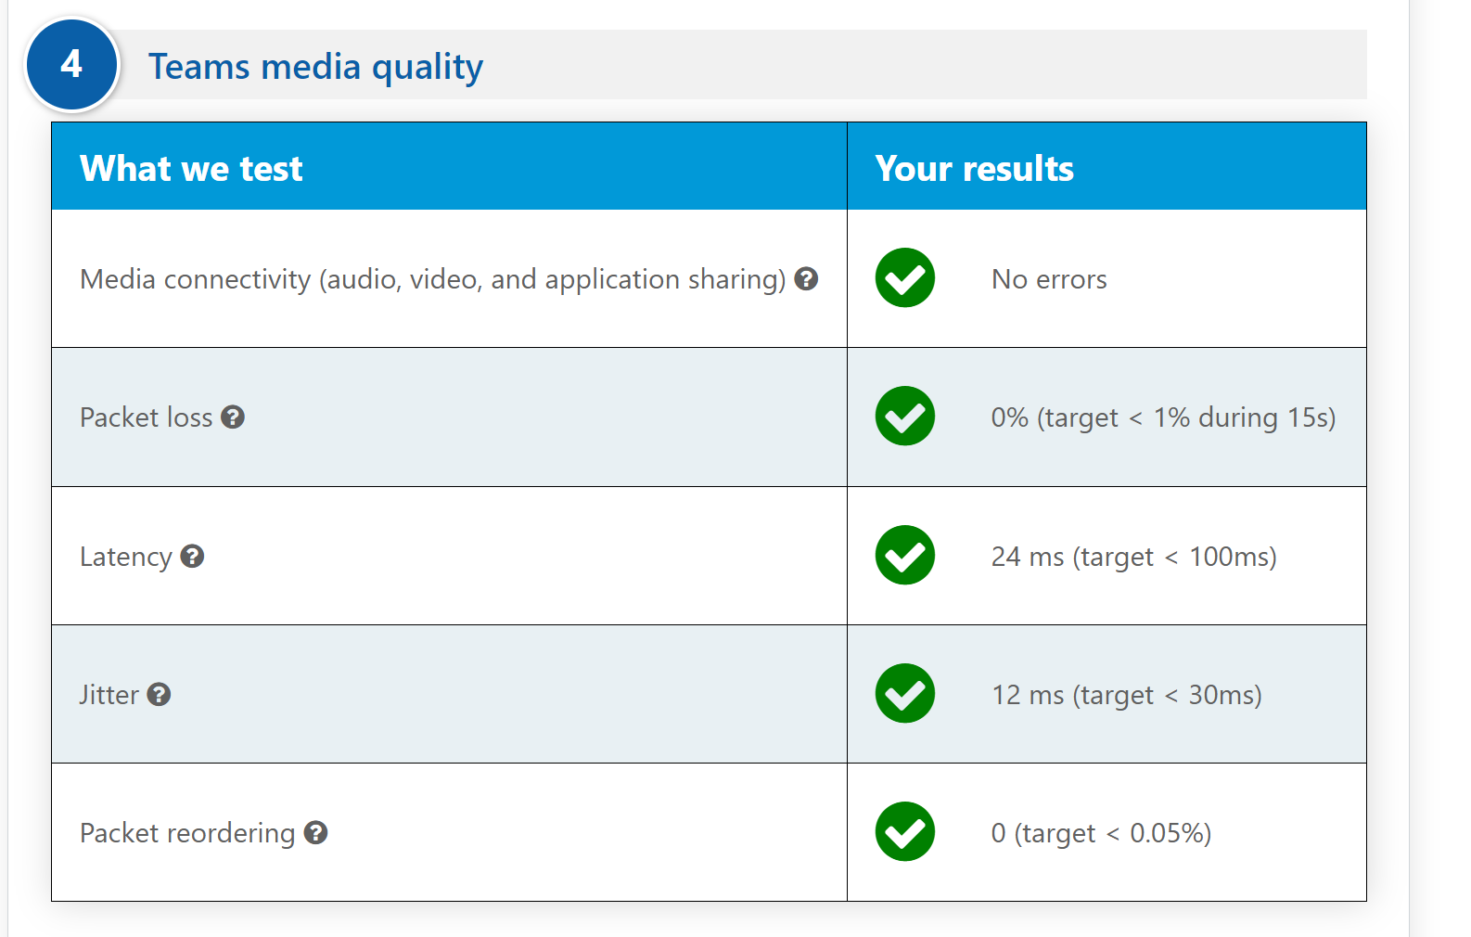
Applicability of Network Connectivity Principles
Enterprise network designs
  Branch office
  Remote/mobile users
Network solution provider evaluation and engagement
  Networking Partner Program
Microsoft 365 admin and user tools
  Tenant network score and insights in M365 Admin Portal
  Network Onboarding tool https://connectivity.office.com

Slide 15
Additional resources and recommended actions
Evaluate your network for SaaS cloud readiness
Invest in your network to optimize for performance and user experience
Microsoft 365 Network Connectivity Principles:
  Incorporate in your network designs for office and remote workers
  Use to evaluate network solutions and services
Use Microsoft 365 tools to monitor for network score
More information at aka.ms/PNC
Great Product
+
Optimal User Connectivity
=
Delightful User Experience

