Slide 1
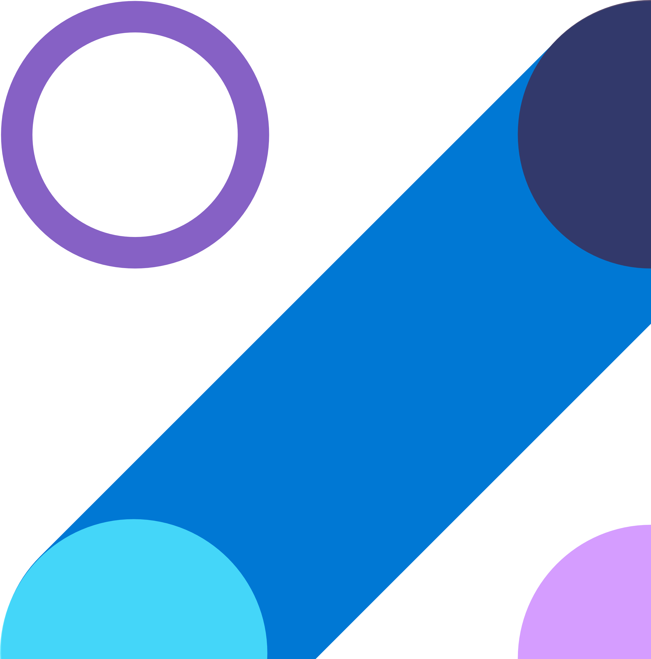
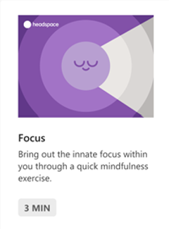
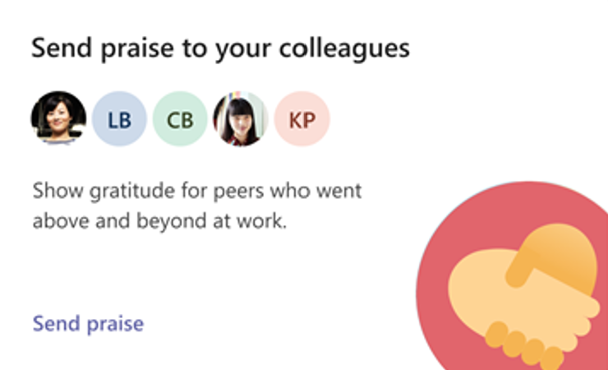
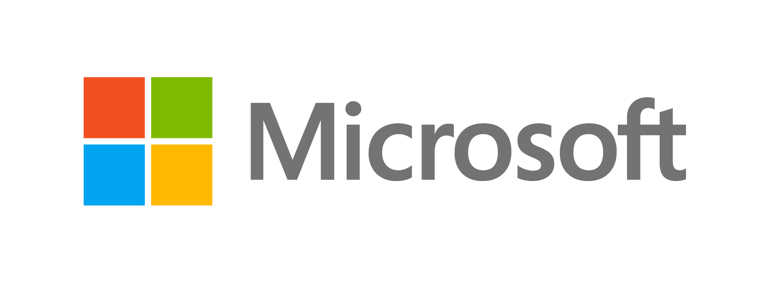
Productivity | Tips & Tricks​
Microsoft Viva Personal Insights👩‍💻 ​
Actionable Recommendations
Personalized, privacy-protected insights and actionable recommendations, aligned to your flow of work.
Data Driven Insights
Receive valuable insights to improve your work patterns via a personalized Viva Insights homepage and the monthly digest email.
Make the most of your day using your email briefing –
prepare for meetings and get reminded to take action on tasks.
What’s in it for me?
Balance workdays
Increase wellbeing
Improve productivity
Protect time
Reduce meeting fatigue
Protect your time to focus on core priorities, help eliminate distractions, give yourself a break from meetings, and transition from work to home life with a virtual commute to close out your day.
Stay connected and nurture your network by staying on top of task suggestions, catching up on documents and messages, and receiving 1:1 meeting suggestions and reminders.
Tap into dedicated moments of mindfulness through private self-reflection and quick, guided meditations with Headspace.
Send praise right within the Viva Insights app, allowing you to quickly acknowledge your colleagues.
“Booking focus time between meetings so
I can stay on top of follow up actions has been a game-changer.”
Want to watch a video instead?
Get started with Focus Time
Want to watch a video instead? Check out this video on our YouTube Channel!
Catch up with all the cool Superheroes videos at our YouTube Channel – don’t’ forget to join our Yammer Community!

