Slide 1
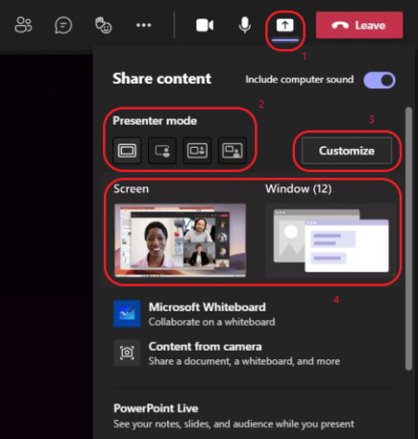
Engaging your audience with Presenter Mode
Become a more captivating and integral part of your presentation
First, start by sharing content to see the presenter modes
After your meeting starts, at the upper-right corner of Teams, select “Share content” to see meeting presenter modes and other options.
Under Presenter mode, choose the mode that you want (Standout, Side-by-Side, or Reporter). Also, don't forget to turn your camera on!
To start your presentation, choose a screen or window on your PC or device.
Next, customize the look and feel of your presentation
When your presentation begins, the presenter toolbar briefly appears at the top of your screen. In the toolbar, you can change presenter modes on the fly, give control to another person, and include computer sound.
To stop sharing a screen or window, select “Stop presenting” in the presenter toolbar, or select “Stop sharing” in meeting controls at the lower-right.
More things to know
Interactive presenter modes are only available for the desktop version of Teams.
Meeting attendees using the mobile or online versions of Teams will see a shared window or screen and presenter video separately.
When you use an interactive presenter mode, a small, moveable picture-in-picture window pops up to show you what your audience sees. If you close this window and need it again, restart the presenter mode.
Standout Presenter Mode
Side-by-Side Presenter Mode
Reporter Presenter Mode
Want to watch a video instead? Check out: Engage your audience with Presenter Modes
Catch up with all the cool Superheroes videos at our YouTube Channel – don’t’ forget to join our Yammer Community!

